Slide 1
RADAR

Slide 2
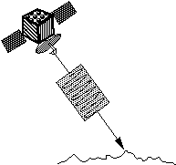
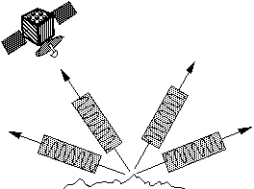
Side-looking Radar
Most radar systems do look off to the side (off-nadir)
For military applications allows planes to fly over friendly territory and look into enemy territory
More importantly, gives us more info about surface characteristics
Radar is sensitive to surface roughness

Slide 4
Radar Geometry
Depression Angle

Slide 8
Earth-observing radar satellites include:
RISAT-1 (SAR, ISRO India, 2012)
RORSAT (SAR, Soviet Union, 1967-1988)
Seasat (SAR, altimeter, scatterometer, US, 1978)
RADARSAT-1 (SAR, Canadian, 1995)
RADARSAT-2 (SAR, Canadian, 2007)
SAR Lupe 1-5 (SAR satellites of the German Air Force)
TerraSAR-X (SAR Germany, 2007)
TanDEM-X (SAR Germany, 2010)
COSMO-SkyMed (SAR, Italy, 2007)
SAOCOM (L band SAR constellation, Argentina)
TecSAR (SAR, Israeli, 2008)
TOPEX/Poseidon (altimeter)
Jason 1 / Jason 2 (altimeter)
Shuttle Imaging Radar (see Shuttle Radar Topography Mission) (SAR)
JERS-1 (SAR)
Geosat (altimeter)
ERS-1 & ERS-2 (European Remote-Sensing Satellite) (altimeter, combined SAR/scatterometer)
Envisat (SAR, altimeter)
Tropical Rainfall Measuring Mission (Precipitation Radar)
Cloudsat (cloud radar)
Metop (scatterometer)
QuickScat (scatterometer)
NISAR (satellite)
Almaz
Sentinel-1

Slide 18
Radar Advantages
Can penetrate clouds
Active, so can use day or night
Less of a radiance vs. reflectance problem since you know exactly how much energy you send out and can measure what you get back—and atmosphere not a problem
Can penetrate dry soil and get subsurface characteristics (e.g., archaeology)

Slide 19
Radar Disadvantages
Developed by military, less civilian experience so far than passive remote sensing
Difficult to interpret—complicated causes of backscatter (reflectance)
Geometric distortions caused by side looking geometry
Image:
Natural Resources Canada

Slide 20
Radar penetration increases with wavelength

Slide 21
Interpreting Radar Data
Longer wavelength bands (P and L bands)
Penetrate canopy and reflects off of standing tree trunks
Can detect amount of wood in a forest
Estimate forest biomass
Shorter wavelengths (C and X bands)
X band can detect leaves
C (and L) band can detect twigs

Slide 22
Resolving Objects with Radar
Radar resolution determined by…
Size of area “illuminated” by microwaves at one time
Depends on antenna length (longer antenna = better spatial resolution)
But…difficult physically for airplane or satellite to carry a very large antenna.
Depends on length of radar pulse (longer pulse = lower spatial resolution)

Slide 23
Pulse length in part determines radar resolution

Slide 24
Real Aperture vs. Synthetic Aperture Radar (SAR)
Real aperture radar actually uses a single antenna of a given length – resolution limited to what plane or satellite can carry.
Synthetic Aperture Radar (SAR) can simulate a large antenna by taking advantage of the Doppler effect
Doppler shift allows sensor to identify electromagnetic waves from ahead and behind the platform and therefore track an object for longer than it otherwise could, as if the antenna were longer.

Slide 25
Synthetic Aperture Radar – Doppler Effect

Slide 26
Radar Applications
Forest inventory
Oceanography
Archaeology
Sea ice studies
Digital Elevation Models (DEMs)
Urban mapping
Wildfire studies

Slide 27
Radar Image – Angkor, Cambodia. Purple spots are possible buried ruins

Slide 28
Radar image of oil slicks

Slide 29
Radar derived elevation with TM draped over it
(but, you need stereo imagery for this sort of thing!)

Slide 30
Kamchatka Peninsula – Shuttle Radar Topography Mission (SRTM)
(Mission generated detailed topographic data for 80% of earth’s land surface)

Slide 31
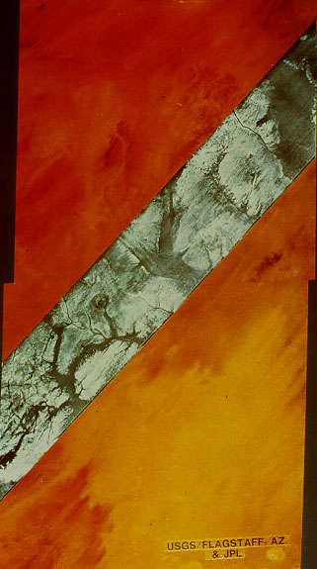
Egypt

Slide 32
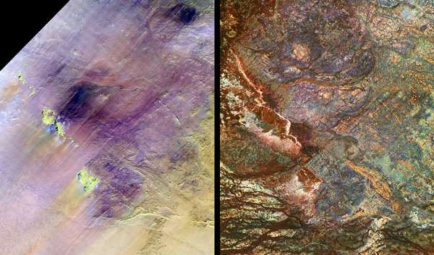
Safsaf oasis, Egypt
Penetration up to 2 m
Landsat
SIR-C L-band 16 April 1994

Slide 33
http://www.spie.org/newsroom/technical-articles-archive/oereports/oereports0700/archeologists-use-remote-sensing-to-decode-the-past?highlight=x2420&ArticleID=x18980
https://www.frontiersin.org/articles/10.3389/feart.2019.00191/full
https://earthobservatory.nasa.gov/features/SpaceArchaeology

Slide 34
Call up Kalimantan radar image. Compare to region in GE

Slide 35
Go through intro part of http://earth.esa.int/landtraining07/D1LA1-LeToan.pdf

