Slide 1
Principal Component Analysis
PCA

Slide 2
Producing a new set of variables that is close to the original data – basically, trying to ID a new variable that contains most of the variability in the old data
Reduce dimensionality (in this context, reduce the number of bands)
Enhance contrast by maximizing the amount of information in the first three bands.
Often can share PC transformed images, when you cannot do so with the original data.

Slide 3
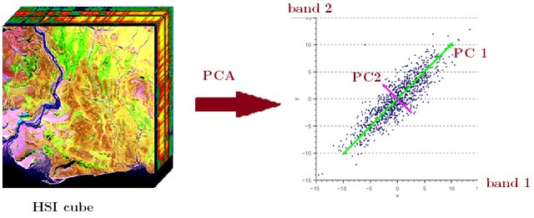
Assume we are looking at a 7-band landsat 8 image.
Start with a regression line.

Slide 4
I like to think of PCA as rotating axes.
First PCA is the line of best fit (regression line).
Every other one is at 90 degrees to the other. Easy to visualize in 2d or 3d space. Computers can do it in as many dimensions as you want.

Slide 5
When you run it
You get as many principal components as you have bands.
However
Each PC has less and less unique information in it.
As we are looking at shared variance.

Slide 6
Typically
PC1 explains 60-90% of the data
PC2 explains 10-30%
PC3 explains 3-15%
Generally speaking,
Ignore PCs that explain less than 1% of the variance. This is basically noise.
1-3%, maybe use/keep
3% plus, this is good stuff.

Slide 7
Remember!
There is absolutely ZERO correlation between principal components.

Slide 8
Generally, but it depends on your study area (use your brain)
PC1 is a general brightness component (think, sorta, a panchromatic image over the full spectrum)
PC2 is often greenness (if there’s a lot of veg)
PC3 is often wetness (if water varies across your image).
The only way to be sure is to LOOK AT YOUR IMAGE and use your brain.

Slide 9
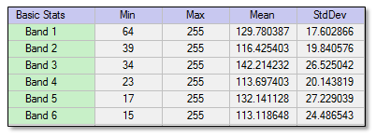
Some stats. From https://www.l3harrisgeospatial.com/docs/principalcomponentanalysis.html
Basic Stats
The Basic Stats section lists the minimum, maximum, mean, and standard deviation pixel value for each PC band. Here is an example:

Slide 10
Correlation A correlation matrix shows the statistical correlation of each input band to other input bands. It is computed before PCA runs. Here is an example from a six-band image:

Slide 11
eigenvectors
An eigenvector matrix shows the statistical correlation between the PCs (dependent variables, or rows) and the input image bands (independent variables, or columns).
The eigenvectors themselves indicate the proportion that each input image band contributes to each PC band. This is referred to as weighting or factor loading. The weighting of each input band is computed by squaring the input band's eigenvector element. Thus, the total contribution of all of the input bands to any given PC band is the sum of the squares of the PC band's eigenvector elements.
There is one eigenvector for each PC band, and each eigenvector contains one element for each input band. For example, a PC rotation of a 128-band input image produces 128 PC bands and 128 corresponding eigenvectors that each have 128 elements. The first element of the eigenvector coresponds to input band 1, the second element to input band 2, and so forth.
The following is an eigenvector matrix where the columns represent six input spectral bands and the rows represent eigenvectors:

Slide 12
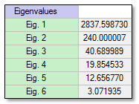
eigenvalues
Eigenvalues indicate the length of each new PC, or the proportion of original information that each PC retains. From these values, you can derive the percentage of the total variance explained by each PC. To do this, compute the ratio of each eigenvalue to the sum of all of them. For example, the sum of all eigenvalues in the following table (for a six-band PC image) is 3153.8717:
Component | % Total Variance | Cumulative %
PC Band 1 | 89.971906 | 89.971906
PC Band 2 | 7.6096945 | 97.581601
PC Band 3 | 1.2901599 | 98.871762
PC Band 4 | 0.6295288 | 99.501288
PC Band 5 | 0.401309 | 99.902594
PC Band 6 | 0.097402 | 100.0
From this table, you can see that the first three PC bands account for 98.87% of the total variance.

Slide 13
OK. Let’s run this on our Landsat 7 kimberly image and see what we get

Slide 14
First thing of importance is the correlation matrix
 | b1 | b2 | b3 | b4 | b5 | b6
b1 | 1 | 0.936369 | 0.920664 | 0.838383 | 0.859512 | 0.837555
b2 | 0.936369 | 1 | 0.97015 | 0.894939 | 0.891857 | 0.866926
b3 | 0.920664 | 0.97015 | 1 | 0.888124 | 0.905535 | 0.888043
b4 | 0.838383 | 0.894939 | 0.888124 | 1 | 0.86973 | 0.771852
b5 | 0.859512 | 0.891857 | 0.905535 | 0.86973 | 1 | 0.925762
b6 | 0.837555 | 0.866926 | 0.888043 | 0.771852 | 0.925762 | 1

Slide 15
Then the eigenvectors
 | pc1 | pc2 | pc3 | pc4 | pc5 | pc6
B1 | 0.197 | 0.171 | -0.300 | 0.390 | 0.801 | 0.223
B2 | 0.170 | 0.174 | -0.224 | 0.155 | 0.021 | -0.931
B3 | 0.355 | 0.288 | -0.501 | 0.345 | -0.583 | 0.284
B4 | 0.340 | 0.717 | 0.186 | -0.569 | 0.094 | 0.058
B5 | 0.714 | -0.262 | 0.584 | 0.281 | -0.035 | -0.013
B6 | 0.424 | -0.524 | -0.484 | -0.550 | 0.092 | 0.007

Slide 16
And the loading
 | Eigenvalues | % variance explained
PC1 | 694.892 | 0.922
PC2 | 28.556 | 0.038
PC3 | 17.872 | 0.024
PC4 | 7.430 | 0.010
PC5 | 3.751 | 0.005
PC6 | 0.851 | 0.001
total | 753.3509546 | 1

Slide 17
Now goto erdas and look at all the imagery

