Slide 1
Digital Terrain Models
Or DTMs… and their uses!

Slide 2
OK. Some terminology
DTM is the generic term for any sort of terrain model
DEM is a raster DTM which depicts the ground surface (bare ground)
DSM is also a raster DTM, but it may depict something other than the ground surface, for example, first returns from LiDAR may represent the vegetation surface.
TIN – Triangulated irregular network. A vector representation of elevation (or really any surface).
Contour lines. Also vector!
LiDAR point files! (which we usually convert to DEMs or DSMs depending on the application).

Slide 3
Generally speaking…
We use DEMs for things related to the earth’s surface. Calculations are simpler and more straightforward. Also, raster is a better model for continuous data.
From here, we will be talking about DEMs.
Which are readily available at many resolutions, depending on where you are.
At worst are the shuttle radar data (SRTM) at about 100m.
In the middle are the USGS 30 and 10m DEMS (though the 10m DEMs often suck). And most of the radar-derived data.
The best is the high resolution LiDAR or structure from motion photogrammetric data.

Slide 4
How do we generate DEMs?
Old School (which is most USGS DEMs) photogrammetry. Requires stereo airphotos. Really not done anymore, but a lot of our existing data was generated this way.
Radar data (Radarsat, for example). https://earth.esa.int/web/guest/data-access/browse-data-products/-/article/radarsat-1-2-scansar-wide (I cover this in remote sensing)
LiDAR. Light detection and ranging. This generates what we call a point cloud (bajillions of points) from which we can interpolate to DEMs and DSMs.
Structure from Motion (SfM). This is the new version of the old school photogrammetry. In this case, you take a LOT of high resolution aerial photos, survey a few control points in x,y,z, and turn the software loose. It will convert those photos into a nice DEM
Check out the poster in the back lab. Had a student win awards for this work a few years ago.
Oooh… a good overview paper: https://www.sciencedirect.com/science/article/pii/S0169555X12004217
Weird conversions. For example, the USGS 10m DEMS seem to be interpolated from the USGS quad sheet contours. Or, I’ve seen LiDAR DEMS from which contour lines were first created, then those interpolated to a DEM. They suck. All of them.
And an overview article: http://www.charim.net/use/92

Slide 5
Alright. We now have a DEM. What do we do with it?
Well, elevation by itself is sometime useful, but for the most part, we’re deriving something from it.
These include slope, aspect, flowdirection, and many others: http://rgis.unm.edu/dem_analysis/
Let’s start with a detailed look at slope. It probably isn’t what you think it is.
In fact, lean back for a sec and think about what you think slope is.
Now, think about how you would calculate this from a raster DEM?

Slide 6
Slope!
How does ESRI (and QGIS) do it?
Well, they look at a 3x3 neighborhood. Then they calculate an E/W slope based on the 3 eastern and 3 western pixels. Ditto a N/S slope from 6 pixels. Then a little more math (see the planar slope algorithm at https://pro.arcgis.com/en/pro-app/tool-reference/spatial-analyst/how-slope-works.htm ).
Note that the center cell is not used in this calculation.
In short, this calculation takes an average slope over a 3x3 cell, ignoring the center cell.
Which means that your effective output resolution is 3x larger than your input.
I like the analogy of a large classroom full of regularly spaced students. I would then assign the grade to each individual based on the scores of the 8 surrounding students.

Slide 7
A smarter way to calculate slope: Maximum Downhill slope angle
We’re still working off a 3x3 neighborhood, but in this case, the GIS calculates the slope between the center cell and each surrounding cell (8 calculations) – then chooses the highest slope. Note that uphill slopes will be negative, and thus have the lowest values.
In this case, your output is cell to cell, preserving the resolution of your original DEM.
It is also calculating slope along the direction that water would flow (so it ties to the flowdirection command – more on that later).
Hah! Conveniently, this is all discussed in greater detail in your week 5 reading on slope. A paper I wrote with an undergraduate back in my Oz days.

Slide 8
We can have even more fun… directional slope!
That is, slope along something. Say, a trail or road (they typically don’t follow the steepest option. Or along the direction that a fire might spread.
In short, calculating slope based on a direction that isn’t only topographic.
Lucky you – I’ve written a paper about this too! With a CWU (former) undergrad and the Mighty Dr. Sterling Quinn.
Check it out:
https://www.directionsmag.com/article/8937

Slide 9
OK. Enough on slope….

Slide 10
What about aspect?
In this case, the output is a bearing (remember that from 301, any of you?) that is between 0 and 360 degrees.
Which is kinda tough to work with because 1 and 359 are closer than 22 and 33. So, math doesn’t work. At least not normal math (I think this gets into some trig or something. I would go bug a math prof friend of mine for this….
But, the calculation in Pro is much like slope – an average aspect over a 3x3 neighborhood, excluding the center cell.
Again, see the planar calculation: https://pro.arcgis.com/en/pro-app/tool-reference/spatial-analyst/how-aspect-works.htm
Which, like Pro’s slope, is kinda useless for any sort of application that tracks the flow of water downhill.

Slide 11
So… if I want to track water? (hydrologic applications)
You would use flowdirection. Which is the “aspect” equivalent of the maximum downhill slope angle.
In short, it is the direction of max downhill slope (in values 1-8 referring to the 8 surrounding cells).
https://pro.arcgis.com/en/pro-app/tool-reference/spatial-analyst/how-flow-direction-works.htm

Slide 12
Why do I get cranky about these calculations?
It goes back to my PhD days…. I wanted to calculate erosion (more on this next week). Figured there’d be a button…. Nope.
So I grabbed my nerd. A buddy in the program would could program! And we set out to calculate erosion. To cut the story short here… turns out we were getting negative slopes. What the heck? Which caused us to look at the slope command. Two problems. First, the FILL command wasn’t working (it does these days, look it up) and we realized that slope wasn’t calculating slope along flowdirection. Which we needed for the erosion model. So, Alan redid the code for slope and fill along the way. And I learned to never trust ESRI. Especially their dang slope tool.

Slide 13
Which takes us to modeling
By definition, modeling is the act of doing something which will predict a future result. There are bajillions of different sorts of models out there in GIS. You name it, someone modeled it. I am resisting the impulse to link a few more papers…..
Here, I want to go over one simple model – the Revised Universal Soil Loss equation (RUSLE). Its goal is to calculate erosion in tons/acre/year.
Yup, this was what I used in my PhD. It’s also what Amanda ( former lab TA) did for her MS.

Slide 14
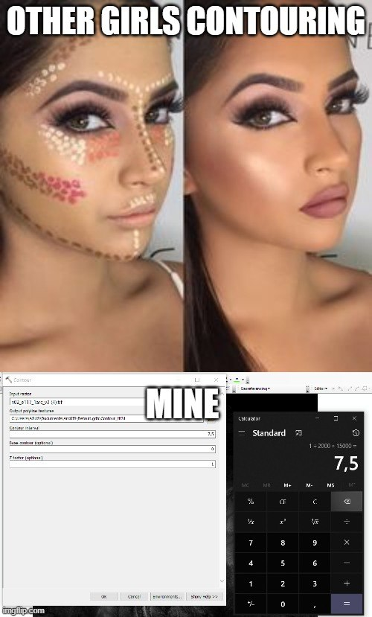
Found on Reddit…..
But that’s enough for this week. Make sure you truly understand the slope, aspect, and flowdirection commands and how they work.

