Slide 1
Introduction to GIS
Chunks stolen from Sterling!

Slide 2
Information Systems Galore
Information System is a piece of technology that you use to work with particular kind of data:
In the case of a geographic information system, the data is geographic!

Slide 3
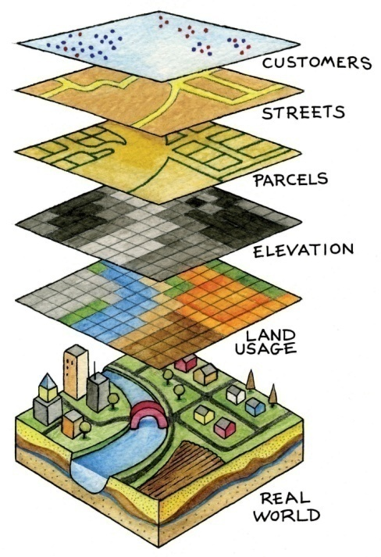
What is GIS?
Geographic Information Systems allow you to work with geographic (spatial) data, in other words, data tied to geographic locations

Slide 4
Elements of a GIS
Software
Data
Hardware
People

Slide 5
The purpose of GIS?
Decision support.

Slide 6
So, is Google Earth a GIS?

Slide 7
Common GIS software
Esri ArcGIS (proprietary)
QGIS (free and open source)
CARTO (cloud-based)
Enterprise database extensions such as:
Oracle Spatial
PostgreSQL + PostGIS

Slide 8
Spatial data
Spatial data consists of:
Locations, or “geometries” (points, lines, polygons, or cells)
Attributes that describe the locations

Slide 9
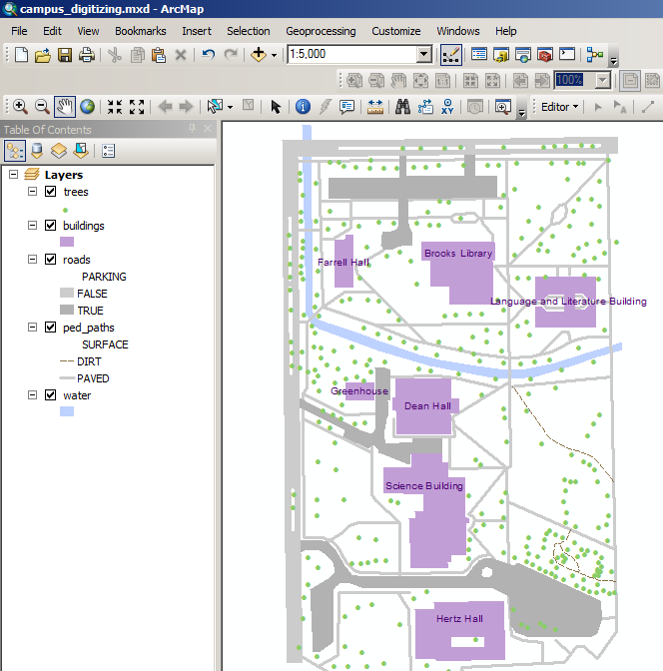
What geometries and attributes do you see?

Slide 10
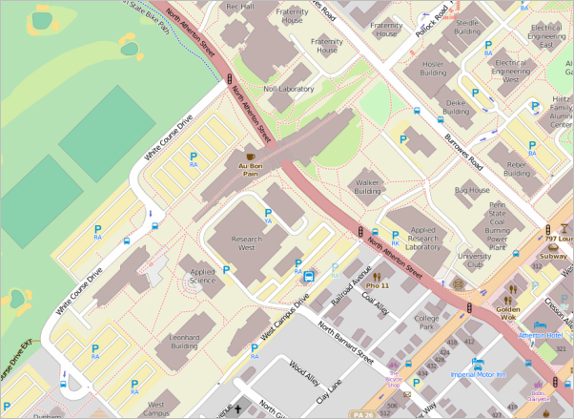
Attributes sometimes influence symbols and labels

Slide 11
Remember
GIGO

Slide 12
Advantages of GIS
Good environment to manage data
Integrates spatial and other data
Manipulate and display geographic knowledge
Access to administrative records
Ability to model scientific and management problems
Catalyst to further development.

Slide 13
Who uses it?
Computer science
Remote sensing
Cartography
Statistics
Geodesy
photogrammetry,
Surveying
Geography
Geosciences
Biology
Environmental science
Civil engineering
Transportation
Etc…etc…

Slide 14
Trends in GIS - Hardware
When I started, it was all about mainframes and Unix workstations. Now, almost all on PCs.
NO MACS! Thank all the gods…
Peripherals – same ole stuff, they just keep getting better and better
Printers
Plotters
Scanners
Digitizers
Storage
Floppy, zip, cd, dvd, flash, harddrives, ssd drives, …….
Don’t ask about tape drives.

Slide 15
Trends in GIS - Software
ESRI is the big dog, always has been.
Most other programs have more or less died (ie. Mapinfo. Remember Comstat in NYC? Now ESRI)
More and more open source stuff. Think QGIS – it’s the top of that category.
Never forget CAD (AutoCAD and Microstation). Not really GIS, but….
Image Processing: ERDAS, ENVI, and PCI Geomatics
Graphics: Illustrator, Corel, Photoshop, etc.
Databases: Oracle, Access, Dbase IV

Slide 16
Then there’s that pesky web
Where everyone is playing these days.

Slide 17
Programming?
VB
C
AML
Avenue
Java
Python
https://www.e-education.psu.edu/geog583/node/67

Slide 18
GIS is….
An integration of all these to some degree. I can honestly say that I’ve worked with, at some level, everything listed in the past few slides.
Everything is good at something, nothing is good at everything.
And remember
Never trust ArcGIS!

Slide 19
How has GIS changed over the past 25 years or so?
Easier software
Faster computers
More data. Lots and lots more data.
Story about learning GIS on a floppy. And the vast increases in storage.
Really, we’re doing the same stuff, only faster, with more data, and over larger areas.

Slide 20
What about a little history. A history of GIS

Slide 21
Pre-gis
~1780 – Battle of Yorktown. Maps drawn by French cartographer Louis-Alexandre Berthier. Hinged overlays of troop movement.
Mid 1800s. “Atlas to accompany the second report of the Irish Railway Commission”. Pop, traffic, geology, and topography. All on same base map.
The Classic. 1854. Dr John Snow. Cholera mapping in London.
Read the book: The Ghost Map

Slide 22
Setting the Stage. The 1960s
Computers coming online. Two different tracks of people in the field
Cartographers (computer cart in the 60s sucked)
Scientists – worried about analysis and number crunching. Computers are good at this!

Slide 23
Factors which led to a change to computer cartography and analysis
Improvements in computer technology (input, analysis, output)
Development of theories of spatial processes in economics, geography, anthro, planning, etc.
Increasing social awareness, education levels, mobility, and awareness of environmental problems.

Slide 24
First GIS
Dang Canadians….

Slide 25
CGIS
Started mid 60s by Roger Tomlinson (the father of GIS)
Still operating, though much evolved.
These guys created the basic technology we use today.

Slide 26
Purpose
View and analyze data collected by the Canada Land Inventory
1:50,000 scale maps, 1-7 rating scheme
Soil capability for ag
Recreation capability
Wildlife (ungulates)
Wildlife (waterfowl)
Forestry
Present land use
shoreline

Slide 27
Technical innovations include:
Data structures
Overlay algorithms
Area (polygon) calculations
First scanner and raster to vector conversions
Map tiling
Map layering
Georeferencing
Vector topology (NOT topography)
Data as spatial and attribute
Many calculations/analysis

Slide 28
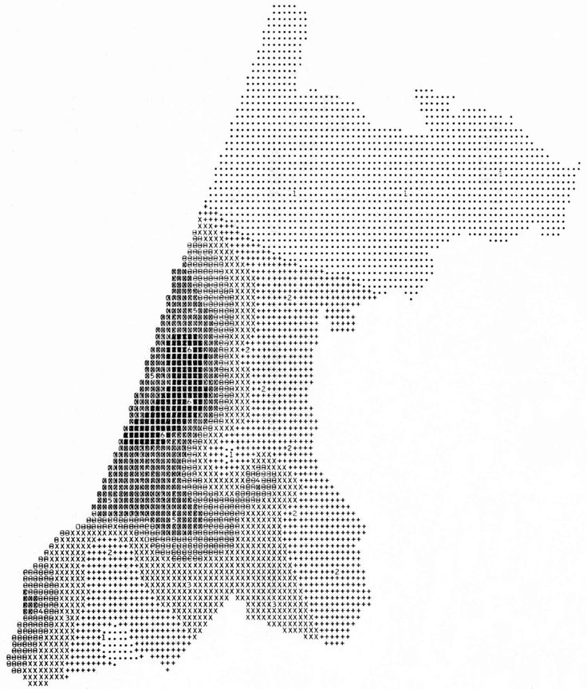
Meanwhile, at Harvard. The carto crowd:
SYMAP: 1964: printing on a line printer
The first computer cartography!

Slide 29
CALFORM, late 60s. SYMAP on a plotter. Allows lines to be drawn. More cosmetic, basically
SYMVU, late 60s: 3D SYMAP output.

Slide 31
GRID – late 60s. Beginning of raster GIS at Harvard.
POLYVERT – early 70s. Translation program between
SYMAP
CALFORM
DIME – data from the 1970 US census.

Slide 32
ODYSSEY: mid 70s. Extended POLYVERT into a comprehensive vector package: “Harvard Graphics”
First robust algorithms for polygon overlay, including sliver removal.

Slide 33
Key Individuals
Howard Fisher – started the whole thing
William Warntz – succeeded Fisher, ran to ‘71
Scott Morehouse. Top coder. Moved to ESRI in the mid-70s. The connection between Harvard and ESRI. He’s still there.

Slide 34
Thus began the history of ESRI
Environmental consulting firm.
Jack Dangermond 100% owns it. He’s da man of US GIS.
Became a software firm only later (still do a LOT of consulting)
From here, pretend to do what you do in lab on a crappy old DOS machine… and then make it good.

Slide 35
The US Census Bureau
Free US data really jumpstarted the GIS industry.
Particularly
DIME in 1970
TIGER in ‘80 and ‘90.
Made insane amounts of data available
Start of urban atlases.
Stimulated work with networks (especially roads)

Slide 36
Spatial data and attributes in a GIS

Slide 37
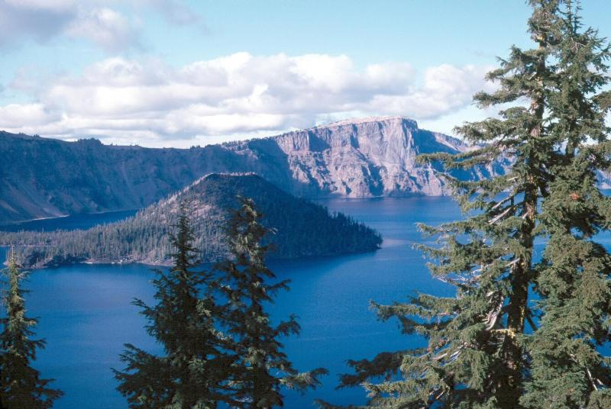
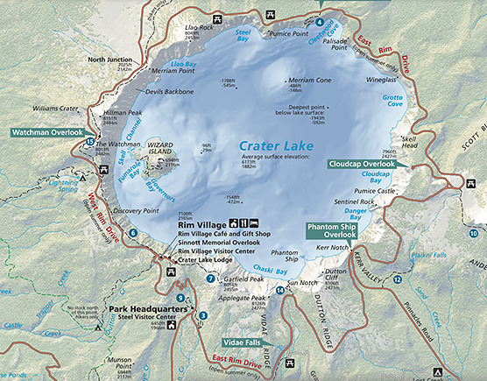
Spatial data is an abstraction of the physical world…
http://www.nps.gov/crla

Slide 38
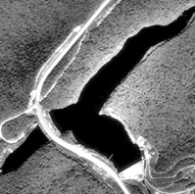
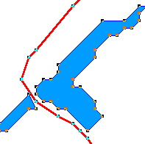
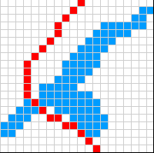
Two approaches to that abstraction
Vector
Raster

Slide 39
Vector data
Uses a sampling of geographic coordinates (called vertices) to construct shapes
Shapes can be…
Points (0-dimensional)
Lines (1-dimensional)
Areas (2-dimensional)
Volumes (3-dimensional)

Slide 40
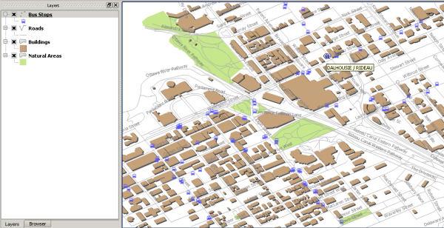
Vector example

Slide 41
Raster data
Formed by a grid where each cell has a value
“Wall-to-wall” coverage, often acquired by remote sensors or scanners

Slide 42
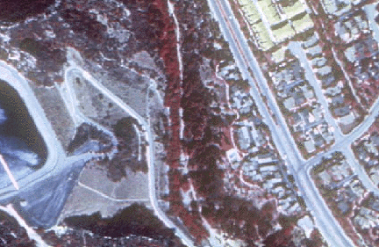
Rasters and imagery
http://www.gislounge.com/geodatabases-explored-vector-and-raster-data/
Images are rasters, but not all rasters are images

Slide 43
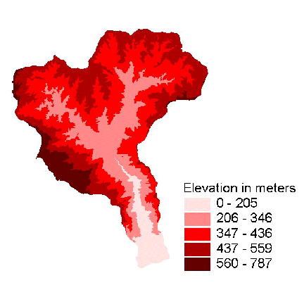
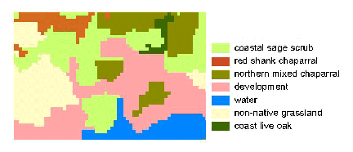
Rasters can represent surfaces and discrete data
http://www.gislounge.com/geodatabases-explored-vector-and-raster-data/

Slide 44
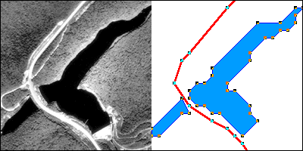
Feature geometries and attributes
In Cartography and GIS, you work with all sorts of spatial objects.
Roads, lakes, cities, states, etc.
A feature geometry is the “where” of a spatial object.
Attributes are the “what” of a spatial object.
Most typical ways to talk about “where” is through geometry: points, lines and polygons, or a raster cell grid.
Attributes are variables like numbers, text, dates, dollars, etc.

Slide 45
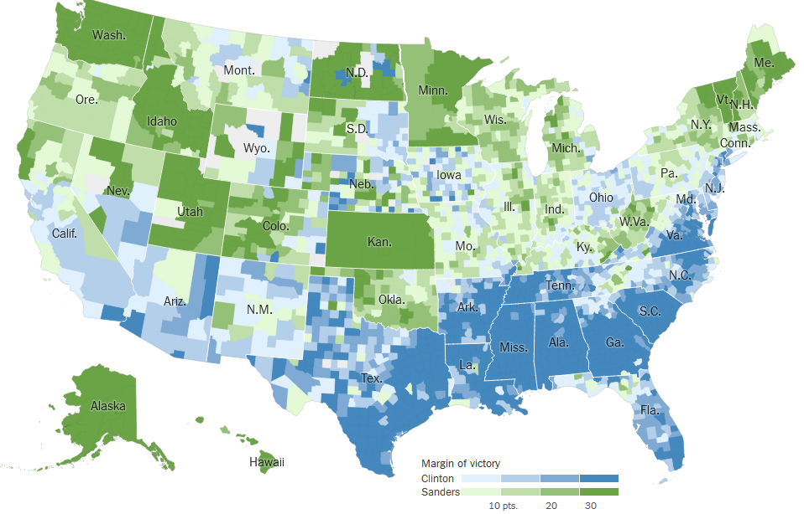
What are the geometries and attributes here?
http://www.nytimes.com/elections/2016/national-results-map

Slide 46
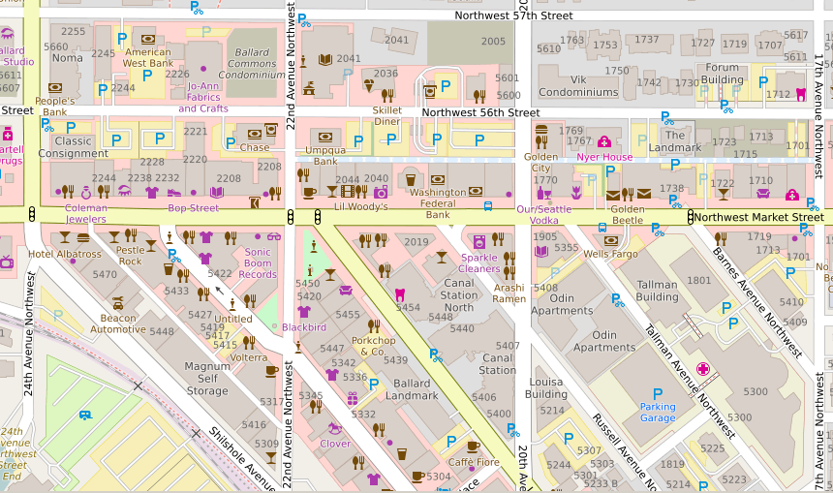
What are the geometries and attributes here?
http://www.openstreetmap.org

Slide 47
What are the geometries and attributes here?
http://www.gislounge.com/geodatabases-explored-vector-and-raster-data/

Slide 48
Common spatial data formats
Esri shapefile
Esri file geodatabase
KML
Google Earth’s data format
CSV
Comma-separated value. A way of storing spreadsheets.

Slide 49
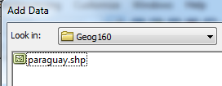
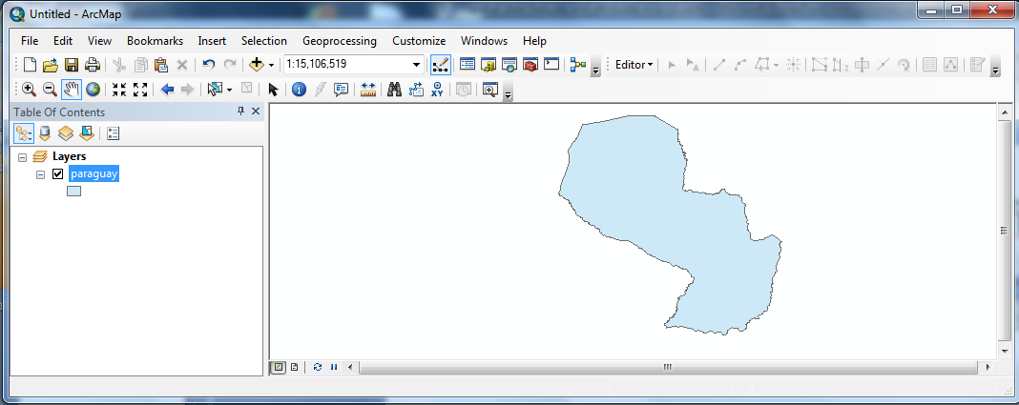
The ubiquitous Esri shapefile

Slide 50
What a shapefile looks like…
…in the ArcGIS catalog window
…in Windows explorer
Always use the ArcGIS catalog window to
move, delete, or create shapefiles

