Slide 1
Geog 301: Lecture 4
The value of spatial data
Again, portions swiped from Dr. Sterling Quinn

Slide 2
What the heck is spatial data?
Data tied to a location.
On earth
Mars
Anywhere. Heck, I’ve even seen detailed maps of the human body.
Note - GE has moon and mars. So cool.

Slide 3
Computers view maps
as collections of “layers”

Slide 4
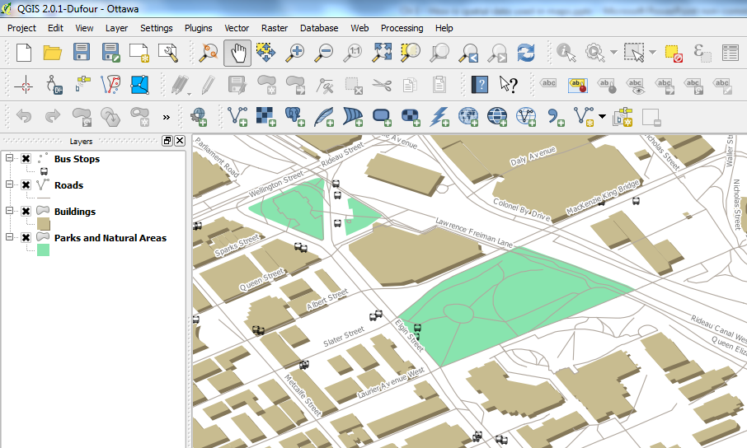

Slide 5
What to do with layers
Each layer is typically a spatial dataset
With geometry and attributes
Geometry is the location. Attributes are the information about that location
Mapping software helps you select, simplify, classify, and symbolize your spatial data at all the needed scales

Slide 6
Where do I get spatial data
to make these layers?

Slide 7
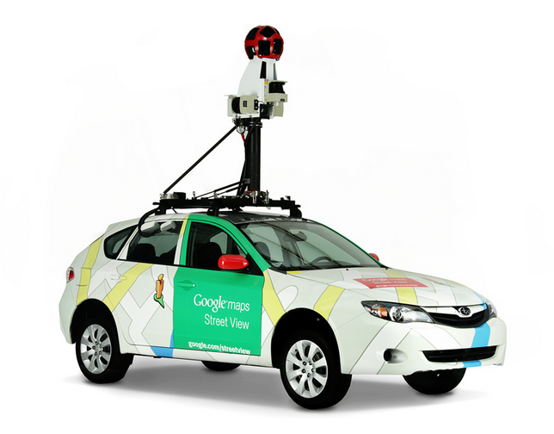
Obtaining spatial data
Get it from someone else
Paid
Free
Get it yourself
Much more on this later. Much….
https://www.google.com/maps/about/behind-the-scenes/streetview/

Slide 8
…and what is a GIS?

Slide 9
Information System
Information System is a piece of technology that you use to work with particular kind of data:
Word, Excel, Gmail and Google Calendar (all examples of office automation technology)
Google search

Slide 10
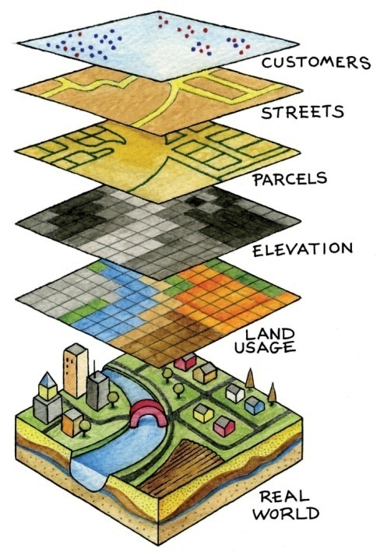
Geographic Information System (GIS)
A Geographic Information System is technology that you use to store and work with geographic (spatial) data:
Esri ArcGIS (commercial)
QGIS (open source)
Oracle Spatial (database driven)
Google (?)
Systems like GIS also involve the people who use them

Slide 11
What do I do with a GIS?
Anything you can map!
Most users are government – town/city/county/state/agency/military. Or subcontractors to them.
Often very much about data and data management.
Other users…. Let’s brainstorm a bit here.

Slide 12
Why does Google
make maps?
Seriously.. They give this cool stuff out for free.

Slide 13
Spatial data is lucrative

Slide 14
Spatial data is lucrative
This is why apps beg you to tell them your location

Slide 15
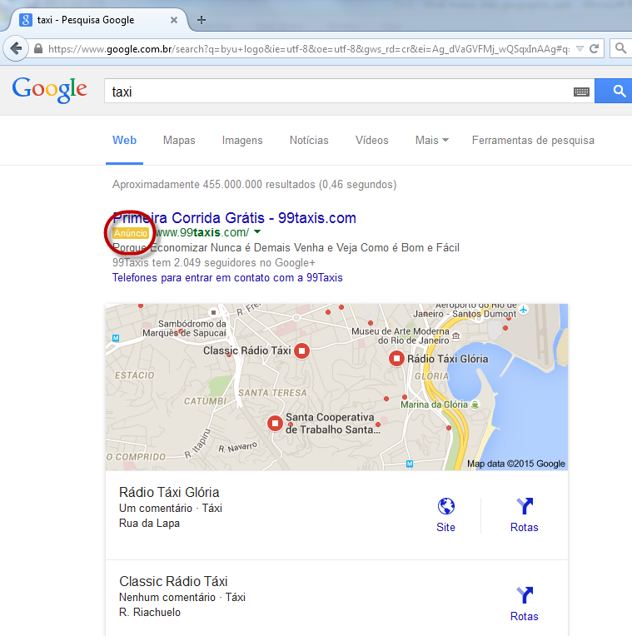

Slide 16
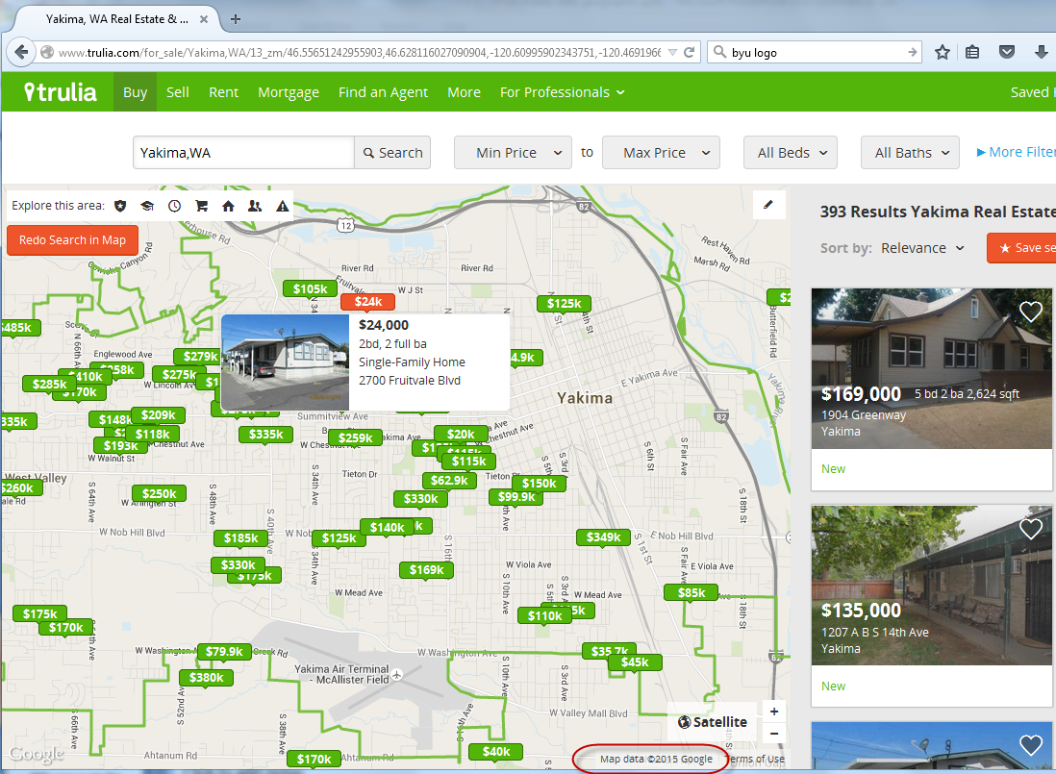

Slide 17
Spatial data is lucrative
How has spatial data affected your own consumer or personal habits?

Slide 18
Map Volunteers?
Open street maps
www.giscorps.org

Slide 19
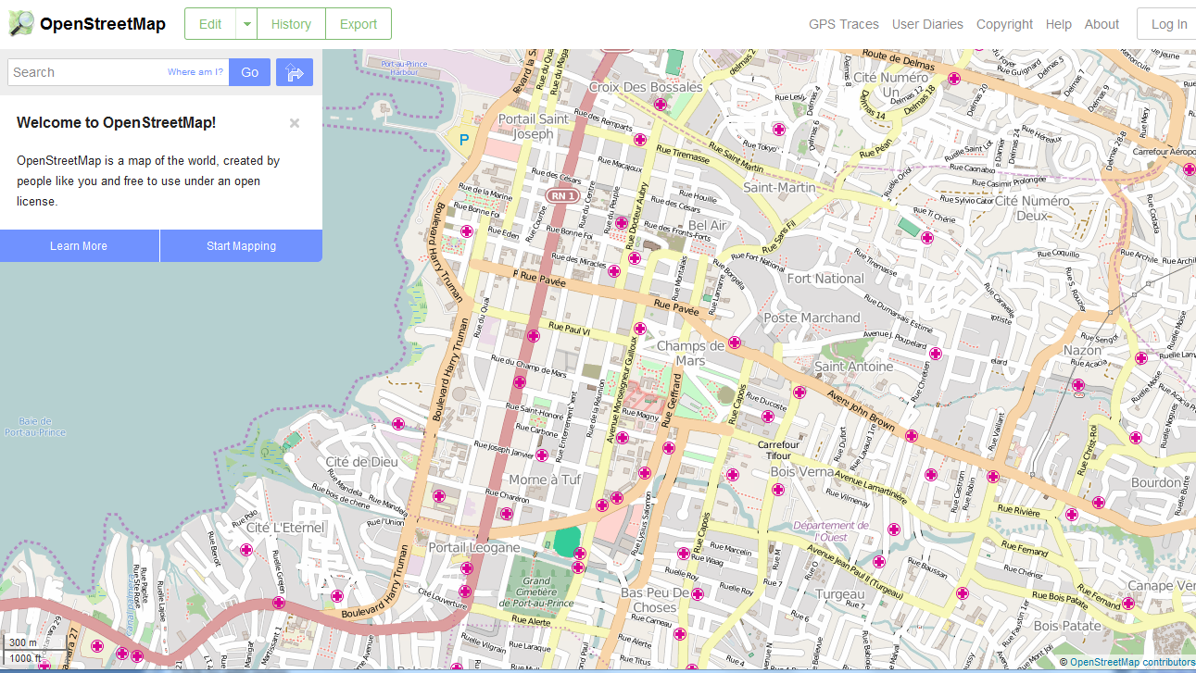
Spatial data is valuable to society

Slide 20
Spatial data is valuable to society
How has spatial data made your life better?

Slide 21
Mixing the two motives…
Value to society and making a buck.
Let’s talk about it a bit.

Slide 22
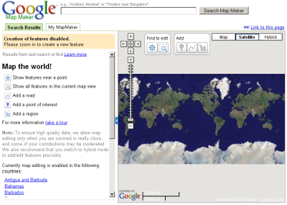
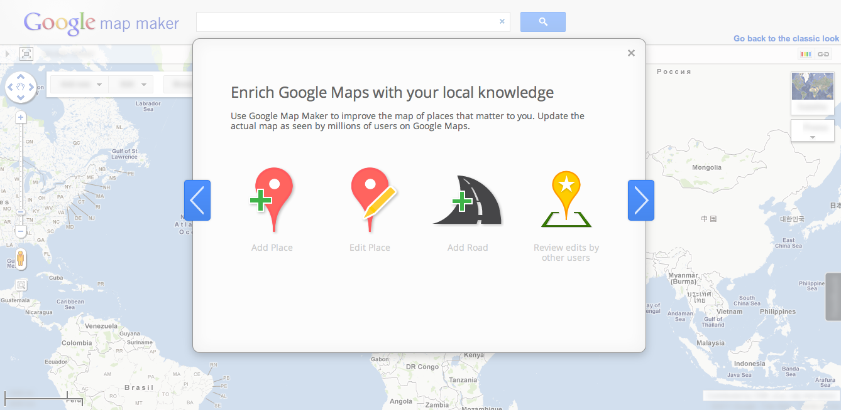

Slide 23
Sometime you screw up
http://www.huffingtonpost.com/2013/09/25/apple-maps-bad_n_3990340.html

Slide 24
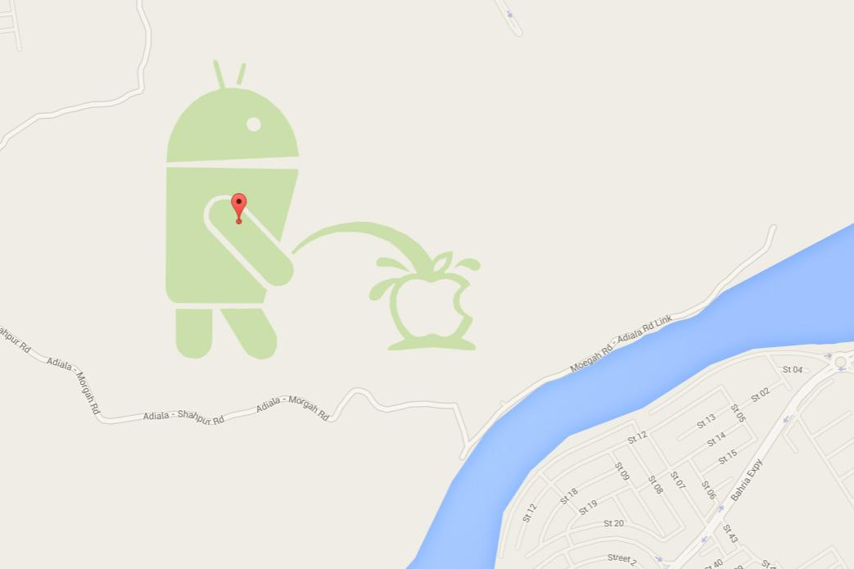
http://www.digitaltrends.com/mobile/google-suspends-map-maker-news/

Slide 25
Who uses an app that
relies on location?

Slide 26
Could spatial data
make your life worse?

Slide 27
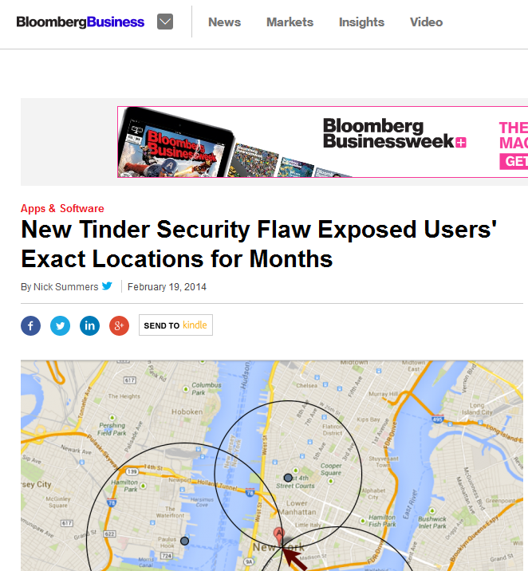

Slide 28
AshleyMadison.com, a site that helps married people cheat and whose slogan is “Life is Short, have an Affair,” recently put up a half million (Canadian) dollar bounty for information leading to the arrest and prosecution of the Impact Team — the name chosen by the hacker(s) who recently leaked data on more than 30 million Ashley Madison users. Here is the first of likely several posts examining individuals who appear to be closely connected to this attack.

Slide 29
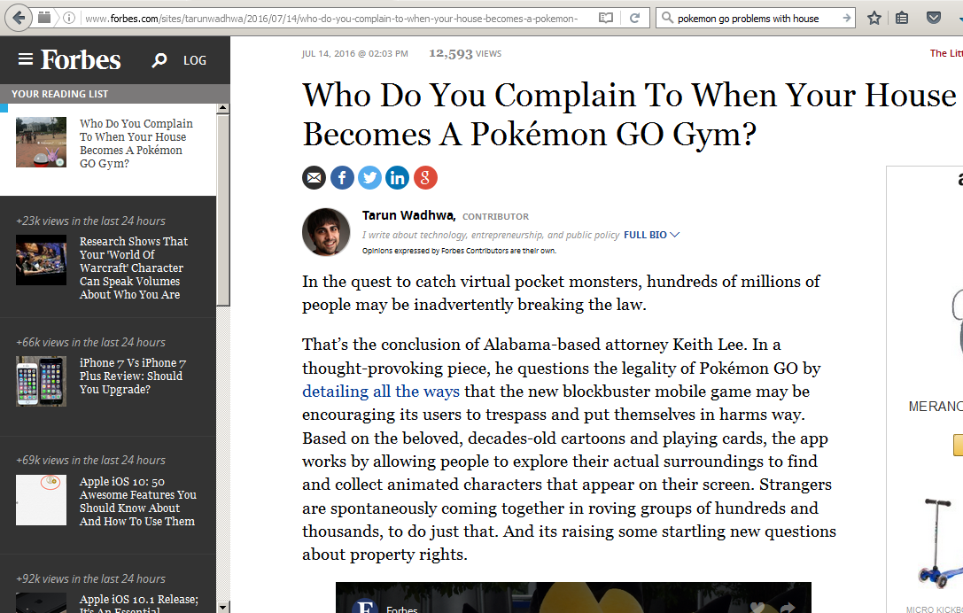

Slide 31
For better or worse, we live in a surveillance society. However, you do have some options regarding what data you release and how.
Do the bennies outweigh the consequences?
Why?
Why not?
Talk.

Slide 32
Eratosthenes story.

Slide 33
A handful of interesting maps
Connected states of America http://senseable.mit.edu/csa/interact.html
Hate maps: https://www.splcenter.org/hate-map#s=WA and
British empire: https://commons.wikimedia.org/wiki/File:British_Empire_evolution3.gif
Antipodes: https://www.antipodesmap.com/
Worldmapper cartograms: http://www.worldmapper.org/display_extra.php?selected=417
David Rumsey https://www.davidrumsey.com/

Slide 34
Real time flight tracking https://www.flightradar24.com/46.98,-120.47/7 and ships: http://www.marinetraffic.com/en/ais/home/centerx:-11.9/centery:24.8/zoom:2
Mapping US linguistics http://www.businessinsider.com/22-maps-that-show-the-deepest-linguistic-conflicts-in-america-2013-6#
Winds: https://earth.nullschool.net/#current/wind/isobaric/1000hPa/orthographic=-72.71,6.91,425 and https://www.windyty.com/ and lightning: http://en.blitzortung.org/live_lightning_maps.php

Slide 35
Edumacation: http://didyouknowfacts.com/map-compares-state-country-similar-education-level/?utm_source=SOMEE&utm_medium=SOMEE&utm_campaign=SOMEE&utm_term=pubexchange-did_you_know-someecards
https://wheremightilive.com/map

