Slide 1
What is effectively an overview of what we’ve done with topo maps and projections (etc).
http://geokov.com/Education/education.aspx

Slide 2
The power of maps
Partially swiped from Dr. Sterling Quinn.

Slide 3
Dean 206 GIS lab logistics
See Monica at Geography front desk (Dean 3rd Floor) to get key access
Log on as student (password: <on whiteboard>)
Keep everything on your own USB drive and back it up regularly at home. If you forget your drive, just put your files on the desktop. Then delete them once you get a copy.
J: drive has all data for the course
J:\301_w_19 has all data needed for labs
Copy data to your own drive before doing anything with it. Or you will regret it. Trust me. I’m a doctor.

Slide 4
Maps empower
In both good and bad ways.
Class discussion, good and bad ways maps empower.

Slide 5
But what is a map?
Means of representing spatial information. Showing what is where. And what is where in relation to other things. Over time. Etc.
It’s a language – one that is designed to communicate location.
And like any other language, it has rules, grammar, etc.

Slide 6
Maps are not value-neutral: They are influenced by the society that constructs them

Slide 7
Each map has a purpose

Slide 8
Maps are generalizations of things in the world. And Mapmakers make choices about…
Selecting what to show (and what not to show)
Simplifying the things they show
Classifying and symbolizing the things they show
Note, the USGS pretty much sets the standards for the world. Google will find you the usgs symbols. Never forget Google. Never. Ever

Slide 9
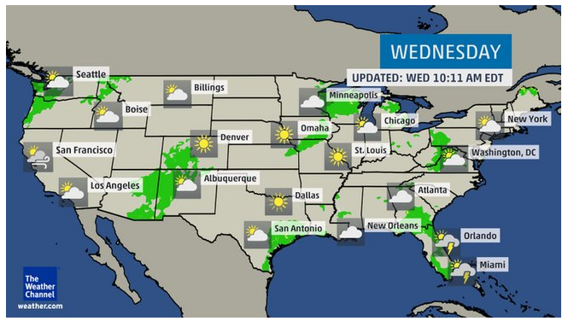
Obvious symbology!

Slide 10
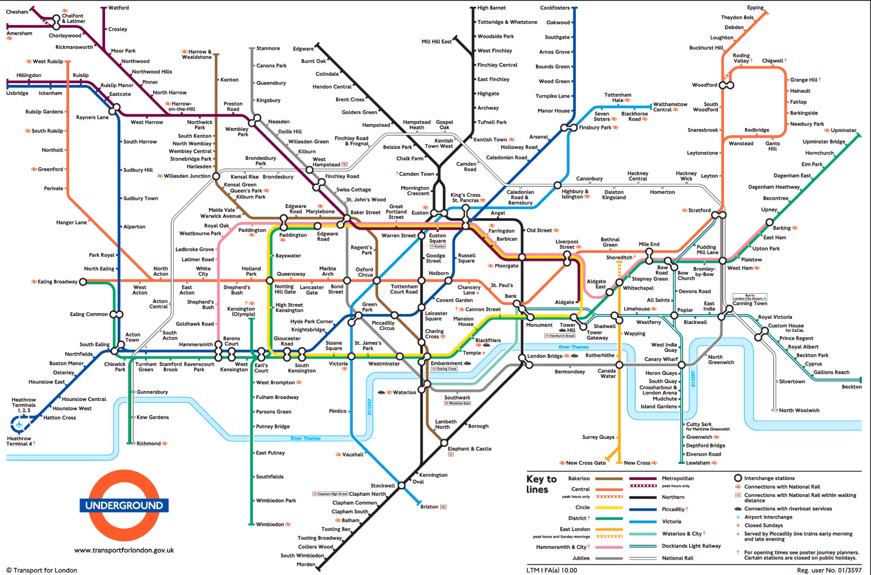
Geography sacrificed for usability!

Slide 11
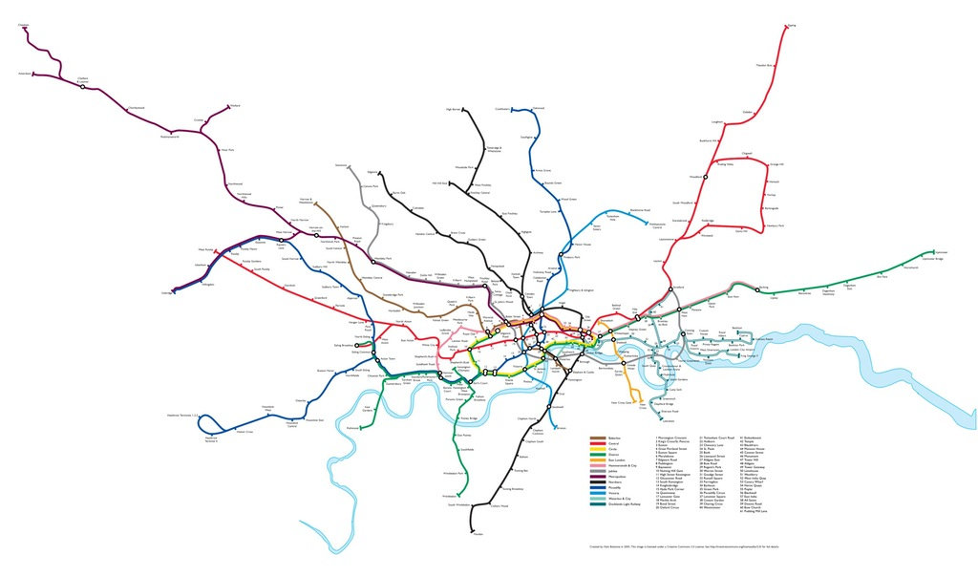
Geographically correct….

Slide 12
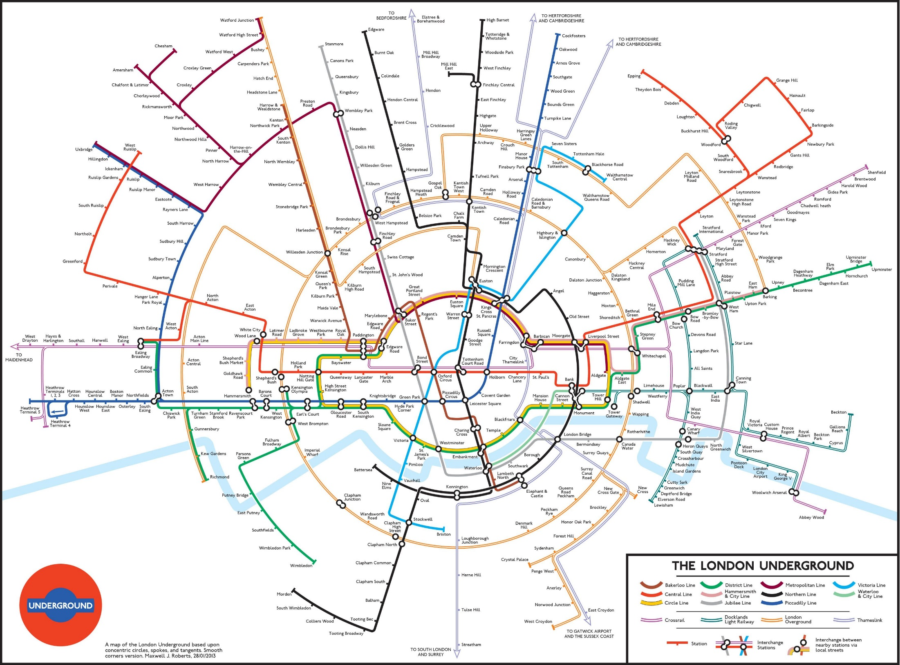

Slide 13
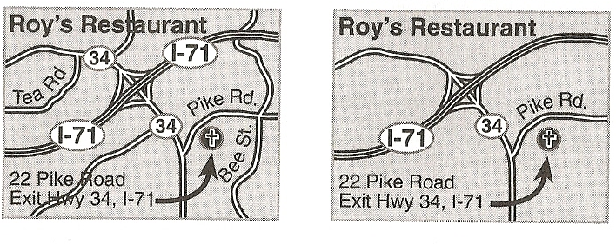
From Making Maps (p. 163) by John Krygier and Denis Wood
Selection.

Slide 14
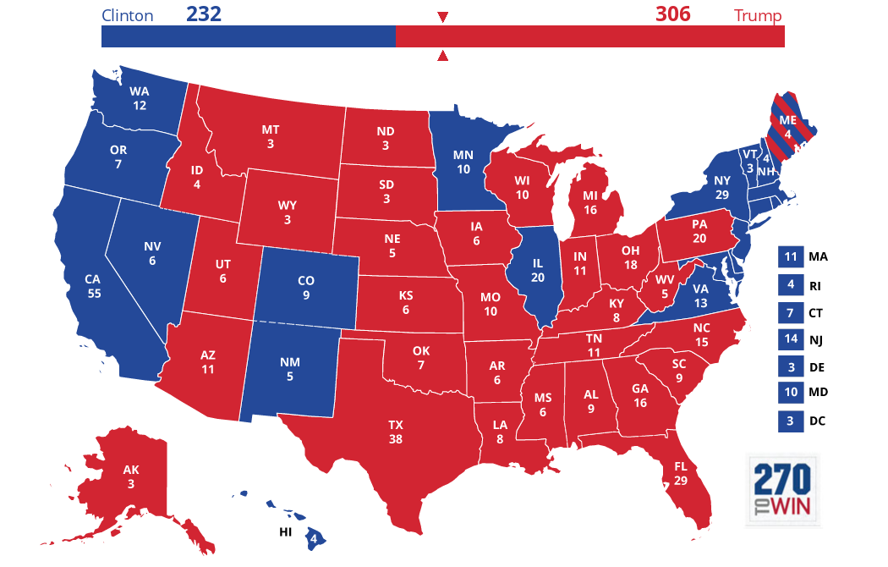
Let’s take a quick look at the last election and different representations. First, the standard by state and electoral college

Slide 15
But there’s much more to the story
https://www.nytimes.com/elections/results/president
http://www-personal.umich.edu/~mejn/election/2016/
https://www.reddit.com/r/MapPorn/comments/dg04y6/votes_scaled_to_population/

Slide 16
Electoral College
State total = house reps + senators.
Heavily biased toward smaller population states.
Winner take all (so, a huge win is the same as small win.
Voter turnout, voting method, gerrymandering, and voter suppression also come into play.
The electoral college was a compromise on two important issues. The first was how much power the people should have, and the second was how much power small and large states should have.

Slide 17
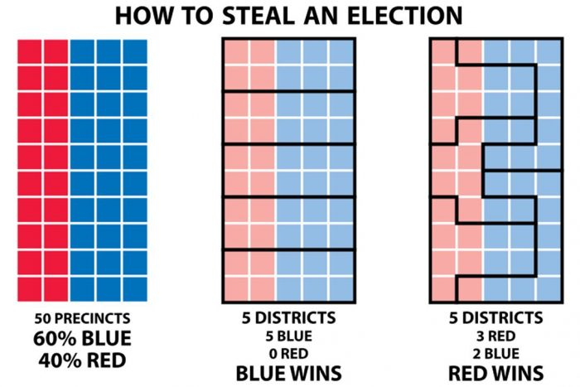
What about gerrymandering?

Slide 18
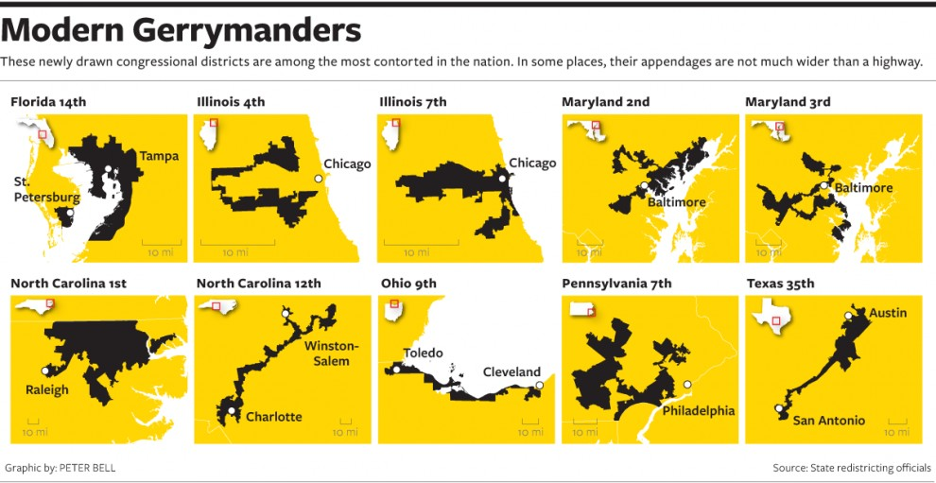

Slide 19
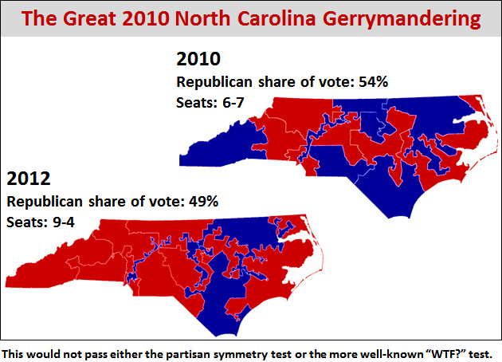

Slide 20
http://www.motherjones.com/politics/2012/11/republicans-gerrymandering-house-representatives-election-chart/
Yay PA! https://www.nytimes.com/interactive/2018/02/19/upshot/pennsylvania-new-house-districts-gerrymandering.html

Slide 21
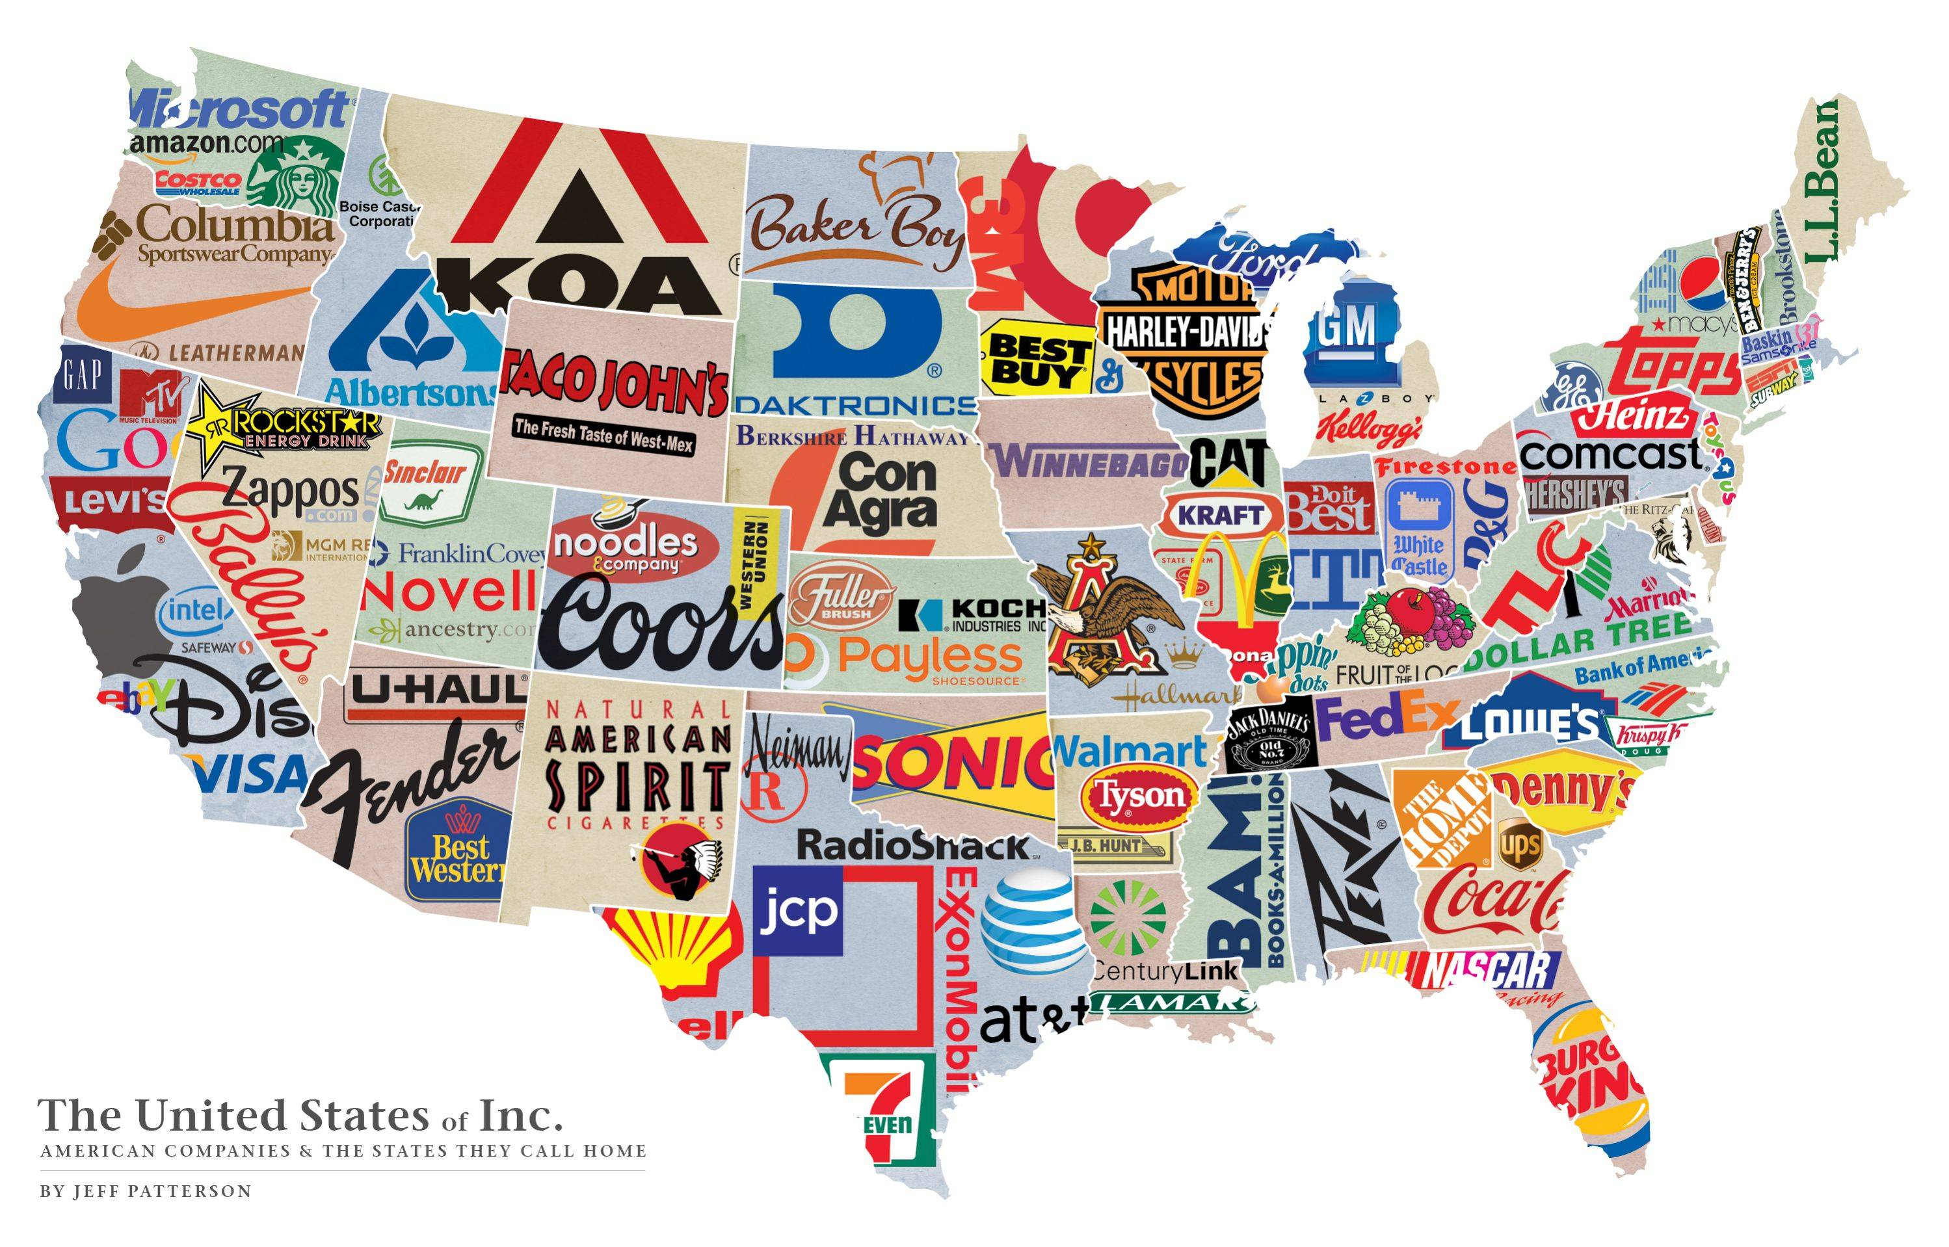

Slide 22
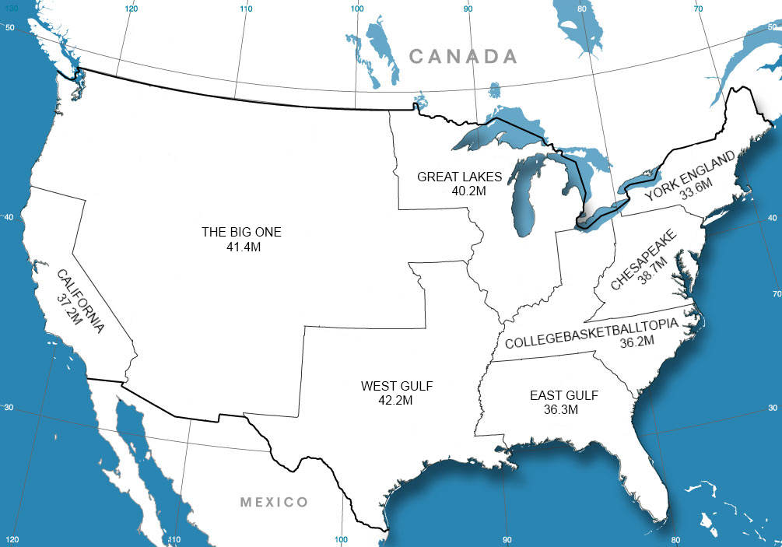

Slide 23
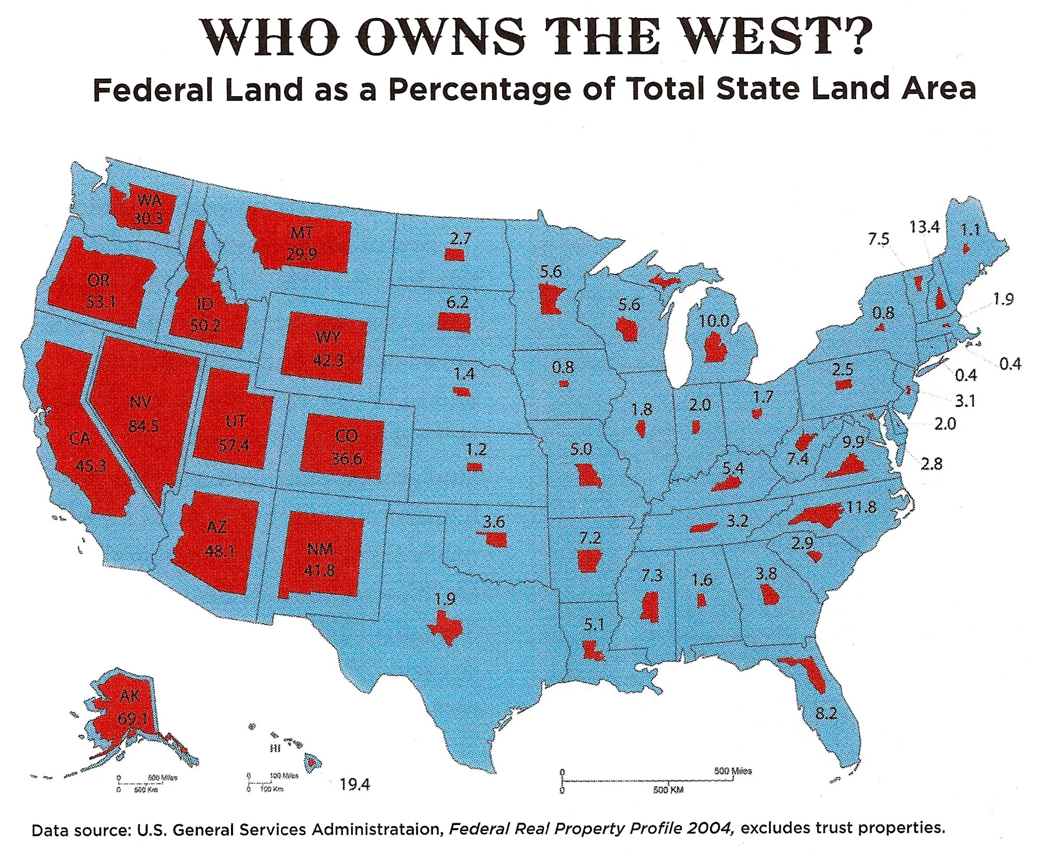

Slide 24
What makes a good cartographer?
Good cartographers know how to make the most effective choices toward achieving the map’s purpose
Selection
Simplification
Classification and symbolization

Slide 25
www.reddit.com/r/mapporn
www.reddit.com/r/shittymapporn

Slide 26
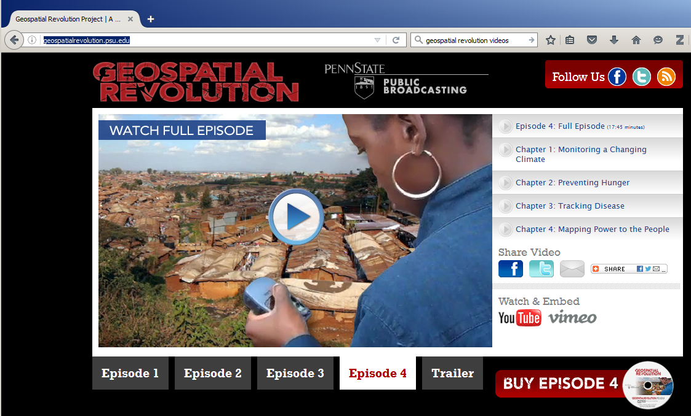
Geospatial Revolution video link
http://geospatialrevolution.psu.edu/
Really: https://www.youtube.com/watch?v=ChWj4yBmE0E

Slide 27
Getting creative?
https://imgur.com/a/LIPg4

