Slide 1
Where are you?
A guide to coordinate systems, datums, projections, and geoids.

Slide 2
Assigning a number
Coordinate systems. Which include:
Latitude/Longitude
Universal Transverse Mercator (UTM)
Military Grid
State Plane
Public Lands Survey System (PLSS)

Slide 3
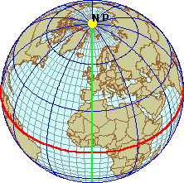
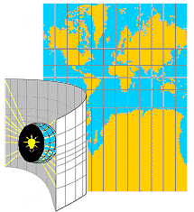
Coordinate Systems Geographic vs. Projected
Geographic Coordinate Systems (GCS)
Location measured from curved surface of the earth
Measurement units latitude and longitude
Degrees-minutes-seconds (DMS)
Decimal degrees (DD) or radians (rad)
Projected Coordinate Syst (PCS)
Flat surface
Units can be in meters, feet, inches
Distortions will occur, except for very fine scale maps

Slide 4
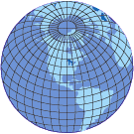
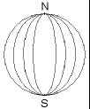
Lat/Long
Latitude/Longitude Lines of latitude Longitude lines N or S of Equator E or W of Prime Meridian
Also called parallels and meridians

Slide 5
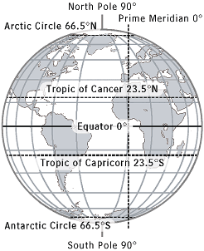

Slide 6
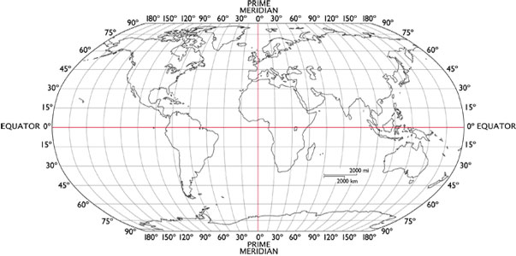
Lat/Long

Slide 7
Solving longitude? http://cudl.lib.cam.ac.uk/collections/longitude
https://www.rmg.co.uk/about-us/board-longitude
Master and Commander books. By Patrick O’Brian. Skip the movie.

Slide 9
Universal Transverse Mercator
Basically, slicing the globe into a series of vertical “peels”
False easting and false northing set for both hemispheres
Everything becomes a grid in meters.
Basically the same as what the military uses!

Slide 10
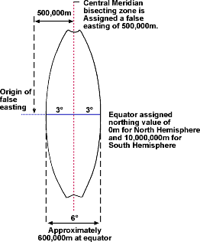

Slide 11
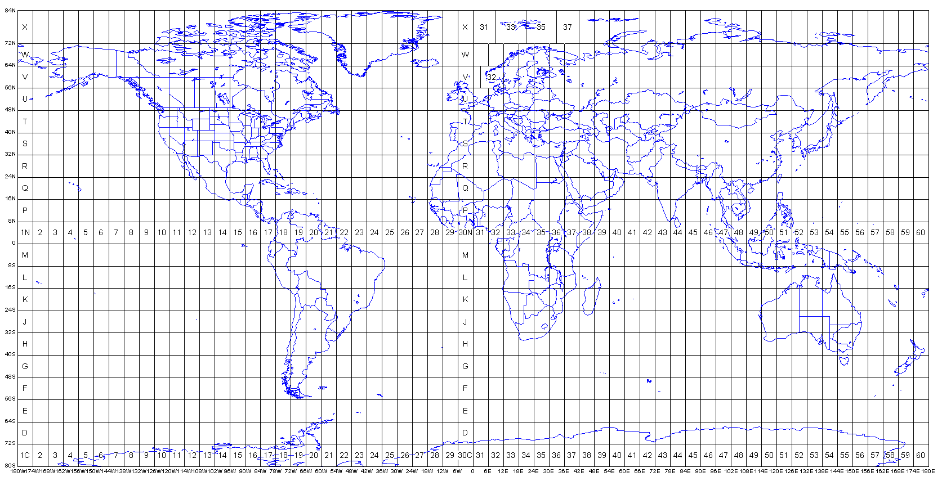

Slide 12
https://gfycat.com/FaroffBelovedBarnacle

Slide 13
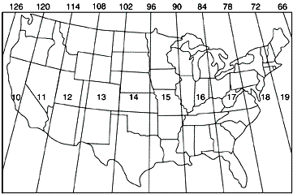

Slide 14
State Plane
Local grids (only cover one [or part of one] state.
Thus, not affected by plate tectonics. Much.
Grid in feet, from false origin

Slide 15
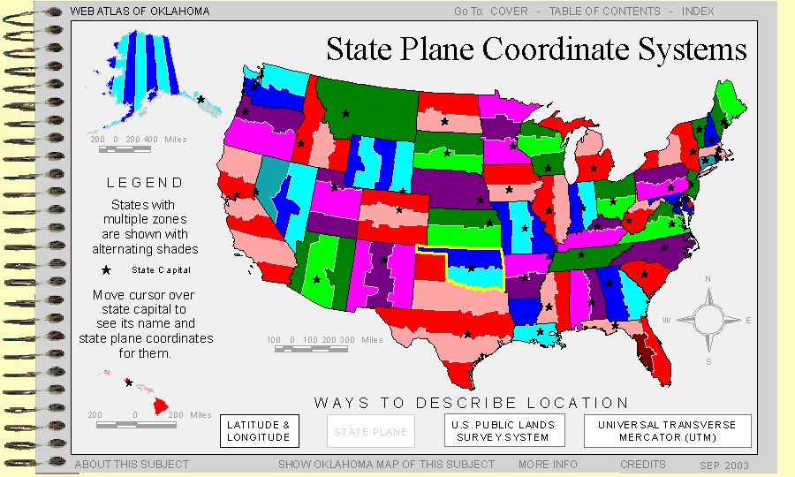

Slide 16
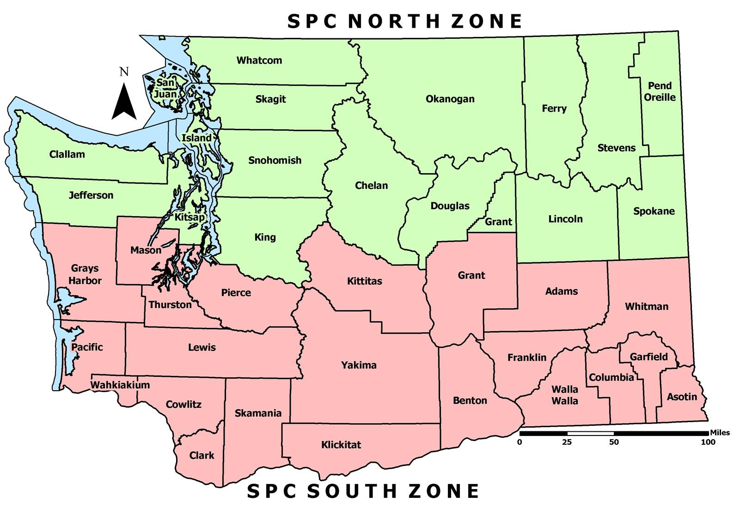

Slide 17
Public Land Survey System (PLSS)
Broken by township, range, section, ¼ section, ¼ ¼ section, etc.
Old school way of partitioning the West, mostly.

Slide 18
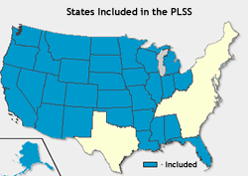

Slide 19
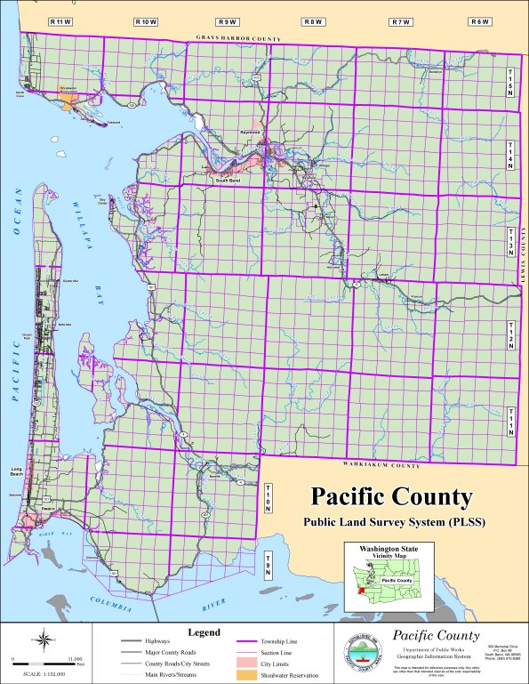

Slide 20
PLSS on Quad maps
There… then not… now back. Clearly still important.

Slide 21
What about the shape of the earth?
It’s not spherical. Not even close. Which would, however, make the math easy.
It’s not even a spheroid…. (two axes of different length)
It’s considered an oblate spheroid…. In other words, a spheroid with bulges and pits. Think a squashed golf ball.
So, we need a mathematical model of the shape of the earth – a datum.
Picture a transparent ball. Now draw lat/long onto it. Put a lightbulb inside. Light the bulb and look at the reflection of the lat/long on the wall. Now, distort the ball – the location of the lines changes.
So, to have accurate coordinates, we need an accurate model of the earth.

Slide 22
They can be centered at the center of the earth or on the surface
Which, really depends on the technology of the time.
They can also be “local” or global.

Slide 23
Datums – the ones to worry about
Clarke 1866
North American Datum of 1927 (NAD27)
NAD83
WGS84
Note which are earth centered. And the approximate error between them.

Slide 24
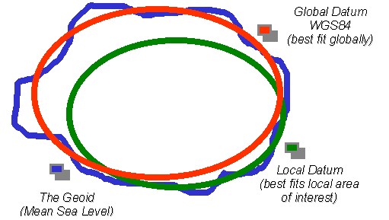

Slide 25
The Geoid
Basically, a high end datum based on gravity.
Needed for crazy accurate measurements – not something most of us will ever need to deal with.
But, gravity isn’t a constant: https://apod.nasa.gov/apod/ap141215.html

Slide 26
What about projections, though???
A projection is just a way of getting a 3D object (the earth) onto a 2D surface (screen or paper map). It has nothing to do with accuracy, coordinates, or datums.
Important point – projections always distort – what they distort and how much is up to the cartographer.

Slide 27
Projection classification
1) By Geometric construction
Conic
Cylindrical
Azimuthal
Modified by
Aspect (equatorial, polar, oblique)
Case (Tangent, secant, polyconic)
or

Slide 28
Classification 2
2) by preserved properties
Area (equal area or equivalent projections)
Angle (shapes are correct – conformal projections). Note, angle and area are mutually exclusive. Mercator!
Distance (equidistant projections) – distances between points are correct. But only to/from a single point! The center
Azimuth. Great circles are straight lines. Often viewed with the poles at the center. Only applies to/from a single point. The center.
Compromise. Nothing is preserved. But nothing super distorted, either.
Now, let’s look at some images. Much of the below swiped from Pease.

Slide 29
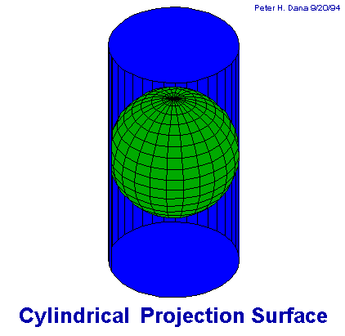
Projections
projecting a spherical surface onto a cylinder. minimize distortion along the equator (in the normal position).

Slide 30
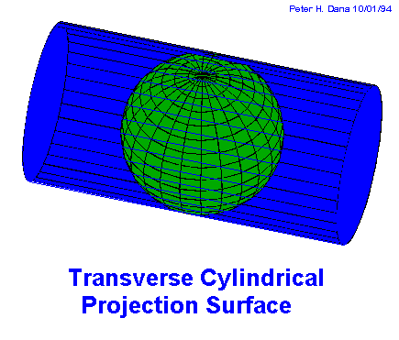
Projections
A transverse projection is rotated 90° from the normal projection.
As the line of tangency is along a meridian instead of a parallel, this reduces distortion along a north-south line while distortion increases on either side in an east-west direction.

Slide 31
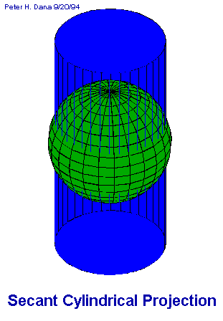
Projections
The secant projection intersects the Earth at two locations creating two standard lines, in this case minimizing distortion along the two standards and reducing the overall distortion away from the standards as compared to a more traditional projection.

Slide 32
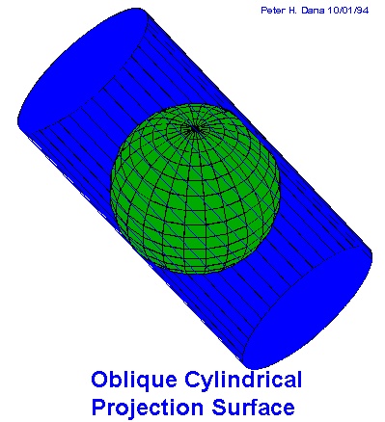
Projections
The oblique projection intersects the Earth at some other angle other than along the meridians or parallels.

Slide 34
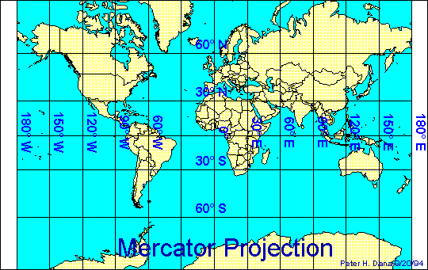
straight meridians and parallels that intersect at right angles.
Scale is true at the equator or at two standard parallels equidistant from the equator.
used for marine navigation because all straight lines on the map are lines of constant azimuth.

Slide 35
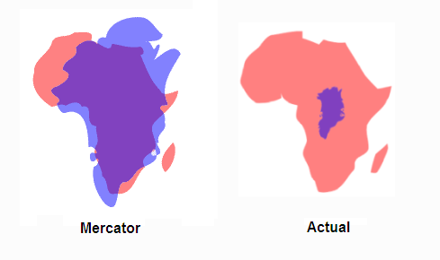

Slide 36
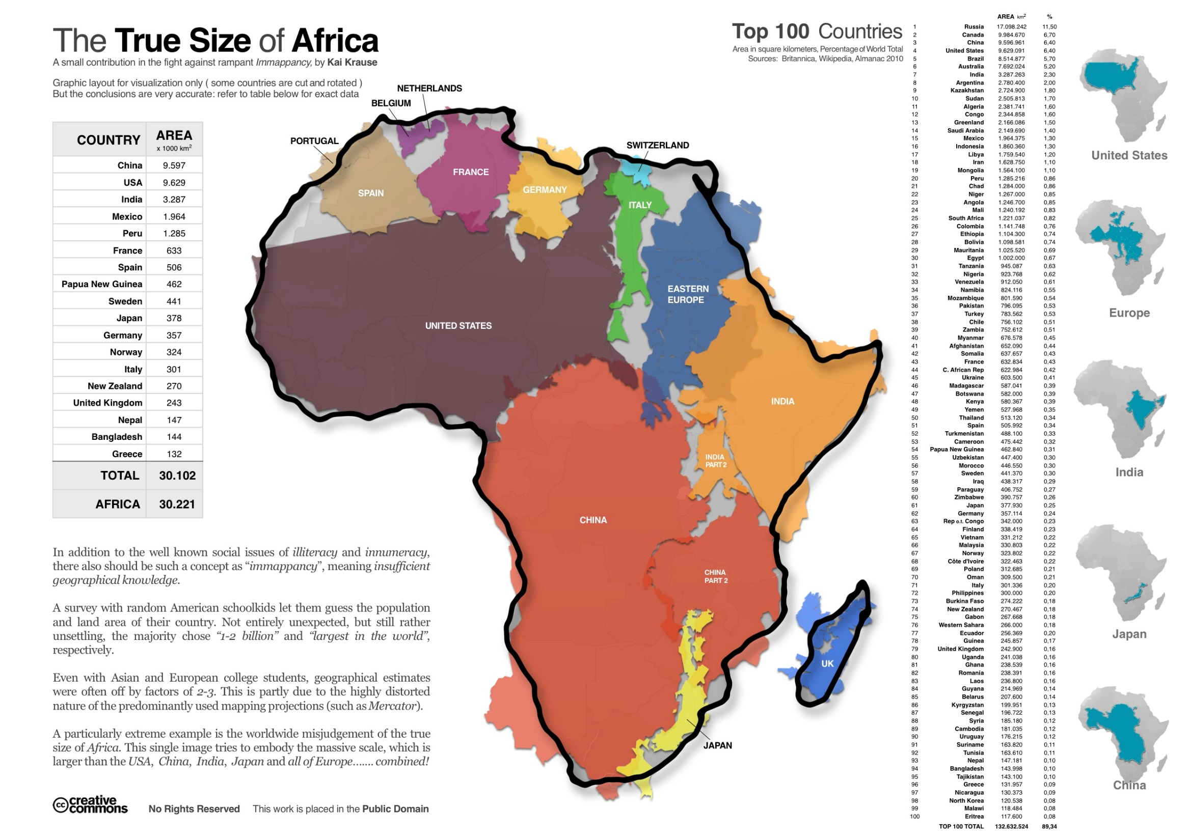

Slide 37
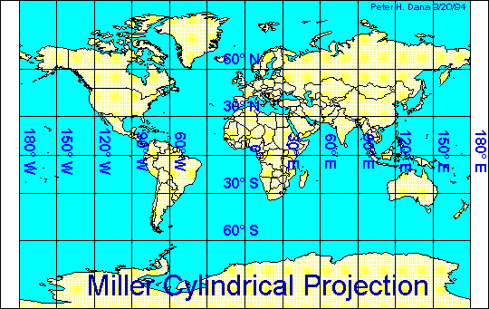
Types of Cylindrical Projections –
These include -
straight meridians and parallels that meet at right angles, but straight lines are not of constant azimuth.
Shapes and areas are distorted. Directions are true only along the equator. The projection avoids the scale exaggerations of the Mercator map.

Slide 38
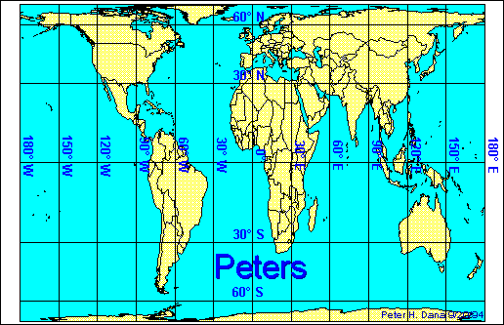
Types of Cylindrical Projections –
These include -
This projection is a cylindrical equal-area projection that de-emphasizes area exaggerations in high latitudes.

Slide 39
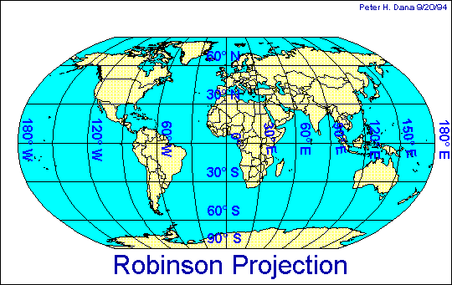
Projections
Types of Cylindrical Projections –
These include -
based on tables of coordinates, not mathematical formulas. The projection distorts shape, area, scale, and distance in an attempt to balance the errors of projection properties.

Slide 40
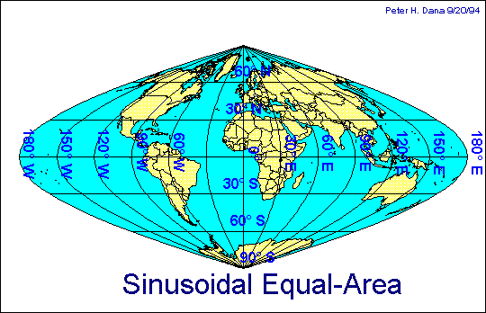
Projections
Types of Cylindrical Projections –
These include -
Equal-Area has straight parallels at right angles to a central meridian.
Scale is true only on the central meridian and the parallels.
Horrible for the globe, but often used in countries with a larger north-south than east-west extent.

Slide 41
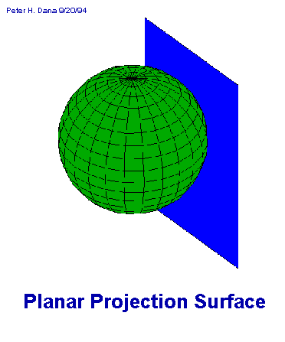
Projections
Planar are are otherwise known as azimuthal.
This type of projection is usually pole-centered because it minimizes distortion in a circle around the pole.

Slide 42
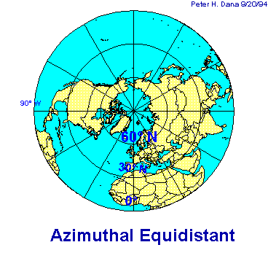
These projections are commonly used to show air-route distances.
Distances measured from the center are true with distortion increasing away from the center point.

Slide 43
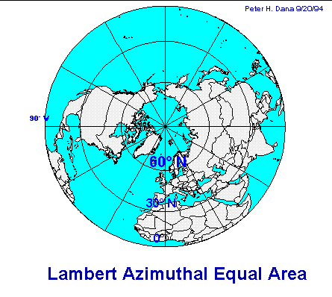
Types of Planar Projections –
These include -
This projection is commonly used to map large ocean areas.
The central meridian is a straight line, others are curved. A straight line drawn through the center point is on a great circle.

Slide 44
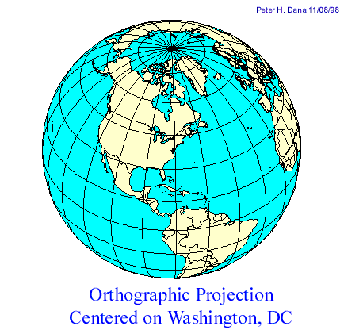
Types of Planar Projections –
These include -
These projections are used for perspective views of hemispheres. Area and shape are distorted. Distances are true along the equator and other parallels.

Slide 45
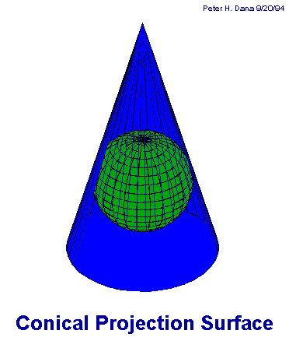
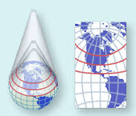
Conic Projections result from projecting a spherical surface onto a cone. These projections tend to minimize distortions in the mid-latitudes.

Slide 46
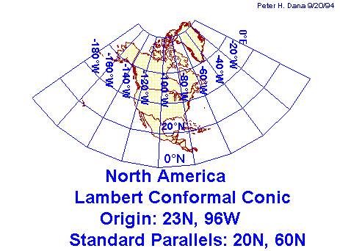
Note: This projection has two standards.
Area, and shape are distorted away from standard parallels. Directions are true in limited areas. Used for maps of North America.

Slide 47
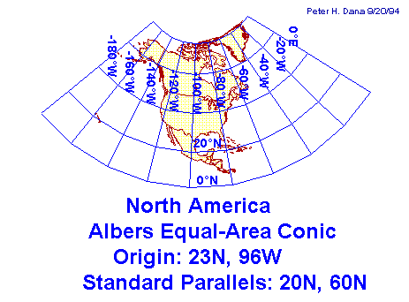
Another secant conic projection.
distorts scale and distance except along standard parallels. Areas are proportional and directions are true in limited areas. Used in the United States and other large countries with a larger east-west than north-south extent.

Slide 48
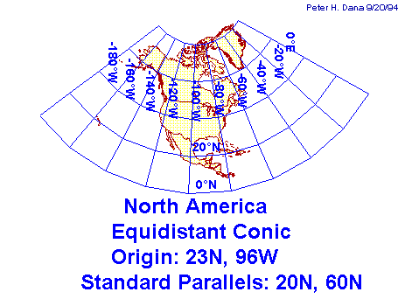
another secant conic projection.
Direction, area, and shape are distorted away from standard parallels. Used for portrayals of areas near to, but on one side of, the equator.

Slide 49
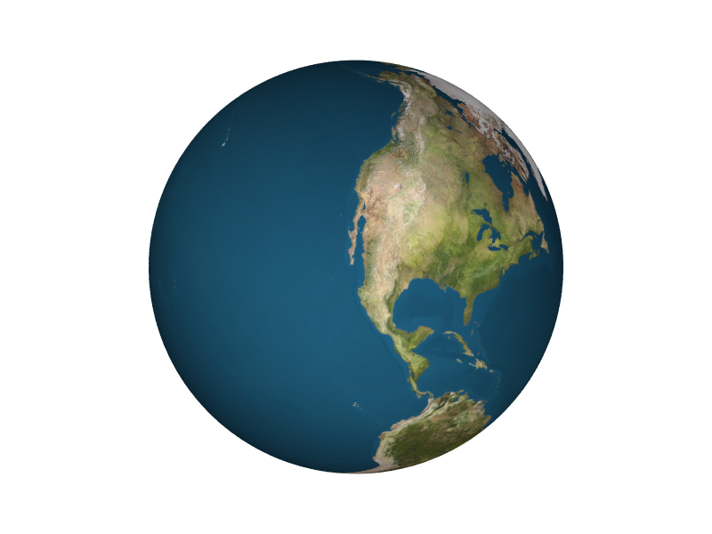
Projections
Other Types of Projections –
Buckminster Fuller’s projection was based on his geodesic globe ideas and projected the sphere on to a icosahedron (20-sided sphere).

Slide 50
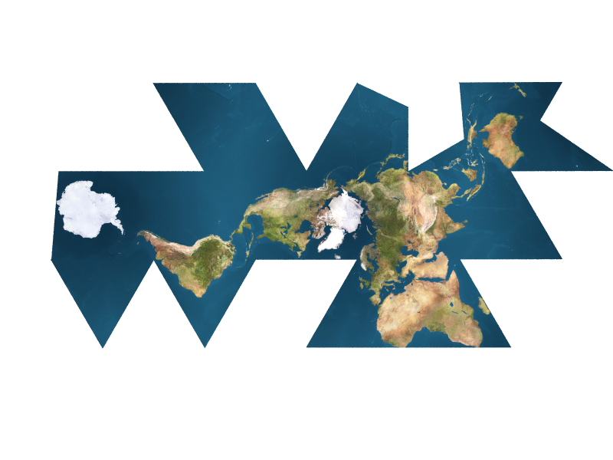
Other Types of Projections –
Buckminster Fuller’s projection was based on his geodesic globe ideas and projected the sphere on to a icosahedron (20-sided sphere).
Then by pulling it apart and flattening it, the result is a map of minimal distortion (each of the axes of the polygons act like a standard).

Slide 51
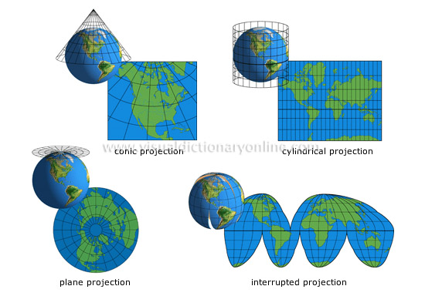

Slide 52
https://bl.ocks.org/mbostock/3711652

Slide 53
Map Projections and Coordinate Systems Choosing Map Projections

Slide 54
Cylindrical projections for countries in the tropics
principal scale preserved along the equator

Slide 55
Conical projections for countries in the temperate zones
principal scale preserved along a parallel of latitude

Slide 56
Azimuthal projections for the polar regions
principal scale preserved at the pole

Slide 57
The larger the area mapped, the more projections distort

