Slide 1
Air Pollution - ozone

Slide 2
A bit of US history re air pollution and legislation
Notes about air pollution go back to ancient Rome. But we’re not interested in that…. But if you’re interested, check this out. https://www.smithsonianmag.com/science-nature/air-pollution-goes-back-way-further-you-think-180957716/
First item of note – Donora, PA. 1948. ~40 deaths over 5 days. Temperature inversion plus massive industrial emissions.
1952 – London. Mostly coal smoke. Cold weather, temperature inversion. And upwards of 10k dead and 100kl+ made ill.
And, of course, CA. The national leader in anything environmental.

Slide 3
CA air pollution history https://www.aqmd.gov/home/research/publications/50-years-of-progress
1943 – smog has gotten bad in LA (the worst air in the US)
  Valley + temp inversions
  So bad folks, literally, cannot breathe.
    The main culprit. Ozone.

Slide 4
Let’s talk about ozone. O3
Great stuff in the stratosphere, a major irritant at the surface.
Forms when NOx and SOx are combined with VOCs (volatile organic compounds) in the presence of UV radiation.
  All about burning stuff…. Gasoline, coal, industry, etc.

Slide 5
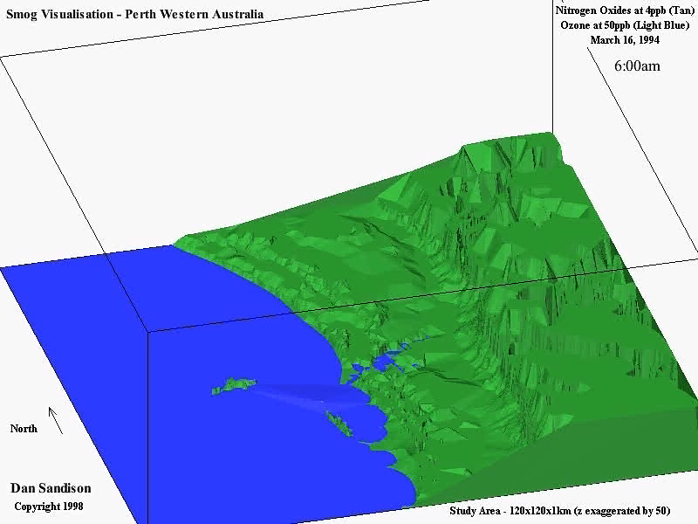

Slide 6
But, back to CA – LA in particular.
The war was on between industry and people who liked to breathe.
Early, minor, control measures in 1905-1912. Didn’t do much
WWII – massive increases in pollution. Also, many more people and cars. Even to the extent that it was a “serious menace” to aviation
1943. County appoints board to examine pollution
Issue ID’d as not being one industry, but really a combo of everything.
1947. CA State Law enacted. Set up Air Pollution Control Districts and provided some teeth. Some.

Slide 7
Cont’d
By 1950, Ozone ID’d as the big issue in LA
  Heck, even tires disintegrated faster in LA.
1952. Source of ozone figured out. Industry horrified.
Late 40s-early 50s. Things helped by regulated open burning in dumps and reducing point source pollution (factories and refineries).
Backyard incinerators banned in ‘58.
Smudge pots also an issue. https://www.nrcs.usda.gov/wps/portal/nrcs/detail/or/newsroom/stories/?cid=nrcseprd1069806

Slide 8
1953. Recommendation:
  Reduce hydrocarbon emissions from refineries/fueling ops
  Auto exhaust standards
  Move from diesel to propane in trucks
  Ease up on heavy industry
  Ban open burning of trash
  Public transportation

Slide 9
Those dang cars….
1978. gas station fuel nozzles recaputure hydrocarbons. Today, the nozzles must recapture at least 95% of the emissions.
Early 60s, efforts to require catalytic converters on vehicles. Became law in 1975
  Technology forcing regulation. The state made the law, and industry had to figure it out. Note that they had a good decade of R&D.
Late 70s, annual vehicle inspections. Including emissions.
  Common in much of the US and Europe.
    In Germany, the licensing fees on vehicles goes up with emissions. Thus, older vehicles are EXPENSIVE to license….

Slide 10
Still all about Ozone and LA/CA
1960s. Started cleaning up fuels
1970, Feds started phasing lead out of gasoline.
70s and 80s – state plugged using natural gas. Honestly, never really got anywhere.
But.. Gasoline companies started really cleaning up fuels. Now required by both federal and state law.

Slide 11
https://www.insider.com/vintage-photos-los-angeles-smog-pollution-epa-2020-1
https://www.lung.org/research/sota/city-rankings/most-polluted-cities
https://www.yakimaherald.com/news/study-ranks-yakima-no-6-in-nation-for-short-term-air-pollution-spikes/article_b588fee1-3383-5e0b-8af5-002f376686ed.html

Slide 12
But what about the Feds?
Really, All about the Clean Air Act
First enacted in 1955 as the Air Pollution Control Act. But it was weak and only included funds for research “let’s study it!”
Clean Air Act of 1963 – more research.
The one we really know is the Clean Air Act of 1970 (Tricky Dick).
  Allowed for control of common pollutants that the EPA had set standards for: particulate matter (also known as particle pollution), ozone, sulfur dioxide, nitrogen dioxide, carbon monoxide, and lead.
  Hazardous or toxic air pollutants that pose health risks such as cancer or environmental threats such as bioaccumulation of heavy metals
  Acid rain that damages aquatic life, forests and property
  Chemical emissions that deplete the stratospheric ozone layer, which protects us from skin cancer and eye damage
  Regional haze that impairs visibility in national parks and other recreational areas

Slide 13
Major revisions in:
  1977 (Carter)
  1990 Amendments. Signed by Bush, jr. Actually strengthened the law.

Slide 14
A lot of progress, but air is still bad…
For example, seattle: https://www.iqair.com/us/usa/washington/seattle
Ellensburg: https://www.iqair.com/us/usa/washington/ellensburg
Global rankings. https://www.iqair.com/us/world-air-quality-ranking
https://www.iqair.com/us/world-air-quality-report
And a bit more info on the clean air act: https://www.youtube.com/watch?v=1-SH3kJpVA4

