Slide 1
Agricultural pollutants
#2 in pollution – after CO2/methane
Remember, a pollutant is a substance that is present in concentrations that may harm organisms (humans, plants and animals) or exceed an environmental quality standard.

Slide 2
Really? How?
Pesticides, herbicides, and fungicides. Already covered!
Antibiotics
Fertilizer
Ammonia
Poop
Soil salinization
erosion

Slide 3
But…..
Food is really, really, really important! And as populations grow, so does the need for food.
As society has become richer, animal protein has become more and more a part of our diets.

Slide 4
In the US
1.1 trillion dollar enterprise. ~5% of the US GDP.
~10% of US employment (the whole industry)
1.4% is direct on-farm employment
Most are in the food service industry (restaurants)
~12% on average of household expenditures.
~40% of the US land area dedicated to ag (including rangelands)
Of that, about 40% is crops, 40% pasture, 10% woodland, the rest other.

Slide 5
Antibiotics
Antibiotics are used extensively in agriculture, livestock and in animal husbandry
In agriculture, these are used to increase crop productivity; in animal husbandry and livestock to treat sick animals and as growth promoters in animal feed at controlled concentrations.
a common perception amongst livestock producers is that the benefits of antibiotics in production outweigh the costs

Slide 6
People can get infections from food in different ways:
From handling or eating meat, seafood, milk, or eggs that are raw or undercooked and contaminated with resistant bacteria
From handling or eating fruits and vegetables contaminated with resistant bacteria
From contact with untreated or un-composted animal waste, either directly or when it gets into water and the environment
From touching or caring for animals without proper handwashing

Slide 7
around 70 percent of the total volume of all medically important antibiotics in the United States is sold for use on the farm.
About 95 percent of the antibiotics were sold for use in feed and water, which makes tailoring treatments to individual animals difficult
About 96 percent were sold over the counter, without any veterinary oversight or involvement, but an FDA policy (2017) prohibits giving medically important antibiotics to critters unless needed and under the oversight of a vet.

Slide 9
Ammonia (NH3)
Extremely common chemically made fertilizer. The goal is to get nitrogen to plants
Otherwise, they’d have to rely on nitrogen fixing bacteria (beans, peas, clover) or natural sources (decaying plant and animal material).
Y’all know what ammonia smells like (cleaners). But, in high enough concentrations it is corrosive and can irritate, burn, and kill. Blindness and lung damage are common results. No antidote – just flush with water asap.
Quickly reacts with water to a form where the N is available to plants (NH4). Also binds to clays and organics so it doesn’t wash away.
Used globally

Slide 10
So, what’s the problem?
Other than being corrosive?
Basically, it’s over-used and gets into waterways, lakes, streams, and the ocean. More on this later!

Slide 11
Poop
Yeah. There’s a LOT. Especially from cows.
Concentrated in feedlots and concentrated areas for chickens and pigs.
Major problem to deal with. Antibiotics, methane, fecal microbiology, smell,
Chock full of phosphorus and nitrogen (basically, fertilizer). Releases methane.

Slide 12
What do we do with it?
Dealing mostly with concentrated animal feeding operations, or CAFOs. 269 million tons of it annually (2012) – 13x what humans produce (US stats)
Well, you could do what we do with human waste and fully treat it.
We don’t. Too expensive, etc.
First, we stockpile it. Manure ponds and piles. (google pics)
Then, we treat it as a fertilizer and spread it on ag lands. But… the volume is so large that we typically over-apply.

Slide 13
Manure spreaders
https://www.youtube.com/watch?v=VqimTMcmbi4
https://www.youtube.com/watch?v=tPp58p_ibxU
https://www.google.com/search?q=manure+spreader+in+action

Slide 14
So, what happens if we overapply?
Basically, those nutrients get into rivers, streams, etc when it rains.
Which means happy plants in rivers, streams, lakes, and the ocean.
Algae blooms. Rapid growth and death.
Sinks to the bottom and rots. Gives off CO2.
Lakes become depleted in O2
Algae blocks the sun for other plants, etc.
Can ultimately kill everything in a stream/lake except the algae

Slide 15
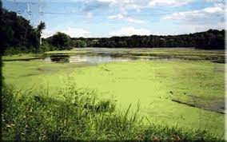
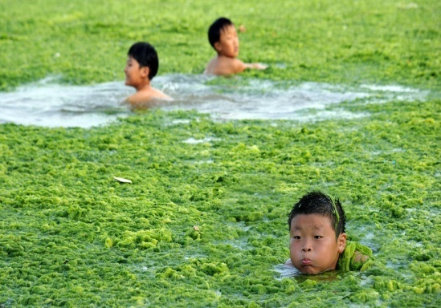
Eutrophication caused by nutrient runoff
Common in ponds, rivers, streams, lakes, and oceans.

Slide 18
Mississippi Delta/Gulf of Mexico
Northern Gulf Hypoxic zone. 6334 square miles (2021). Potentially unavailable to fish and bottom species.
Lots of nutrients, mostly from ag lands, washed down the Miss and into the gulf.
Low oxygen due to algae blooms
When the excess nutrients reach the Gulf, they stimulate an overgrowth of algae, which eventually die and decompose, depleting oxygen as they sink to the bottom. The resulting low oxygen levels near the bottom of the Gulf cannot support most marine life. Fish, shrimp and crabs often swim out of the area, but animals that are unable to swim or move away are stressed or killed by the low oxygen. The Gulf of Mexico dead zone occurs every summer.
https://www.noaa.gov/news-release/noaa-forecasts-average-sized-dead-zone-for-gulf-of-mexico

Slide 19
The USGS operates more than 3,000 real-time stream gauges, 60 real-time nitrate sensors, and 38 long-term monitoring sites to measure nutrients in rivers throughout the Mississippi-Atchafalaya watershed. Data from these networks are used to track long-term changes in nutrient inputs to the Gulf and to help build models of nutrient sources and hotspots within the watershed.

Slide 20
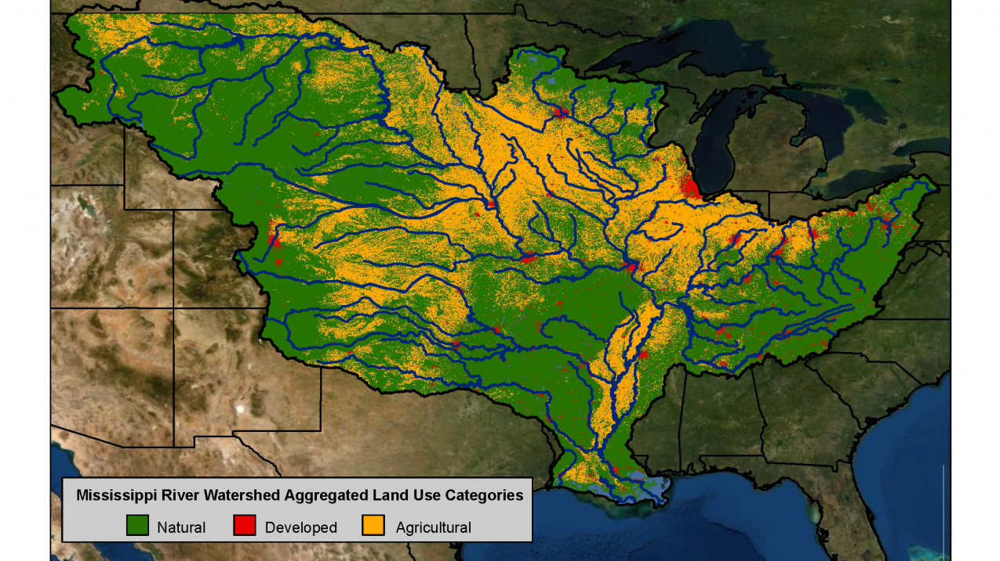

Slide 23
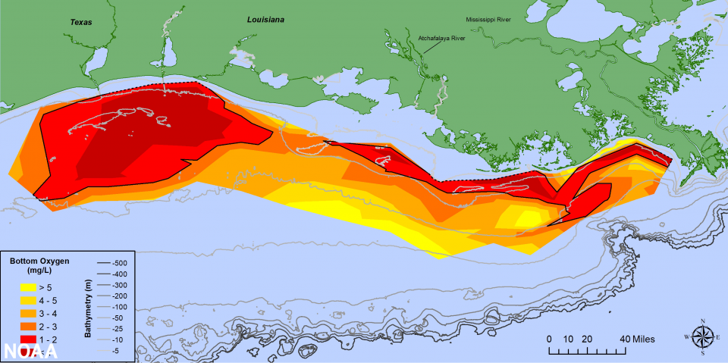

Slide 24
Map of phytoplankton concentrations. This is how we get at dead zones in oceans.

Slide 25
Florida
The dreaded Red Tides. And no, that’s not a college football team.
Again, eutrophication. This time, an algae which, in high enough concentrations, releases toxins.
Bad enough to kill dolphins, turtles, and manatees.
Due to wave action, toxins can go airborne and severely irritate beachgoers.
Lasts up to 2 years.

Slide 26
Off Texas. Red tide.

Slide 27
https://scijinks.gov/red-tide/

Slide 30
Chesapeake Bay
Lots of ag in this region. Ditto industry, people, etc.
So, a lot gets into the Bay. Stormwater runoff, fertilizer, animal wastes, deforestation, wetland destruction, sea level rise. Etc.
Largest estuary in the US

Slide 33
https://www.chesapeakebay.net/issues/agriculture
https://www.cbf.org/how-we-save-the-bay/chesapeake-clean-water-blueprint/the-history-of-bay-cleanup-efforts.html

Slide 34
globally
~2/3 of applied nitrogen is not used by crops
~1/2 the applied phosphorus is not used by crops.

Slide 35
Last but not least: the soils.

Slide 36
Erosion
When you clear lands for agriculture – or reduce cover through grazing. Or compact soils (think cows).
You get increased erosion when it rains.
Not only are you losing prime soils as they are washed downhill, but the sediment chokes plants and animals downstream.
But it’s not really pollution (unless you consider all the stuff carried with it).
Natural process, accelerated by humans.

Slide 37
Soil salinization
The accumulation of salts in the soil.
Typicaly because of irrigation
As the water dumped on the ground evaporates, it leaves behind whatever salts it’s carrying. The higher the initial salt content, the faster the salt buildup.
Limits plant development by limiting nutrient uptake. At high enough levels, kills the plants.
Also messes with soil structure, which also limits plants.

Slide 38
Human-induced factors that may lead to salinisation:
irrigation with waters rich in salts;
rising water table due to human activities (filtration from unlined canals and reservoirs, uneven distribution of irrigation water, poor irrigation practices, improper drainage);
Note west Australia situation.
use of fertilisers and other inputs, especially where land under intensive agriculture has low permeability and limited possibilities of leaching;
use of wastewaters rich in salts for irrigation;
salt-rich wastewater disposal on soils;
contamination of soils with salt-rich waters and industrial by-products

Slide 39
Has the potential to destroy civilizations
Hohokam lived 600-1600 years ago in the Lower Salt valley in Arizona and were well-known for their irrigation engineering. The Soil Science Society of America’s (SSSA) May 15th Soils Matter blog explores how the salty irrigation water played a role in the civilizations ultimate fate. https://www.newswise.com/articles/how-did-soil-salinity-affect-ancient-civilizations
Mesopotamia.
Aztecs

Slide 40
https://organicfarmermag.com/2021/06/identification-mitigation-and-management-of-saline-and-sodic-soils/

Slide 41
Fixing? Really, the only thing is to flush the system with clean water, either washing the salts downstream or deeper into the ground.
Expensive, as if there was clean water, they’d be using it.

