Slide 1
Ocean Circulation

Slide 2
Closely tied to the atmosphere, as you might expect.
Another way of moving energy from the equator to the poles

Slide 4
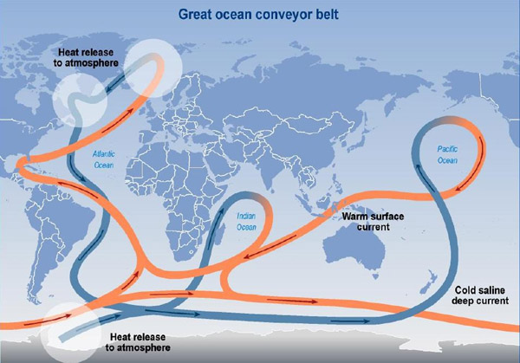

Slide 5
Nasa – animation of ocean conveyor belt
https://www.youtube.com/watch?v=3niR_-Kv4SM
But.. Fear the blob. http://www.dailymail.co.uk/sciencetech/article-3254786/Should-fear-North-Atlantic-blob-Climate-scientists-warn-record-cold-ocean-sign-changes-ocean-currents.html

Slide 6
Now, a closer look at the pacific
El Nino, La Nina, and pacific decadal oscillation

Slide 8
El nino, la nina events
ENSO: El Nino Southern Oscillation – the term for the overall cycle.
Tied to water temperatures (and thus, currents and winds) along the equator.
El Nino = warm pacific. No upwelling near S America. This is a bad thing….
La Nina = cooler pacific. Heavy upwelling near S America
6-18 month events.

Slide 9
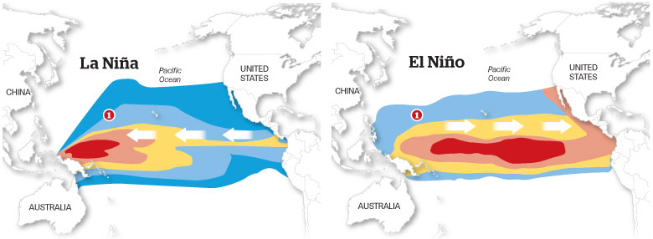

Slide 10
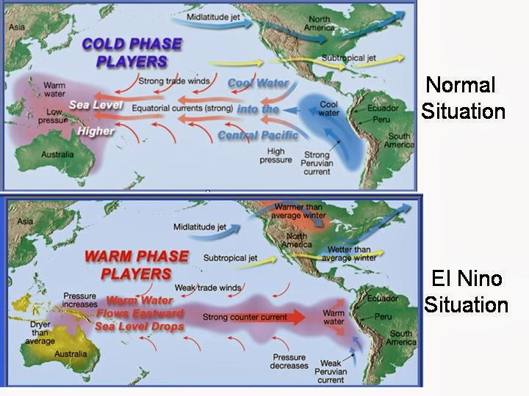

Slide 11
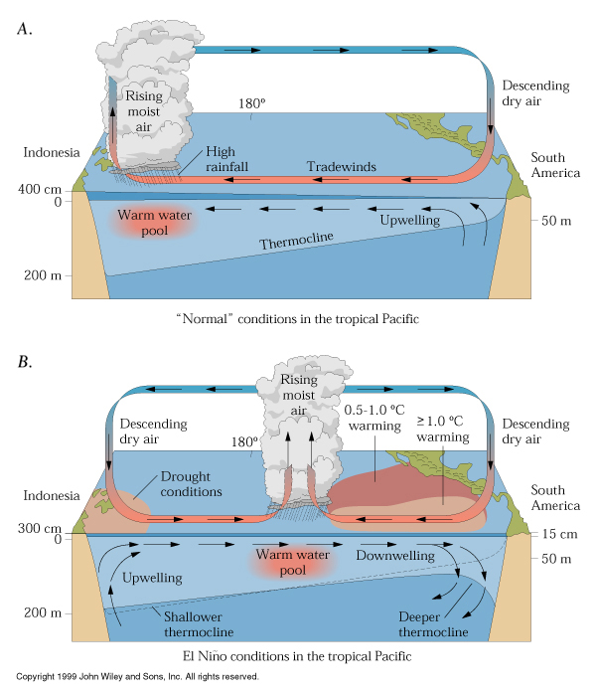

Slide 12
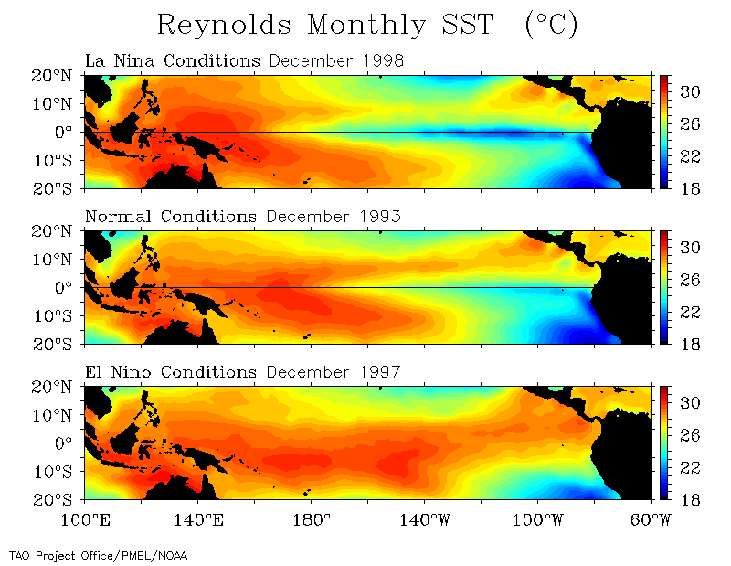

Slide 13
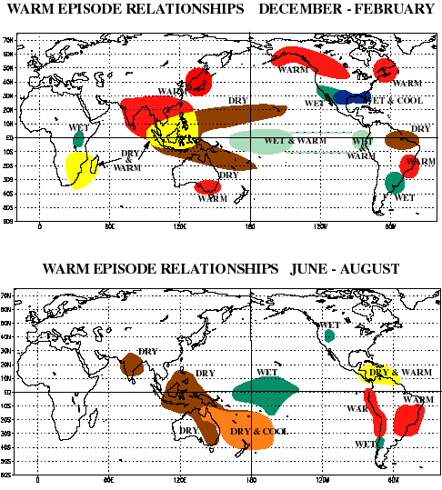
Global impacts

Slide 14
El Nino predictions

Slide 15
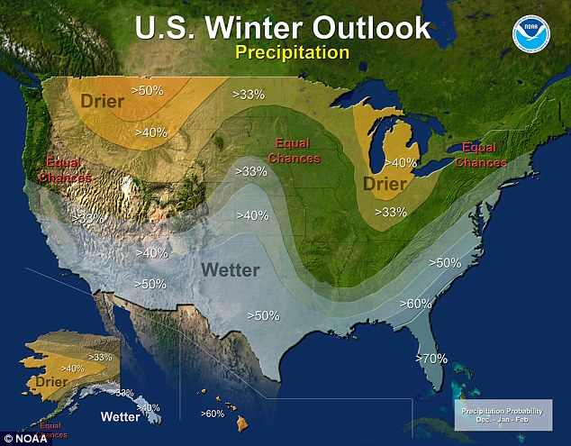
El nino predictions

Slide 17
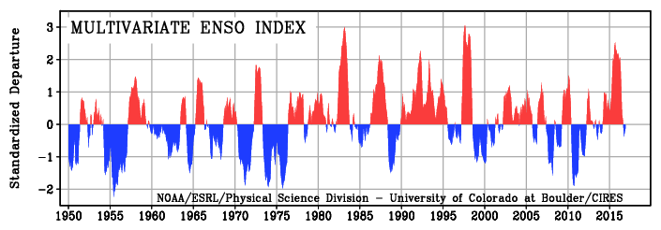

Slide 19
The blob

Slide 24
But what about the Pacific decadal oscillation?
Similar to El Nino, but affects the northern pacific.
Warm and cold phases
BUT – operates over decades (20-30 years), not months.

Slide 25
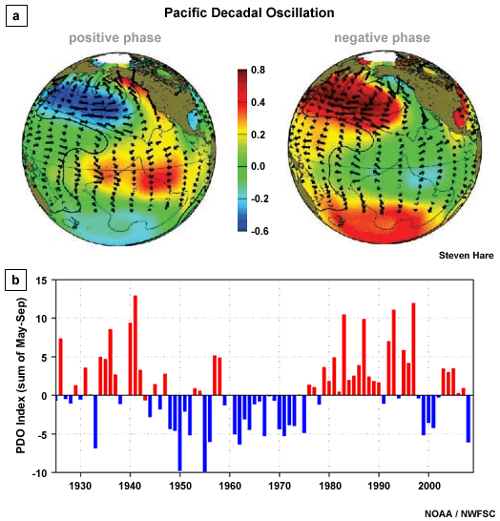
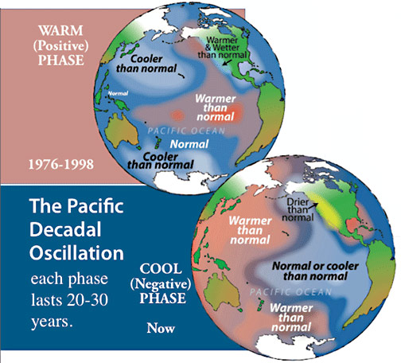

Slide 26
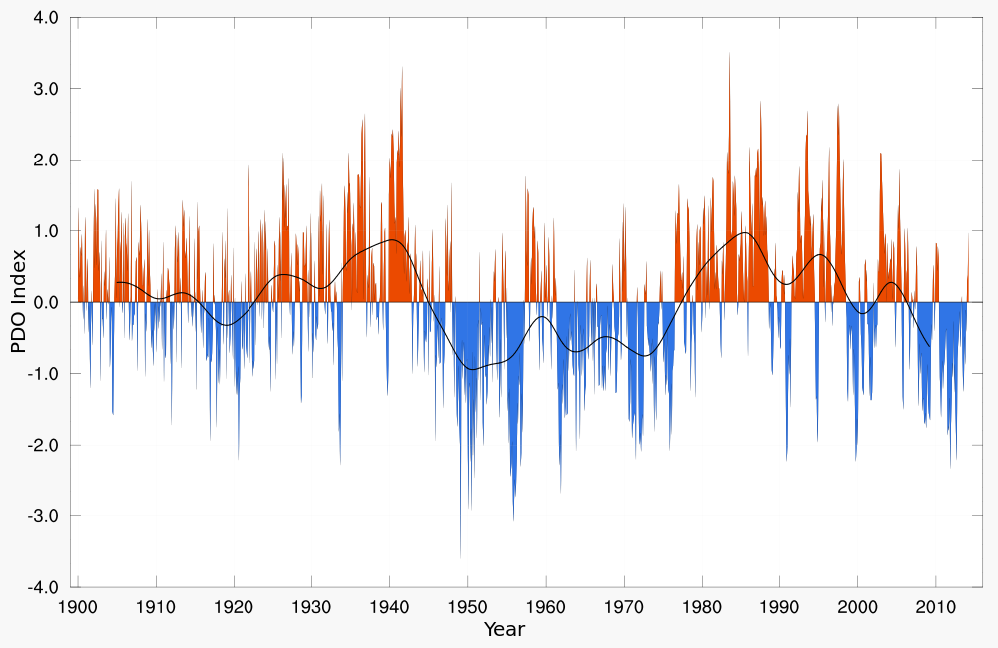
Red = warm phase, blue=cold phase, line= 5-year running average

Slide 27
Experts also believe the PDO can intensify or diminish the impacts of ENSO according to its phase. If both ENSO and the PDO are in the same phase, it is believed that El Niño/La Nina impacts may be magnified. Conversely, if ENSO and the PDO are out of phase, it has been proposed that they may offset one another, preventing "true" ENSO impacts from occurring.

Slide 28
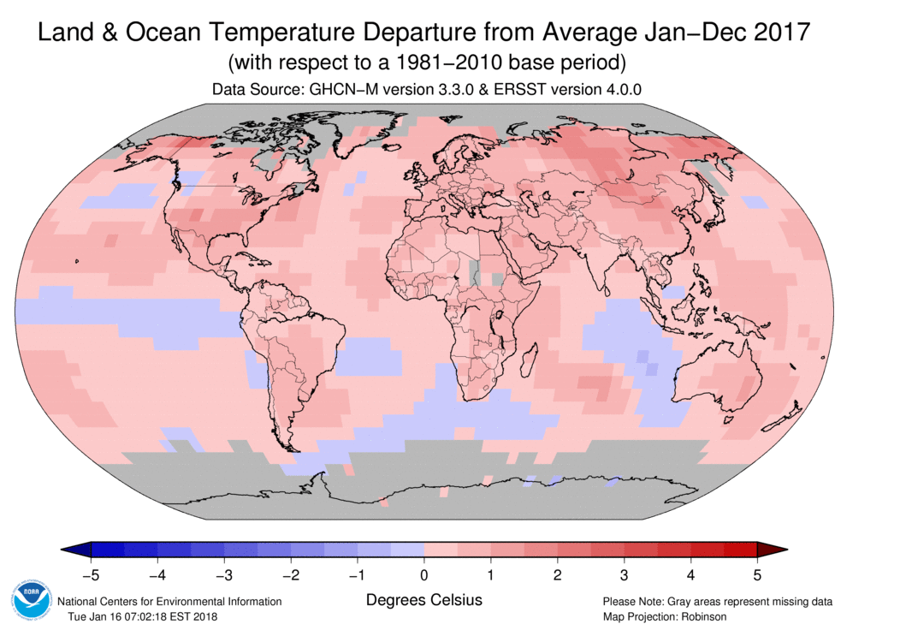
Try to tie ocean temps to ENSO/PDO

Slide 29
And there are more of these all over the world
Interrelationships not well understood, if at all.
If you’re interested, a lot more info, including interrelationships, can be found at https://www.ncdc.noaa.gov/sotc/synoptic/201712

Slide 30
Ocean environmental issues
General pollution. Including plastics:
https://www.dailymail.co.uk/sciencetech/article-4651756/Shocking-interactive-maps-Earth-s-plastic-pollution.html
https://www.theoceancleanup.com/sources/
http://plasticadrift.org/?lat=47.3&lng=-130.6&center=-5&startmon=jan&direction=fwd
https://news.nationalgeographic.com/2018/03/great-pacific-garbage-patch-plastics-environment/
Overfishing

