Slide 1
Ozone
But first, let’s deconstruct this. https://www.insider.com/far-right-pundits-deep-state-made-hurricane-ian-to-target-desantis-2022-10

Slide 2
What’s the big deal?
Protects the surface of the earth from damaging UV radiation
Impacts, cancers, temperature.
Most pronounced over the southern hemisphere

Slide 3
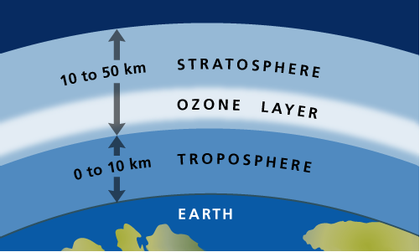

Slide 4
Note, ozone is great stuff in the ozone layer. It’s bad stuff at sea level

Slide 5
Ozone layer
Part of the stratosphere
What’s going on up there?
Diagram. UV hits O3, breaks into O2 and O, naturally reforms.
However, if there is Cl up there, process is interrupted – basically, the Cl grabs the O and the O3 cannot reform.

Slide 6
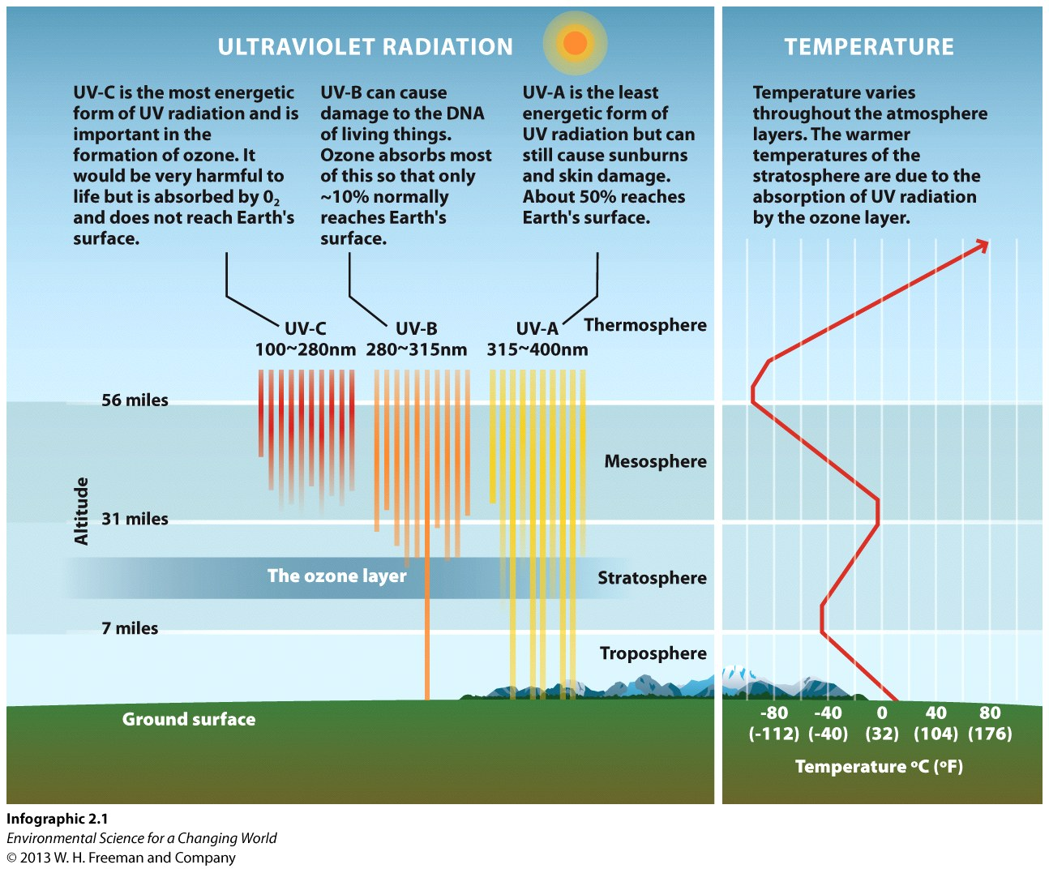

Slide 7
Scientists noticed:
A growing “hole” in the ozone layer over the poles, especially the S pole.
Increasing incidences of skin cancer, especially in Australia/NZ
Slip slop slap

Slide 8
But why??????
Primary culprit (by far) is chlorofluorocarbons.
Human-made molecules:
Coolants for refrigeration
and air conditioners (Freon)
Dispersants in aerosol cans
Styrofoam production

Slide 9
History of CFCs
Developed for refrigerators! A good thing.
No negative effects according to the technology of the times.
Oops!

Slide 10
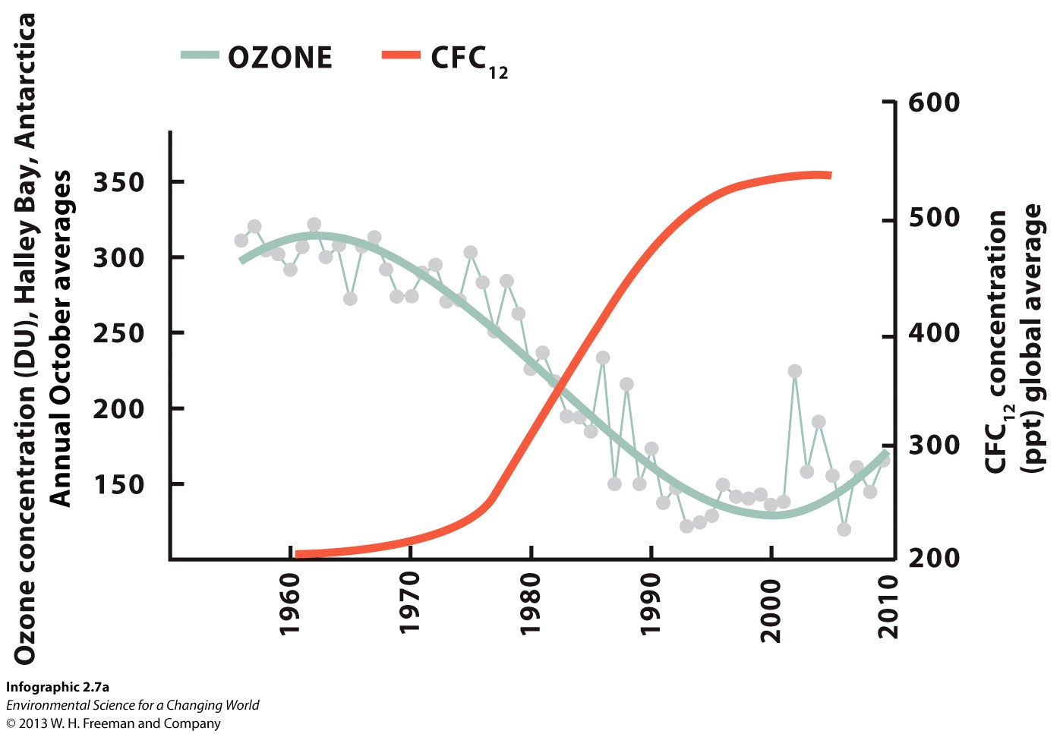
Do CFCs cause ozone depletion?
Observation?
Lower than normal ozone levels in the atmosphere
Inference?
CFCs might be causing the ozone to disappear

Slide 11
HYPOTHESIS
CFCs are breaking down O₃.
PREDICTION
IF polar clouds and sunlight were causing Cl to react with O₃,
THEN many ClO molecules should be found in the atmosphere.

Slide 12
How do you test hypotheses?
Observational studies
Data collected in the real world
No manipulation of subjects
Can only show correlations
Experimental studies
Data collected by manipulating variables
Uses test group(s) and control group(s)
Can show cause and effect

Slide 13
CORRELATION
CAUSE and EFFECT
When two things occur together,
but one does not necessarily cause the other
When two things occur together,
but one directly occurs (the effect) in response to, or as a result of, the other (the cause)

Slide 14
Well.. We can measure the amount of Cl in the stratosphere. Has it increased?
Yes.
Has it increased along with increasing CFC production?
Yes.
Can we duplicate this reaction in the lab at stratospheric conditions?
Yes.

Slide 15
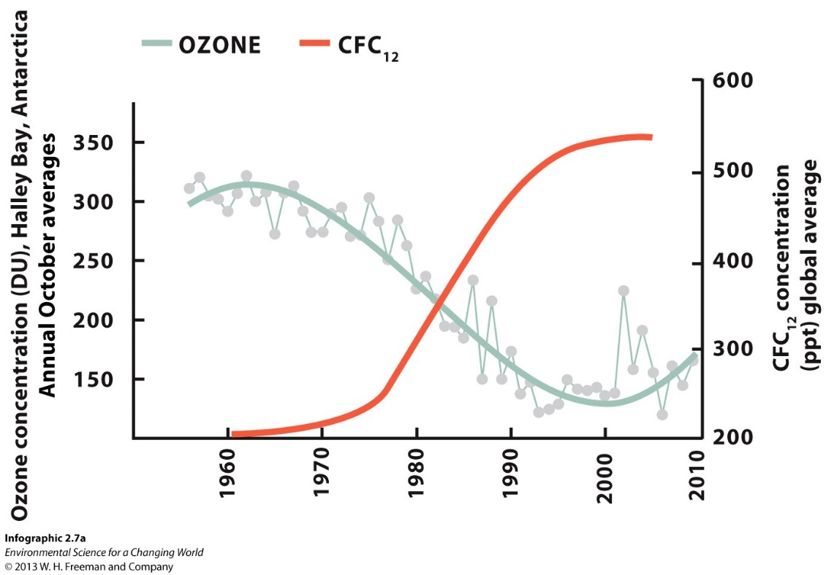
Could something other than CFCs be causing ozone depletion?
Ozone concentration (DU), Antarctica
annual October averages
CFC₁₂ concentration (ppt) global average
Not that we can figure out.

Slide 16
Is ozone depletion (and increased exposure to UV rays) causing higher rates of skin cancer?

Slide 17
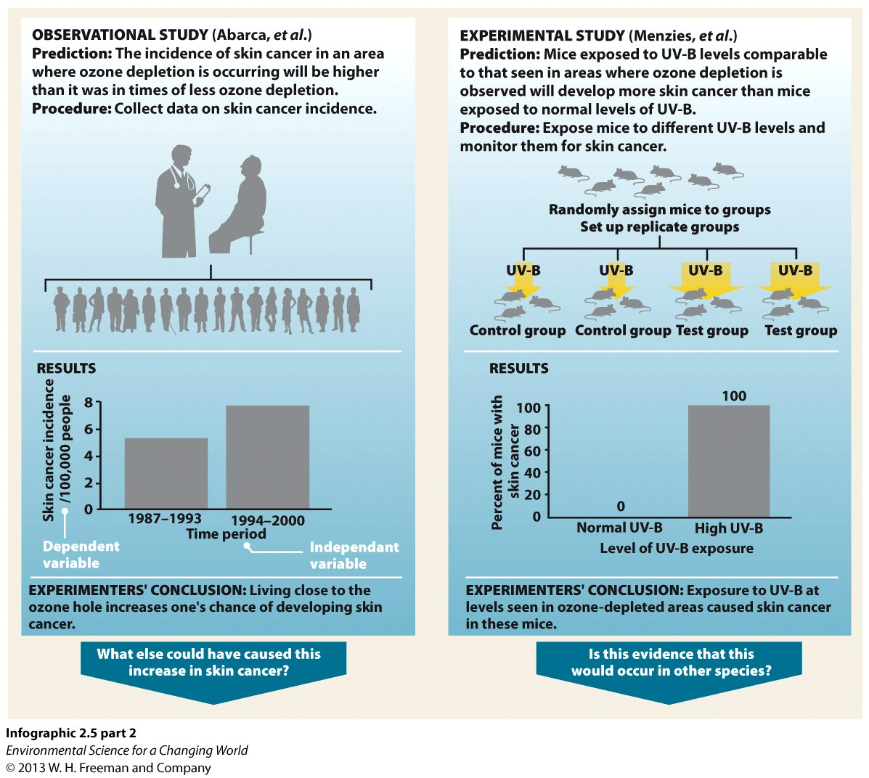
Ozone/UV radiation experiments

Slide 18
So how do we solve the problem?

Slide 19
Montréal Protocol –1987
Administered by the U.N.
A plan developed to phase out CFCs
By 2009, every country had signed the agreement; governments developed their own policies for reduction of CFCs.

Slide 20
Policies
=
Translating values into action
The U.S. banned CFCs in certain products
in the 1970s.
In the early 1990s, the U.S. started phasing out CFCs entirely.
Industry, public, and government sectors cooperated to find solutions to this problem.

Slide 21
The precautionary principle
Though you are not 100% sure of what is causing a problem, there is a big risk to “doing nothing.”
Taking Action
e.g., Montréal protocol – 1987

Slide 22
Adaptive management
A plan that allows you to alter strategies as new information comes in or the situation changes (e.g., the original Montréal protocol target list is not comprehensive)

Slide 23
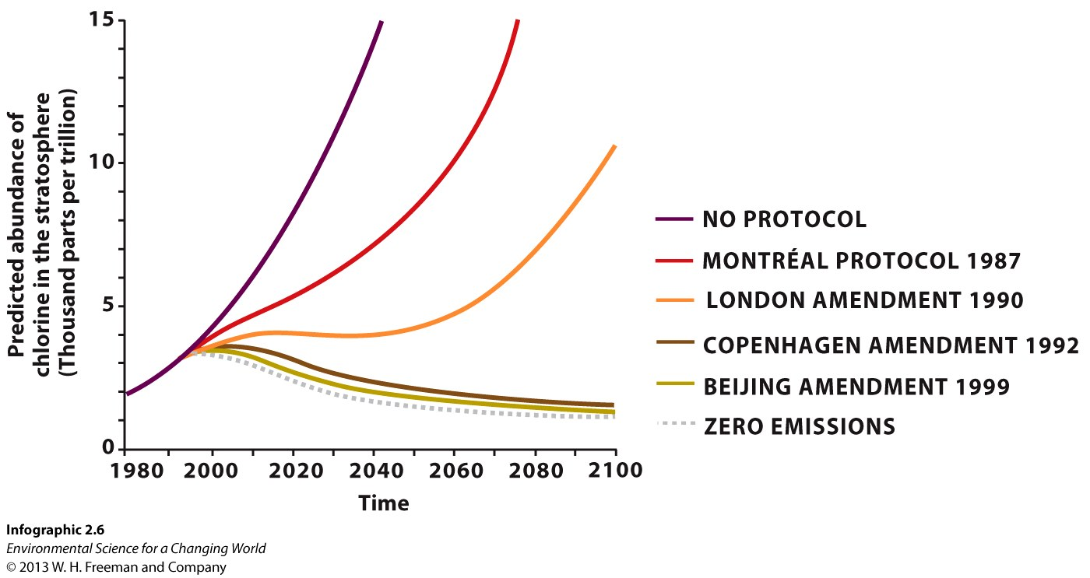
The Montréal protocol and amendments
Predicted abundance of chlorine in the stratosphere
(thousand ppt)
Note the lag in getting the stuff out of the atmosphere.

Slide 24
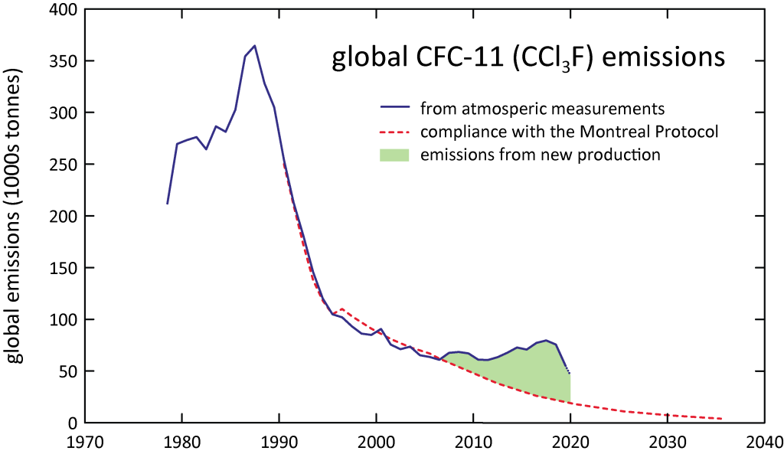
https://research.csiro.au/acc/global-cfc-emissions-now-declining-again/

Slide 25
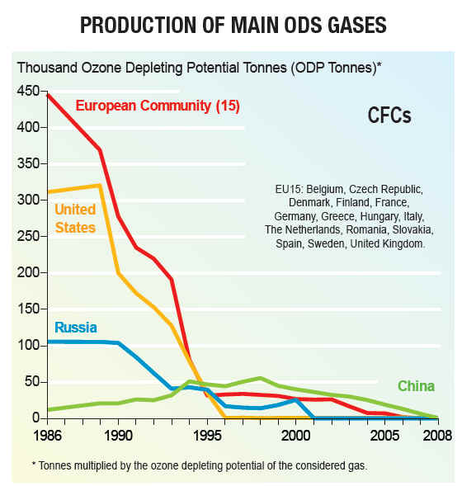

Slide 26
Present and future
ozone levels
2011
2016
Below average size.
Seems to be recovering.
Better news in 2017: http://www.iflscience.com/environment/the-hole-in-the-ozone-layer-is-the-smallest-its-been-in-almost-30-years/
Largest ozone “hole” ever recorded above the Arctic!

Slide 27
“It’s clear that ozone will ultimately recover but it’s also clear that it will take many decades to do so.”
– Susan Solomon

Slide 30
https://www.youtube.com/watch?v=phbvQenRgLw (visualization of hole)
https://svs.gsfc.nasa.gov/cgi-bin/details.cgi?aid=11781 (current status)
National Geographic summary https://www.youtube.com/watch?v=aU6pxSNDPhs

