Slide 1
Convectional storms, continued

Slide 2
Hurricanes!

Slide 3
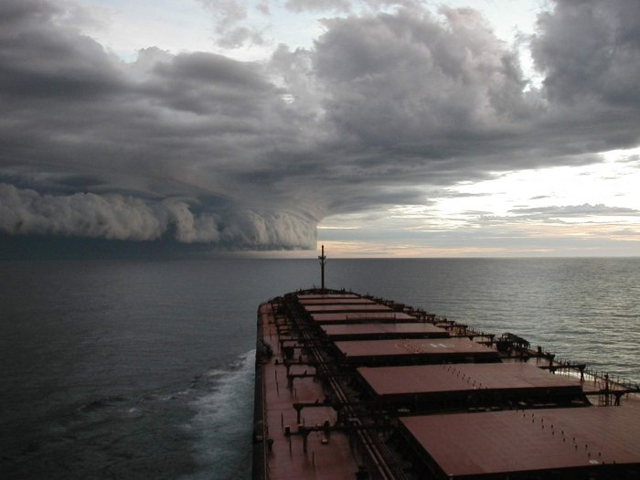

Slide 4
Energy from both the warm ocean and latent heat release as the air rises (much rain, much heat)
In the N Hemisphere, August/Sept (warmest)

Slide 5
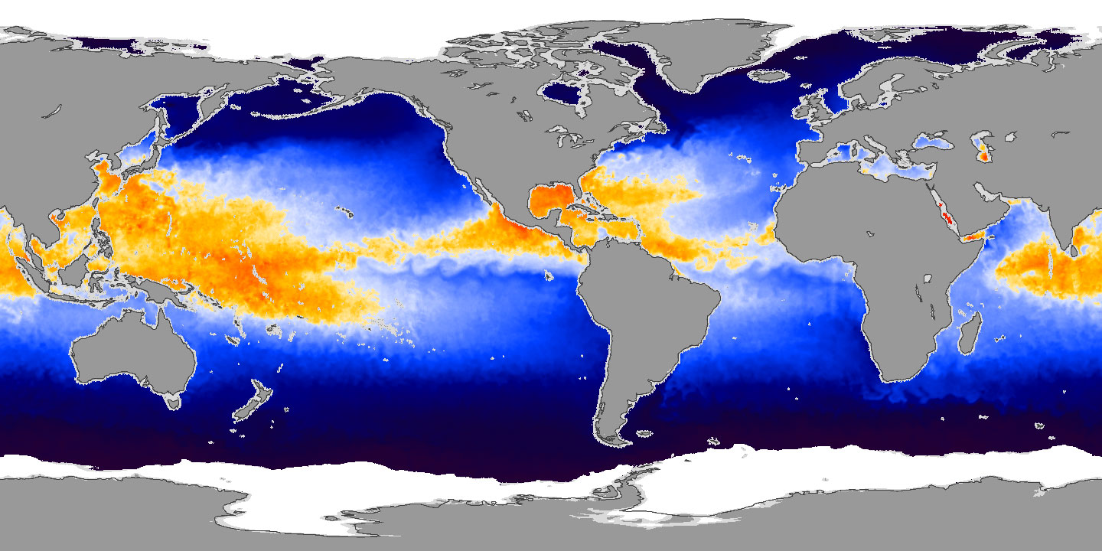
Hurricanes need a large body of hot water

Slide 6
Hurricane characteristics
Sustained winds 74mph or greater
Relatively small compared to other weather phenomena – 350 miles across (approx.)
Lasts days to a week or so.
Very low pressure in the center (air is going up, fastest in the eyewall)
An “eye” (descending air)
Circular pattern (like all atmospheric and oceanic stuff)

Slide 7
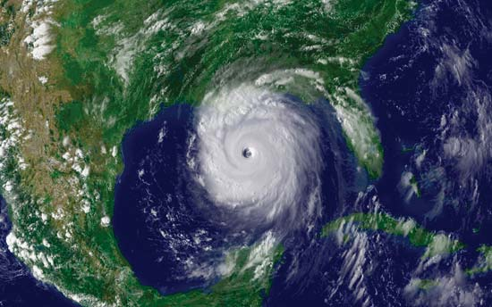
Katrina

Slide 8
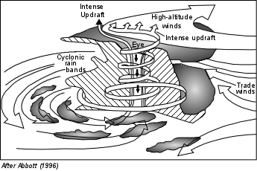

Slide 9
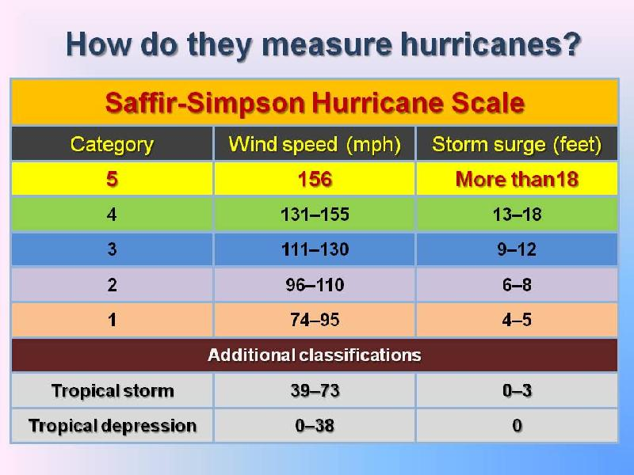

Slide 10
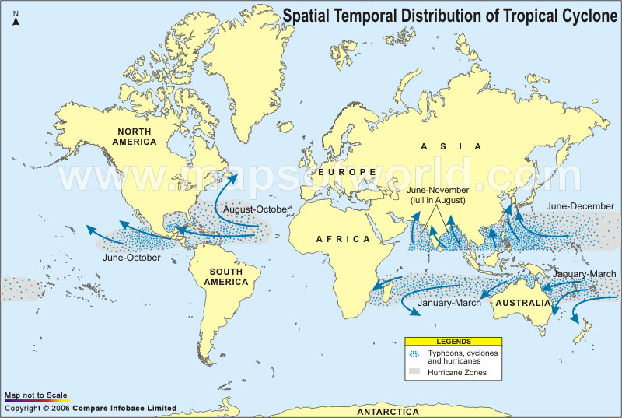

Slide 11
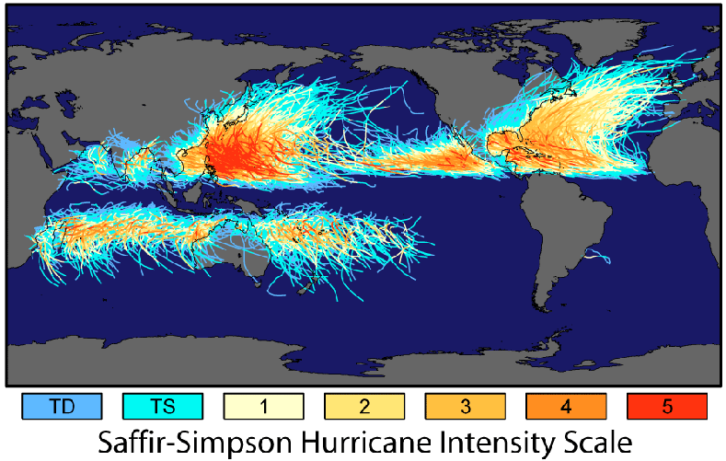

Slide 12
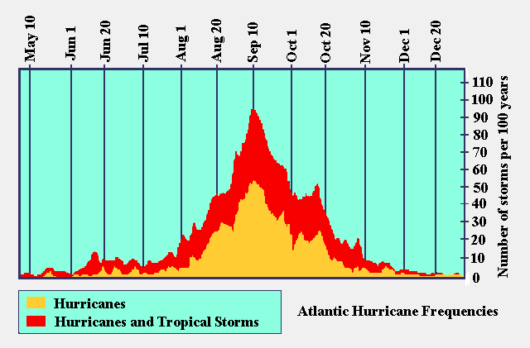

Slide 13
Hurricane death….
Basically, one of two things – either it becomes cool enough that the energy simply isn’t there (moving away from the equator), or the storm runs out of water (goes overland).
Often, it’s a combination of the two.

Slide 14
Damages
Heavy Rainfall
Strong winds
Storm surge (beware especially at high tide and on one side). 1-2m is typical, up to 7m.
Occasional tornadoes.

Slide 15
Hurricane Ian. 2022. 15 ft storm surge

Slide 16
Current global tracking: http://www.wunderground.com/hurricane/
https://earth.google.com/web/data=CiQSIhIgMmE1YThjNDc2ZDIxMTFlOTgxMjY2YjMzNGRiYmRhYTA

Slide 17
Katrina
2005
Costliest natural disaster in the US (~160 billion, estimated)
One of the 5 deadliest hurricanes in US history
Third most intense hurricane to hit the US
12-15 foot storm surge (above usual high tide)
Massive storm surge and levee failures
80% of New Orleans flooded.

Slide 18
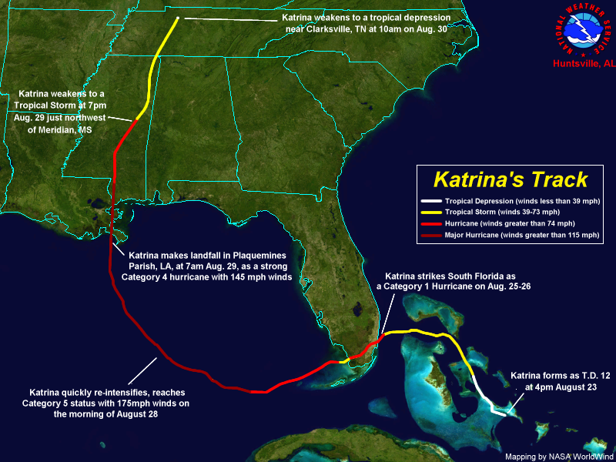

Slide 19
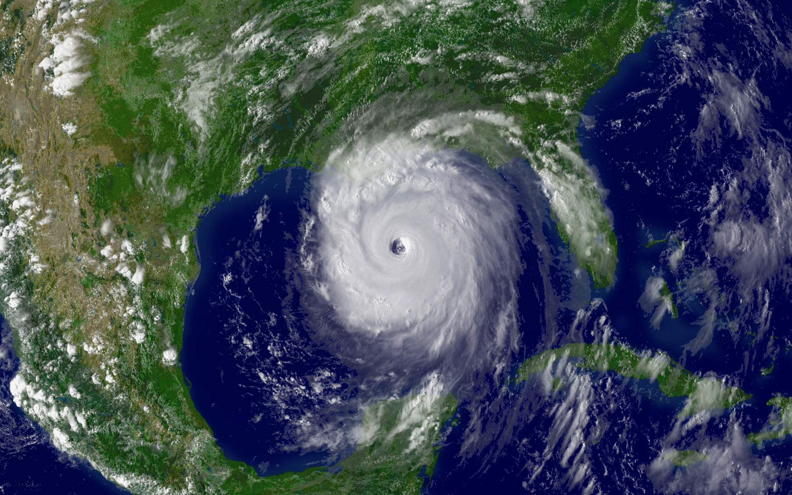
Some Katrina pics

Slide 20
https://en.wikipedia.org/wiki/Hurricane_Katrina#/media/File:Hurricane_Katrina_LA_landfall_radar.gif

Slide 21
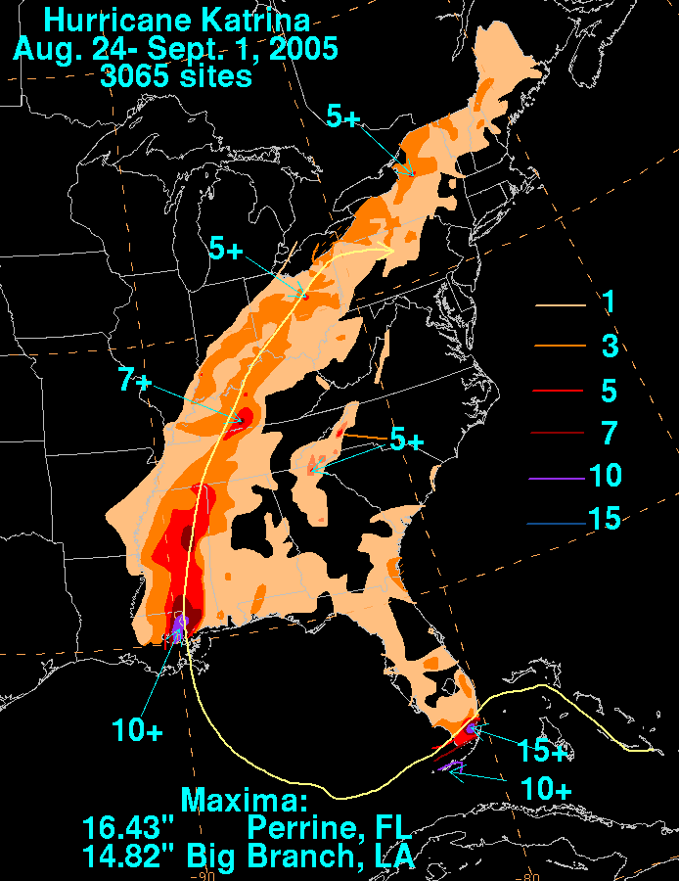

Slide 24
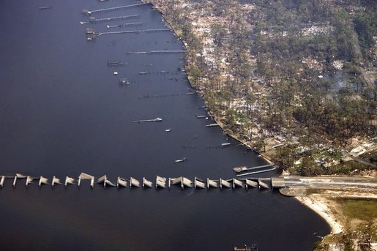

Slide 25
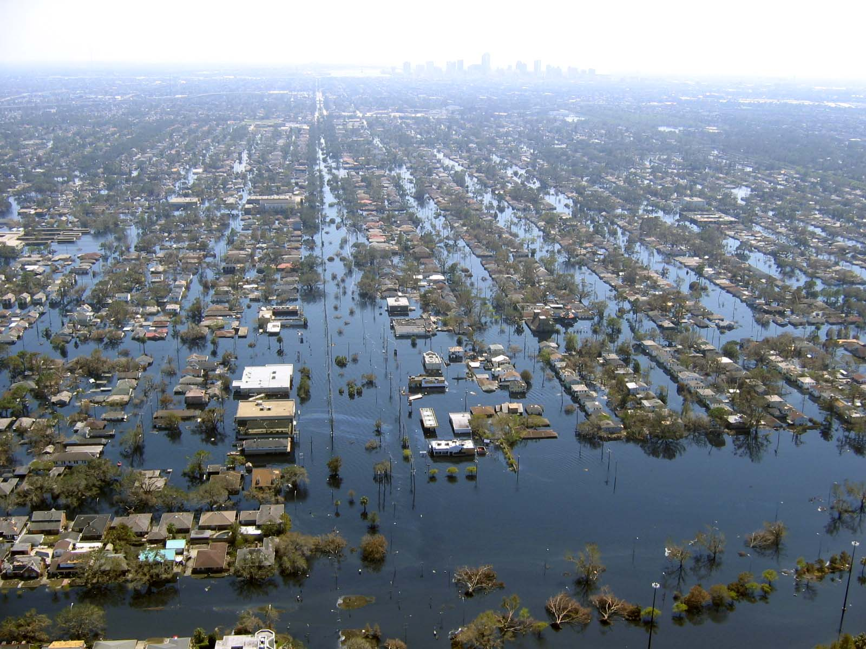

Slide 26
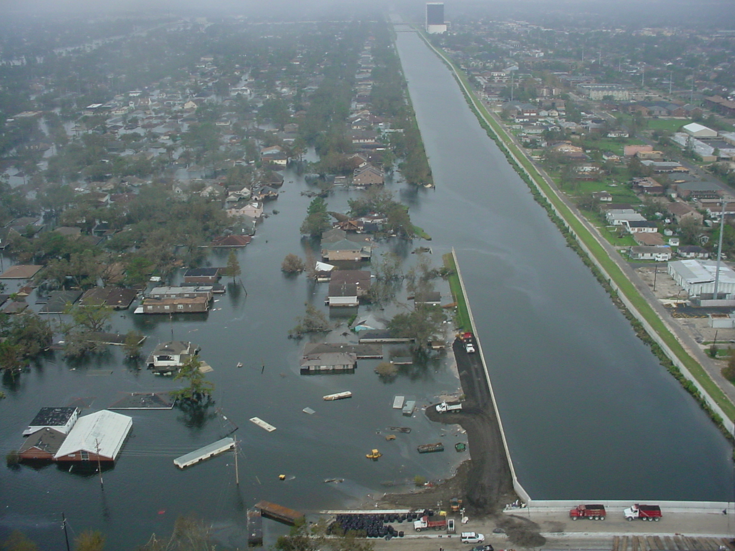

Slide 31
US response
Awful and embarrassing. That’s the only way to put it. And we knew for decades that this would happen.
Huge amounts of international aid came in. Much at least initially rejected.
Cuba and Venezuela first to respond. Rejected.
Kuwait, Qatar, and UAE threw 700 mil at us.
Many others sent significant aid. Consider reading the Wikipedia page.
NGO responses – 4.25 Billion. Half by the Red Cross.
One result, the population of NO halved, as folks left and didn’t come back.

Slide 32
2017 Hurricane season
https://en.wikipedia.org/wiki/2017_Atlantic_hurricane_season
Big 3 (to the US): Harvey, Irma, and Maria
Costliest SEASON on record.

Slide 33
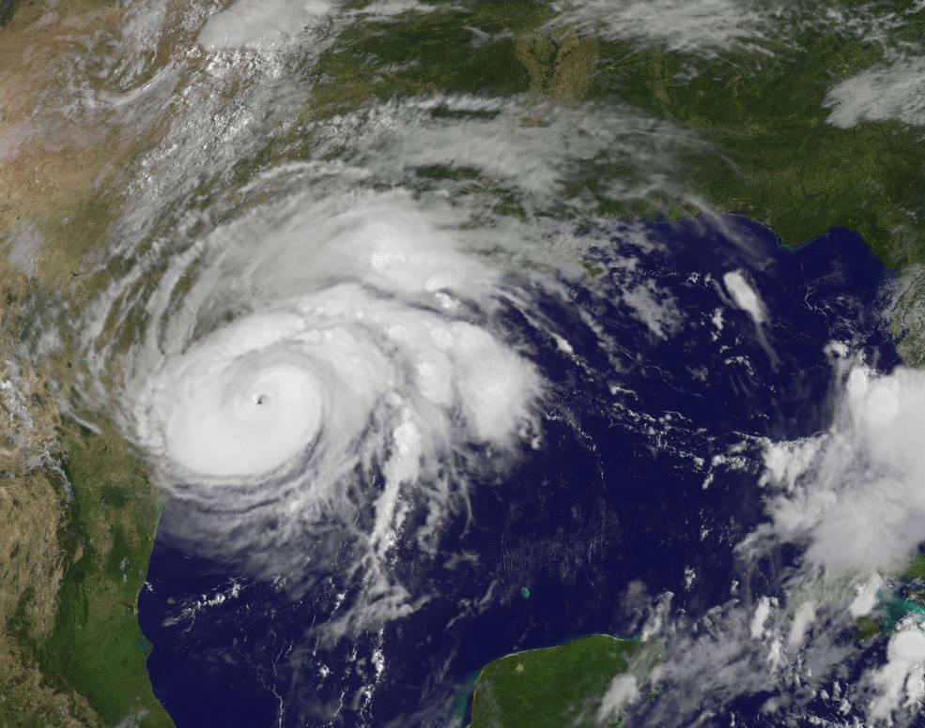
Harvey
125 Billion in damage (second in US)
106 US fatalities
60.5 inches of rain in one place in TX. Another record.
Mostly TX
Pretty much all about the rain.

Slide 36
https://weather.com/storms/hurricane/news/tropical-storm-harvey-forecast-texas-louisiana-arkansas
https://www.lamar.edu/_files/documents/resilience-recovery/grant/recovery-and-resiliency/hurric2.pdf

Slide 37
Next up, Irma.

Slide 40
Hurricane Irma, Jose up next

Slide 41
Jose was the wimp of the lot…. Just chewed things up a bit more and made it harder for aid to get there.
Before…..

Slide 42
Hurricane Maria
Worst disaster in Dominica and Puerto Rico
10th most intense Atlantic Hurricane on record. Most intense of the year. 155mph winds
PR hit by 3 hurricanes, all right after each other: Irma, Jose, and Maria
http://time.com/a-land-they-no-longer-recognize/
https://www.theatlantic.com/science/archive/2017/10/what-happened-in-puerto-rico-a-timeline-of-hurricane-maria/541956/

Slide 43
Google some pics

Slide 44
Different responses and why?
What about the rest of the Caribbean?
https://www.vox.com/2017/12/23/16795342/puerto-rico-maria-christmas
http://www.foxnews.com/world/2017/10/25/hurricane-maria-recovery-highlights-puerto-rico-inequalities.html
https://gh.bmj.com/content/4/1/e001191

Slide 45
naming
https://www.nhc.noaa.gov/aboutnames_history.shtml

