Slide 1
Moving on to Weather!

Slide 2
But first, more about air masses and the atmosphere

Slide 3
Atmospheric composition
Nitrogen (N2) 75.5%
Oxygen (O2) 23.1%
Argon (Ar) 1.3%
Everything else: 0.1%

Slide 4
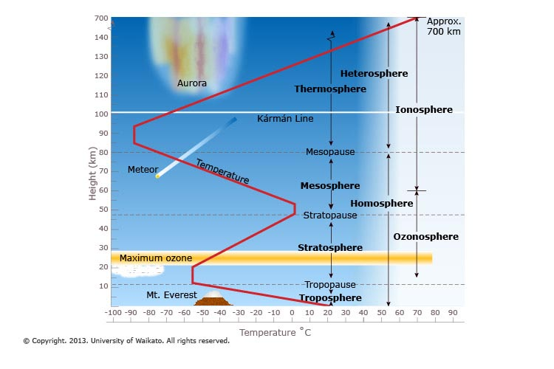
Atmospheric structure

Slide 5
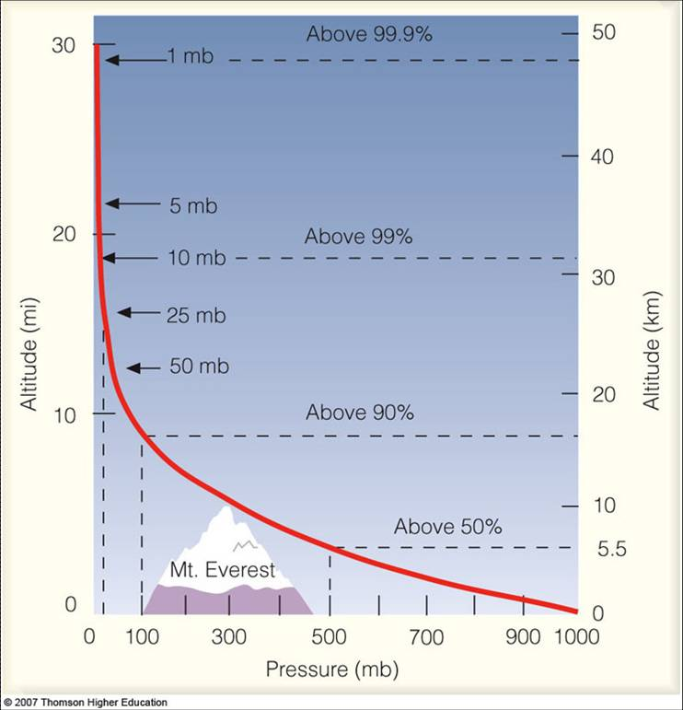
% of atmosphere by altitude
~1 atmosphere = 1000mb

Slide 6
Temperature change in the troposphere
Environmental lapse rate (ELR). 0.6 degrees C per 100m. Note, this is for air that is NOT moving vertically. It’s just hanging out.
Adiabatic lapse rates
Dry: 1 degree C per 100m (DALR)
Wet: ~.5 degree C per 100m (WALR)
Explain reasons for difference (changes in pressure, mostly).

Slide 7
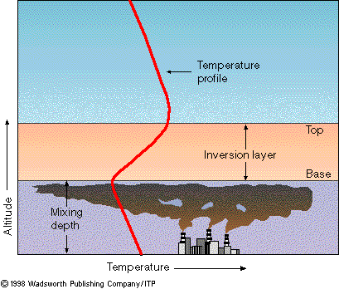
Temperature inversions
Warmer air above colder air.
Common in valleys and over cities
Google a few pics
https://www.aiche.org/chenected/2011/10/donora-death-fog-crisis-led-modern-air-pollution-laws
https://www.nrdc.org/experts/christina-angelides/1990-clean-air-act-will-save-42-million-lives-2020
http://news.mit.edu/2017/cleaner-air-longer-lives-organic-aerosols-1225

Slide 8
Atmospheric pressure and winds the too-simple example
This assumes a uniform earth that doesn’t spin. Really, a uniform, stationary earth that is orbited by the sun.
However, neither is true…

Slide 9
Coriolis effect
Different speed/energy between poles and equator
Gives things a spin
Effect is that air masses have an effective spin as they move along
https://www.youtube.com/watch?v=HIyBpi7B-dE

Slide 10
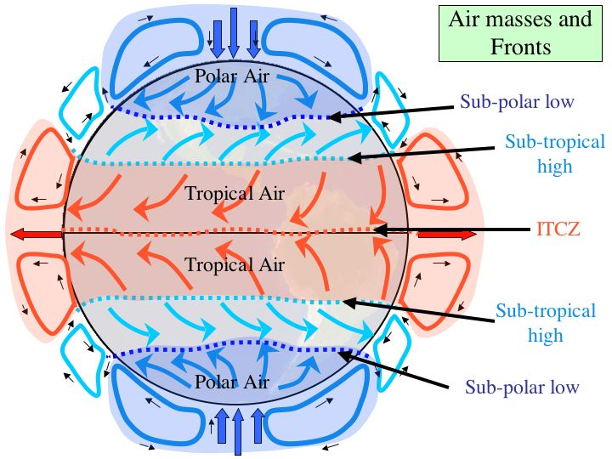

Slide 11
Global circulation (less simplified)

Slide 12
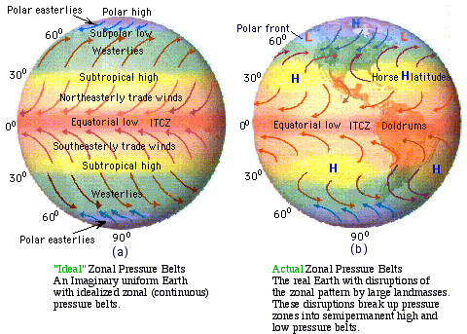

Slide 13
High vs low pressure
High – descending colder air. Presses on the earth’s surface. Descending = no precip! Because it is warming as it descends. Winds blow out of a high.
Low – ascending warmer air. Pulling up from the surface. Often associated with precip. Winds blow into a low.
Hurricanes
tornados

Slide 14
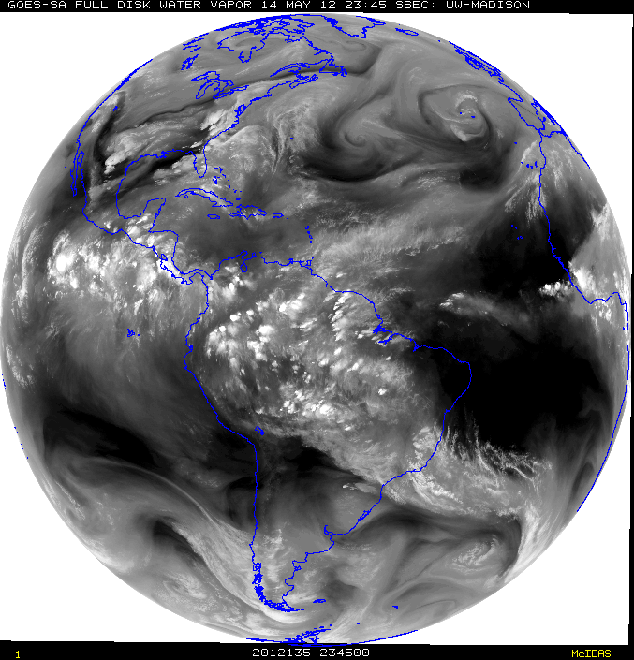
Combine Coriolis with pressure. See wind patterns
https://www.windyty.com
http://hint.fm/wind/
http://www.weather.com/
https://weather.com/maps/satellite/pacificoceanweathermap

Slide 15
Weather!
Long term weather is climate.
So… climate is what you should get, weather is what you get.
Think wind, temperature, precip. We’ve covered temp. Wind speed = differences in pressure.
How do we get water out of the air?
Cool it. But how do we do that?
Force it to rise.
Mountains
Denser air masses (frontal precipitation)
Convectional

Slide 16
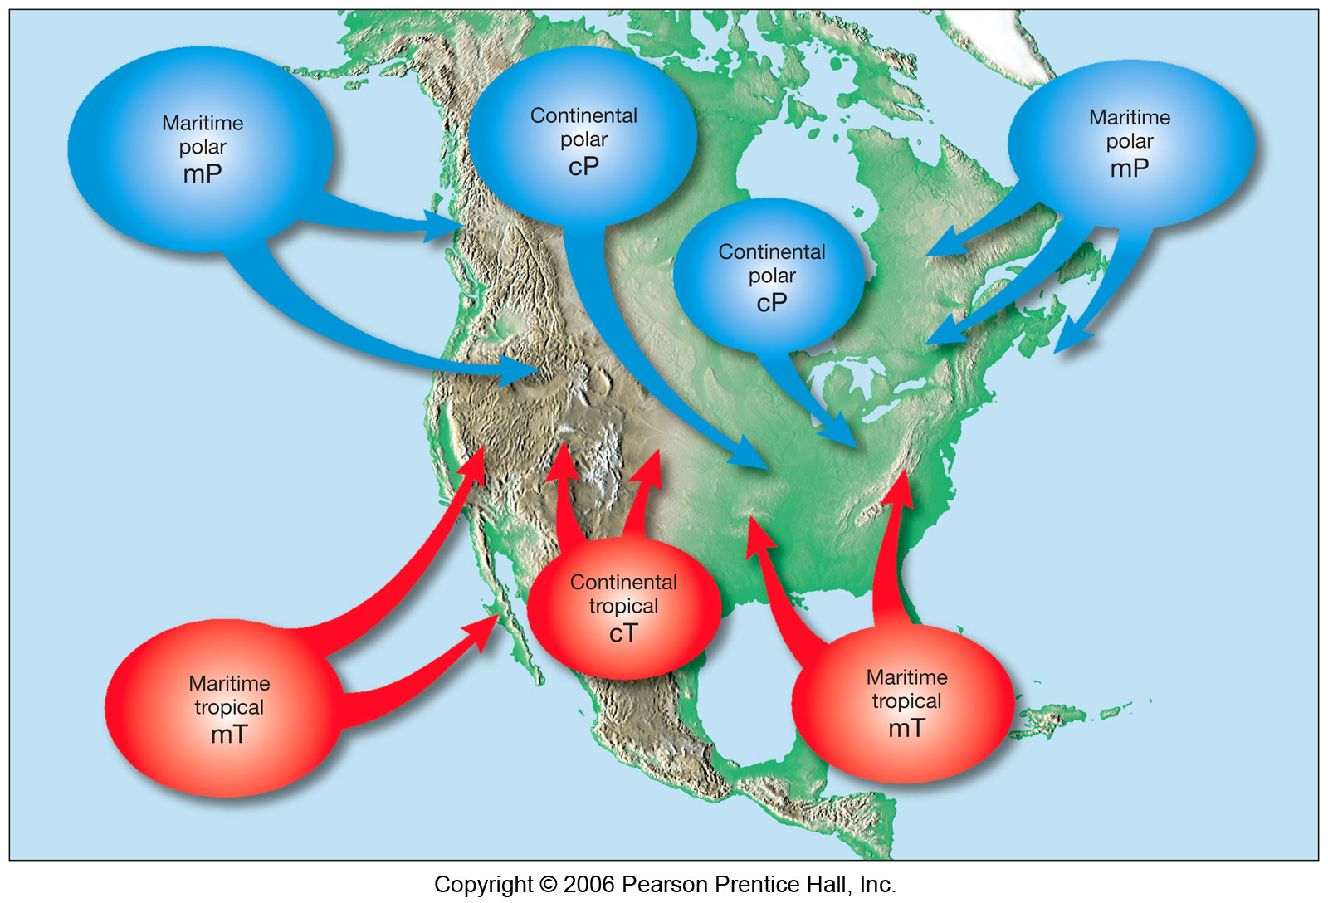

Slide 17
Orographic Precipitation
Mountains. Air going over mountains.
Explains weather in the west.
Relationships between elevation, temperature, pressure, and humidity.

Slide 18
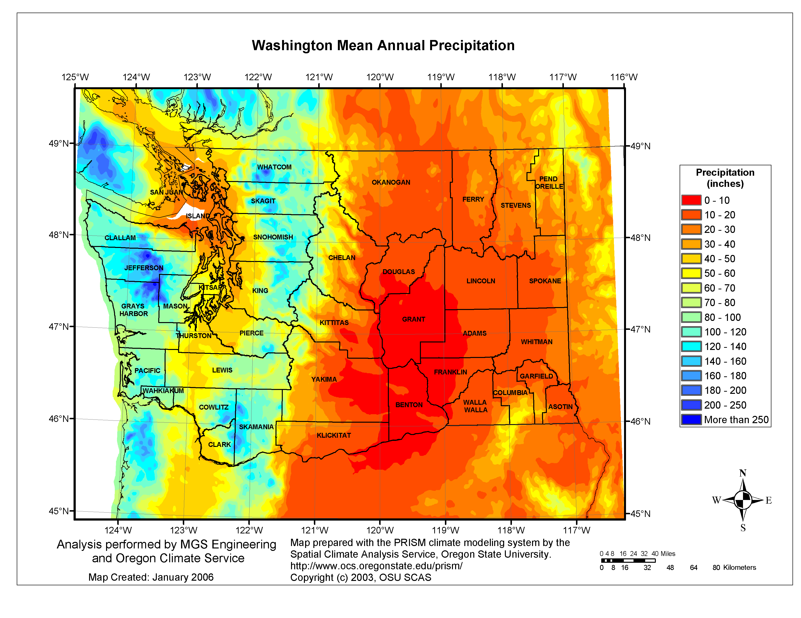

Slide 19
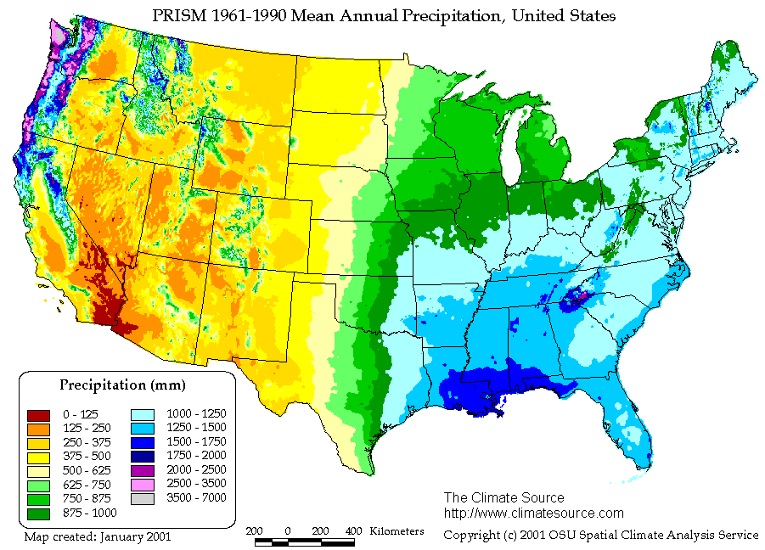

Slide 20
Google Earth. Look at current wind/weather patterns.
Then onto https://www.windyty.com/?50.177,-108.809,3
And http://hint.fm/wind/
Check out www.weather.com for general weather and http://www.nhc.noaa.gov/ for hurricanes. Or turn on weather in Google Earth.

