Slide 1
Geog 107: Dynamic Earth
Lecture 1….

Slide 2
A reminder!
All course material at www.onlinegeographer.com
All grades, quizzes, and assignment submissions will be via Canvas.

Slide 3
Google Earth
Using it all quarter, both in labs and lecture
Get started on lab 1 (download GE, etc). Get all your technical difficulties out of the way this week while I can help (bring in your laptop – me or the IT dept on campus). I can’t do anything over the weekend or late in the evening….
Quick demo.

Slide 4
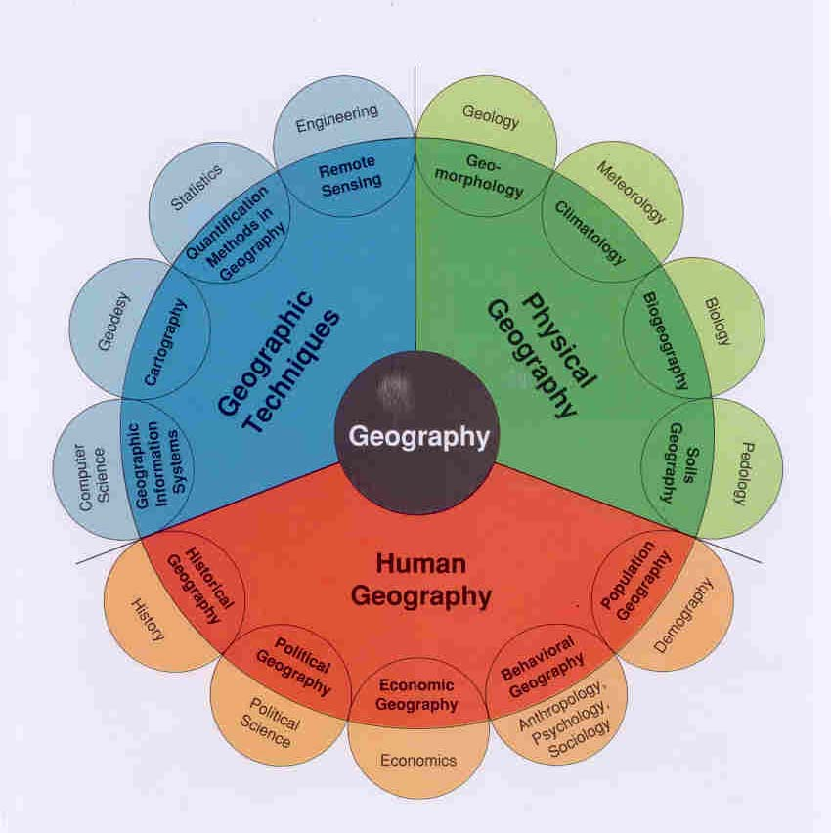
What is physical geography?
Nothing more than moving energy around.
Two sources:
Sun
Radioactive decay
These drive everything that happens on planet earth
Everything.

Slide 5
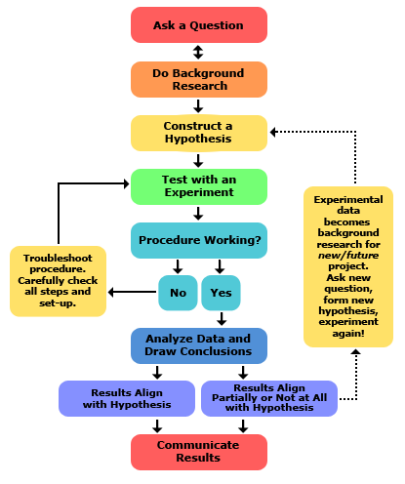
Scientific Method
(theoretical)
The reality:

Slide 6
But….
To really talk about what we don’t know, we first need to know what we do know.

Slide 7
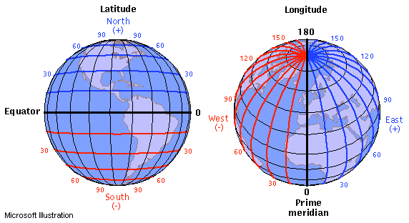
First, A little lat/long.

Slide 8
Let’s now talk about energy from the sun
This drives all atmospheric events and most surface of the earth events.
The other driver is radioactive decay within the earth’s crust, which drives plate tectonics and volcanism.
These are the only two sources of energy on the planet. EVERYTHING comes back to these two things.

Slide 9
Insolation.
Aphelion (earth furthest from sun) and perihelion (closest in January)
The tilt of the earth.
Solstices and equinoxes (time of the year).
These are the three things that determine how much energy any location on the earth’s surface receives from the sun.

Slide 10
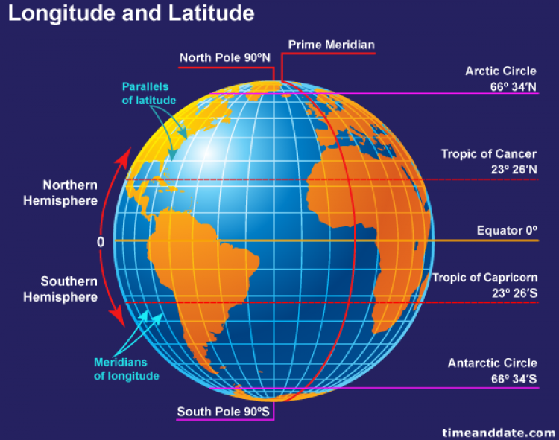

Slide 11
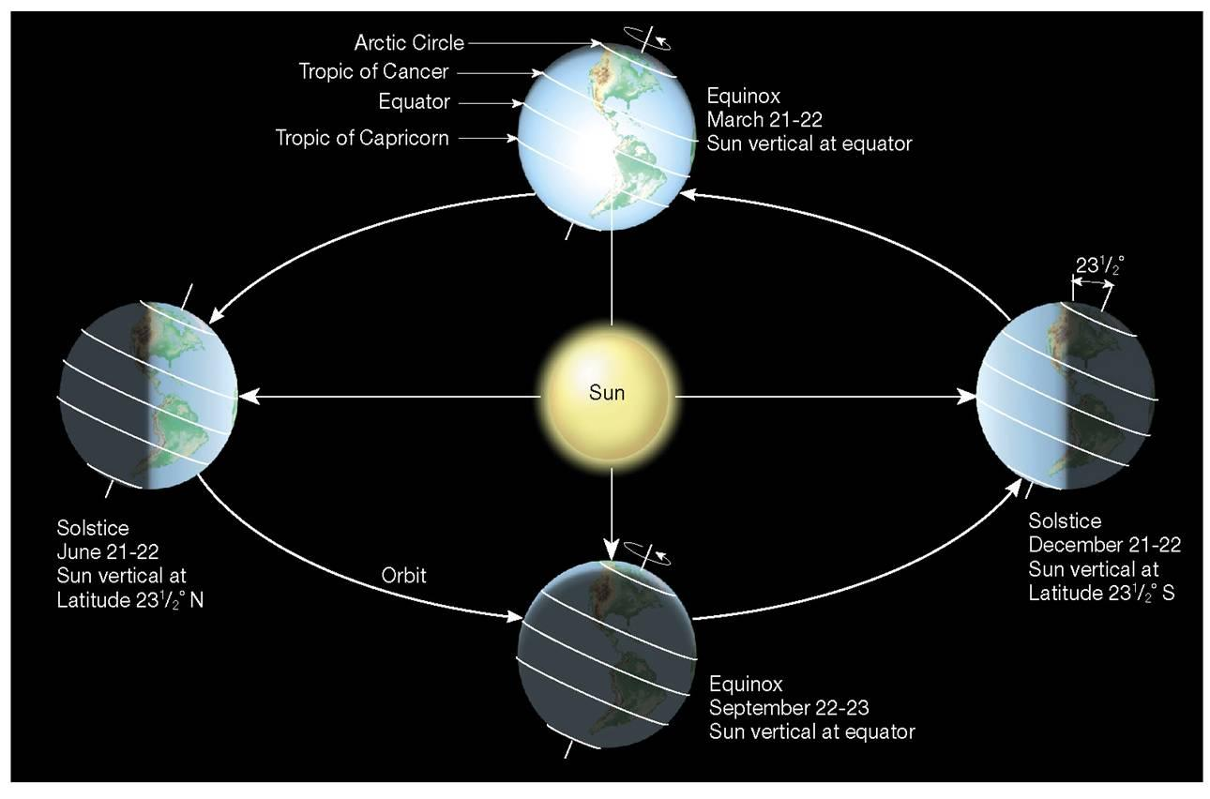

Slide 12
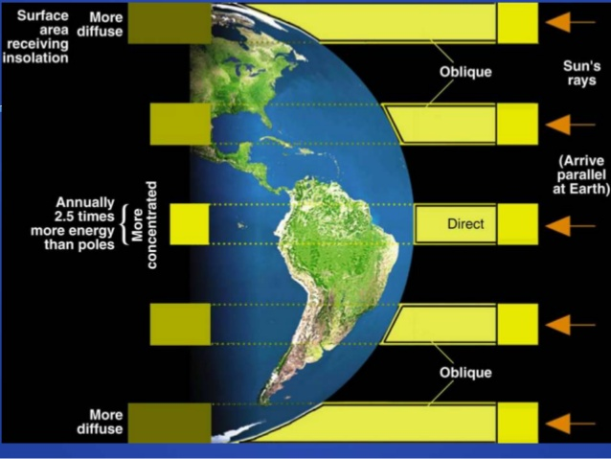

Slide 13
Effects of latitude (Go over latitude/longitude)
Seasons. (tie orbit, tilt, hours of sunlight, angle of sunlight, and temperature together)
Summary – the equator gets more energy than the poles. Ma Nature hates inequality. Thus weather (and ocean circulation) is nothing more than energy moving from the equator toward the poles.
But.. It’s more complicated… more later. Once we know a bit more about energy transfer.

Slide 14
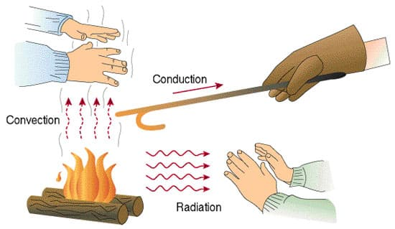
Energy transfer
Radiation
Conduction
Convection

Slide 15
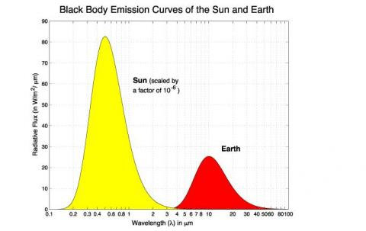
What happens to all this energy from the sun?
Entering atmosphere as radiation. Difference between shortwave and longwave
Absorbed, reflected, or scattered

Slide 16
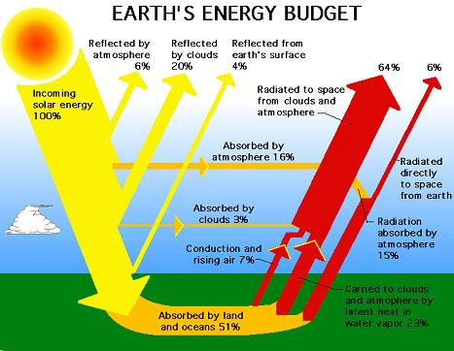

Slide 17
Water
Magical stuff. Truly.
Found in all three states at normal earth temperatures
Required for life
Expands when it freezes
Universal solvent
High specific heat
Absorbs and transfers incredible amounts of heat both in oceans and atmosphere.

Slide 18
Now, how does all this translate to temperature on the ground?

Slide 19
Our primary variables to determine surface temperature
Insolation
Tilt of the earth relative to the sun
Latitude
Aphelion/perihelion
The earth itself
Albedo
Elevation
Land/water contrast (continentality)

Slide 20
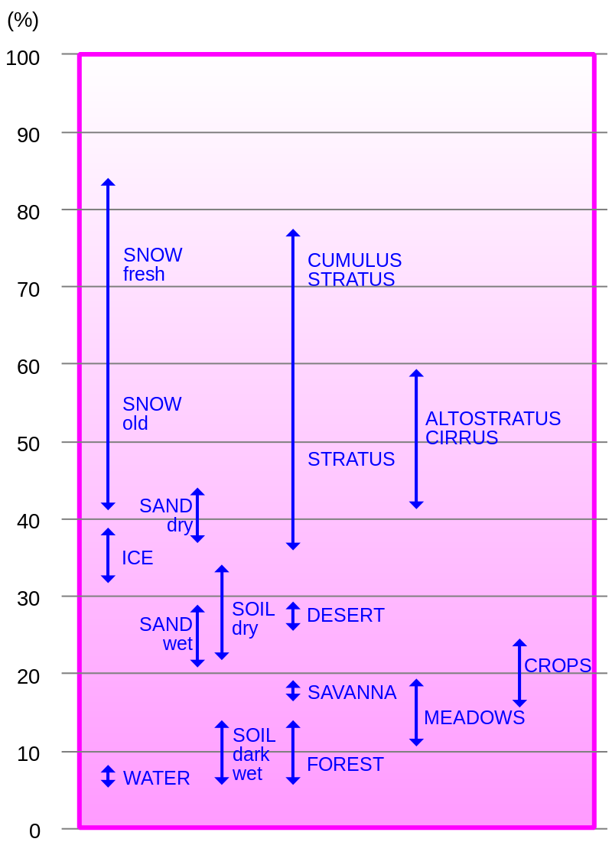
Albedo
Fancy word for reflectance
Discuss albedo for different earth materials

Slide 22
continentality

Slide 23
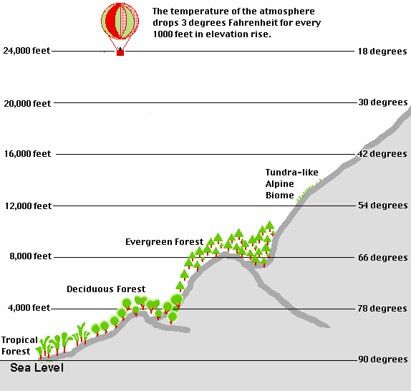
Elevation
Warmer or colder?
More or less radiation from the sun?
(Environmental Lapse Rate [3 degrees F per 1000 feet])

Slide 24
Results in uneven heating of the earth’s surface atmosphere!!!

Slide 25
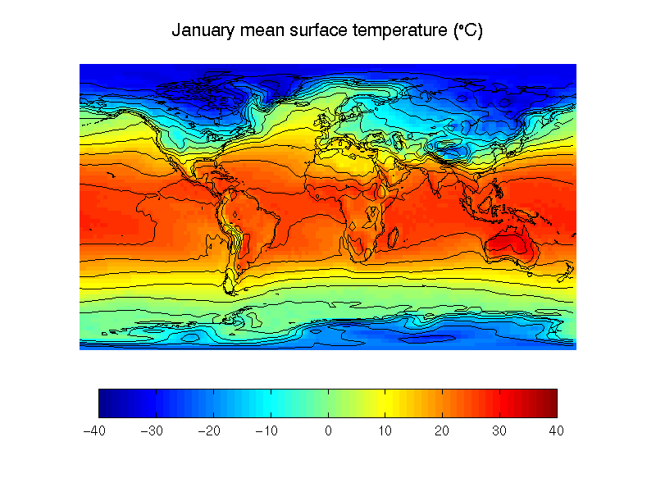

Slide 26
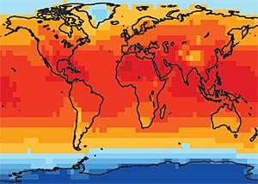
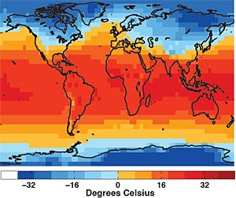
July The average distribution of global temperatures for July and February.

Slide 27
Uneven heating – the result is “Air masses”
So… large chunks of land/water with similar properties generate air masses.
Ie. Ocean near the equator = warm, wet air. High latitudes, middle of continent = warm and dry in summer, cool and dry in winter.

Slide 28
So.. Uneven energy input + air masses
We get air masses moving around. Roughly, warmer stuff headed away from equator and cooler stuff moving toward the equator.
Energy transfer via primarily
Conduction (molecule to molecule)
Convection (matter moving about) and
Where these air masses bump into each other (or mountains), something happens. Usually precipitation of some sort. And wind. And changes in temperature. Yup, weather!

Slide 29
How this energy is actually transported: A basic convection cell

Slide 30
A quick look at ocean circulation

Slide 31
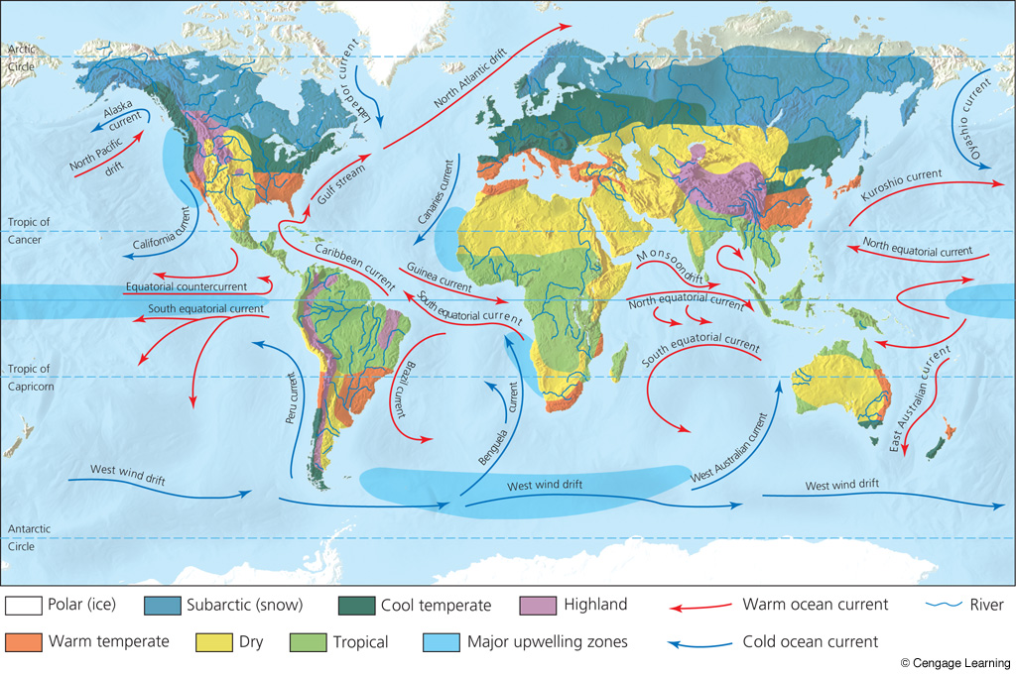

Slide 32
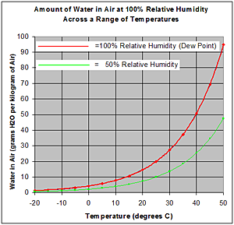
From here, we digressed a little bit and talked about:
Absolute humidity, relative humidity, max humidity, and dew point temperature
And how all these things relate.

Slide 33
Work through a few cases of heating /cooling

Slide 34
We moved onto how to get water out of the air.
You must cool the air, but how?
Answer, force it to rise.

