Slide 1
Karst Landscapes

Slide 2
Concepts
Karst
Limestone
Role of chemical weathering
U.S. regions
Karst Formations
Sinkholes
Surface water features
Karst Towers
Caves
Water Drainage
Aquifers & water tables
Real-world example: Ogallala Aquifer
Real-world example: Floridian Aquifer

Slide 3
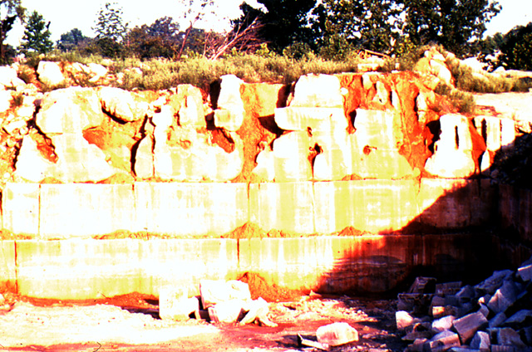
Karst
definition: a landscape formed mainly by rock being dissolved by surface or groundwater.
2 key ingredients: Rock (typically limestone) + Water
The warmer, the better/faster.
Limestone
Sedimentary rock
Calcium Carbonate: CaCo₃
Extremely soluble in water
Rectangular jointing: fractures in the rock which allow water to easily travel through limestone

Slide 4
Karst Role of chemical weathering
Dissolution: process of rock dissolving when it comes into contact with water
Limestone is dissolved by surface or groundwater and transported in solution
Karst mostly occurs in humid regions where carbonate rock (e.g., limestone) is present
However, karst does occur in every region (tropical, temperate, polar, etc.)

Slide 5
Limestone (potential Karst) U.S. Regions
3
2
1
Carlsbad Caverns, NM
Ozarks, MO and AR
Mammoth Cave, KY
Florida (“Limestone Peninsula”)
4

Slide 6
Karst Formations
Sinkholes (also called a “doline”)
Surface water features
Disappearing Streams
Springs
Karst Towers
Caves
Many other smaller formations occur within caves!

Slide 7
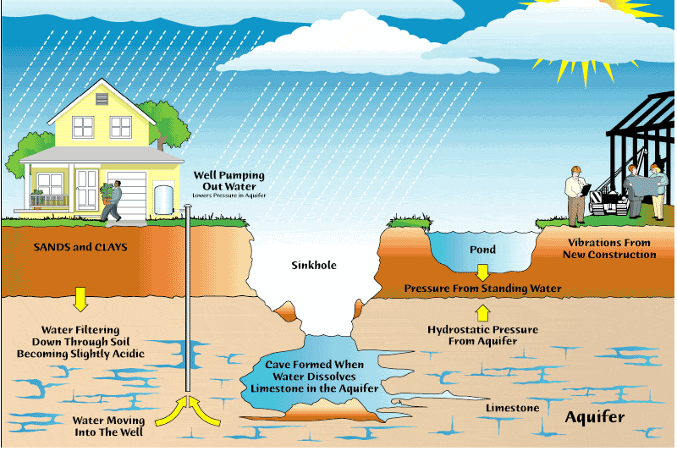
Karst Formations Sinkholes: How do they form?

Slide 8
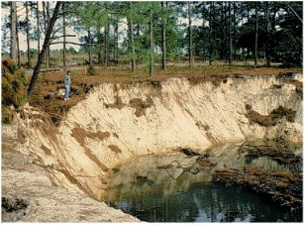
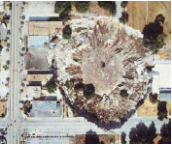
Karst Formations Sinkholes: 3 types
Solution Sinkhole
Little or no sediment is present over limestone
Easily dissolved by water
Cover-Subsidence Sinkhole
Thick sediments overlay limestone
Underlying limestone is dissolved, sediments dump into the void
Cover-Collapse Sinkhole
Triggered by heavy rainfall, drought, overloading
Cause sudden collapse into void

Slide 9
Cover subsidence sinkhole

Slide 11
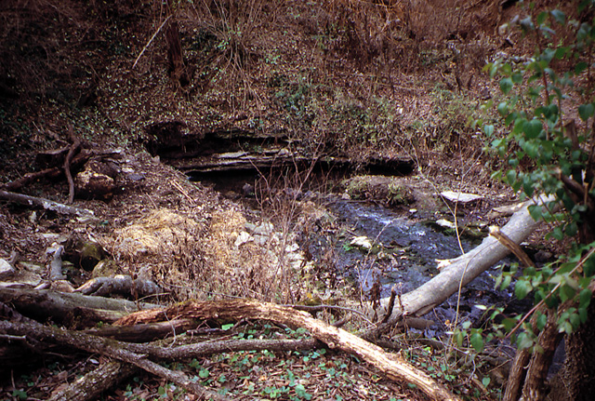
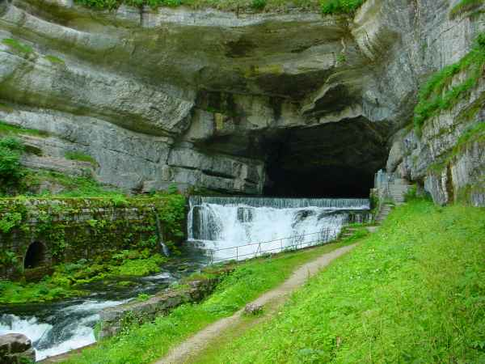
Karst Formations Surface Water Features
Karst regions are noted for their lack of well-established surface drainage.
Surface drainage is actually replaced by extensive underground drainage.
Where surface streams do develop, they do not flow very far – they “disappear” (disappearing streams) and “reappear” (springs).
point at which the stream goes underground
point from where the water comes above ground, often from a cave
Spring
Disappearing stream

Slide 12
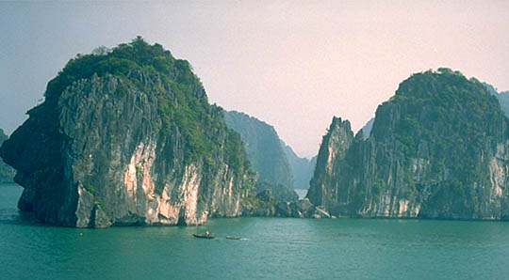
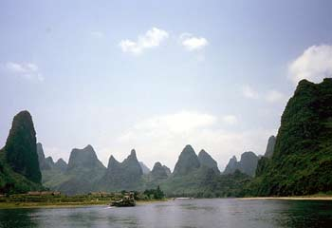
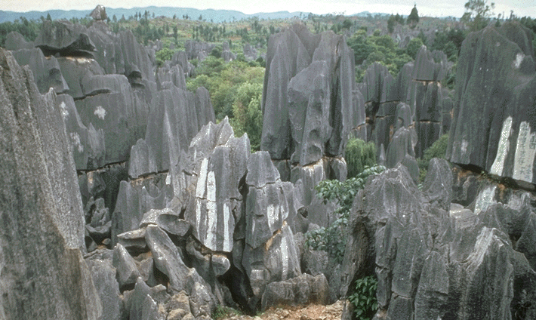
Karst Formations Towers
Formation is due to a combination of tectonic uplift and tropical erosion.
Halong Bay, Vietnam
Guilin Region, SE China
Stone Forest, China

Slide 13
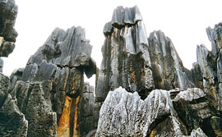
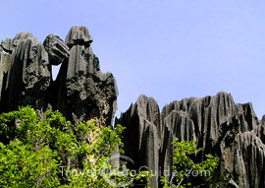
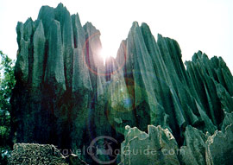
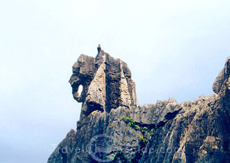
Karst Formations Towers (con’t): Stone Forest, China

Slide 14
Cockpit karst

Slide 15
Arecibo Radio Telescope
Inside sinkhole
Goldeneye

Slide 16
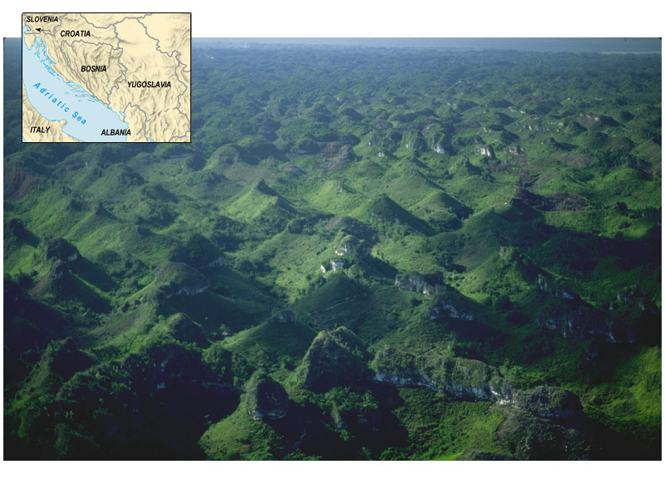
Term “karst” originated in the Krs region of Slovenia.

Slide 18
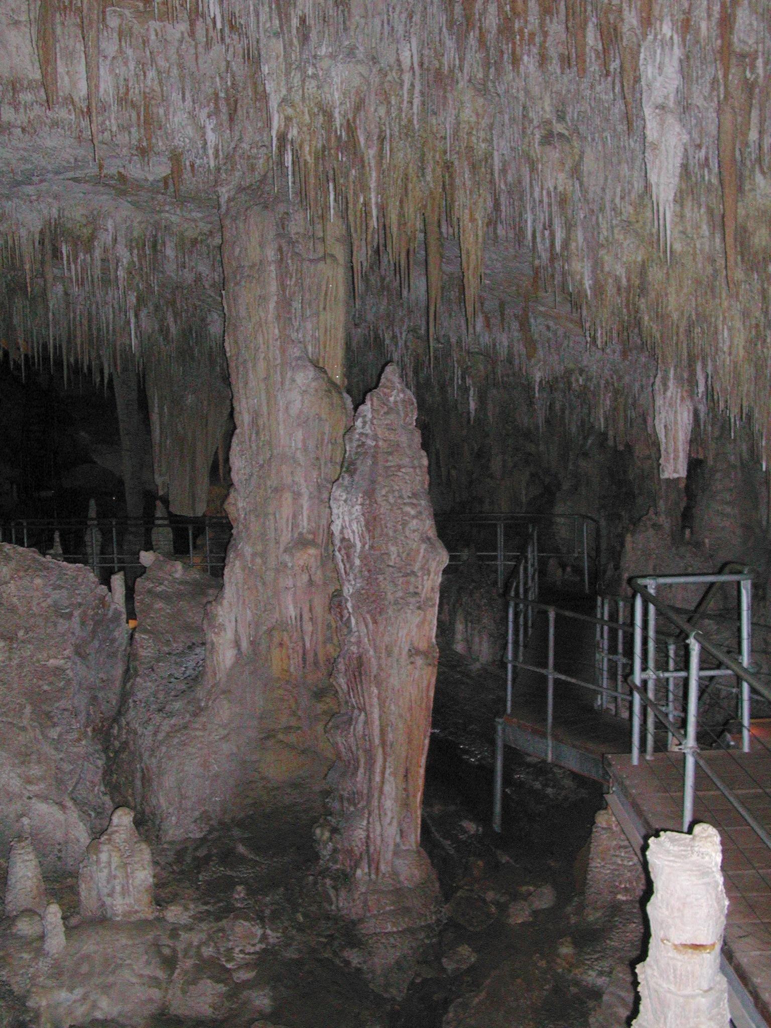
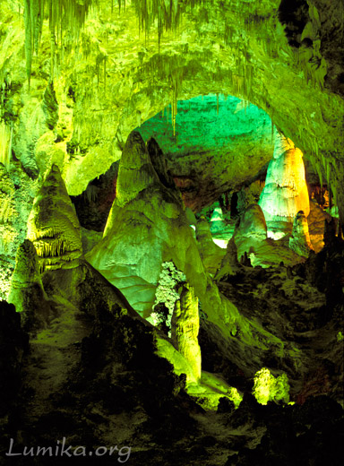
Karst Formations Caves
Forms in a manner similar to sinkholes
Water travels through (limestone’s) rectangular joints and dissolves limestone, leaving a void below ground
Often have other limestone formations within the cave
Hall of Giants
Carlsbad Caverns, NM
Mammoth Cave, KY

Slide 19
Del Arco Cave, Puerto Rico

Slide 20
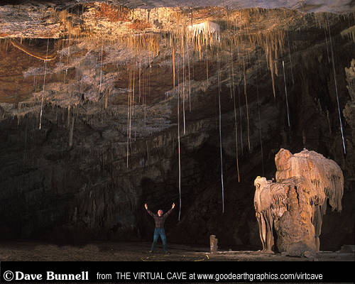
Karst Formations Caves: common interior formations
Soda Straws
Stalactites & Stalagmites
Columns
(stalactites & stalagmites grown together)
Pool spar & shelfstones

Slide 21
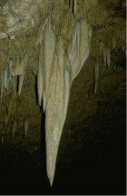
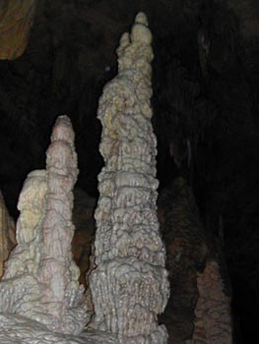
Karst Formations Caves: common interior formations
Stalactite
Stalagmite
Soda Straws

Slide 22
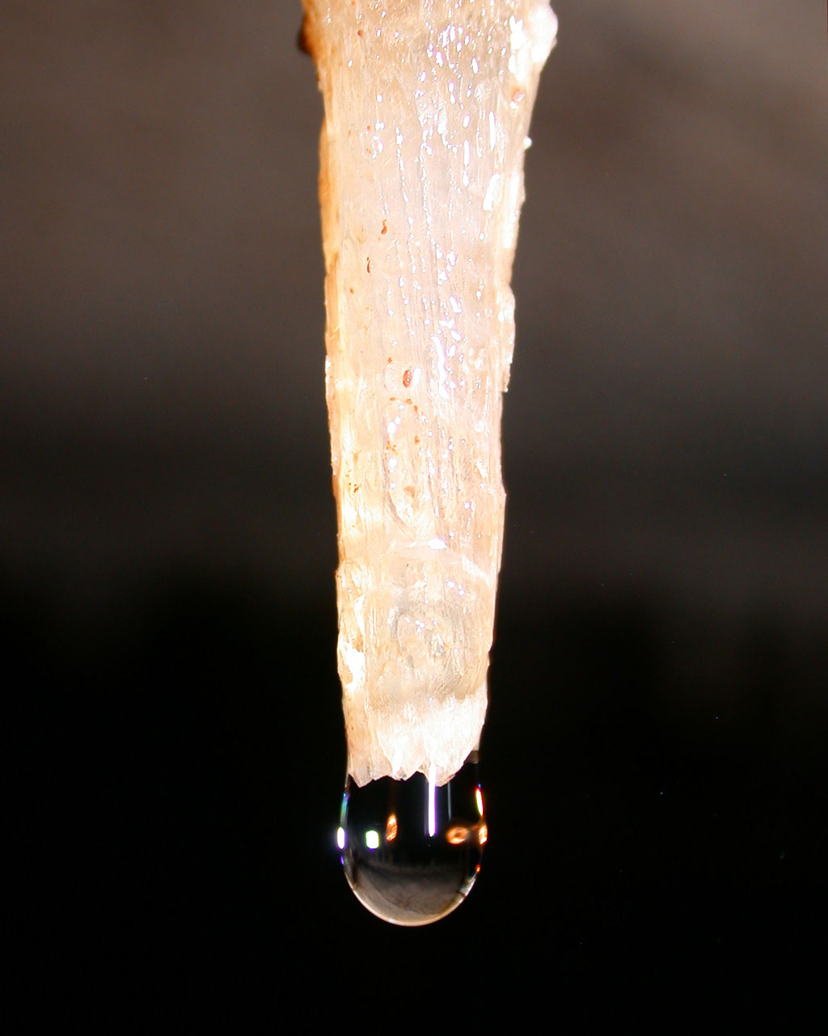
Karst Formations Caves: how soda straws develop into stalactites
Soda straws are initially hollow, allowing dissolved limestone to travel through the tube.
Because a dissolved solid is traveling through the tube, it sometimes gets plugged up.
This forces the dissolved limestone to “back up” and start flowing on the outside of the straw.
Eventually, it thickens and becomes recognizable as a stalactite!

Slide 23
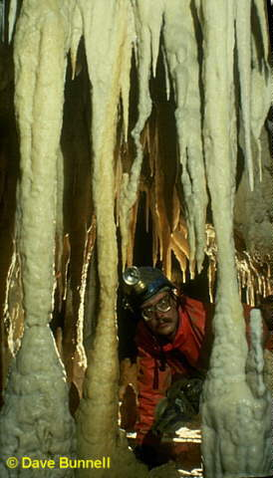
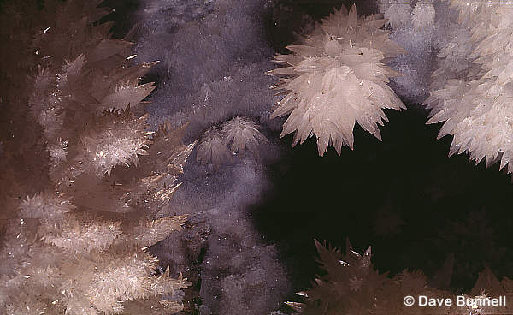
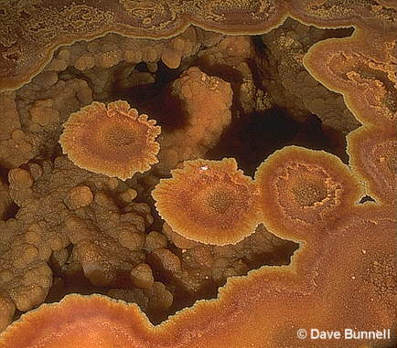
Karst Formations Caves: common interior formations
Pool Spar crystallization of dissolved limestone in water
A shelfstone develops when spar attach to side of a cave pool
Columns form when stalactites & stalagmites grow together

Slide 26
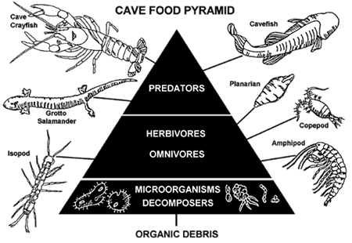
Unique biology
Constant temp and humidity
No light (blind, no pigmentation)
No plants
Many unique species
Often home to bats!

Slide 27
Just ewww https://www.fs.usda.gov/detail/elyunque/learning/nature-science/?cid=fsbdev3_042936

Slide 28
Water Drainage
Lack of well-established surface drainage – deranged drainage!
Surface drainage is actually replaced by extensive underground drainage!
Aquifer: an underground layer of permeable rock containing water. Sometimes, the aquifer is “confined” between two layers of impermeable rock.
Unconfined aquifers allow water to easily pass in and out (from above and below)
Water Table: the level at which underground water stays. It is the very top of the zone of saturation.

Slide 29
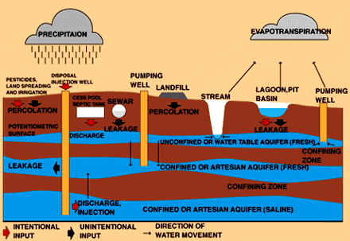
Water Drainage Aquifers & Water Tables

Slide 30
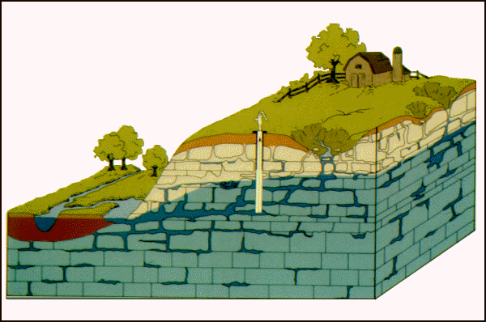
Water Drainage Aquifers & Water Tables
Where is the water table level? Would this be a “confined” or “unconfined” aquifer?

Slide 31
Let’s look at a few pics

Slide 33
Guatemala

Slide 34
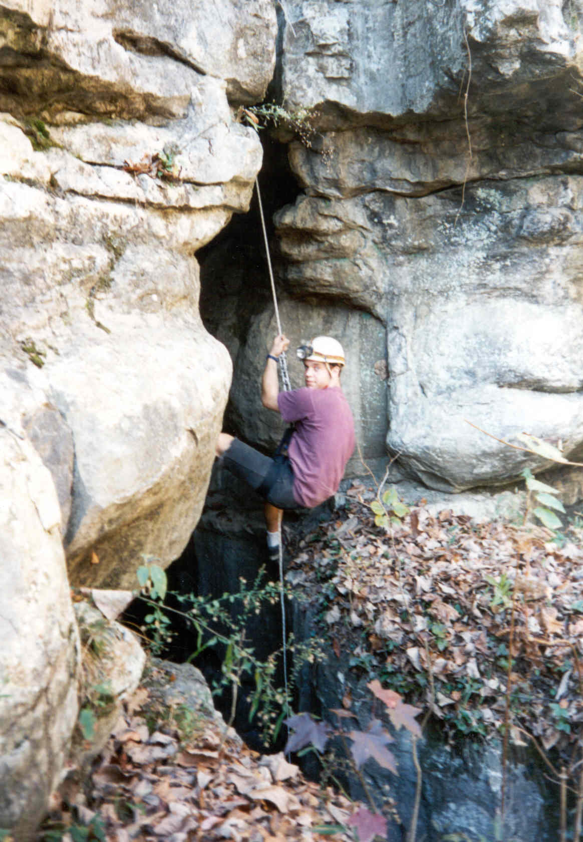
Alabama!

Slide 36
Go through https://www.youtube.com/watch?v=KTViaGA1cqA
Google a few sinkhole vids

Slide 37
https://www.usatoday.com/story/news/nation/2014/02/12/corvette-museum-sinkhole/5417171/

Slide 39
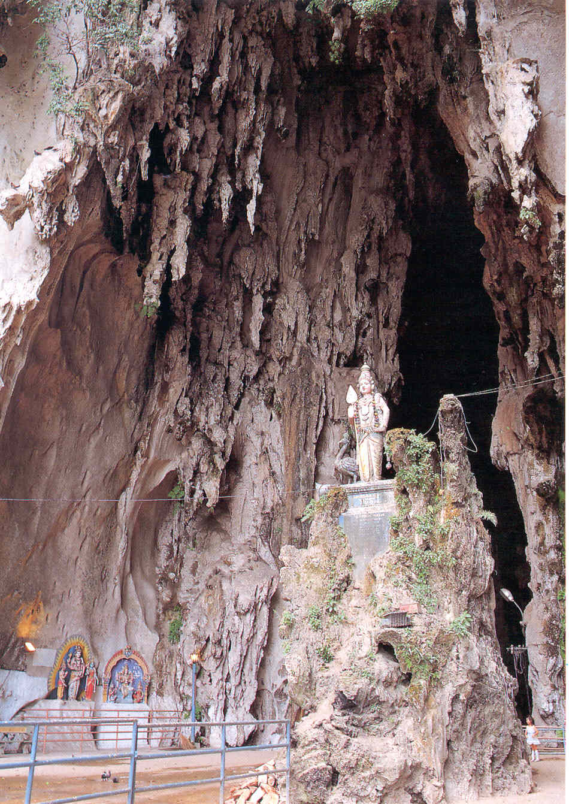

Slide 40
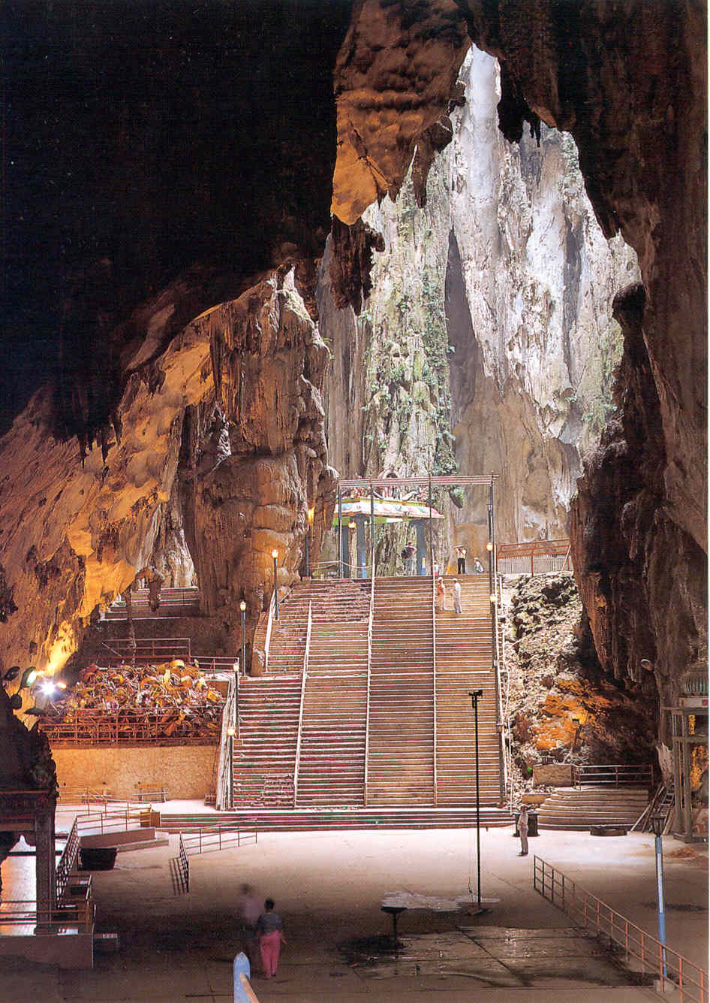

Slide 46
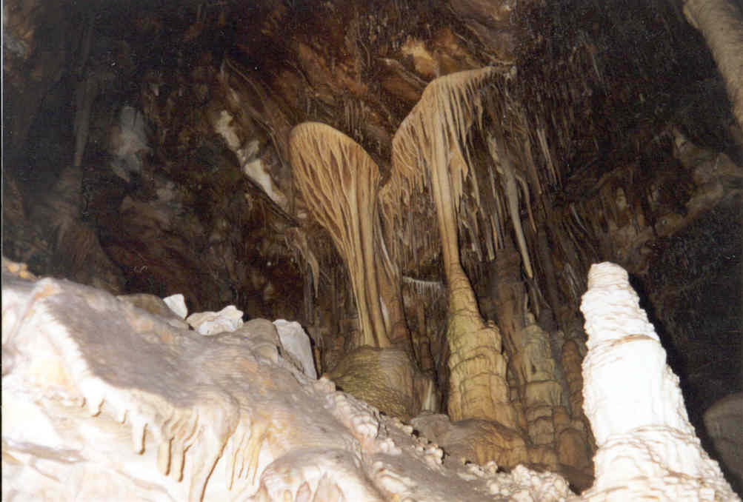
Great Basin

Slide 47
Goto Great Basin. Look at glacial and karst.

Slide 48
Florida sinkholes

Slide 62
And off to winter park, FL

