Slide 1
Glaciers

Slide 2
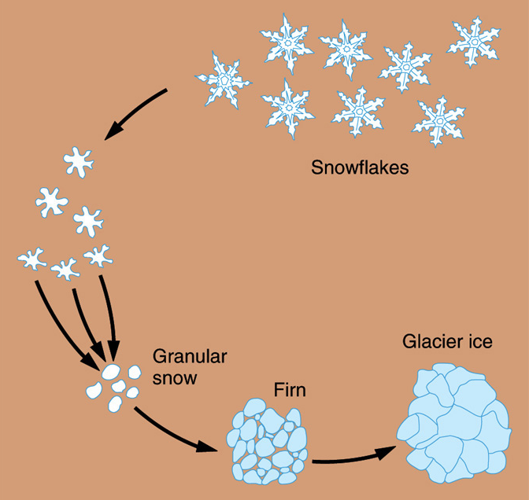
What is a glacier?
A body of ice on land which is thick enough that it flows under the influence of gravity
Bare minimum, 50 feet of ice (not snow).
Usually includes a lot of dust, rocks, and other debris.
All about pressure (basically, the weight of snow and ice that piles up)

Slide 3
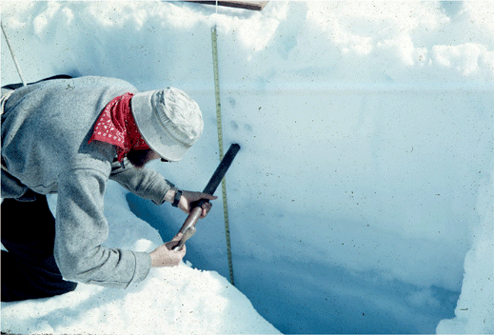

Slide 4
Zone of ablation
Zone of accumulation
Over time, accumulation must exceed ablation for the glacier to advance.
If not, we have glacial retreat. Though it is still flowing downhill, it just doesn’t get as far

Slide 5
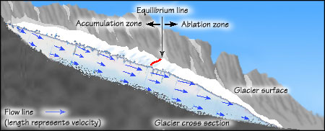

Slide 6
South Cascade Glacier (about 3 km long) in the N. Cascade Range, Washington. (A. Post). No clue on date.
Go see it in GE. Look at retreat.

Slide 7
But… how do they actually move?
Near the surface of a glacier, ice is brittle. When the glacier moves over irregular terrain, the uppermost zone (called zone of fracture) is subjected to tension, resulting in cracks called crevasses.
Plastic flow (think thick oil)
Basal sliding – on a slick of water.
Friction is a big issue. Especially if very cold and the glacier is frozen to the ground.

Slide 8
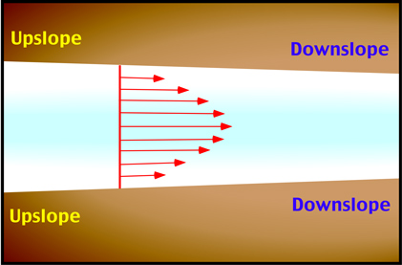

Slide 9
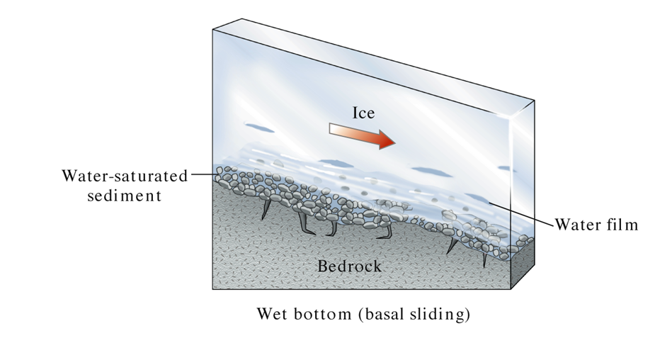

Slide 10
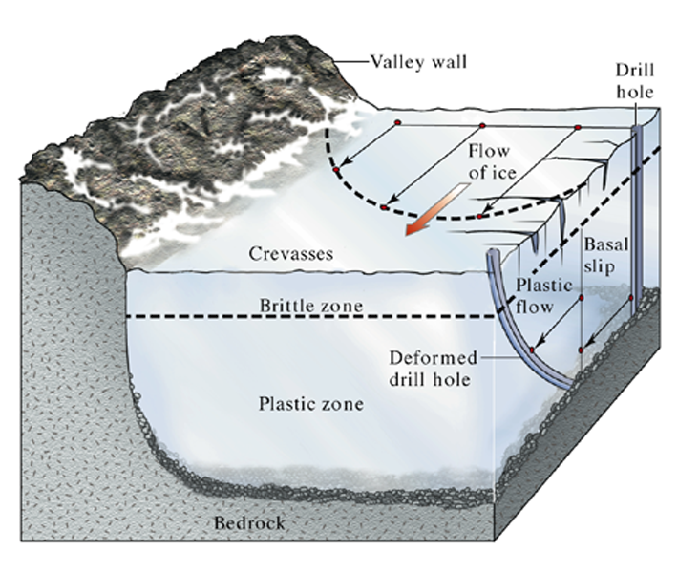
Different parts of a glacier flow at different velocities. (W.W. Norton)

Slide 11
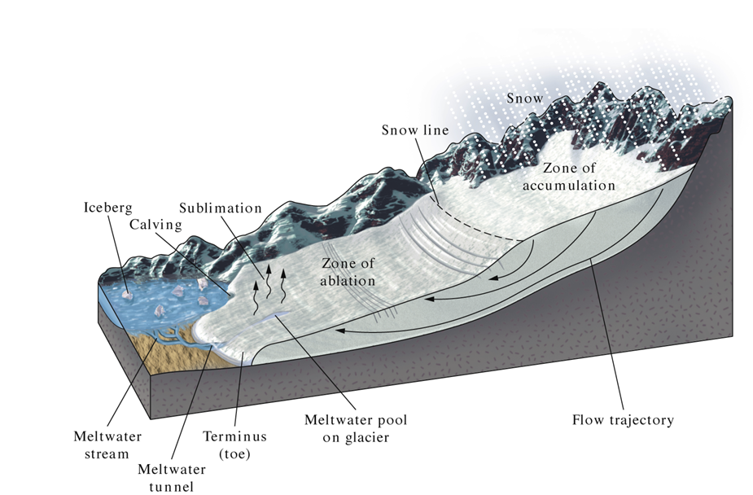
Glacial advance or retreat is determined by the balance between the accumulation of snow and the removal of ice by sublimation, melting, and calving (ablation). (W.W. Norton)

Slide 12
https://www.youtube.com/watch?v=6dFbuaz130c
https://www.youtube.com/watch?v=xRZaDJxFjIA

Slide 13
Type of Glaciers
Valley (alpine) glaciers: Valley glaciers are bounded by valleys. Found in the mountains!
Ice sheets (continental glaciers): Ice sheets exist on a much larger scale. Current ice sheets are found in Greenland and Antarctica.

Slide 14
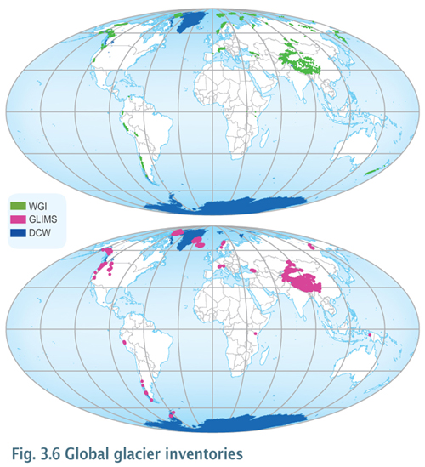
Surf around GE a bit

Slide 15
The only present-day continental ice sheets are those covering Greenland and Antarctica, which represent 10% of Earth's land area. The Antarctic Ice Sheet has a maximum thickness of 4.3 km and an area of 14 million square kms. (Tarbuck and Lutgents)

Slide 16
How do glaciers wear down the land?
Glaciers erode land by plucking (lifting pieces of bedrock) and abrasion (grinding and scraping).
Glacial abrasion sometimes is evident in the long scratches and grooves in the bedrock (called glacial striations or polish).

Slide 17
Glacial polish, striations, and grooves on bedrock, Glacier Bay National Park, Alaska. (Carr Clifton)

Slide 18
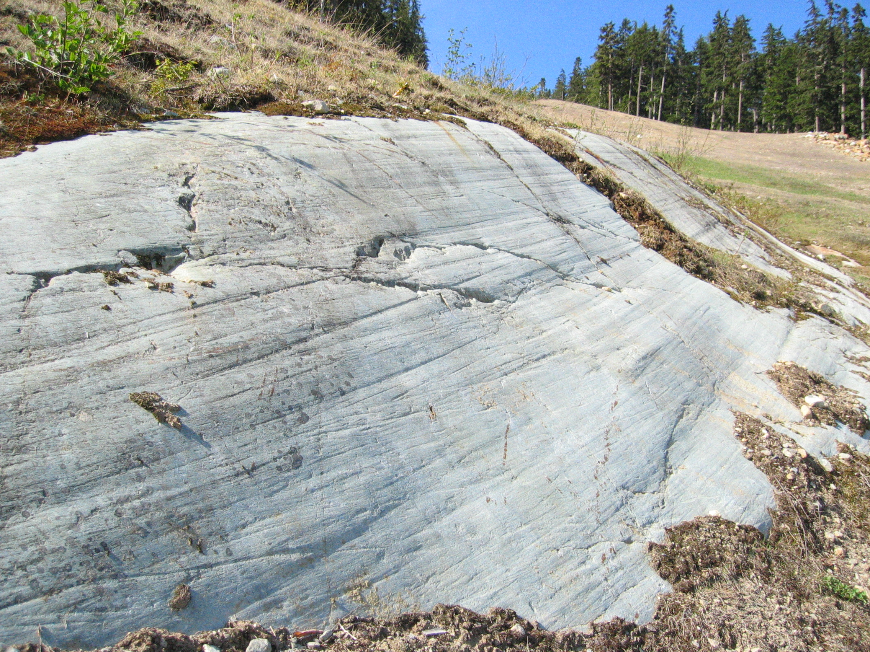

Slide 19
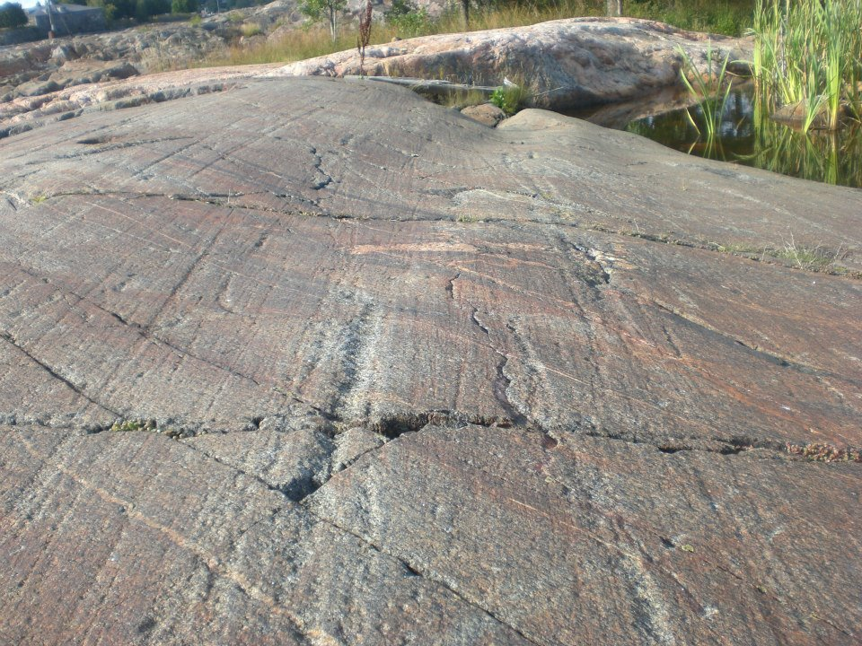

Slide 20
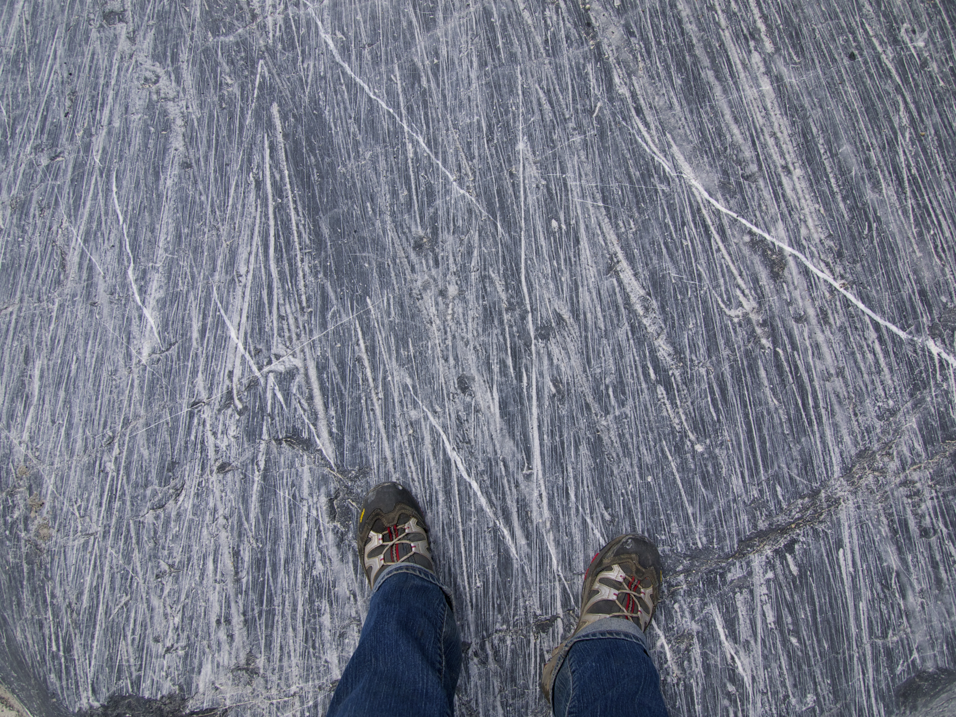

Slide 21
An outstanding example of glacial grooves can be found at the Glacial Grooves at Kelleys Island, Ohio (a National Natural Landmark), the most impressive of which is 400 feet (120 m) long, 35 feet (11 m) wide, and up to 10 feet (3.0 m) deep. These grooves cut into the Columbus Limestone. Striations cover the sides and bottoms of the grooves. https://nsidc.org/cryosphere/glaciers/gallery/grooves.html
Definitely go there on GE. NE part of the island.

Slide 22
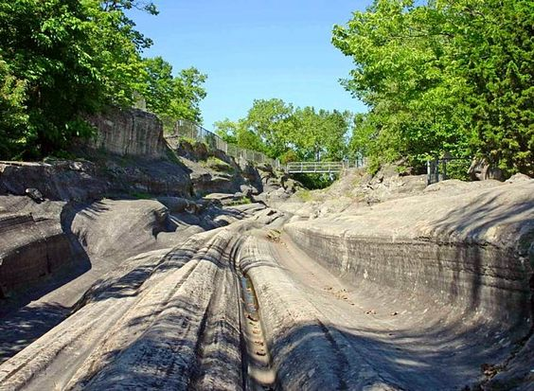

Slide 23
Closest place I’ve seen striations is along the hike from Cooper Lake to Pete’s Lake. Just above Ronald/Roslyn.

Slide 24
Landforms associated with continental glaciers
Look at the Laurentide Ice sheet, about 15000 years ago. Ditto cordilleran ice sheet. Note, multiple advances/retreats during last ice age.
Up to 2 miles thick in places
Sea level 400 feet lower than it is now. http://www.iceagenow.com/Sea_Level_During_Last_Ice_Age.htm (follow link at bottom of page to “ice age maps”

Slide 25
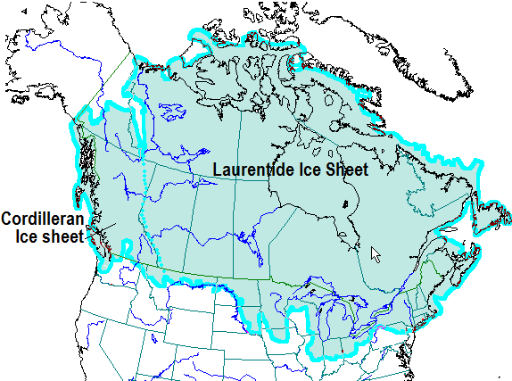

Slide 26
Pretty much flattened most of Canada and the northern US.
Created Hudson Bay and the Great Lakes.
And.. The epic Lake Agassiz

Slide 27
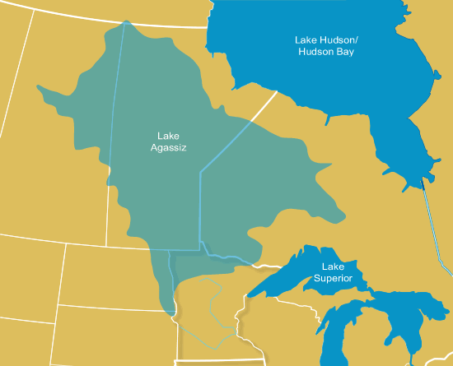
At the time, larger than any current lake in the world.
Multiple lakes over time.
Evidence for the lake?
Where is it now?
Why is it gone?
http://www.geostrategis.com/p_agassiz.htm

Slide 28
Isostatic rebound.
Still going on
In Hudson Bay, at about the same rate as sea level rise!
Helped create the conditions to drain Lake Aggasiz.

Slide 29
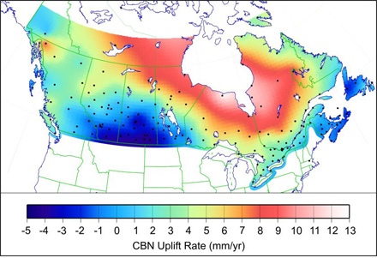

Slide 30
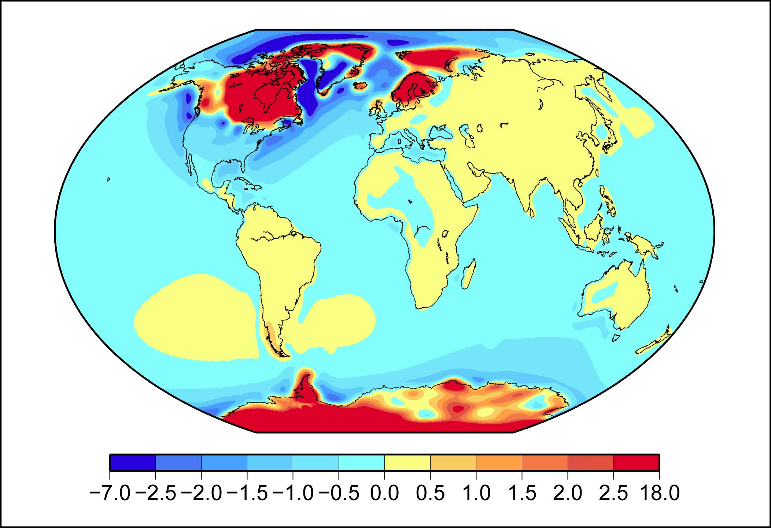

Slide 31
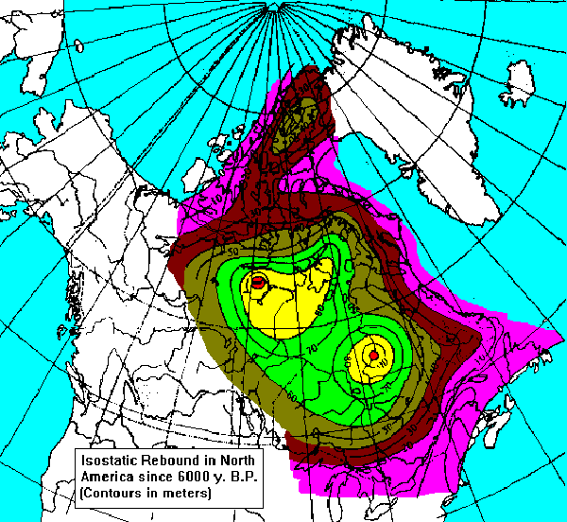

Slide 32
https://www.youtube.com/watch?v=V7HP1jsoisE

Slide 33
Continental glacier landforms
Terminal Moraine
Esker
Drumlin
Kame
Kettle
Till
Outwash plain
Erratic
Roche moutonnee
Crag and tail

Slide 34
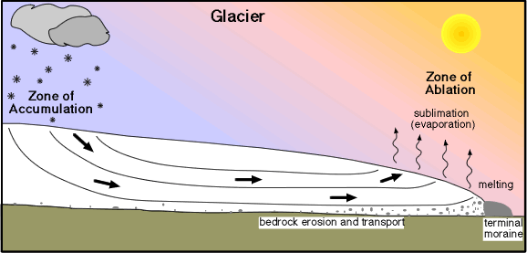

Slide 35
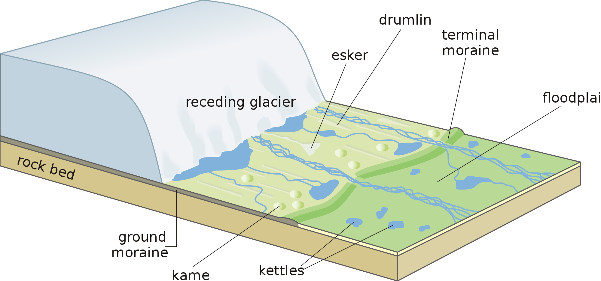

Slide 36
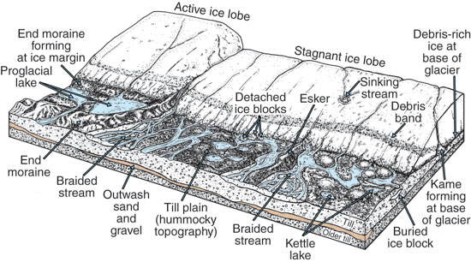

Slide 37
Kames and Kettles
Highs and lows in the glaciated landscape. Typically all till.

Slide 38
Head to N MN and look at lakes, etc.

Slide 39
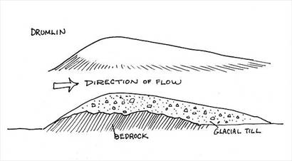
Drumlins – reshaped till.

Slide 40
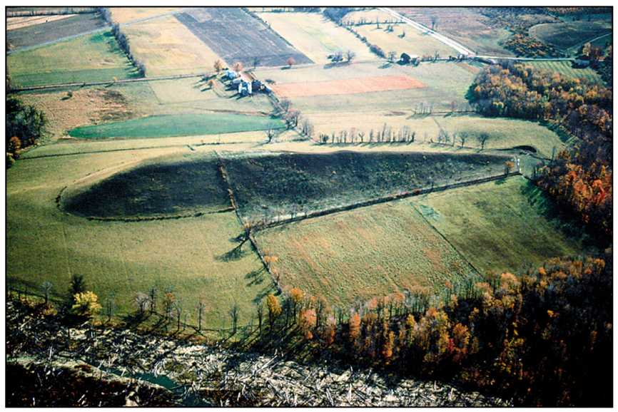

Slide 41
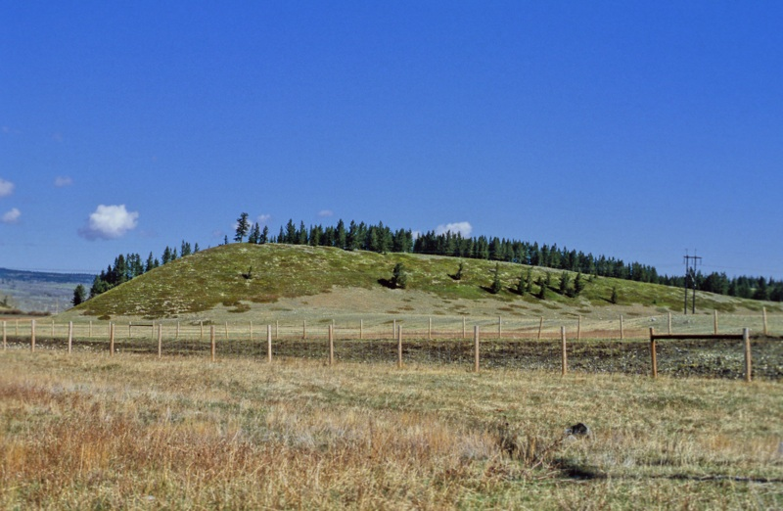

Slide 42
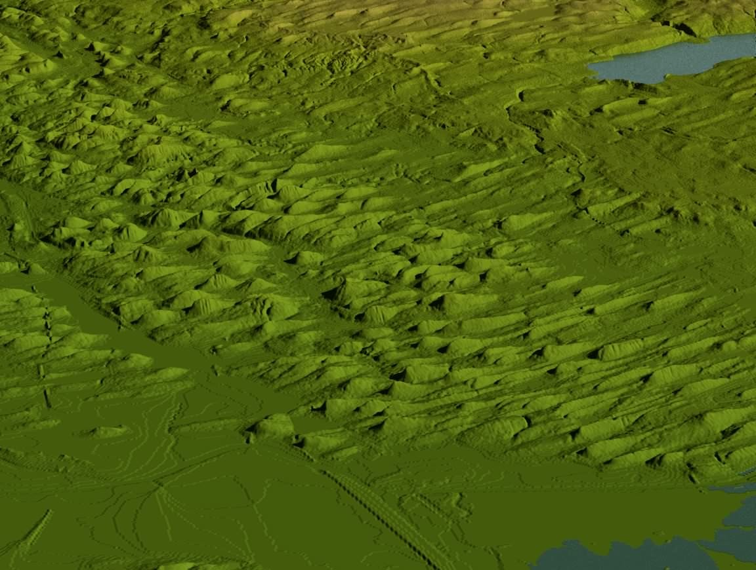
Near Auburn, New York (GE!)

Slide 43
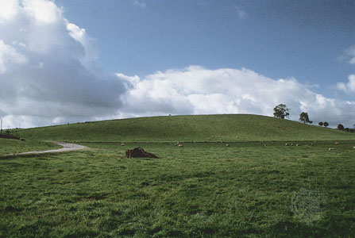
https://nsidc.org/cryosphere/glaciers/gallery/drumlins.html

Slide 44
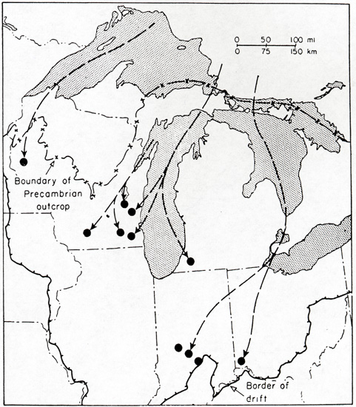
Diamonds?
Erratics….
https://geology.com/articles/canada-diamond-mines/

Slide 45
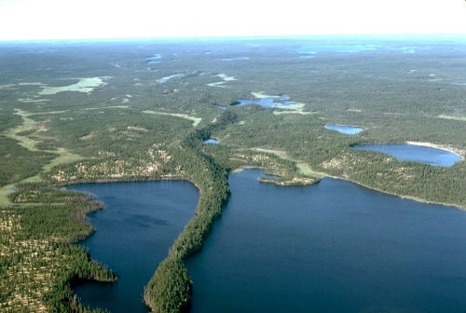
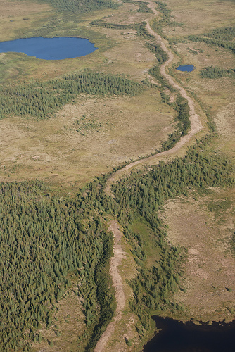
esker

Slide 46
https://en.wikipedia.org/wiki/Esker - links to famous eskers

Slide 47
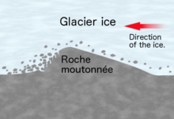
Roche Moutonnee
Basically, a drumlin, only solid rock!
And pointing in the opposite direction

Slide 48
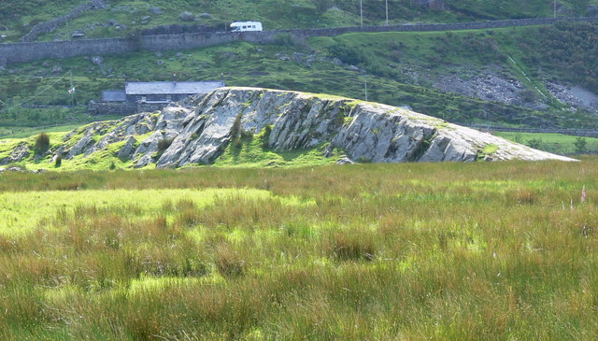

Slide 49
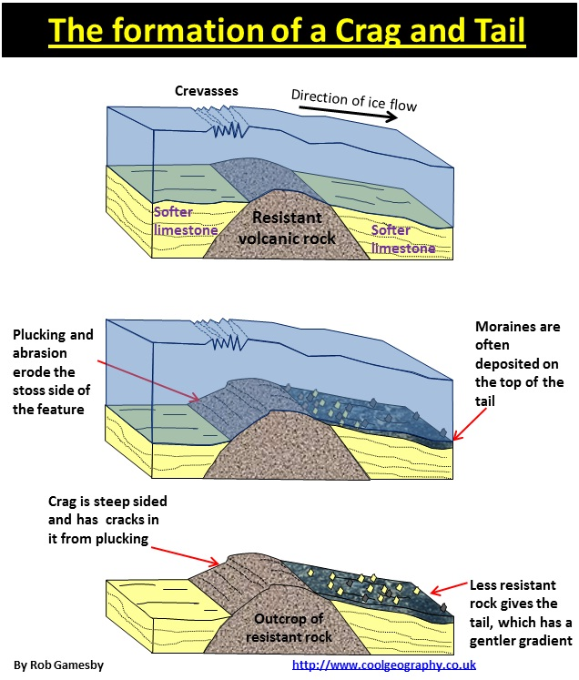
Crag and tail!
Goto Edinborough Castle in GE. Turn on terrain and 3d buildings

Slide 50
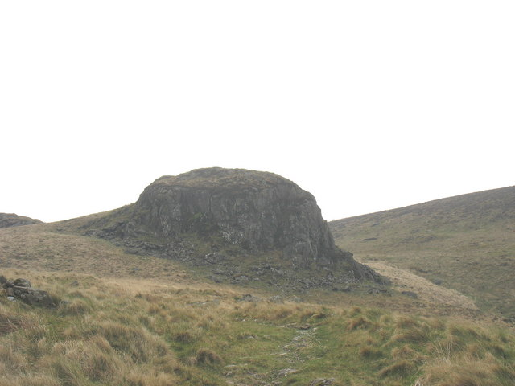

Slide 51
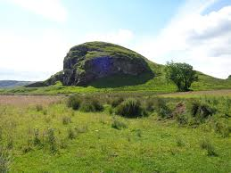

Slide 52
And now! To the Mountains!!!!
Horn
Arete
Col
Cirque
Tarn lake
U shaped valley
Hanging valley
Fjord
Glacial milk
Crevasses. They’re everywhere! Remember the brittle zone of a glacier
Terminal moraine
Medial moraine
Lateral moraine
Pater noster lakes
Ice caves

Slide 53
Decent descriptions and pics at http://www.physicalgeography.net/fundamentals/10af.html

Slide 54
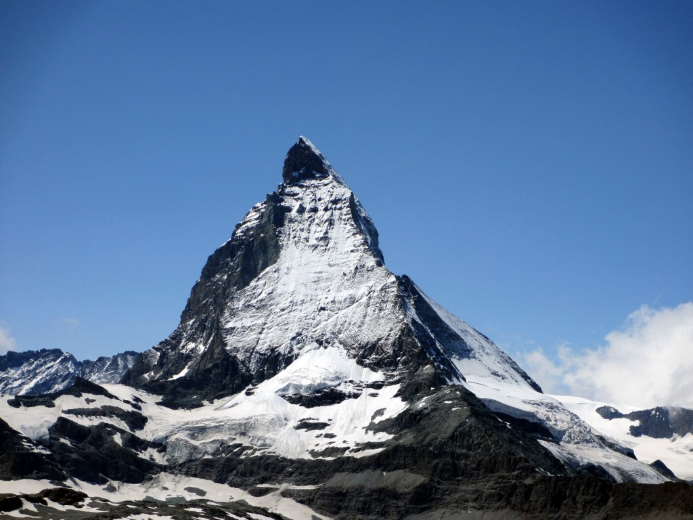
horn
Matterhorn!

Slide 55
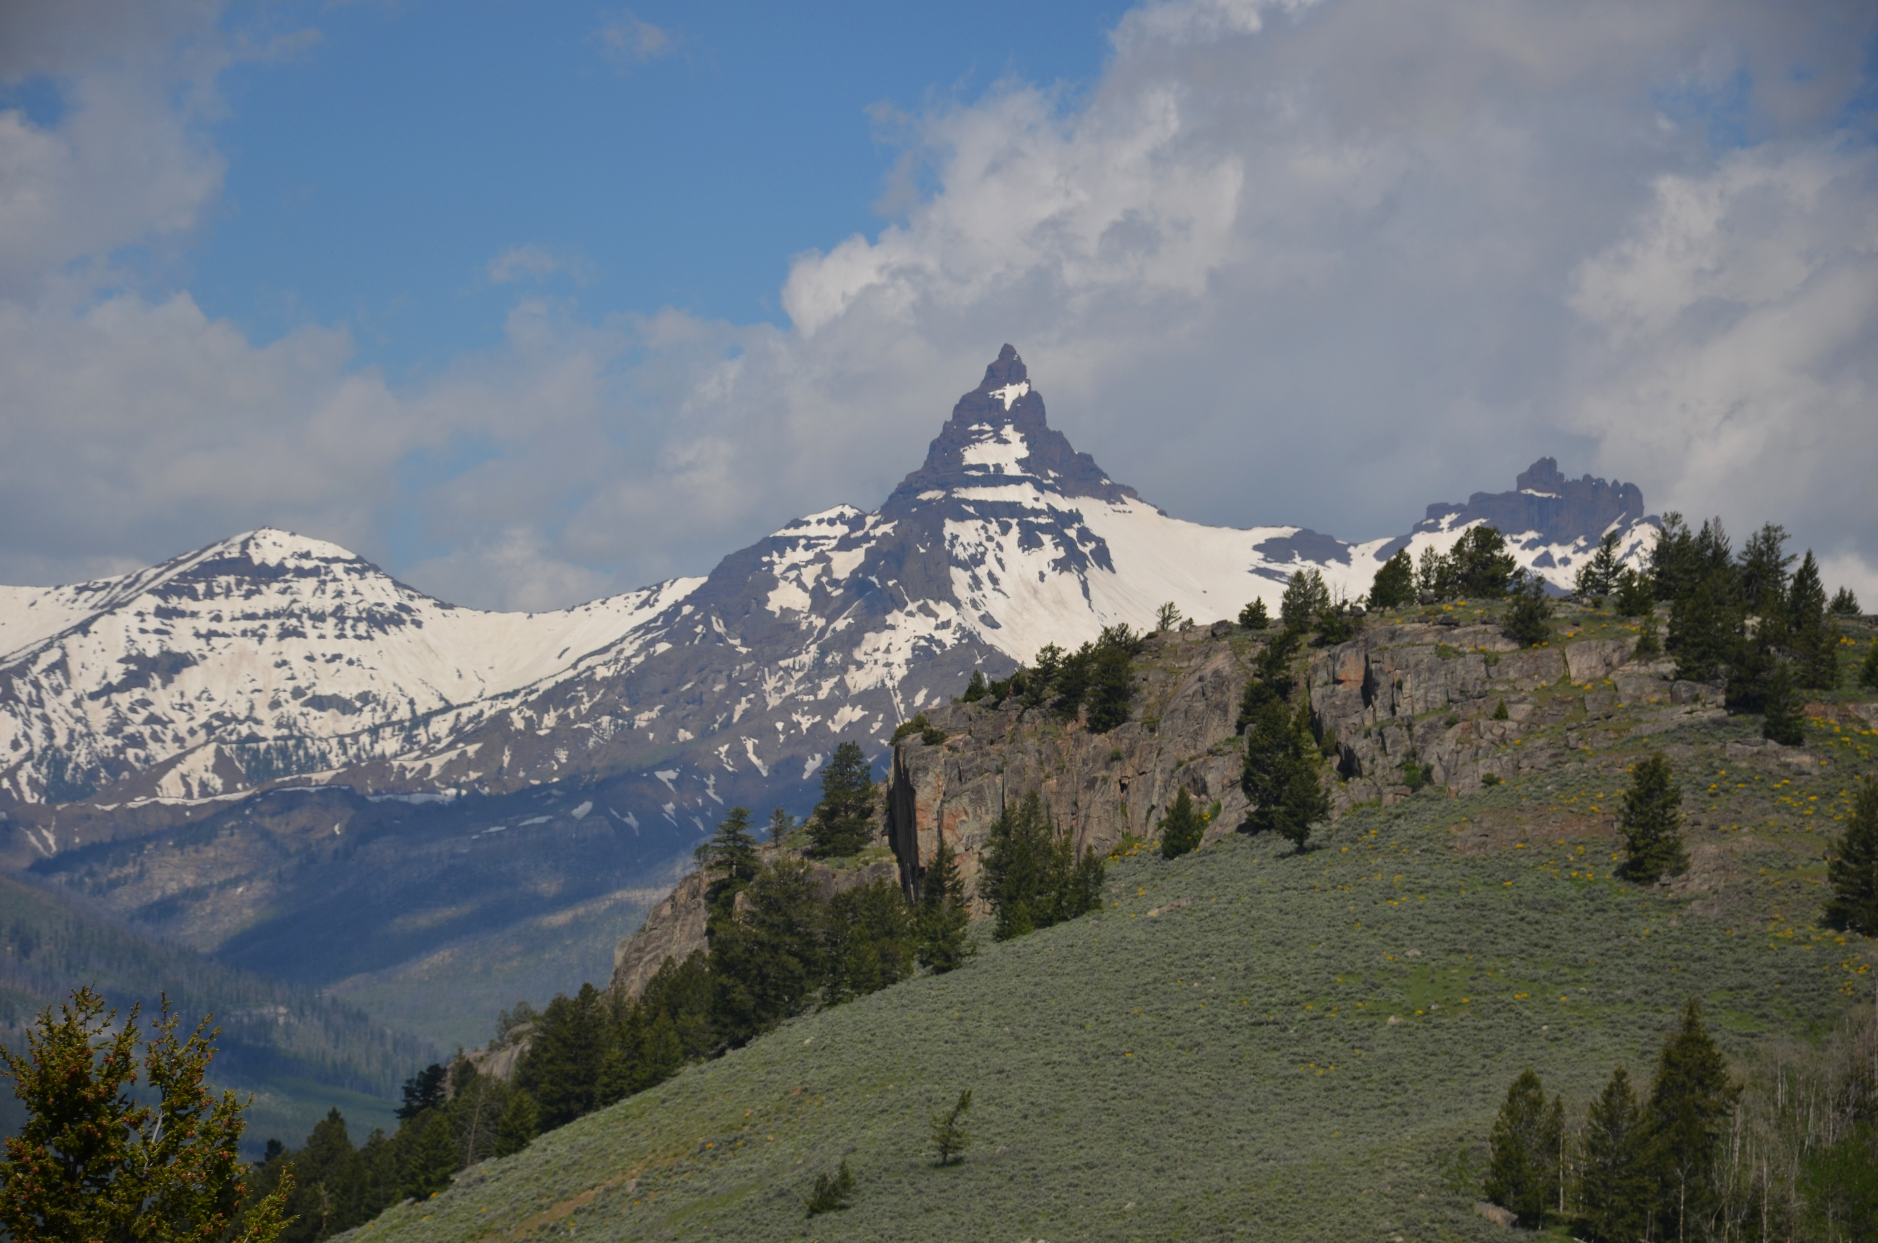
Pilot peak, MT

Slide 56
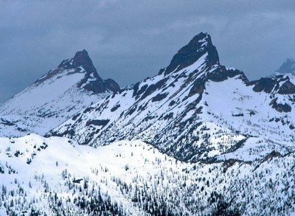
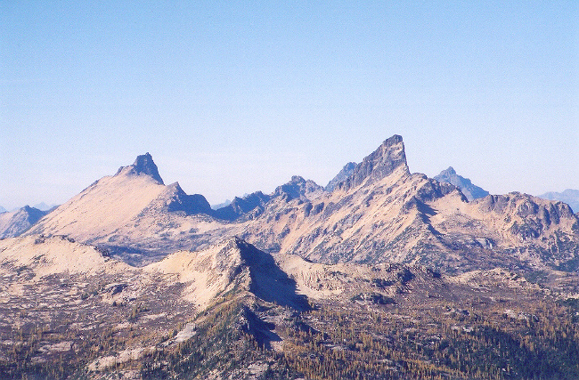
Golden horn and Tower Mtn.
Cascades of WA!

Slide 57
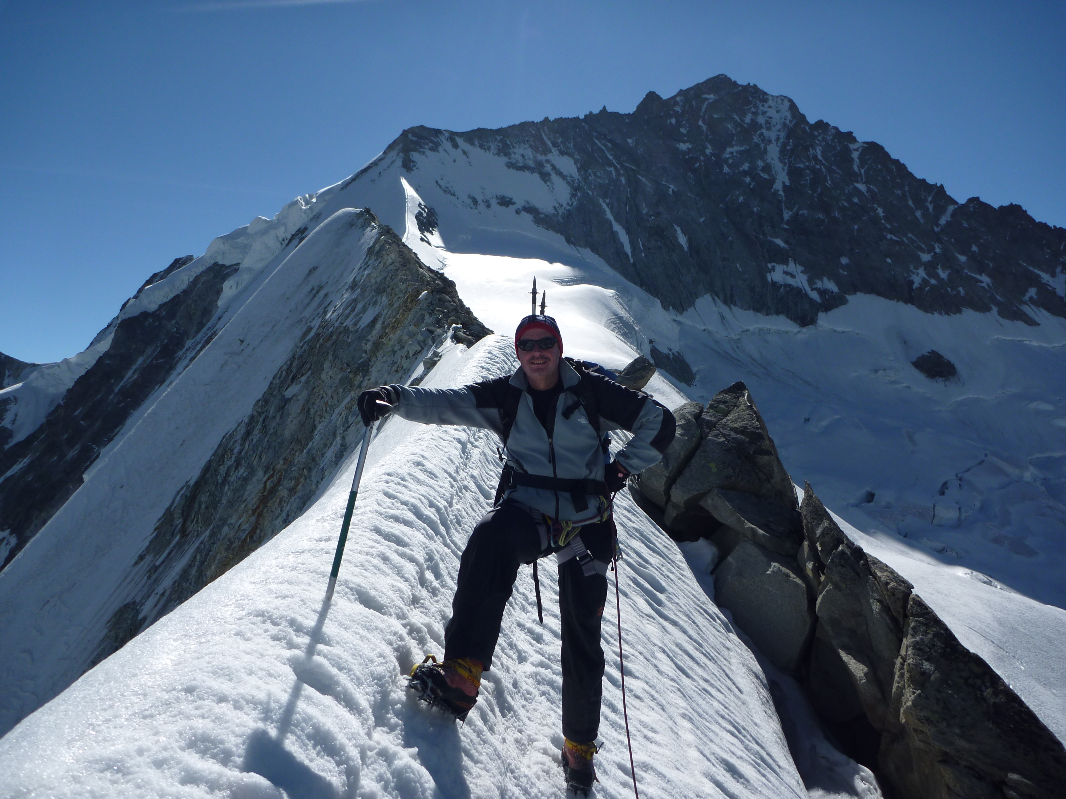
Arete!
“knife edged” ridge

Slide 58
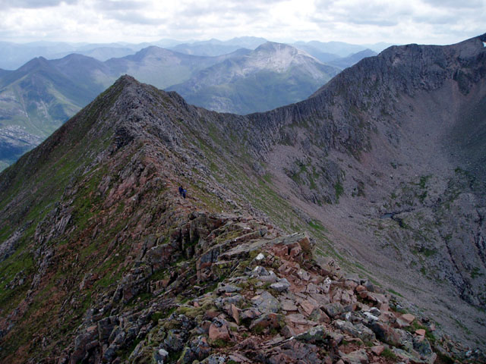

Slide 59
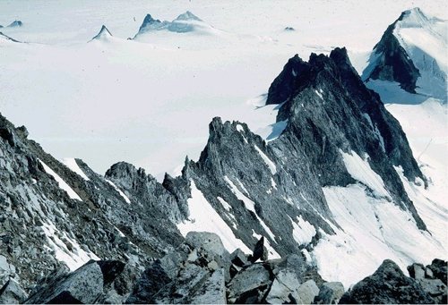

Slide 60
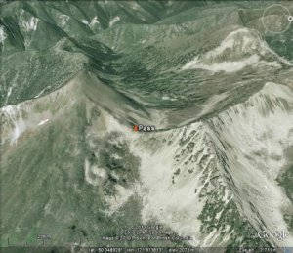
Col
Saddle or low spot along an arete

Slide 61
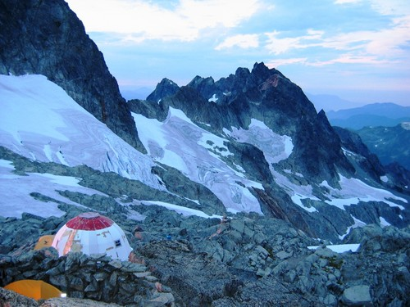

Slide 62
Col de tourmalet

Slide 63
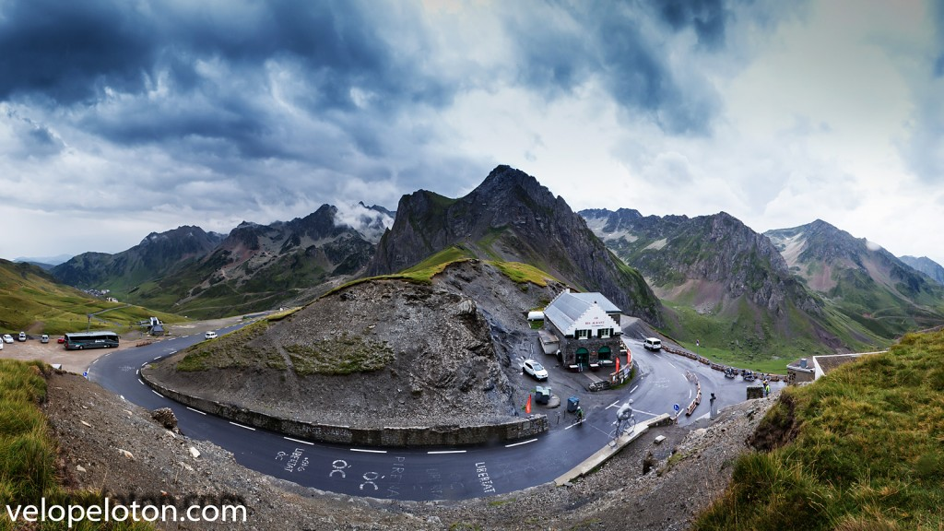

Slide 64
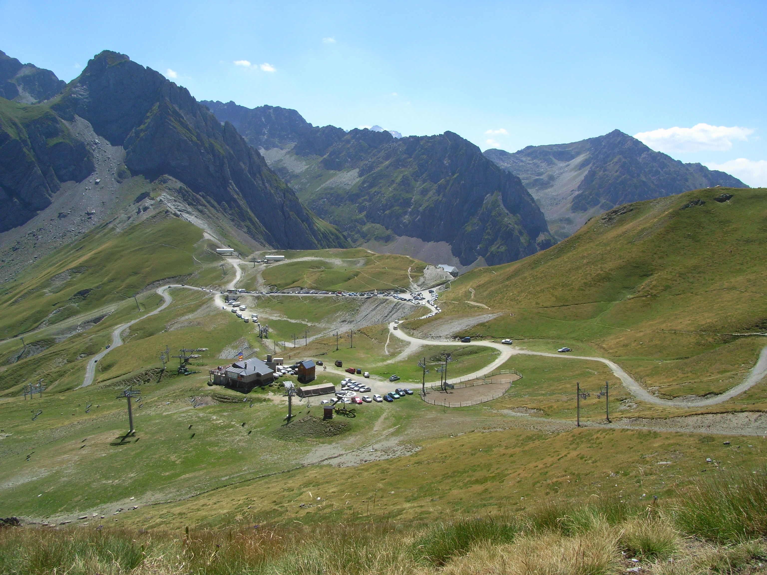

Slide 65
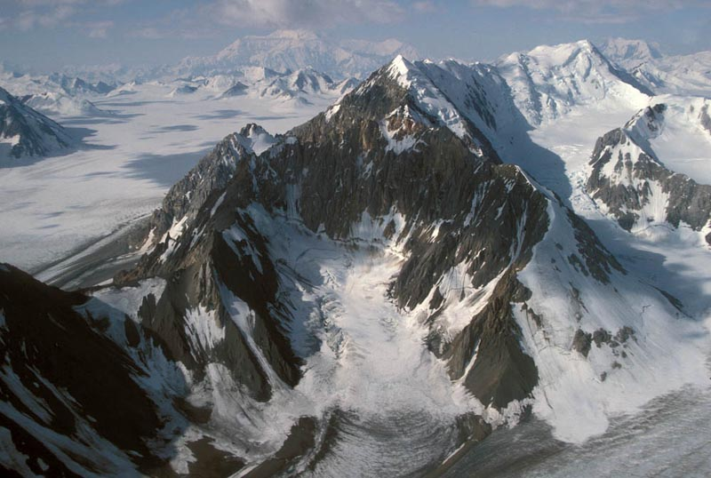
Cirque
Bowl shaped depression where a mountain glacier starts

Slide 66
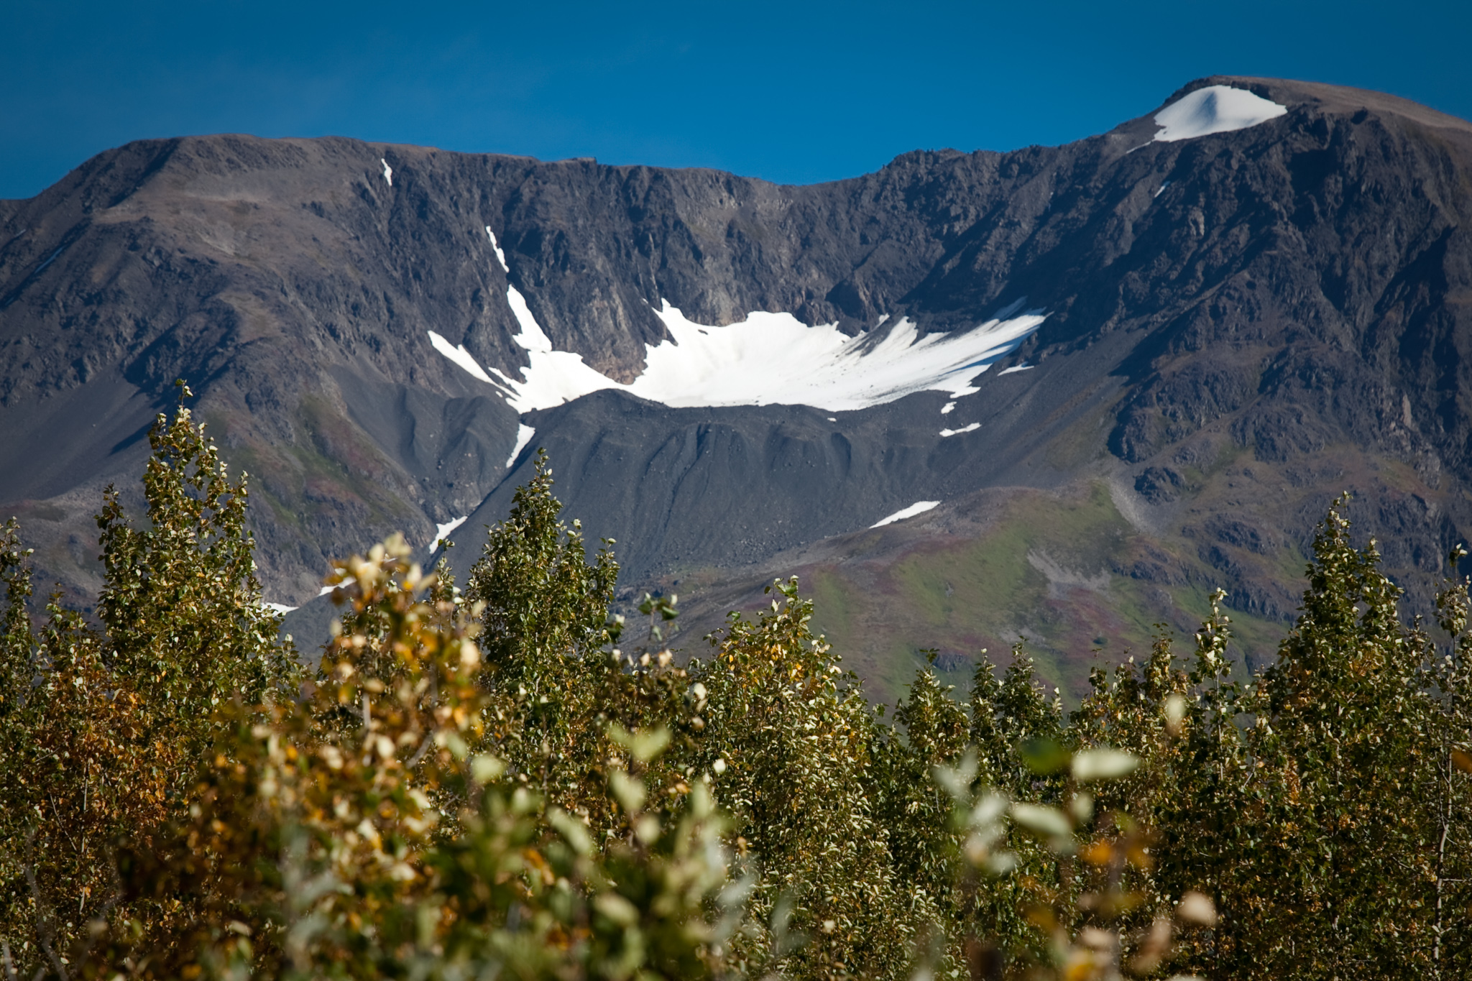
Cirque + terminal moraine

Slide 67
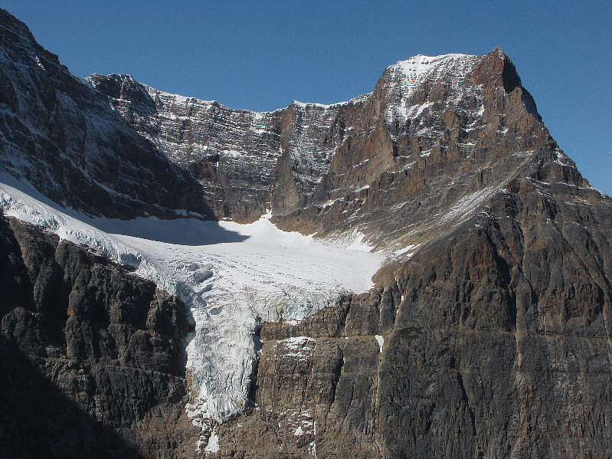
Cirque plus hanging valley

Slide 68
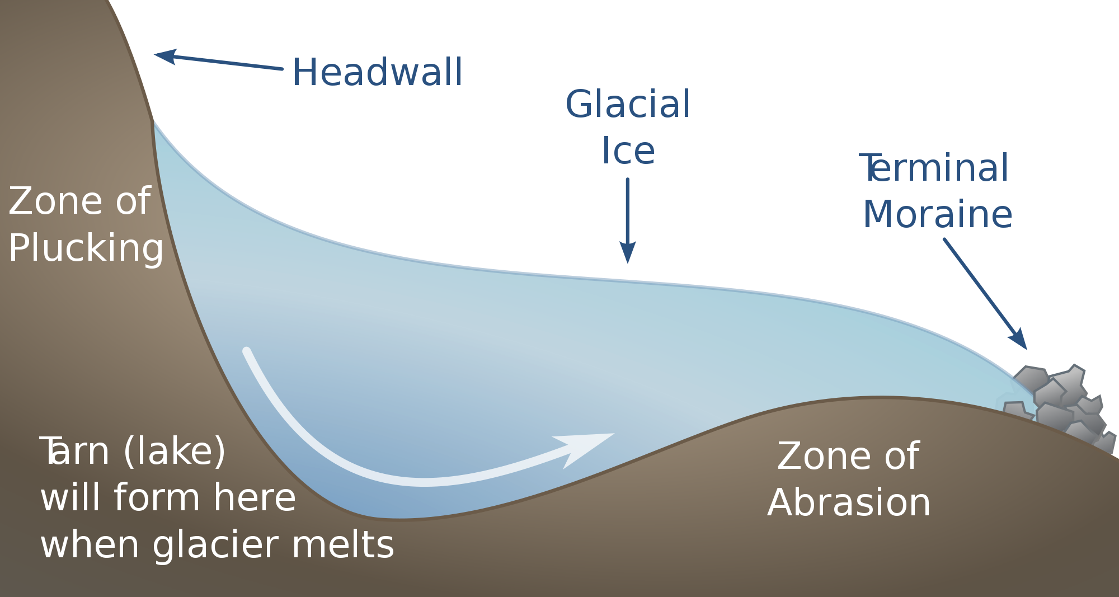

Slide 69
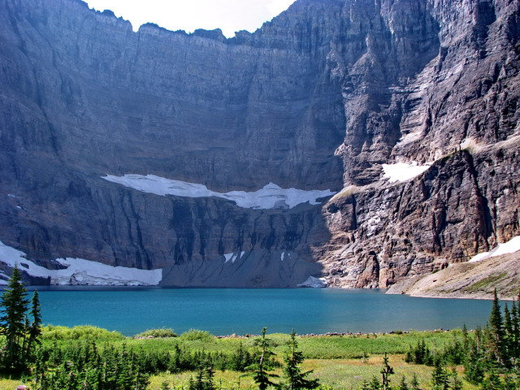
Tarn lake
A lake in a cirque
From Glacier NP

Slide 71
U shaped valley Hanging valley
Typical of glacial terrains
River valleys typically a V
LOTS of erosion all along base, little along the sides.

Slide 72
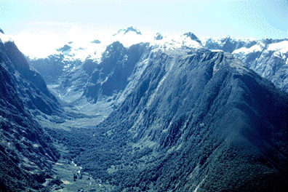

Slide 75
fjord
U shaped valley which heads into the ocean
Typically, very deep with very steep sides
Puget Sound is an example, though not a very good one.
Norway wins.
https://www.reddit.com/r/interestingasfuck/comments/z3su18/small_piece_detached_from_glacier/

Slide 79
Glacial milk

Slide 82
Crevasse
Crack in the ice.

Slide 86
Moraines
Terminal (or end) moraines
Lateral moraines (along the sides)
Medial moraines (in the middle of glaciers)

Slide 94
Pater noster lakes
A string of lakes, each dammed by a terminal moraine.

Slide 97
Ice caves

Slide 99
https://guidetoiceland.is/book-trips-holiday/nature-tours/caves

Slide 100
https://www.wildlandnw.net/osborne-panoramas-historic-and-modern/
Goto GE and visit montagu island. Slides, volcanos, glaciers, it’s got it all.
http://www.iflscience.com/editors-blog/people-think-they-have-discovered-an-alien-spaceship-on-an-island-off-antarctica/
https://earth.google.com/web/data=CjkaNxIxCgAZ2ob2VslUS8AhdLkcCvoYQsAqGzU0wrAzOSc0NC42IlMgMzbCsDExJzQyLjUiVxgCIAE (open in chrome) – you’ll see a pin, but google maps only shows latest imagery. Need to goto this area in google earth and look at the 2011 imagery.

