Slide 1
Biogeography

Slide 2
Biogeography is the study of the distribution of species and ecosystems in geographic space and through geological time.
Organisms and biological communities often vary in a regular fashion along geographic gradients of latitude, elevation, isolation and habitat area
Modern biogeographic research combines information and ideas from many fields, from the physiological and ecological constraints on organismal dispersal to geological and climatological phenomena operating at global spatial scales and evolutionary time frames.
From Wikipedia.

Slide 3
Basically….
The distribution of plants and animals across geographic space.
Biogeography is a synthetic discipline
Draws from Geography, Ecology, Population Biology, Systematics, Evolutionary Biology, Genetics, and Geology

Slide 4
Range
Restricted
Cosmopolitan

Slide 5
Based upon mobility and barriers
Mobility: All organisms are mobile at some stage
Ferns & Fungi: fine spores: wide distribution
Fresh-water Fish: motile: restricted in distribution.
Marine Fish: planktonic eggs & larvae widely dispersed by ocean currents.
Think about different plants and animals and how they disperse/spread

Slide 6
True Range expansion
Peripheral colonization or range expansion
Satellite populations (accidental dispersal)

Slide 7
Barriers to dispersal
Unsuitable habitat: oceans, mountains, deserts, rain forests, etc.
Strong competition
Severe predation

Slide 8
Ways to Expand Range other than Dispersal:
Adaptive Radiation : adaptation to formerly unsuitable habitat
e.g. progressive drought resistance: eventual dispersal across desert. May evolve into separate species.
Geological & Climatological Changes: elimination of dispersal barrier
Humans… think Barred owls. fire suppression—along with tree planting in the Great Plains—allowed them to spread northward and westward during the past century. https://www.usgs.gov/media/images/barred-owl-movement-west
https://en.wikipedia.org/wiki/Barred_owl

Slide 9
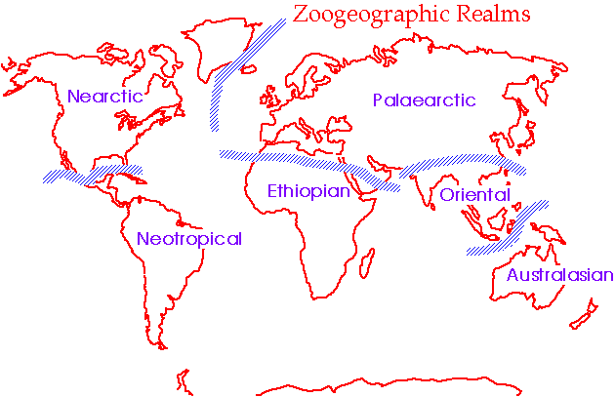
Patterns in biogeography often reflect tectonic history
e.g. Biogeographical realms reflect breakup of supercontinent
Wallace’s line

Slide 10
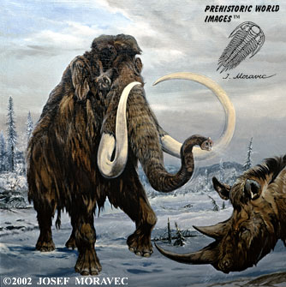
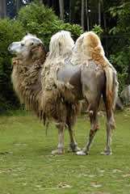
Distributions
Elephantidae:
Origin: Africa (Pliocene 5mya)
Dispersed: N. Amer. (Bering land bridge)
mammoths: extinct (last one: Wrangel Island, 2000BC) https://www.livescience.com/woolly-mammoth-genetic-problems.html
Camels:
Origin: N. Amer. (Eocene)
Dispersed: Eurasia (Bering)
: S. Amer. (Isthmus)
Extinct in all but S. Amer. (camelids, llama, etc), N. Africa, Asia

Slide 11
Theory of Island Biogeography
“Why do islands have fewer species than same area on a continent?”
Function of SIZE of island and DISTANCE from mainland
Small islands have higher extinction rates.
Farther islands have lower probability of immigration

Slide 12
Biogeographical Realms maps
https://www.discovermagazine.com/environment/biogeography-map-updated-after-136-years

Slide 13
Wallace, 1876

Slide 14
Holt et al, 2012

Slide 15
Biogeographical Provinces

Slide 16
Big variables: temperature, water availability, connectiveness

Slide 17
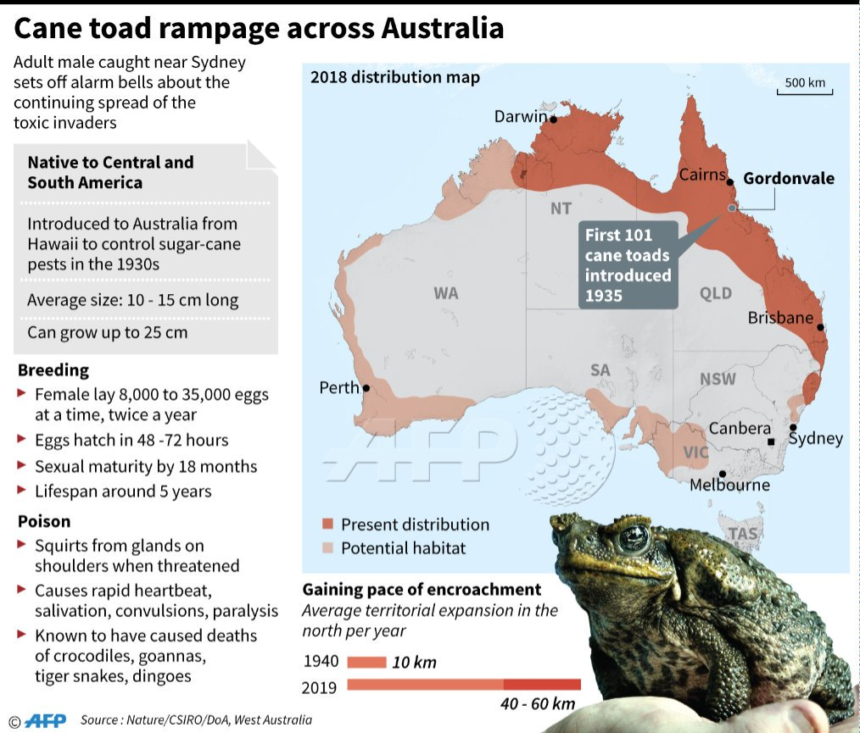
The fun part, invasive species!
Cane toads

Slide 18
Major IS in the US
Burmese python (FL)
Emerald Ash Borer. From Russia, China, and Japan. Wiping out ash trees.
Nutria (swamp rats!). Louisiana. Imported from S America for fur
European Starling
Northern Snakehead. Chesapeake Bay Watershed. China/korea. Aquarium owner or fish market?
Brown Marmorated stink bug. China. Eat fruits and veggies. Controlled there by wasps

Slide 19
Feral hogs. Throughout SE. Eat everything out. Hogzilla.
Lionfish. Eat everything. From the pacific, in gulf/Atlantic/Caribbean
Norway Rat. General menace pretty much everywhere. Stowaways.

Slide 20
What about plants?
https://www.si.edu/stories/escape-invasives
Purple loosestrife
Japanese honeysuckle
Kudzu
In WA: https://invasivespecies.wa.gov/ go there and go through a few of them.
Murder hornets! Aauuugh.
https://www.nwcb.wa.gov/class-c-noxious-weeds
https://www.sagegrouseinitiative.com/why-is-cheatgrass-bad/

