Slide 1
https://www.nytimes.com/2021/11/09/science/kilauea-volcano-eruption.html

Slide 2
Mineral Resources
If it can’t be grown, it’s gotta be mined

Slide 3
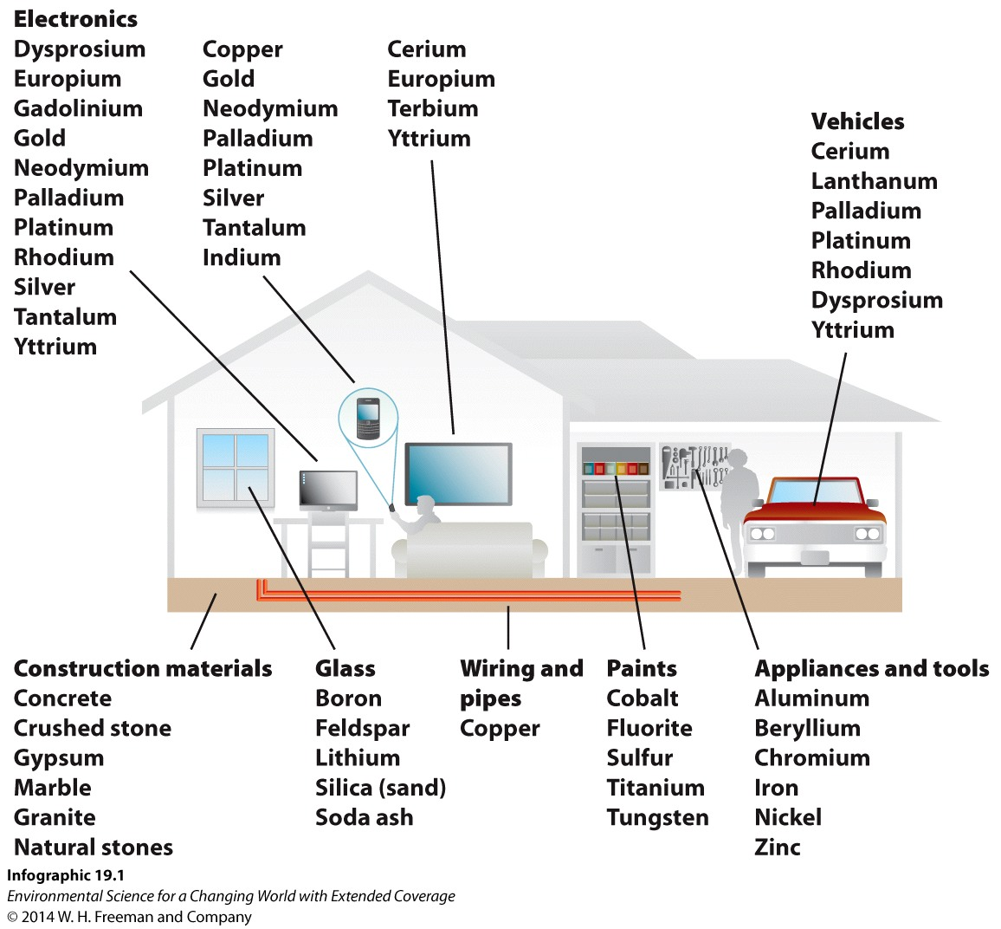
We depend on minerals for everyday products:

Slide 4
definition
Something that can, and is, mined for use by humans
Includes such things as metals, coal, oil/gas, gravel, marble, etc.
Ore deposit: a rock in which mineral resources are concentrated
Economic ore deposit: an ore deposit which can be mined profitably

Slide 5
Profitablilty depends on
Level of concentration
Location
Energy costs (transportation, milling, mining, refining)
Price of the resource
Labor costs
“environmental” costs

Slide 6
Break into two basic types:
Metallic ore deposits
The metals – iron, aluminum, rare earths, copper, etc.
Non-metallic ore deposits
Sand, gravel, marble, gemstones

Slide 7
Now, let’s take a look at a few in some detail.

Slide 8
Aluminum
8% of the crust, needs to be concentrated (naturally) 3-4x.
It’s everywhere.
VERY tough to process – extremely high energy costs

Slide 9
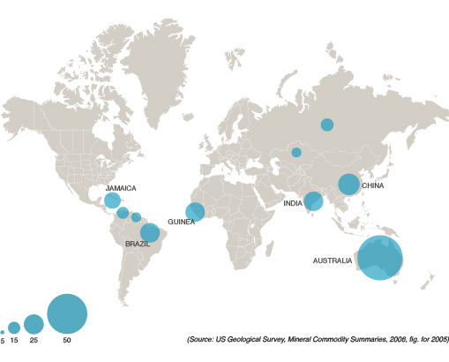
Bauxite (aluminum). Million metric tons per year. USGS 2005

Slide 10
Alcoa in Wenatchee.
Recycling is good…..
Look at list of major smelters, compare to mining: https://en.wikipedia.org/wiki/List_of_aluminium_smelters

Slide 11
Deposits form from….
Extremely intense chemical weathering of granitic rocks.
Requires hot, wet environments.

Slide 12
Iron
Crustal abundance, 5.8%
Concentration factor 6-7x
Also very common.
Again, need to find it in the right form

Slide 13
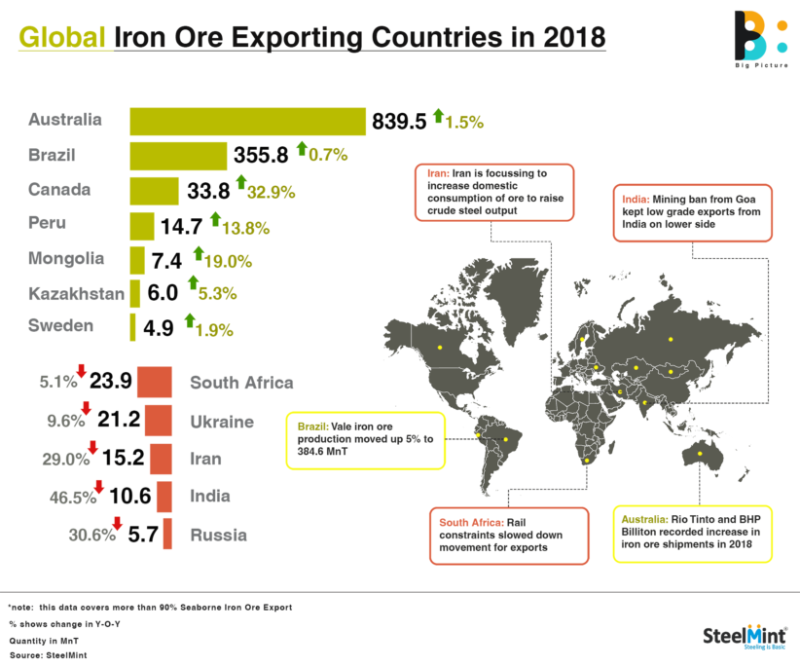
Iron ore production https://en.wikipedia.org/wiki/List_of_countries_by_iron_ore_production

Slide 14
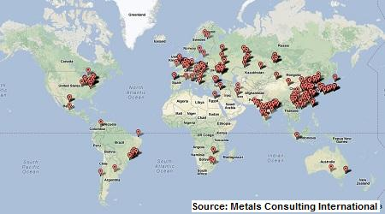
Steel production

Slide 16
Copper
Crustal abundance 0.0058
Concentration factor 100-200x
Primary uses
Copper wiring to transmit power
Radiators on cars
Copper alloys for buildings, downspouts, ships, etc.

Slide 18
Uranium
Crustal abundance 0.00016
Concentration factor 500-1000x
Often weathering does this! Oxidation.
Primary uses
Nuclear fuel in reactors
Nukes
Depleted uranium tipped weapons

Slide 20
Largest Uranium Reserves In The World
 | tonnes U | percentage of world
Australia | 1,692,700 | 28%
Kazakhstan | 906,800 | 15%
Canada | 564,900 | 9%
Russia | 486,000 | 8%
Namibia | 448,300 | 7%
South Africa | 320,900 | 5%
Brazil | 276,800 | 5%
Niger | 276,400 | 4%
China | 248,900 | 4%
Mongolia | 143,500 | 2%
Uzbekistan | 132,300 | 2%
Ukraine | 108,700 | 2%
Botswana | 87,200 | 1%
Tanzania | 58,200 | 1%
Jordan | 52,500 | 1%
USA | 47,900 | 1%
Other | 295,800 | 5%
World total | 6,147,800

Slide 21
Rare Earth Elements (REEs)
Huh. They’re super rare. And need insane concentrations to be mined.
And are super useful – especially in our modern world. In fact, it’s only been the past few decades when they became relevant or important.

Slide 22
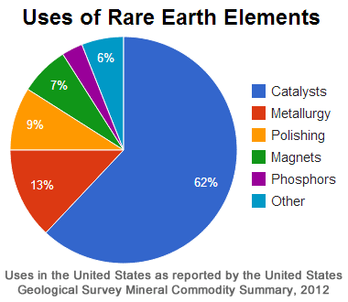

Slide 23
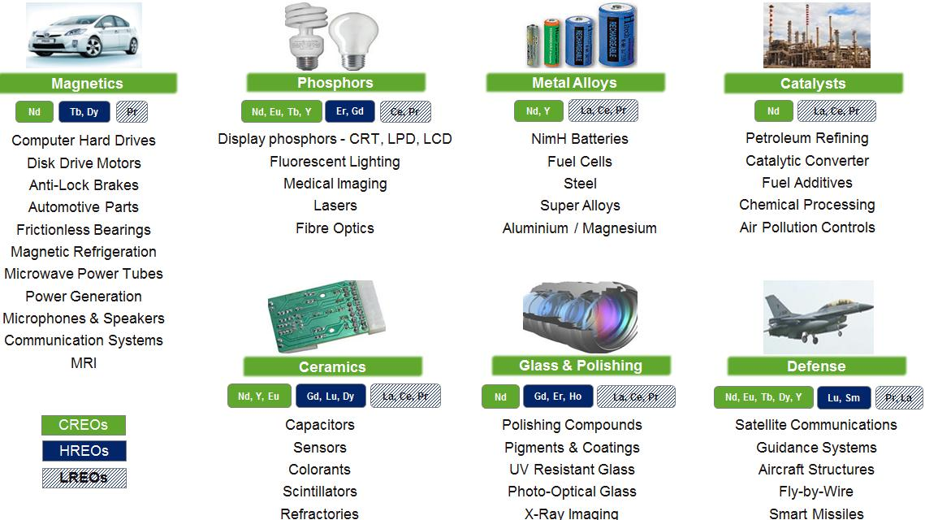

Slide 24
First, S Africa, then US, now, china.

Slide 25
https://investingnews.com/daily/resource-investing/critical-metals-investing/rare-earth-investing/rare-earth-producing-countries/
https://www.cnbc.com/2021/04/17/the-new-us-plan-to-rival-chinas-dominance-in-rare-earth-metals.html

Slide 26
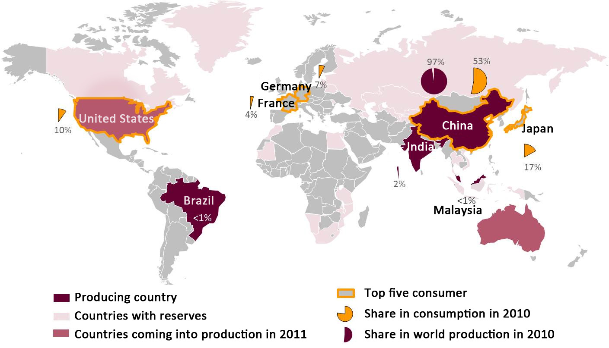
REE 97% mined in China (2010) – including ALL the heavy REEs

Slide 28
Insane geopolitical implications.
https://www.euronews.com/2019/05/14/us-leaves-rare-earths-critical-minerals-off-china-tariff-list

Slide 29
What about (rechargeable) batteries?
Lithium Ion Batteries (expensive, light, high energy density)
Lithium (more below)
Cobalt: Democratic Republic of Congo
Aluminum (common)
Manganese (common)
Nickel (Indonesia, Philippines, Canada
Ni-CD batteries.
NI: common. Mined around the world.
CD: Also relatively common.
Sodium Ion batteries (cheap, heavy, lower energy density)
NA – freaking everywhere
FE – also everywhere.

Slide 30
What about Lithium. Not a REE, but required for batteries

Slide 31
Diamonds
Not particularly rare
Many industrial applications – hardest naturally occurring substance (Wurtzite boron nitride [synthetic] and lonsdaleite [which comes from meteorites] are both harder.)
DeBeers… sigh….
Blood diamonds
“Champagne” Diamonds

Slide 32
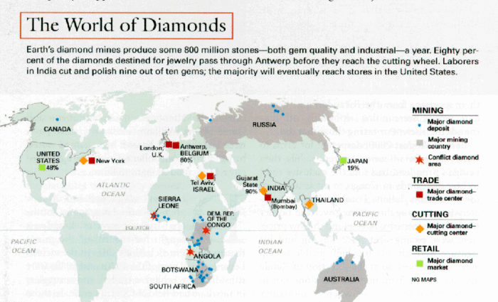
diamonds

Slide 33
Extracting and processing mineral resources impacts
the environment.

Slide 34
Strip mining is used in areas where the land is flat and the resource-deposit seam is horizontal and close to the surface.

Slide 35
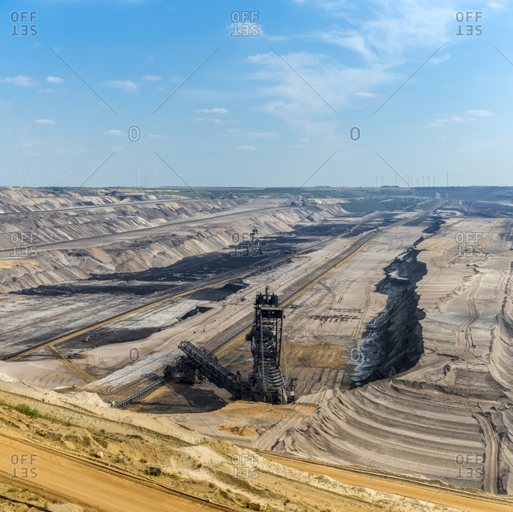

Slide 36
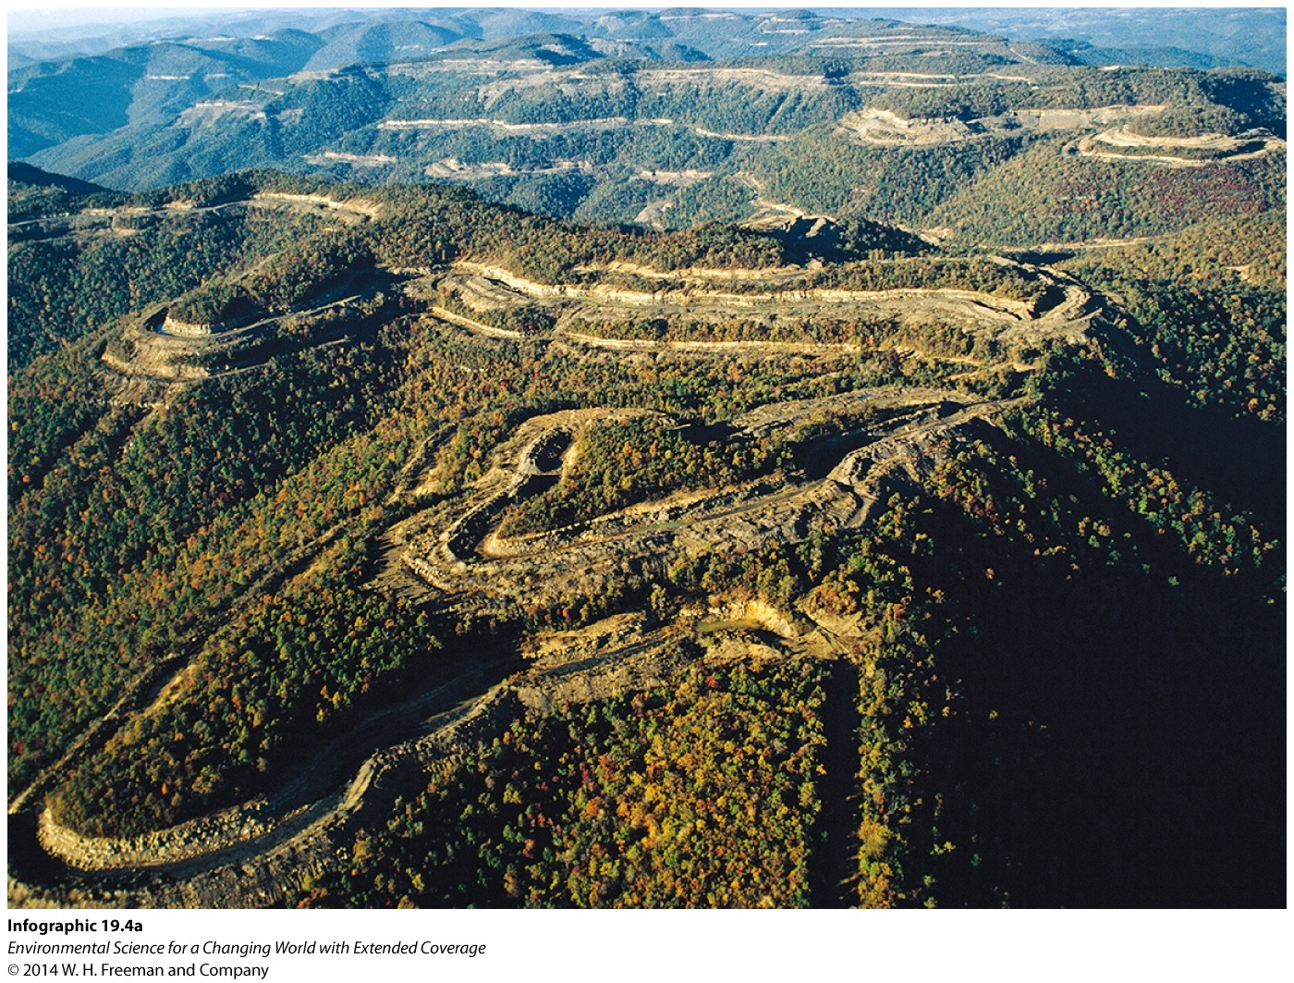
Special type – mountain top removal.

Slide 37
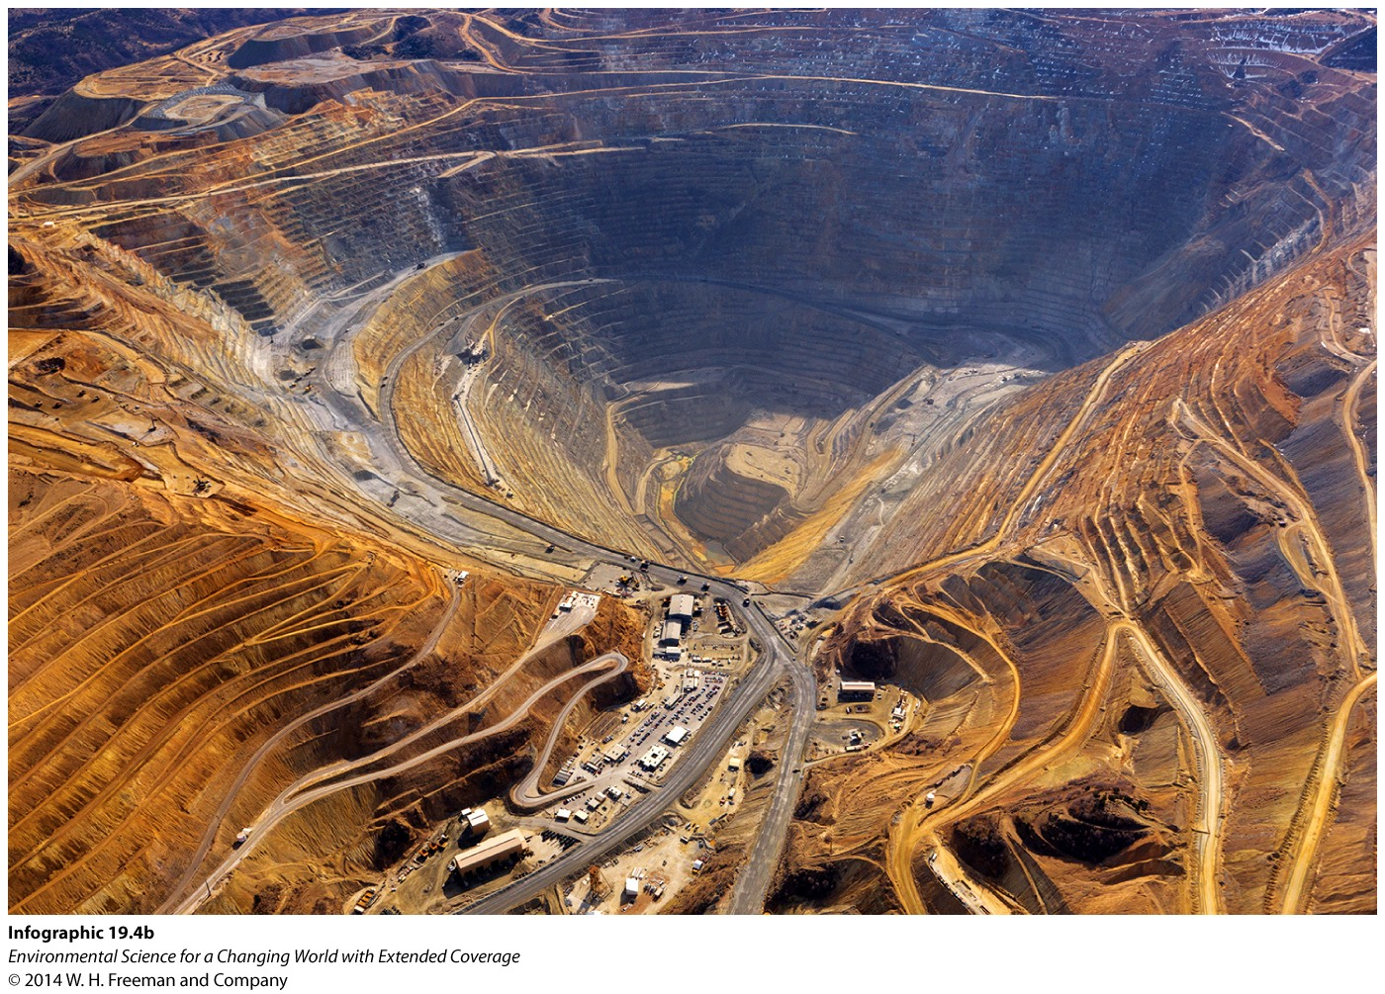
Open-pit mining is used when the top of an ore deposit is close to the surface. Drilling and blasting loosen the rock.

Slide 38
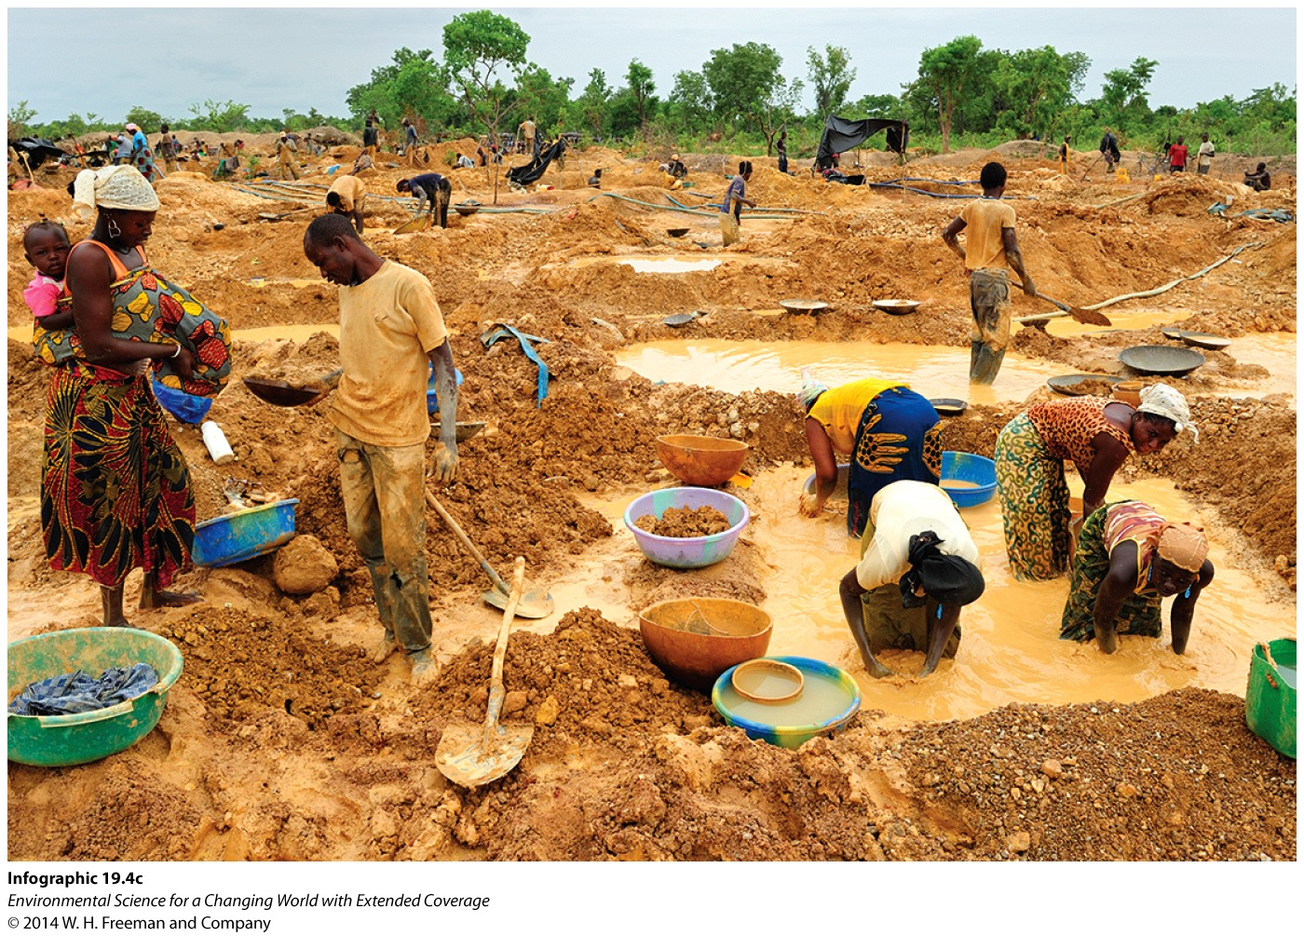
Placer mining is used when sediments contain heavy metals like gold.

Slide 39
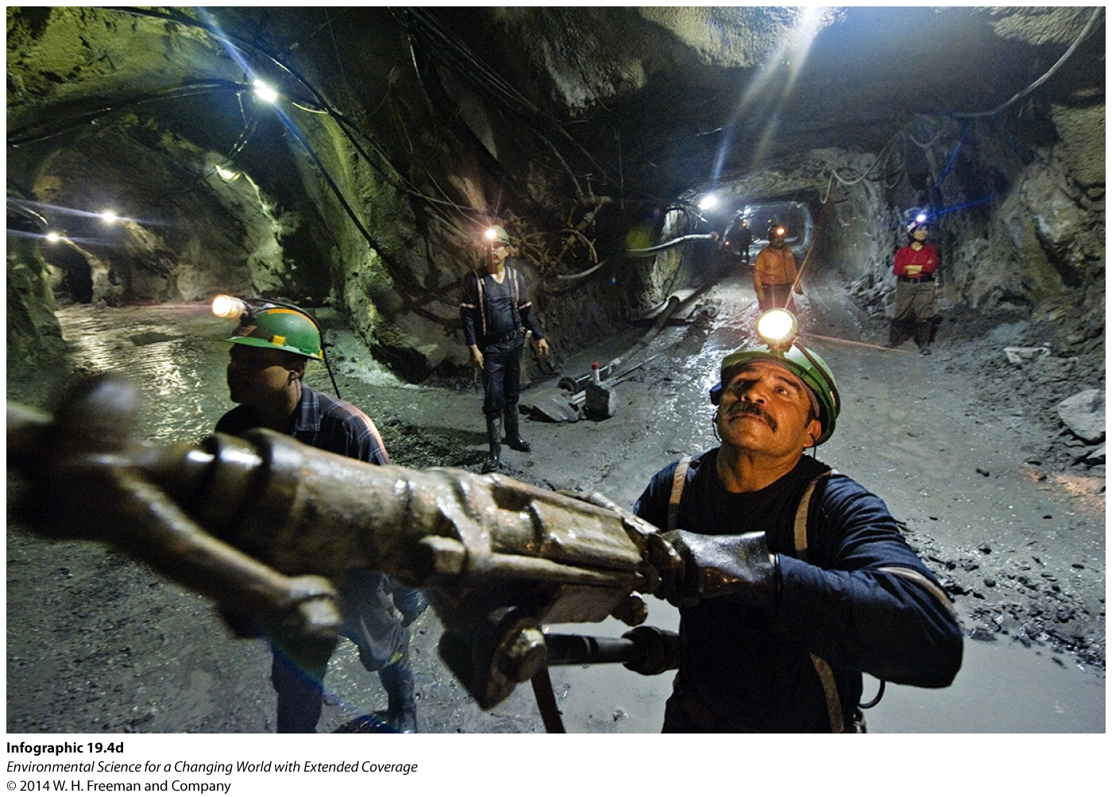
Subsurface mining is used when deposits are deep underground or in mountainous areas.

Slide 40
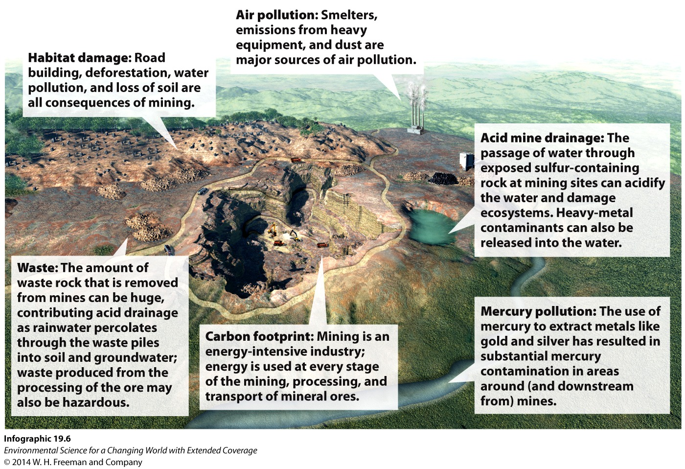

Slide 41
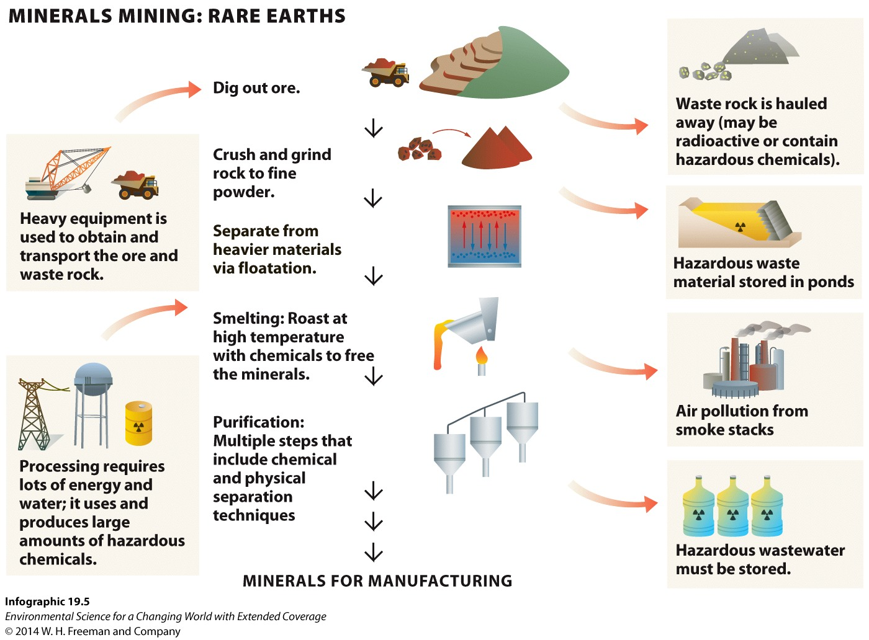

Slide 42
Mining also comes with
significant social impacts.

Slide 43
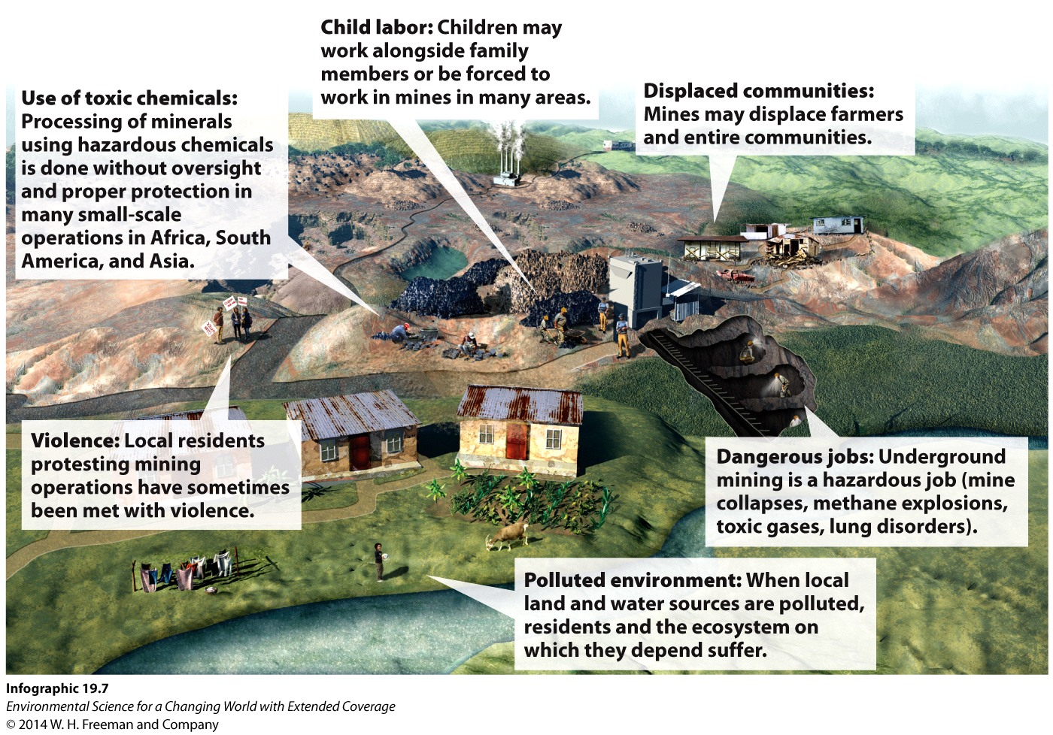

Slide 44
“The real question is not ‘do
we have enough [mineral resources],’ but rather ‘how far are we willing to go to access what we know is there?”
-George Rossman, geologist,
California Institute of Technology

Slide 45
We can minimize mining impacts through conservation.

Slide 46
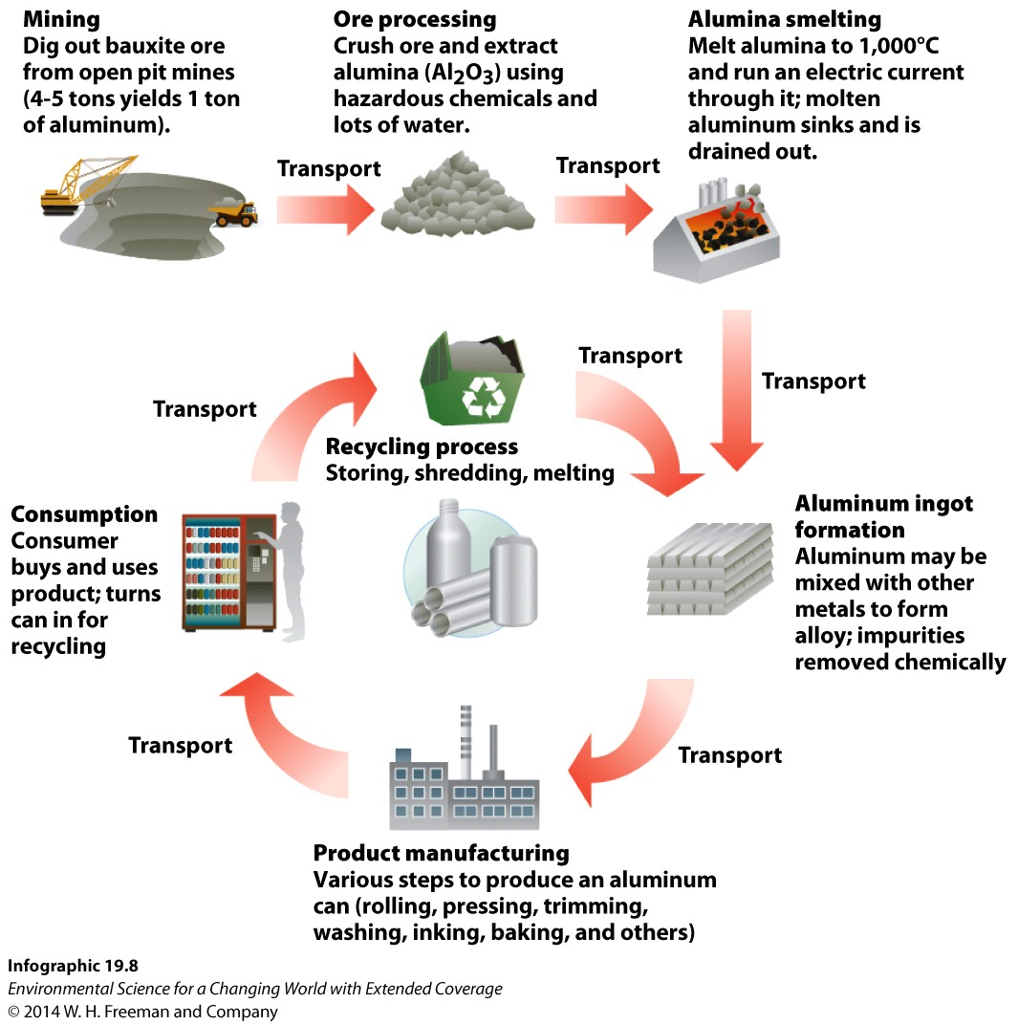
Aluminum Recycling: A Success Story

Slide 47
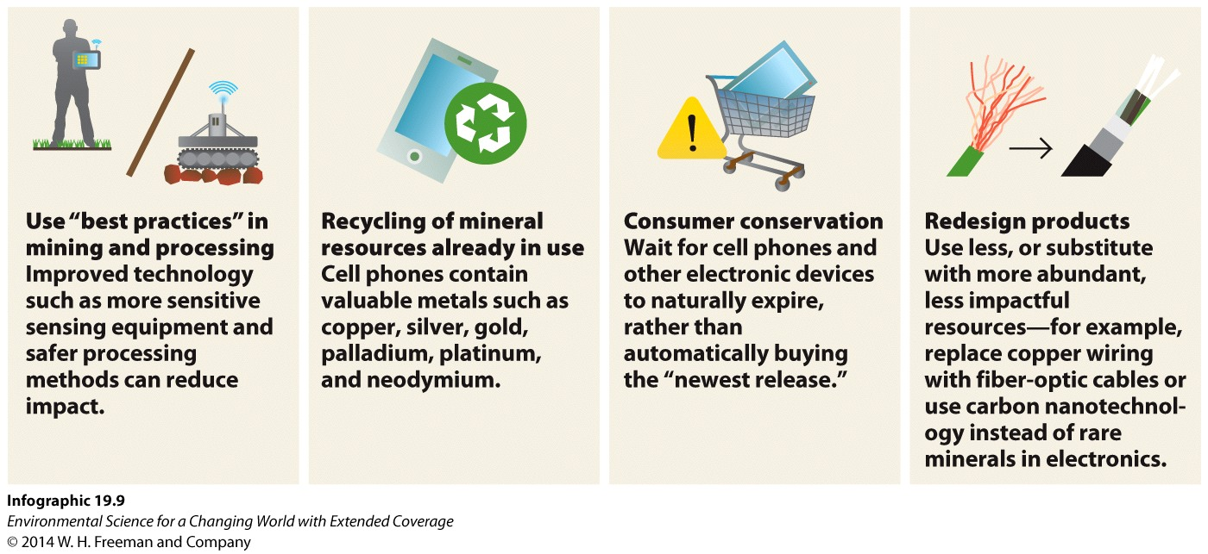
Alternatives That Reduce Our Use of Mineral Resources:

Slide 48
“We’ve gone kind of upgrade mad in this country. If we used our cell phones and laptops until they naturally expired … we could really make a difference.”
-Brendan Cummings,
environmental attorney,
Center for Biological Diversity

Slide 49
Talk about landfill mining a bit

Slide 50
Cell phones?
https://www.acs.org/content/acs/en/education/resources/highschool/chemmatters/past-issues/archive-2014-2015/smartphones.html
http://gizmodo.com/the-metals-in-your-phone-arent-just-rare-theyre-irre-1477904295
Recycle that stuff! http://www.electronicproducts.com/Computer_Systems/Standalone_Mobile/How_much_precious_metal_is_in_your_iPhone.aspx

