Slide 1
Groundwater
Water stored in soils or rocks.
Soils – vadose and saturated zones.
But wait, aren’t rocks solid?
Nope. Pore spaces, fractures, caves, all sorts of stuff.
Discuss porosity, permeability, and sorts of rocks which have fractures, caves, etc.

Slide 2
Aquifer!
Rock layer with enough water that moves fast enough for humans to pump/use.
High porosity/permeability

Slide 3
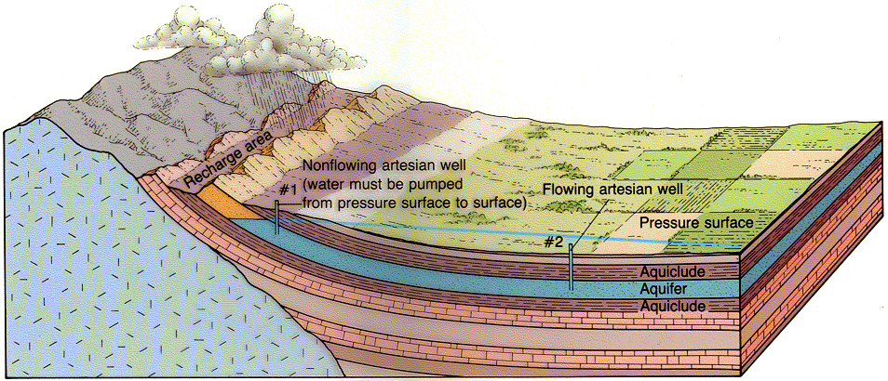
Aquifers and aquicludes

Slide 4
Terms to know
Aquifer, aquiclude, confined aquifer, artesian well, permeability, porosity, cone of depression.

Slide 5
Not a cone of depression

Slide 8
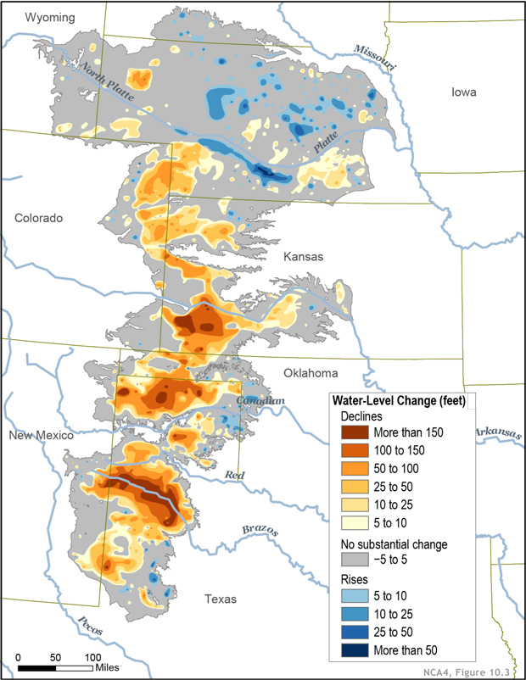
Ogalla aquifer
https://www.climate.gov/news-features/featured-images/national-climate-assessment-great-plains%E2%80%99-ogallala-aquifer-drying-out
https://www.myhighplains.com/water-and-drought-on-the-high-plains/the-ogallala-aquifer-when-will-the-wells-run-dry-what-then/
https://www.youtube.com/watch?v=XXFsS94HF08
https://www.scientificamerican.com/article/the-ogallala-aquifer/

Slide 9
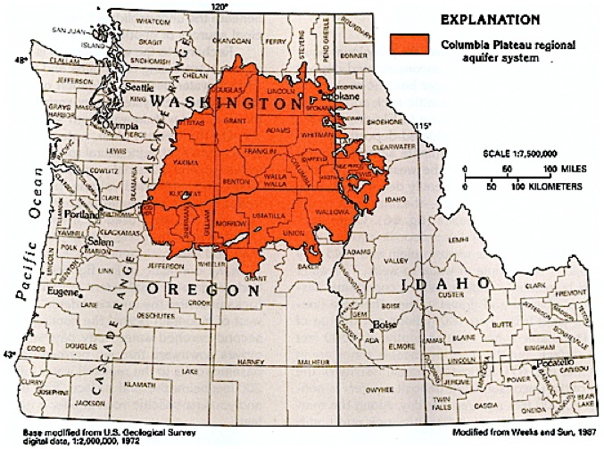
https://www.spokesman.com/stories/2013/feb/06/columbia-plateau-aquifers-declining/

Slide 10
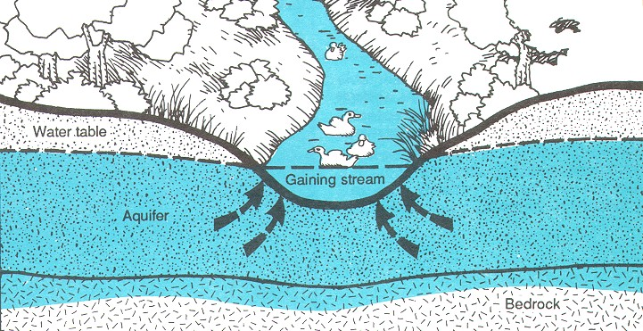
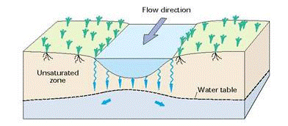
Connecting streams and groundwater

Slide 11
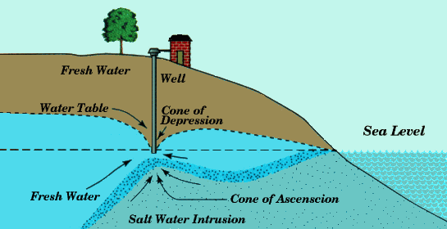
Issues with coastal aquifers

Slide 12
https://www.nytimes.com/2023/09/29/us/new-orleans-saltwater-intrusion.html

Slide 13
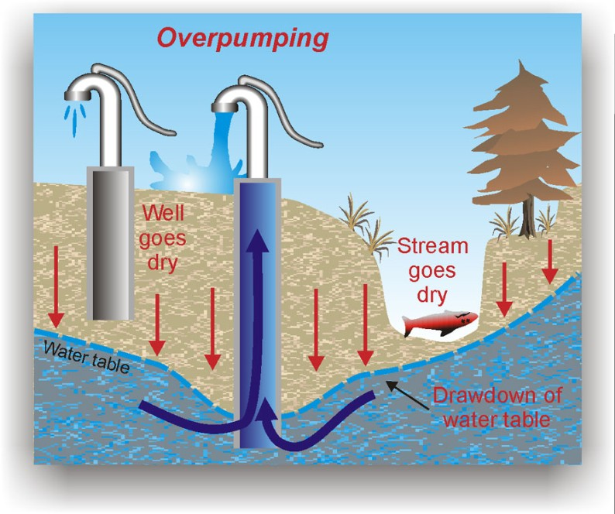
overpumping

Slide 14
https://www.nytimes.com/interactive/2023/08/28/climate/groundwater-drying-climate-change.html

Slide 15
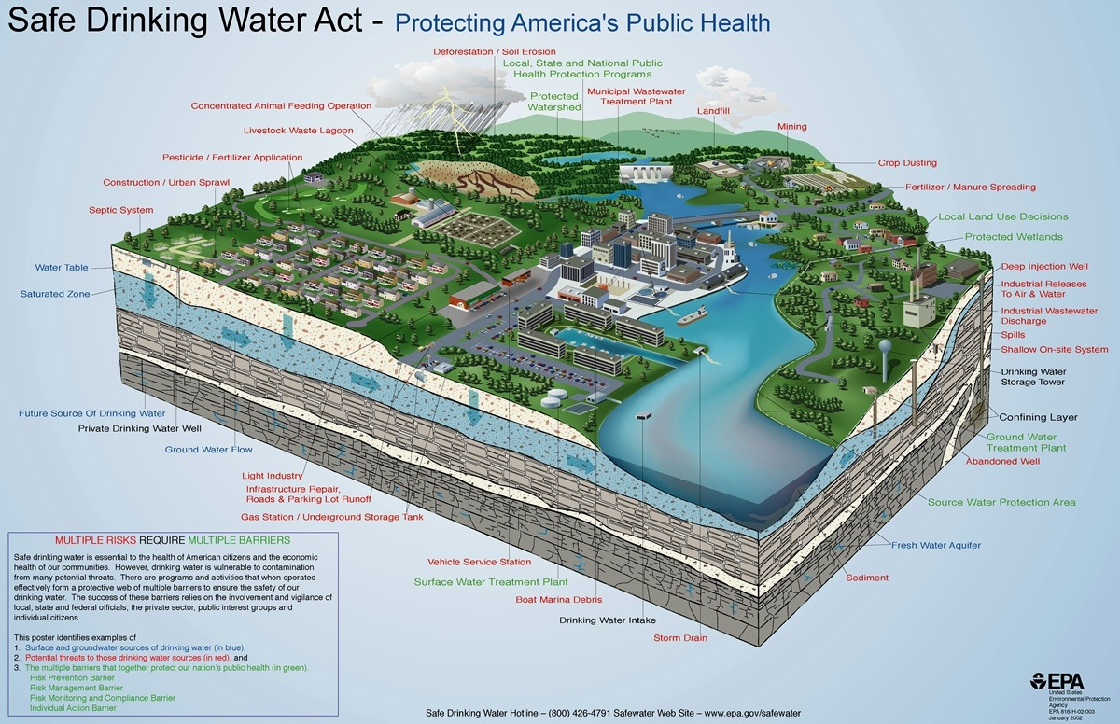
http://www.provo.org/home/showdocument?id=2062

Slide 16
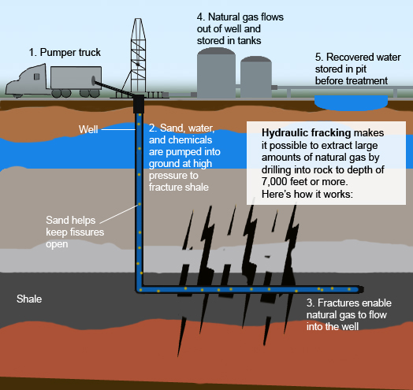
What about fracking?

Slide 17
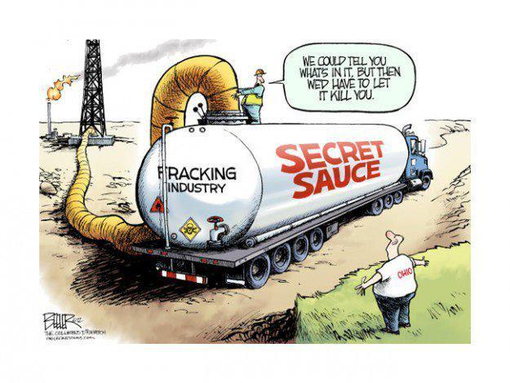
So?
Contamination of aquifers
Drilling fluid itself
methane

Slide 18
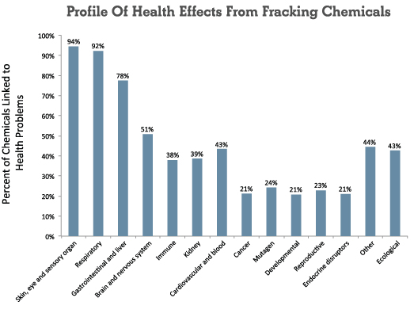

Slide 19
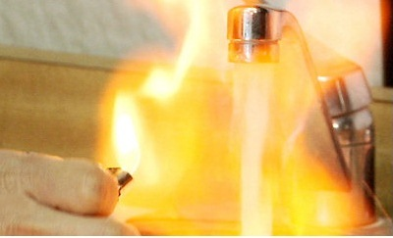

Slide 20
https://www.scientificamerican.com/article/fracking-can-contaminate-drinking-water/ Definitely read this article.
https://www.ncbi.nlm.nih.gov/books/NBK201899/
https://www.marketplace.org/2016/12/13/sustainability/epa-reverses-stance-fracking-drinking-water

Slide 21
And, of course, earthquakes
http://www.commondreams.org/news/2015/04/23/fracking-induced-earthquakes-highlighted-new-usgs-map

Slide 22
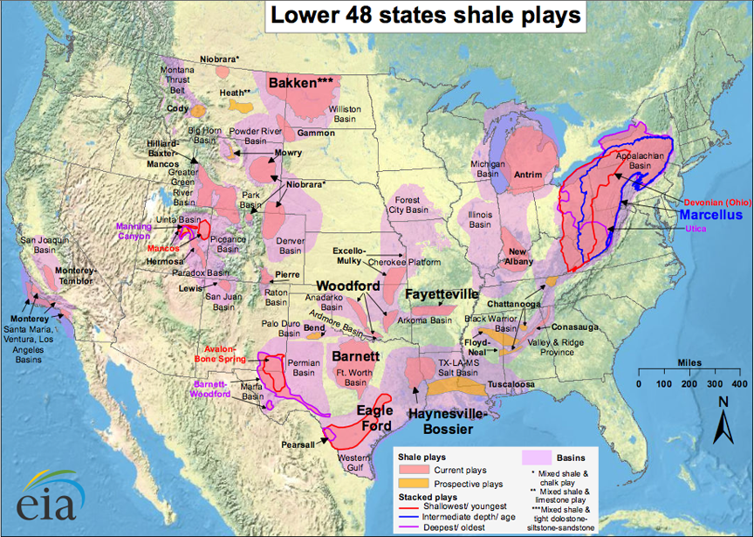

Slide 23
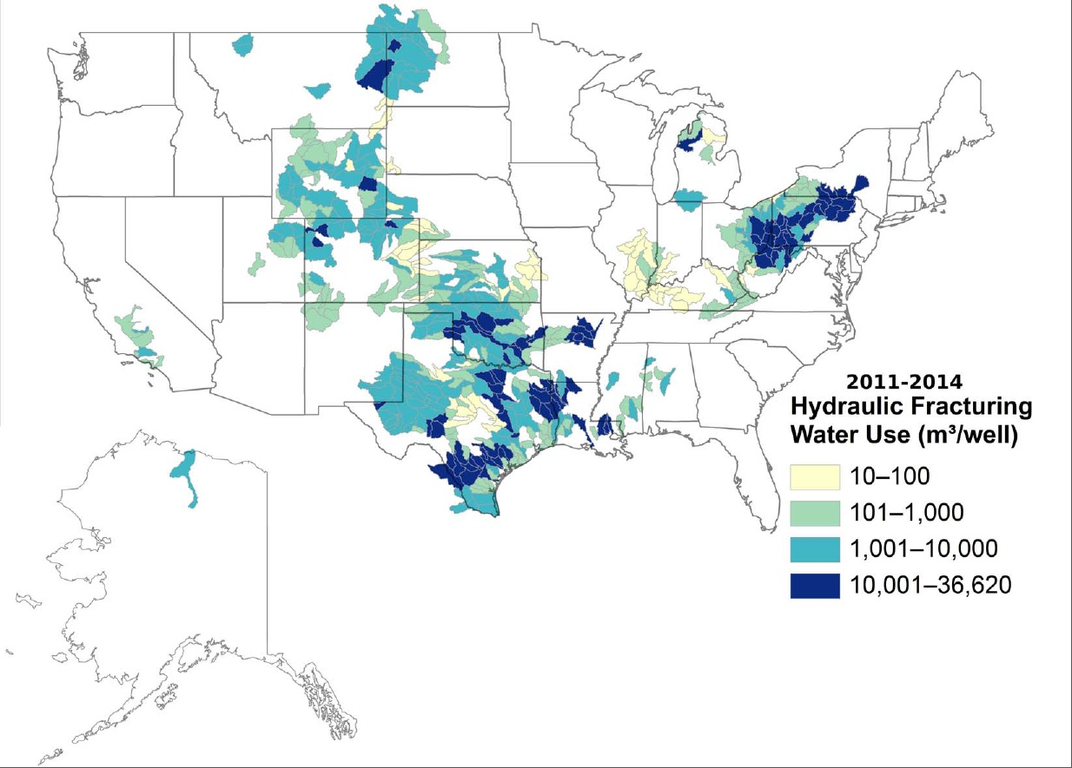

Slide 24
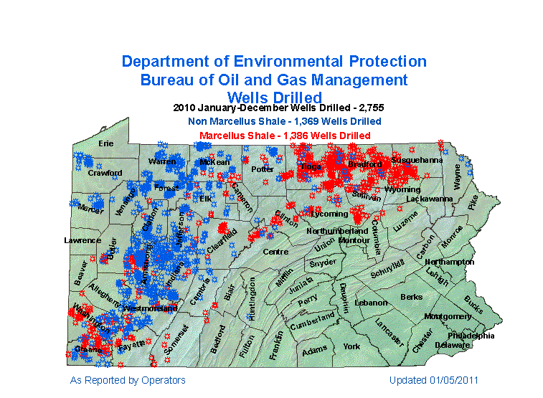

Slide 25
Today’s oil price: http://www.nasdaq.com/markets/crude-oil.aspx
Cost to produce: http://money.cnn.com/interactive/economy/the-cost-to-produce-a-barrel-of-oil/index.html?iid=EL

