Slide 1
Water!
Here we start looking at the interface between the atmosphere and geology. Which will be the focus for the rest of the quarter.

Slide 2
Newsbreak: we mentioned the importance of water yesterday: http://www.iflscience.com/environment/cape-town-might-soon-become-the-first-city-in-the-world-to-run-out-of-water/
https://www.cnn.com/2020/10/05/weather/cape-town-celebration-water-drought/index.html
https://www.unep.org/news-and-stories/story/climate-dries-american-west-faces-power-and-water-shortages-experts-warn
https://www.thetrumpet.com/26080-the-western-us-is-running-out-of-water
https://www.cnn.com/2022/07/10/us/west-water-crisis-property-rights-climate/index.html

Slide 3
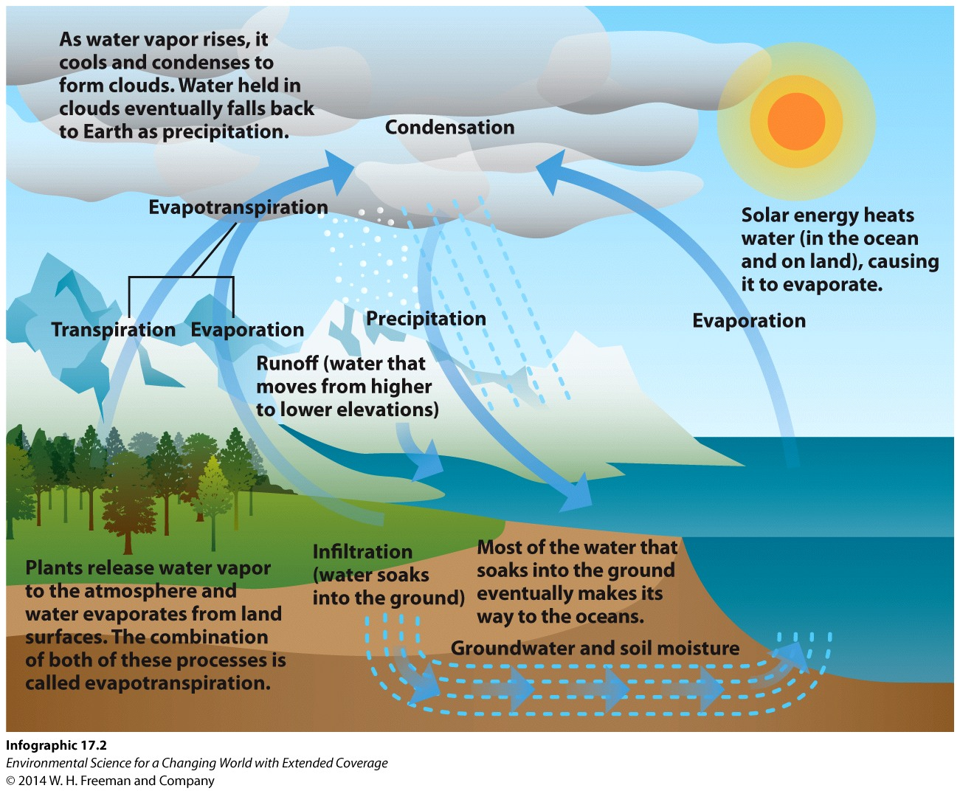
Water cycle. Know all the terms on this figure.

Slide 4
Surface water is any body of water found above ground, such as oceans, rivers, and lakes.
Groundwater is found below the surface of the earth
Atmospheric water is in the atmosphere.
Notes:
Answer: C

Slide 5
Fresh water
Basically, anything liquid or ice that isn’t too salty to use.
We also include atmospheric water, though by volume, it isn’t much.

Slide 6
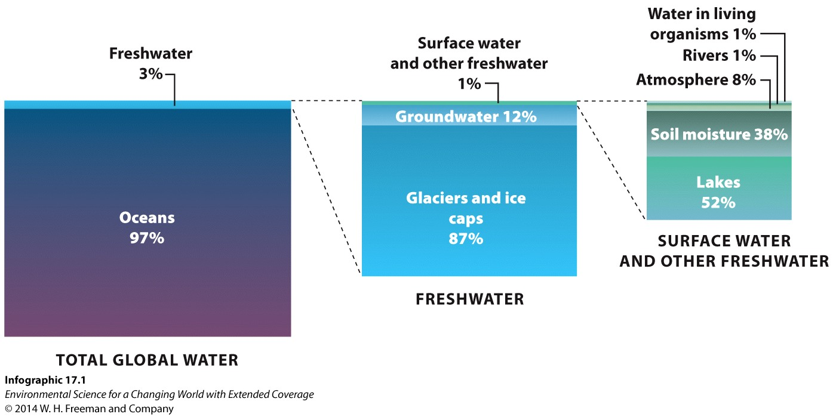
Nearly 80 percent of the freshwater on the planet is trapped in ice caps and glaciers.

Slide 7
Almost all precipitation falls in
the oceans. But a tiny amount falls on land, which is what humans can access.

Slide 8
Although 75 percent of Earth’s surface is covered by water, only 1/100 of 1 percent of that water is useable by humans.

Slide 9
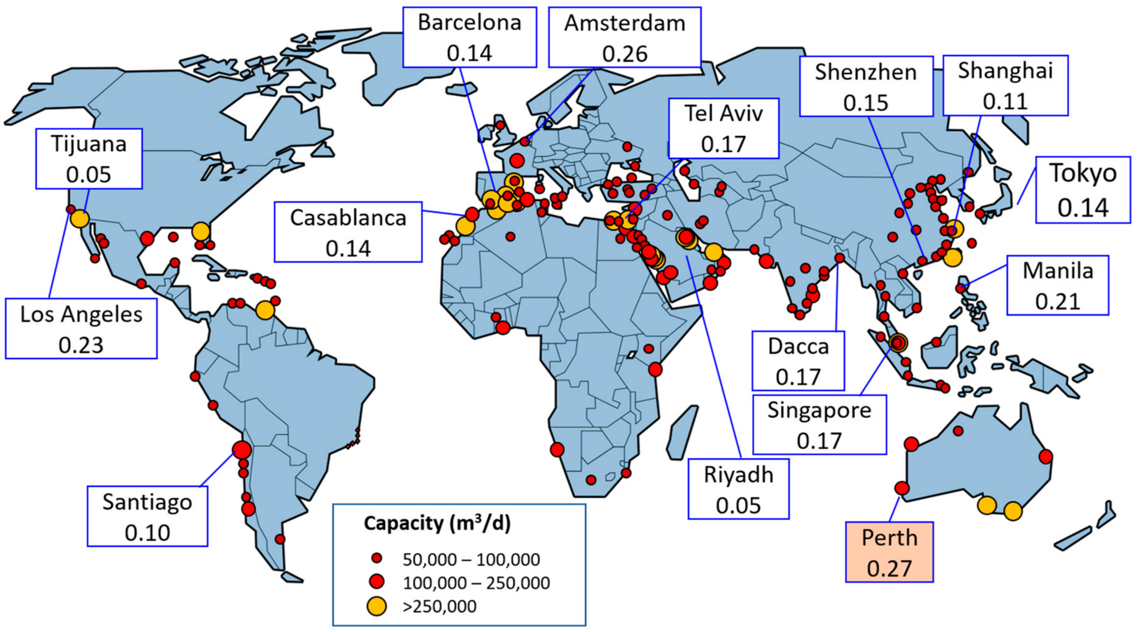
Major desalinization plants. 2020

Slide 10
http://pmm.nasa.gov/education/videos/earths-water-cycle

Slide 11
We’ve already talked about oceans a bit. Howsabout streams?
(and lakes) – basically, any surface water.
Ephemeral (only water during occasional rains)
Intermittent (wet and dry seasons)
Perennial (water all year)
Some important concepts
Start with stream evolution
Small, high velocity in mountains
Carves a floodplain
Eventually, a mature stream with a large floodplain

Slide 12
Youthful stream: V shaped valley, stream occupies all of valley bottom. Straight.
Mature stream – floodplain developed. Meanders utilize most of floodplain
Old age – floodplain MUCH larger than meanders (stream uses only a small part of the floodplain.

Slide 13
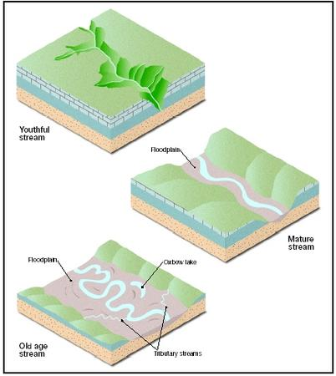
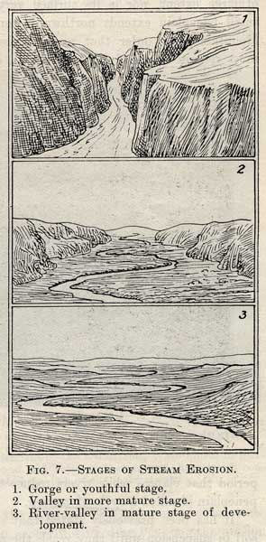

Slide 14
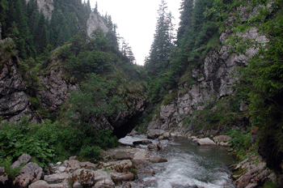
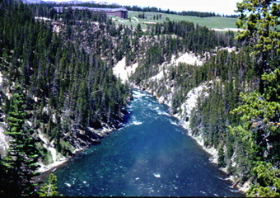
Youth!

Slide 15
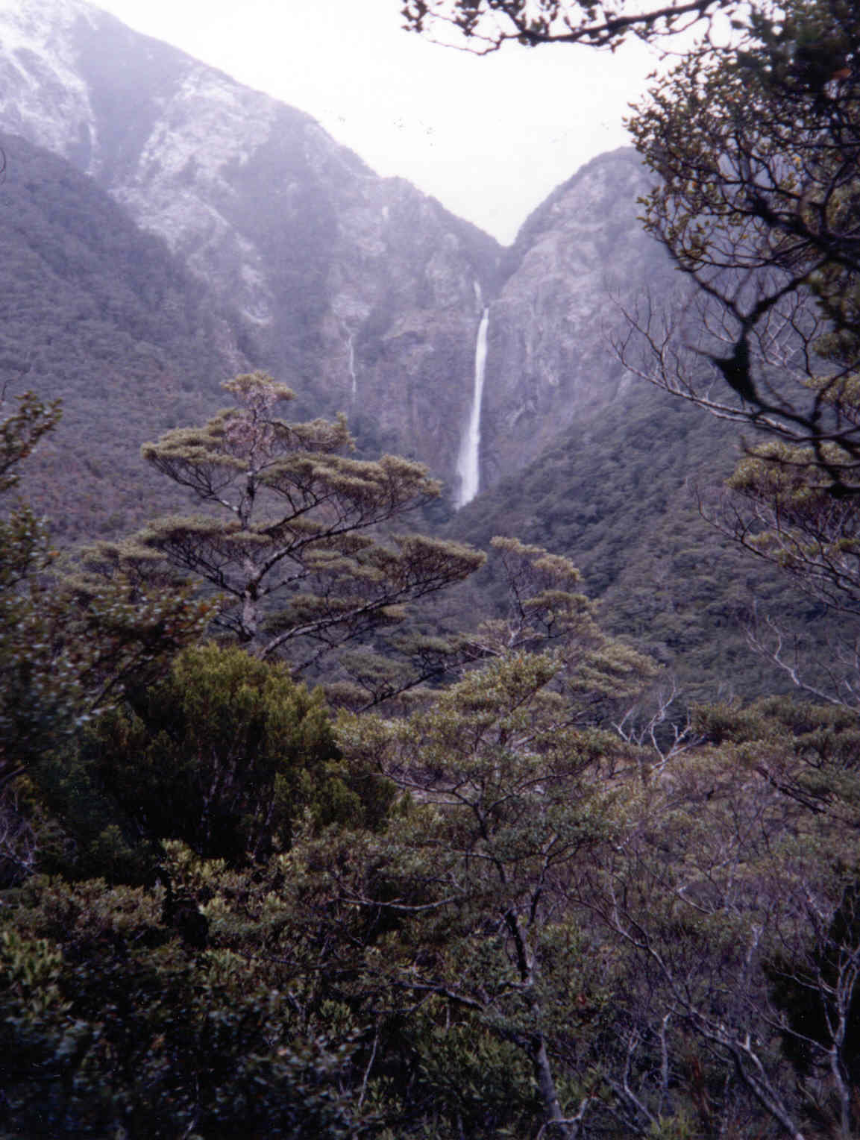

Slide 16
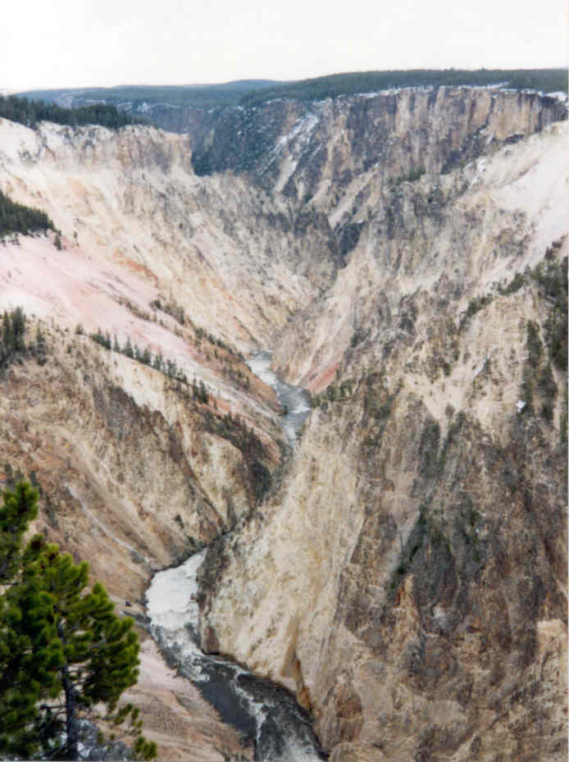

Slide 18
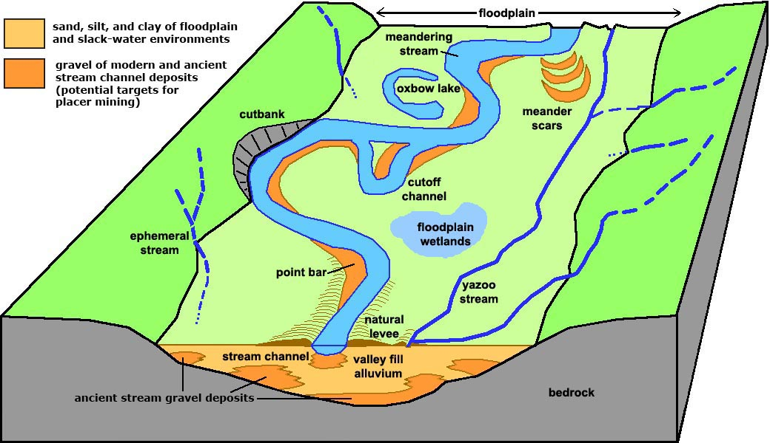
mature

Slide 19
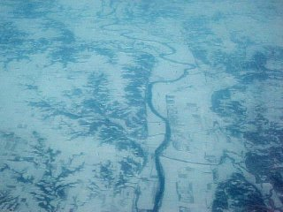
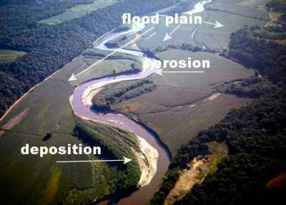
Mature 2

Slide 22
Old age
The Mississippi is probably the best example in the US.

Slide 23
Parts to a stream
V-shaped valley
Floodplain
Meanders
Oxbow lakes
Meander scars
Levees
Entrenched meanders
GE – go look at examples of all these.

Slide 24
Head to GE and look at examples of stream types.

Slide 25
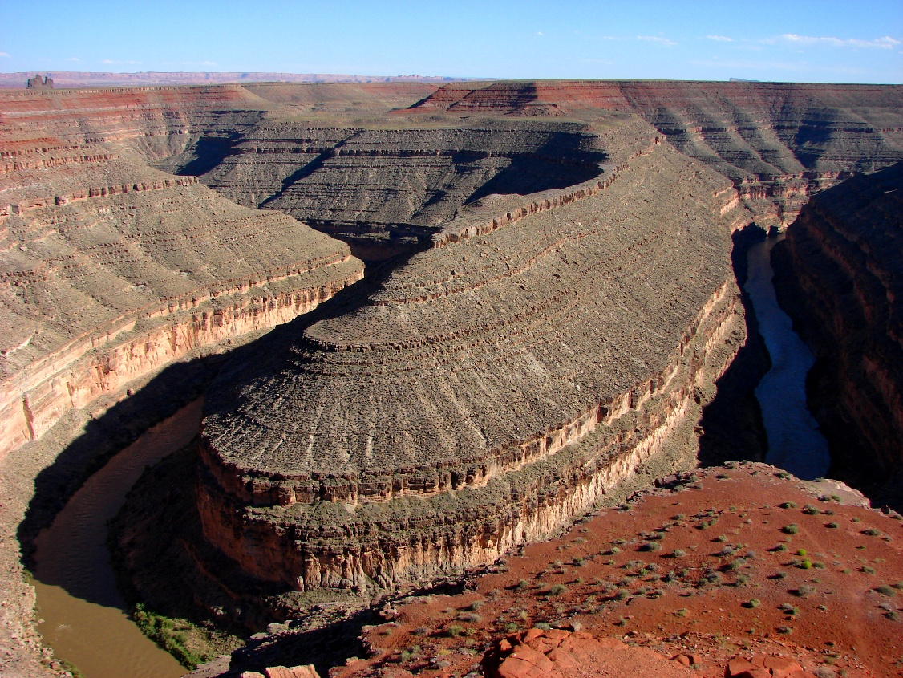
Entrenched meanders. San Juan River, UT

Slide 27
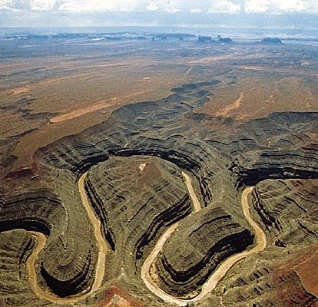
GE. San Juan river, UT. Canyonlands. Grand Canyon.
All called river rejuvenation – thank plate tectonics!

Slide 28
Stream gradient
Slope. Rise/run. The steeper the slope, the faster the stream.
Also known as the stream gradient.

Slide 29
Velocity within a stream
three variables
Stream gradient
Curvature
friction

Slide 30
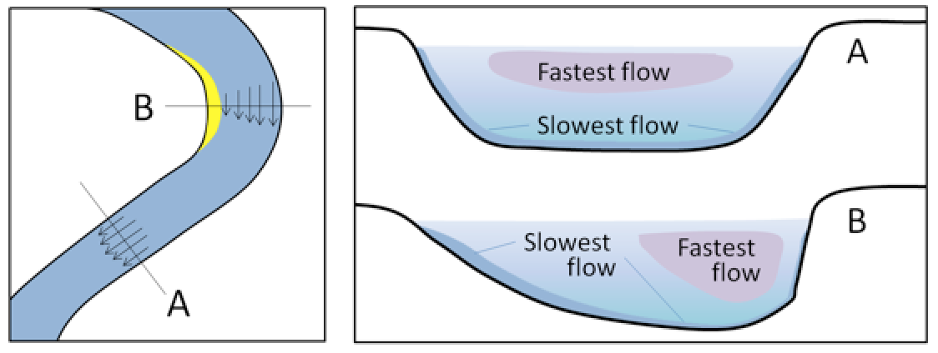

Slide 31
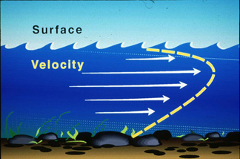
Explain pattern of stream velocity and why.

Slide 32
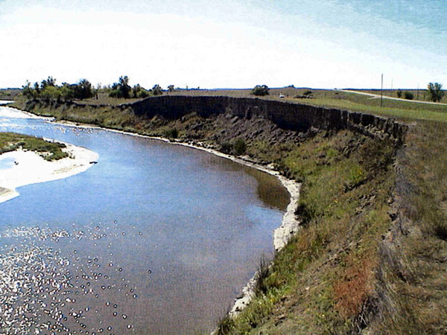
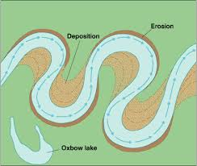
Cut banks and point bars.

Slide 33
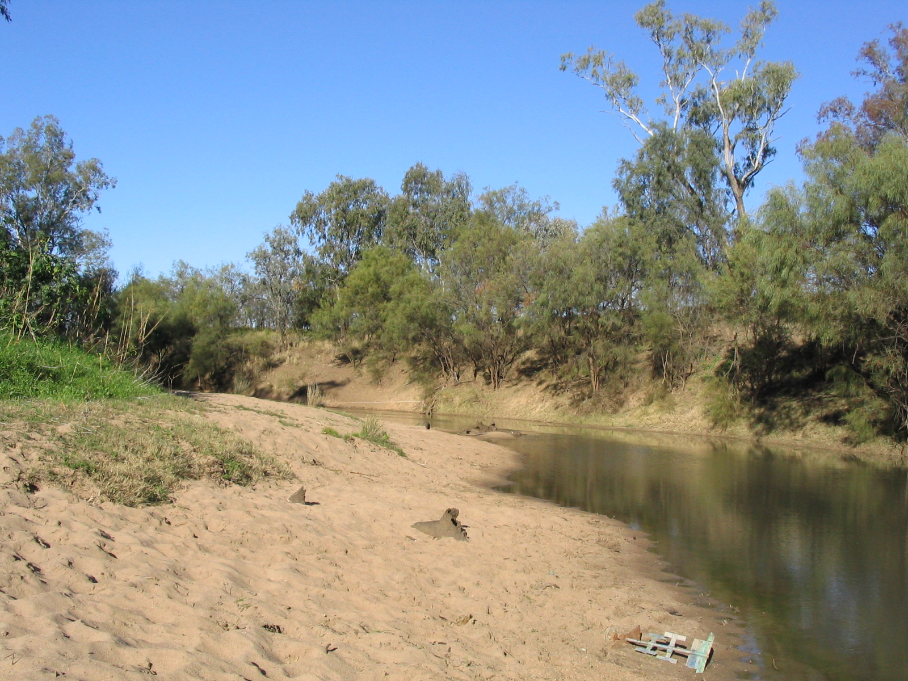

Slide 35
Some more GE.

Slide 36
Sediment load
Dissolved load
Suspended load
Bed load
Rolling
saltation

Slide 37
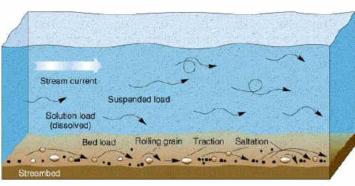
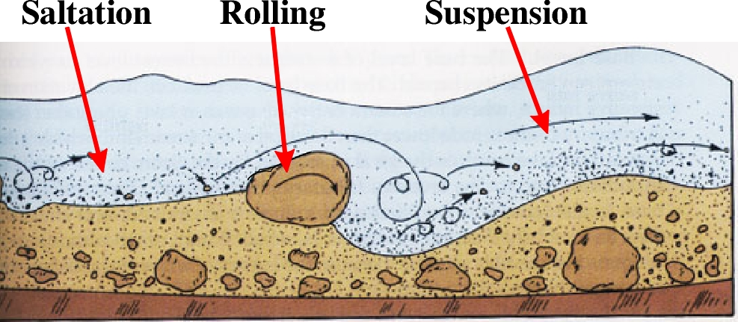

Slide 38
The size of the particles at the bottom of the stream tells you a lot about how fast a stream can/does move. Particularly, max speed.

Slide 39
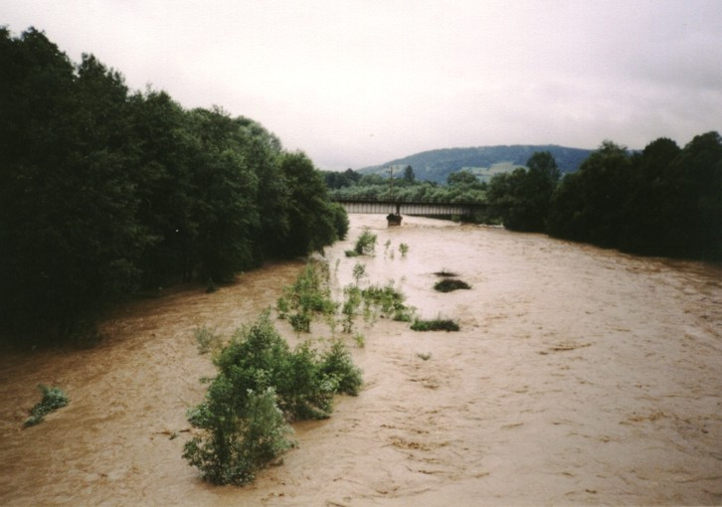

Slide 40
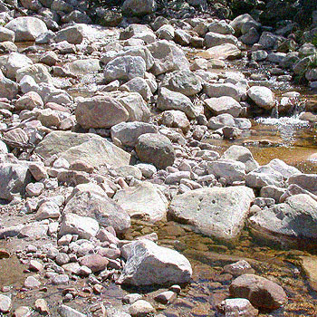
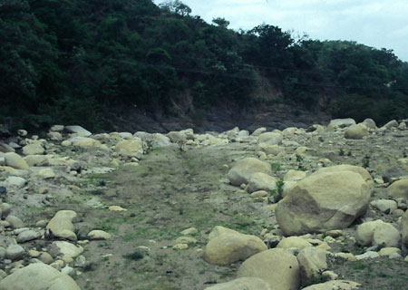

Slide 41
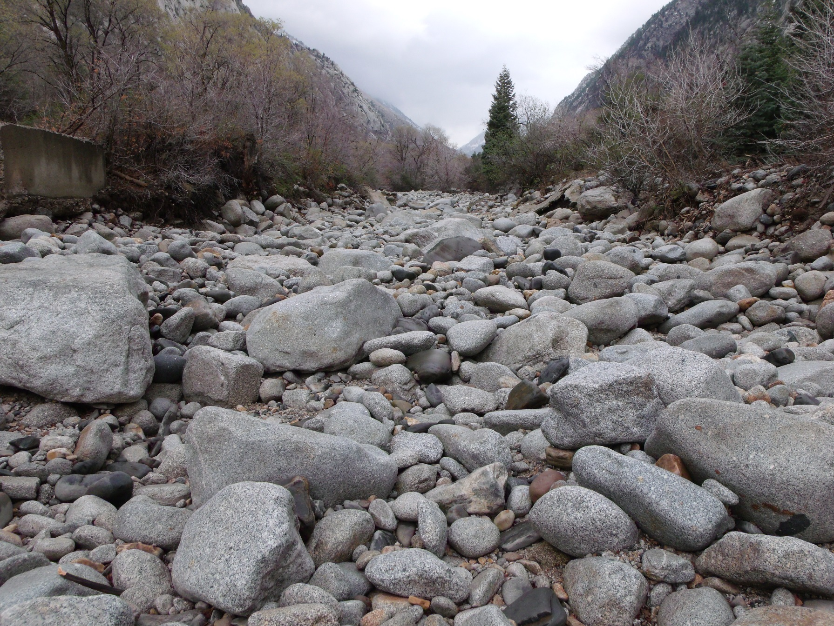
How do I know these are stream transported?

Slide 42
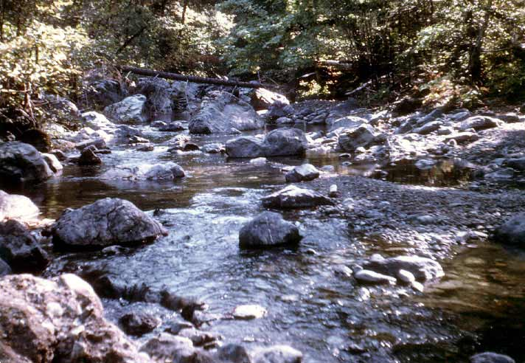

Slide 43
Potholes!

Slide 46
FLOODS!!!!
Yup. Rivers flood. It’s natural and normal. Though, probably becoming more normal as extreme weather increases. Why is this?

Slide 47
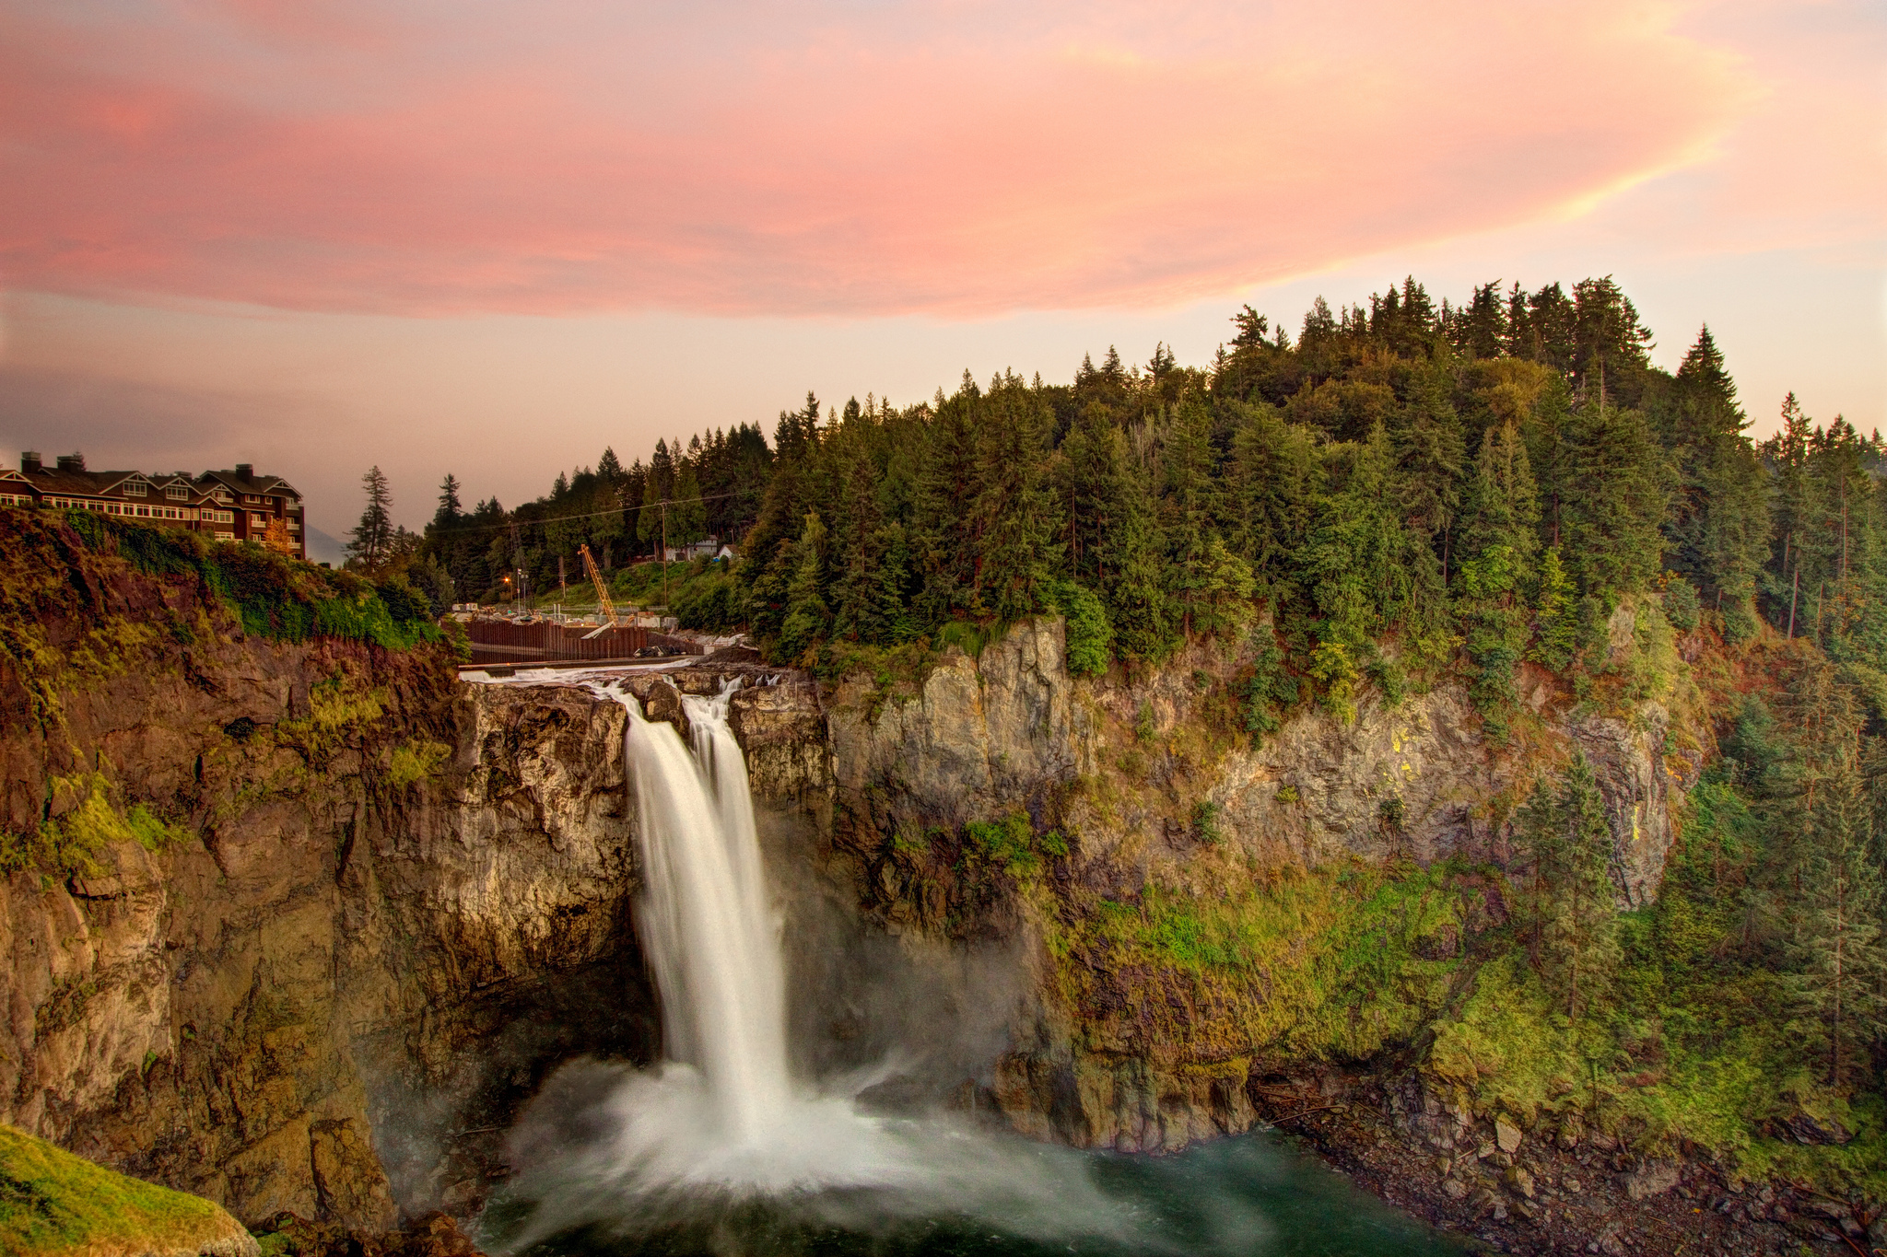

Slide 48
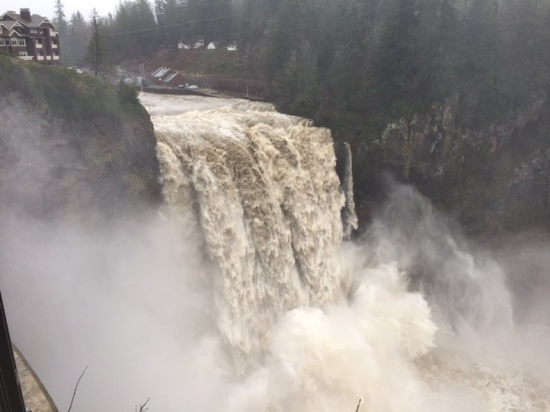
Jan. 2015

Slide 49
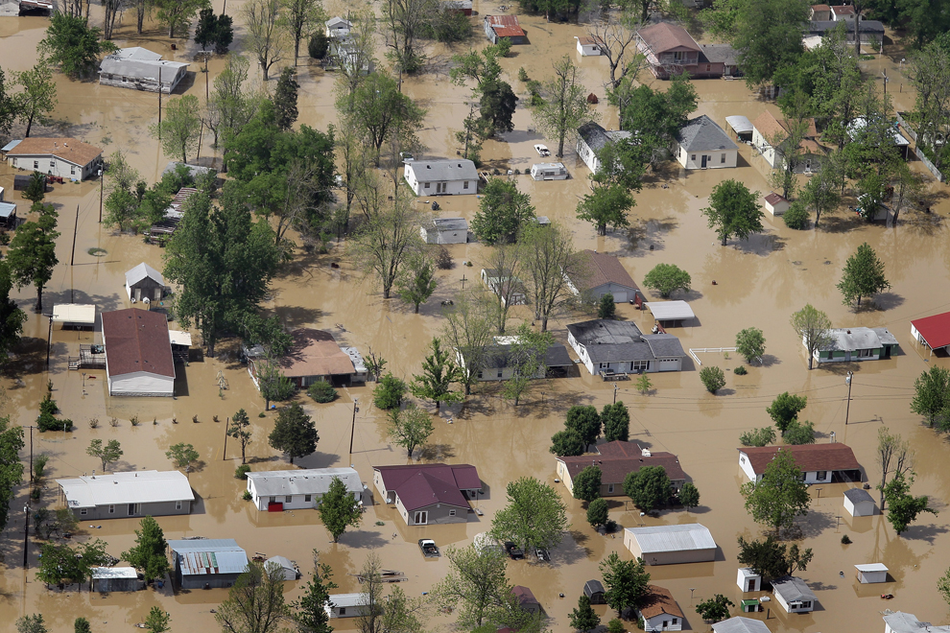
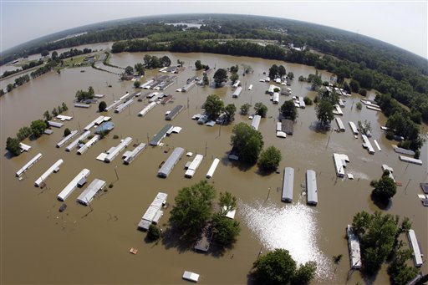

Slide 50
http://earthobservatory.nasa.gov/IOTD/view.php?id=5422
Check out the GE files there.
https://weather.com/news/weather/news/flooded-mississippi-meramec-rivers-satellite-nasa (2015/2016)

Slide 51
But what about gorgeous Venice?

Slide 54
Then there was the winter of 2012

Slide 57
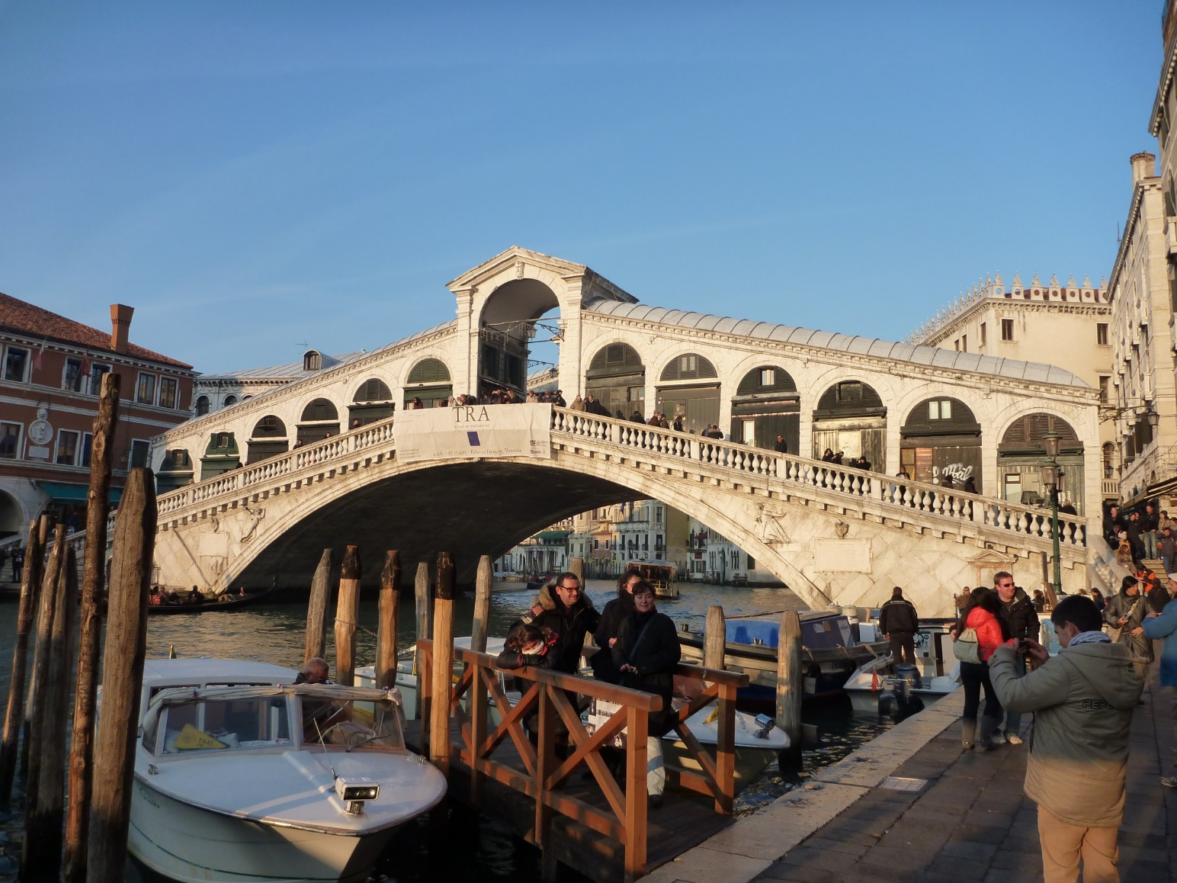

Slide 59
And then there’s CA.
10-day storm. Feb 1986
Start at the Russian River, then on to the
Feather,Yuba/American rivers

Slide 79
Oroville Dam. CA. 2017
Go there in GE first
https://nypost.com/2017/02/14/nearly-200000-face-pure-chaos-after-california-dam-breach/
https://www.newsdeeply.com/water/articles/2017/06/14/oroville-dam-incident-explained-what-happened-why-and-whats-next
https://www.sfchronicle.com/bayarea/article/Riverbanks-collapse-after-Oroville-Dam-spillway-10976144.php

Slide 80
Chehalis flood 2007
Go there on GE first
Google images
https://www.seattletimes.com/seattle-news/did-development-logging-set-the-stage-for-disaster/

Slide 82
Drainage patterns

Slide 83
Dendritic
Trellis
Rectangular
Radial
Annular
Deranged
braided

Slide 84
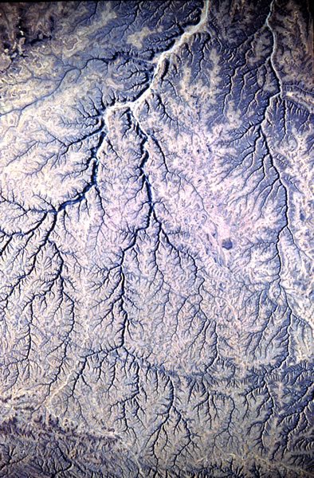
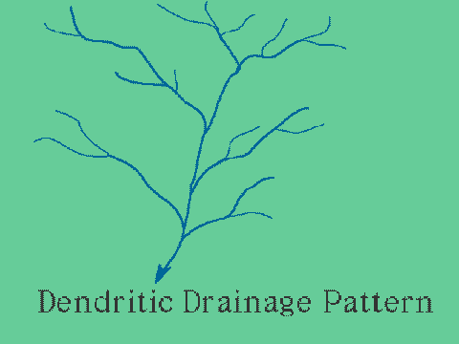
dendritic

Slide 85
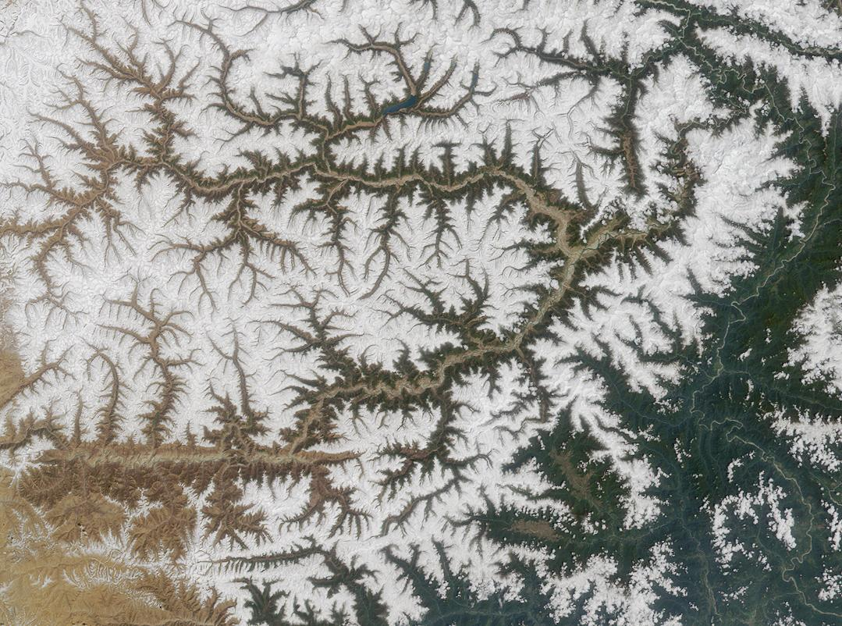

Slide 86
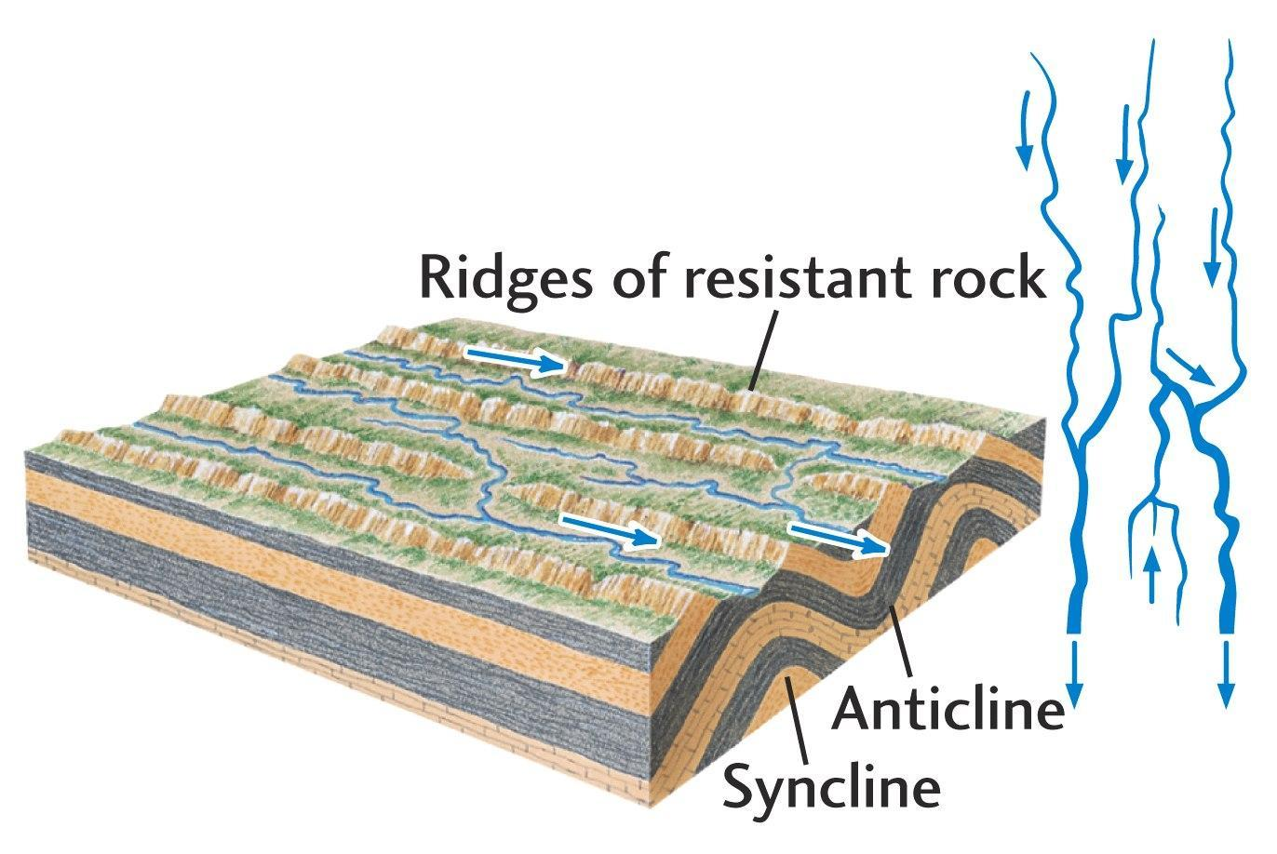
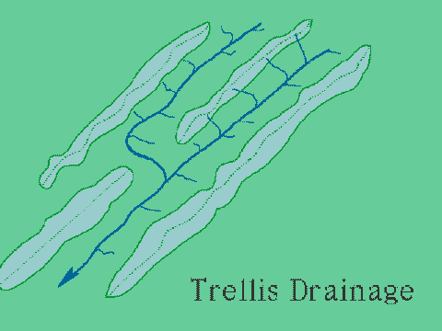
Trellis

Slide 87
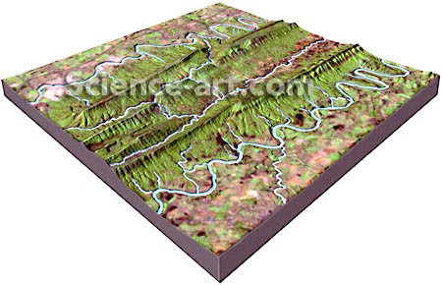

Slide 88
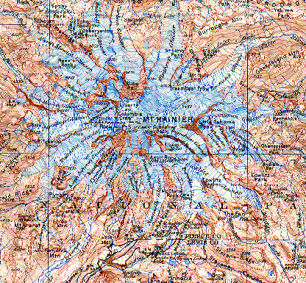
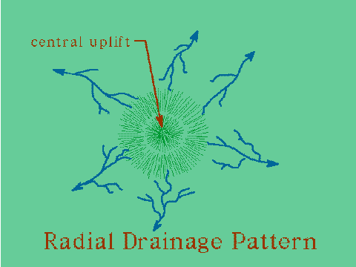
radial

Slide 89
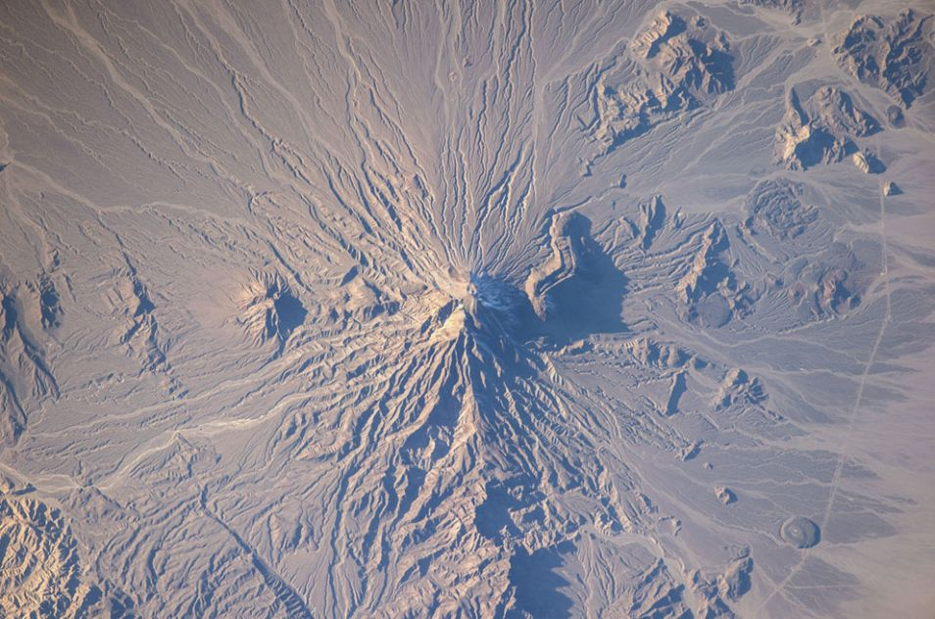

Slide 90
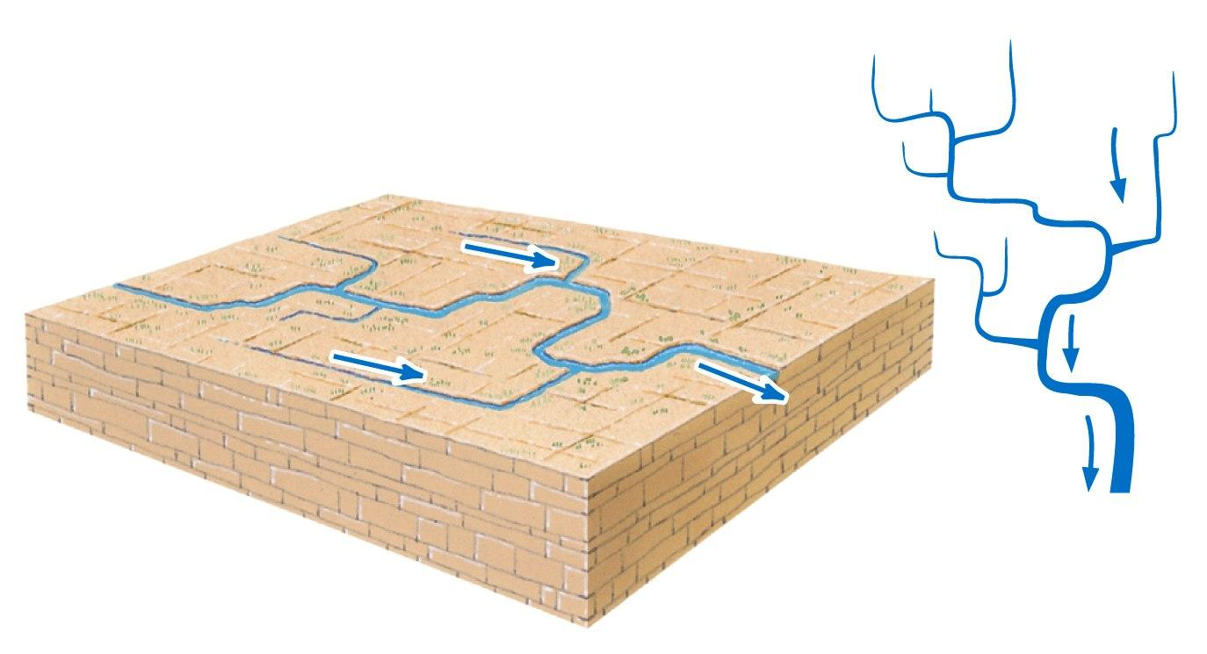
rectangular

Slide 91
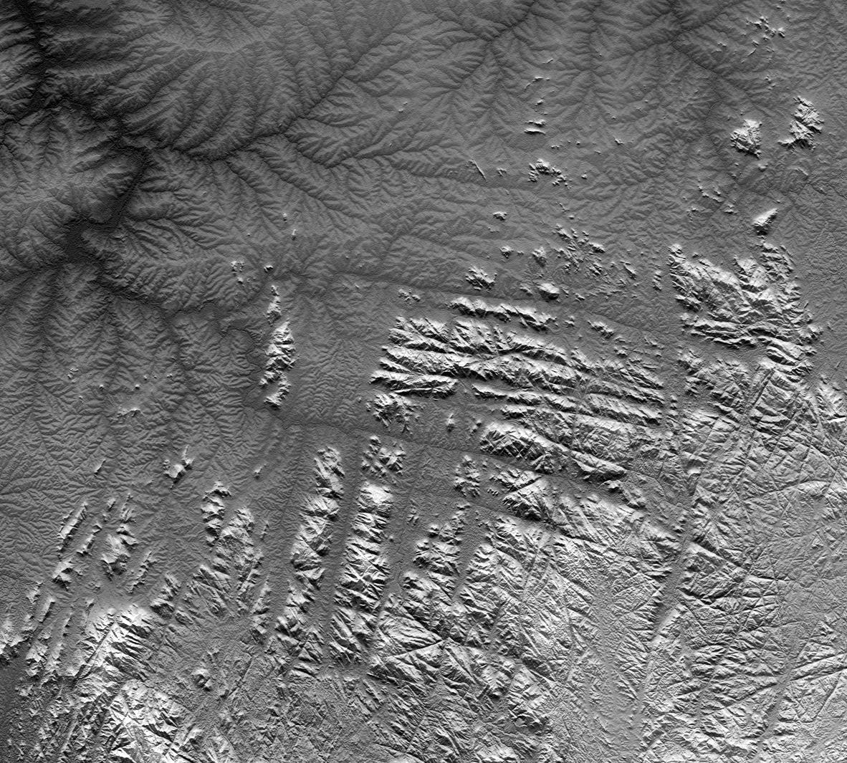
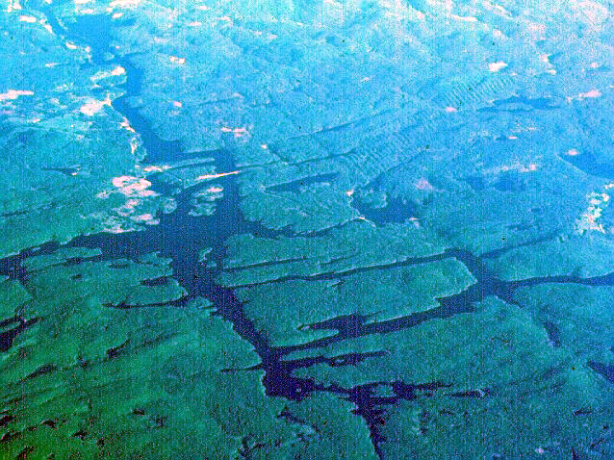

Slide 92
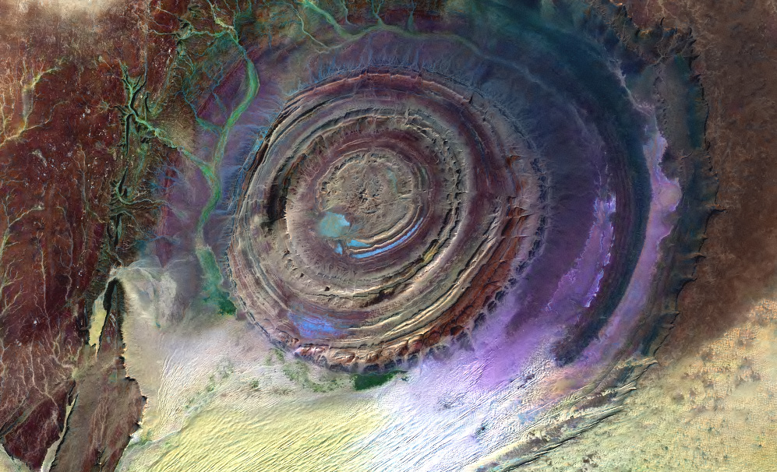
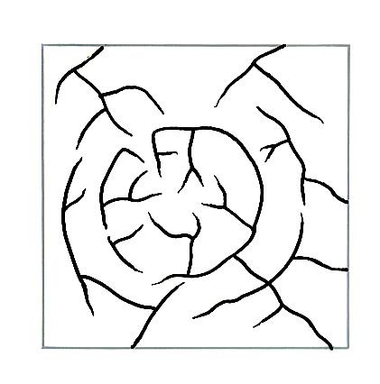
Annular
Mauritania. Salt?

Slide 93
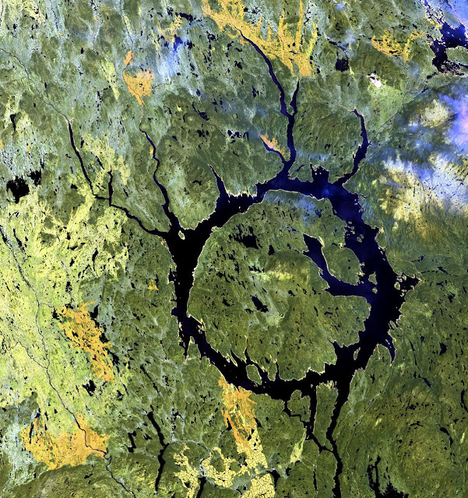
N. Quebec Manicouagan Lake

Slide 94
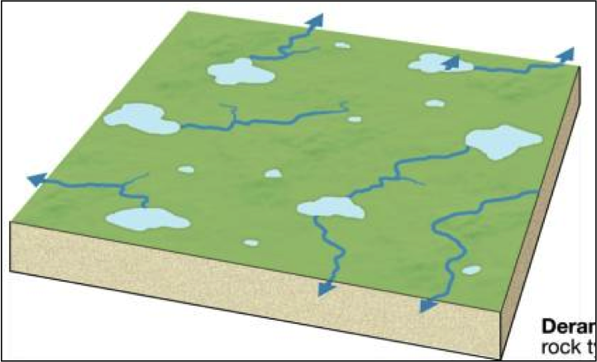
deranged

Slide 95
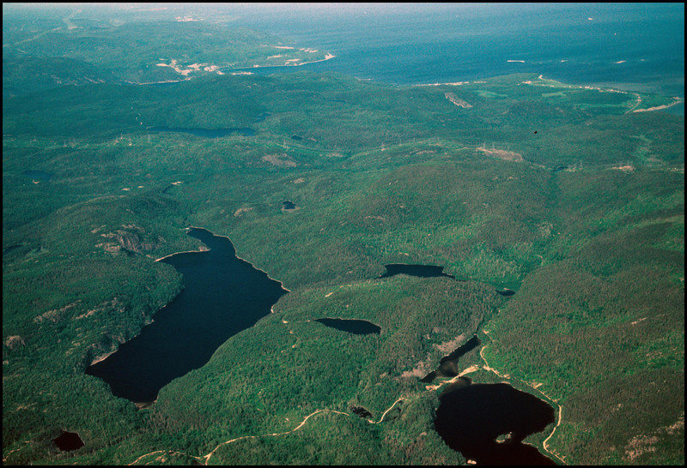
Canadian shield
Minnesota/Michigan glaciated areas

Slide 96
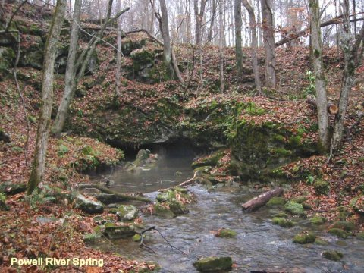
Karst topography
Disappearing/reappearing streams
Limestone regions.

Slide 97
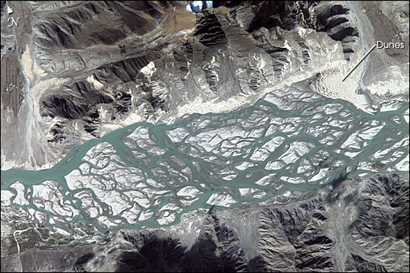
Braided streams – channel pattern

