Slide 1
Earthquakes
http://earthquake.usgs.gov/earthquakes/map/
https://earthquake.usgs.gov/ (all kinds of great earthquake info)
https://earthquake.usgs.gov/earthquakes/feed/v1.0/kml.php

Slide 2
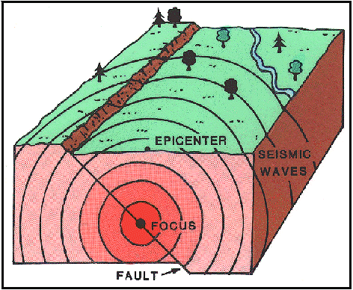
Energy release caused by shifts in the earth’s crust
Plate tectonics. Tie to types of plate interactions. Largest at subduction zones.
Humans: lakes, fracking, nukes, mining
Epicenter (location above the focus)
Focus (where it happens)

Slide 3
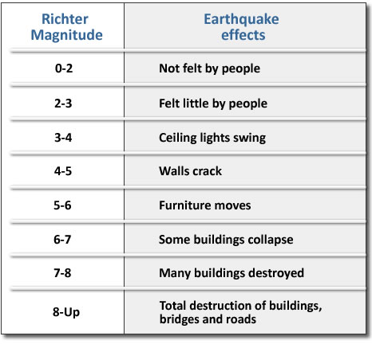
Measuring!
Richter scale. Log scale, 1-10
Below 3, pretty much you can’t feel them
3-7, the earth moves for you
7+ Danger zone, depending….

Slide 4
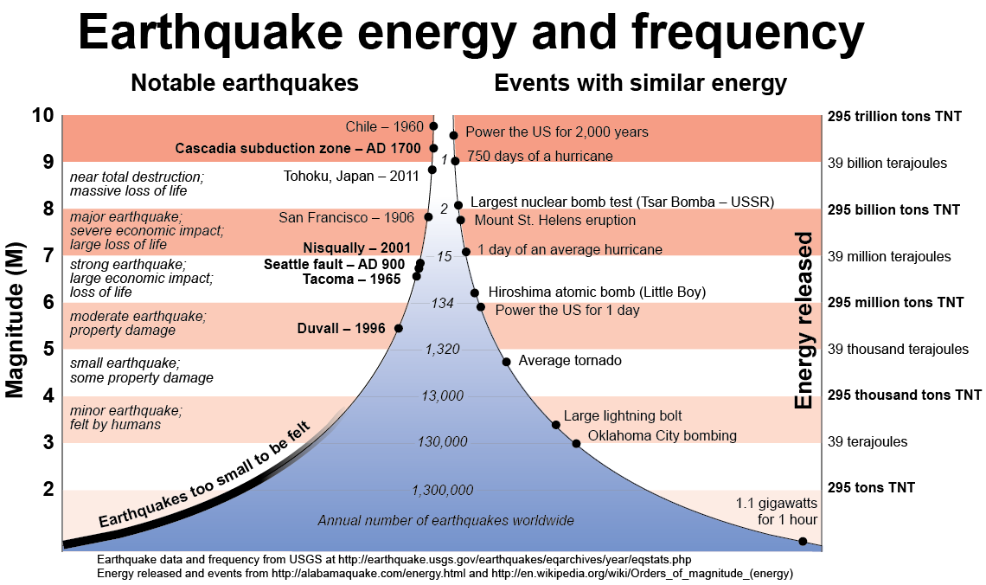

Slide 5
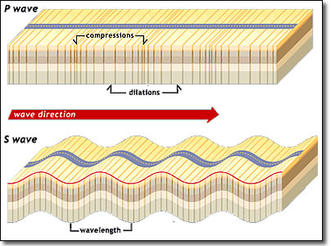
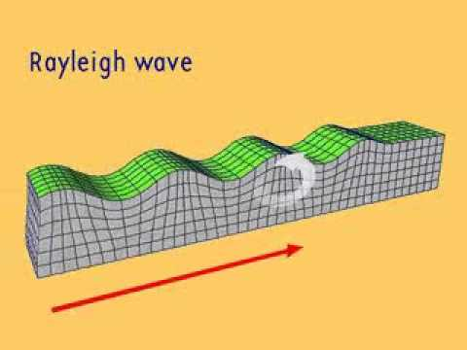
Shock waves
P waves (primary) fastest
S waves (secondary).
Rayleigh waves.

Slide 6
500,000 earthquakes occur each year, detectable with current instrumentation. About 100,000 of these can be felt

Slide 7
Effects
Shaking (yup, the earth moved)
Landslides and avalanches
Fires (rupturing fire/gas lines) San Fran.
Soil Liquefaction https://i.imgur.com/bd6kCkS.gifv
Tsunamis and Floods (Quake Lake)

Slide 8
The Killers
1556. Shaanxi. China. 830,000+ killed. Loess caves.
1976 Tangshan. China 240k – 655k. Deadliest of 20th Century. Only a 7.8. Cheap building collapse.
1960. Chile. Largest recorded at 9.8. Double the energy release of the next largest. 2-6k dead. Many tsunamis across the pacific, including tatering Hilo.
Good Friday Quake. Anchorage, AK. 1964. 9.2.
https://en.wikipedia.org/wiki/Lists_of_earthquakes#Deadliest_earthquakes scroll up and down on this page, many cool things.

Slide 9
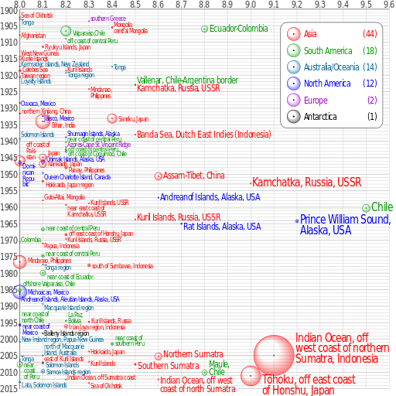
Circle size = deaths.
(elementary school kid on vacation story)

Slide 10
Some tips
Build on rock, not dirt. And especially not muddy sediments.
Wood>steel>concrete>brick. Beware glass.
Avoid exposure to tsunamis.
Less tall buildings.
Earthquake engineering (basically, put buildings on shock absorbers/rollers.
Flat areas.

Slide 12
Cascadia quakes?
https://magazine.wsu.edu/web-extra/the-dangers-of-a-major-cascadia-earthquake/
https://en.wikipedia.org/wiki/1700_Cascadia_earthquake

Slide 13
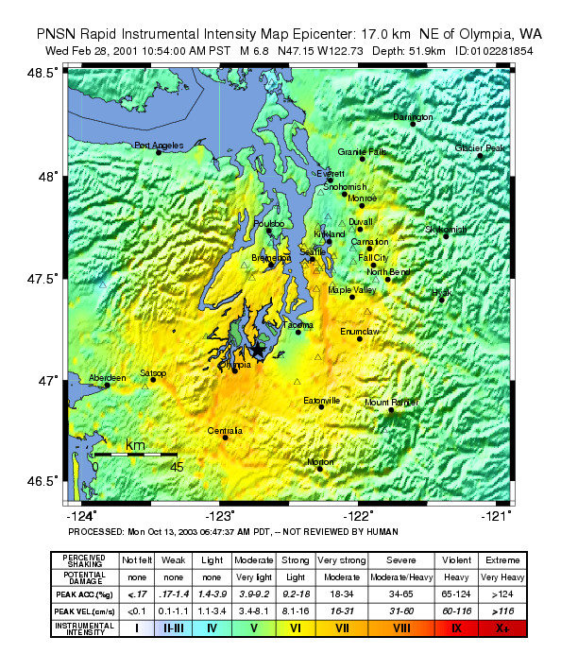
Nisqually quake
2001, feb 28
6.8
11AM
No deaths, 400 injuries

Slide 14
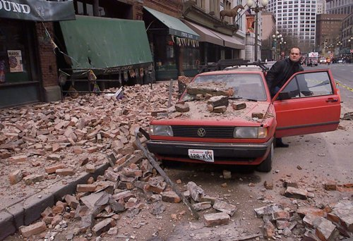
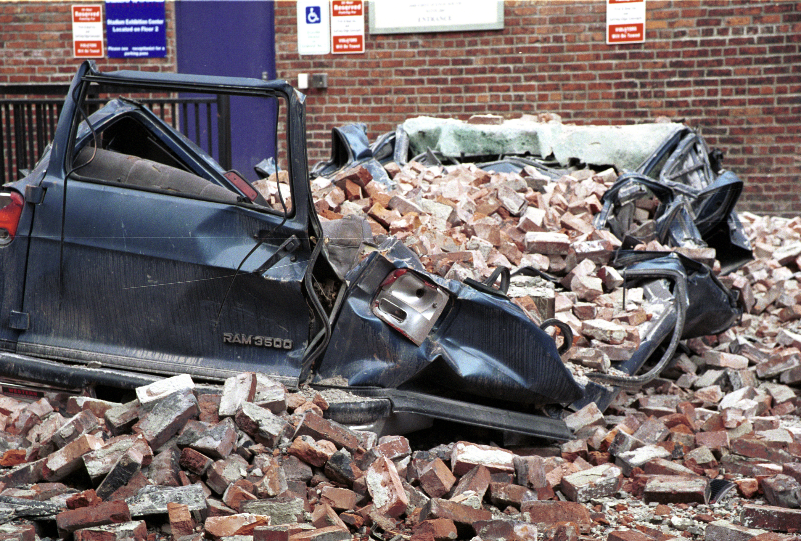

Slide 15
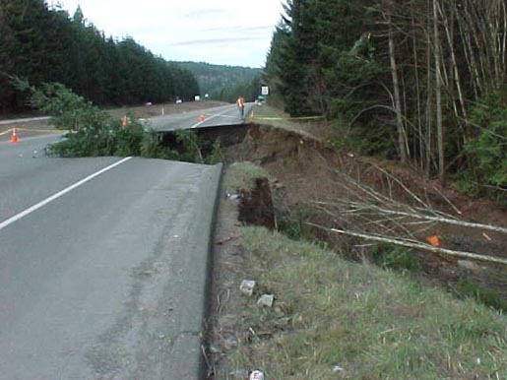
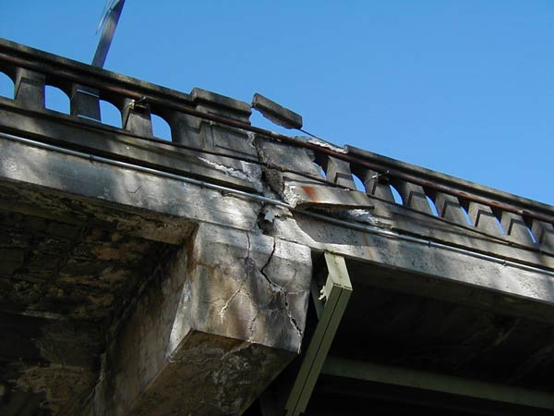

Slide 17
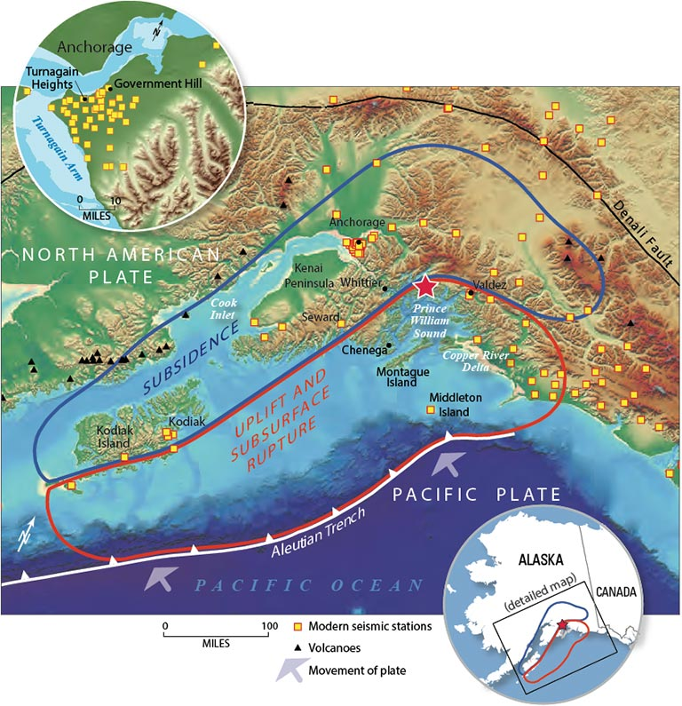
Alaska. Good Friday quake.
1964. 5:36PM. 27 March
139 deaths (landslides and tsunamis)
9.2. Near Anchorage.
2nd most powerful recorded.

Slide 18
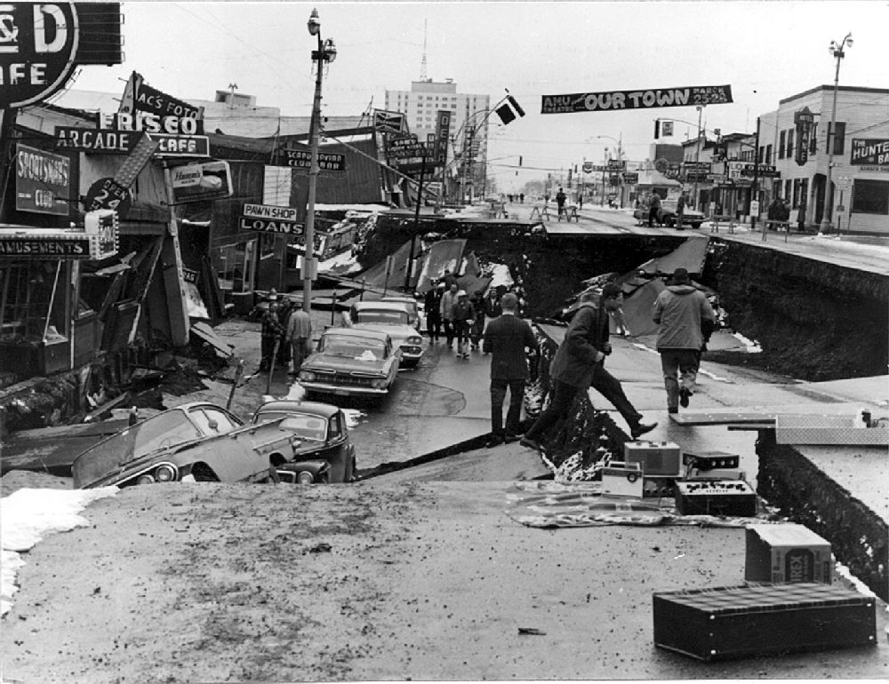

Slide 19
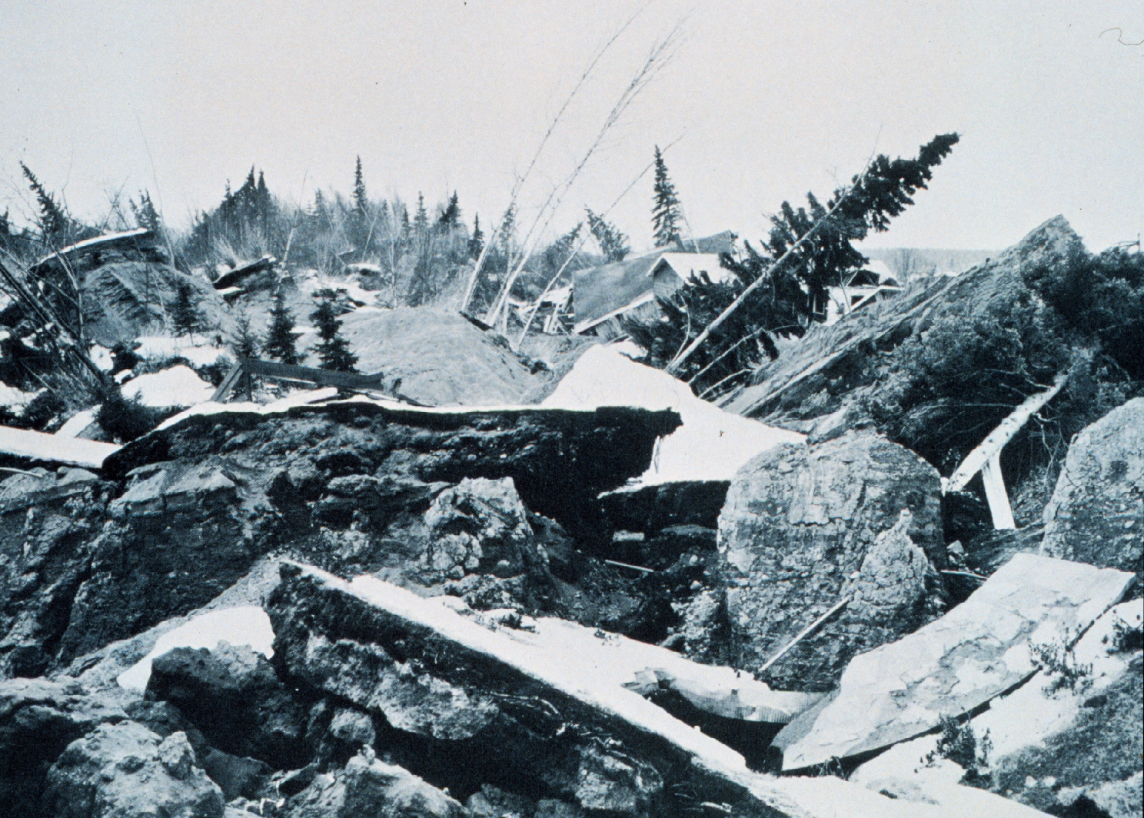

Slide 20
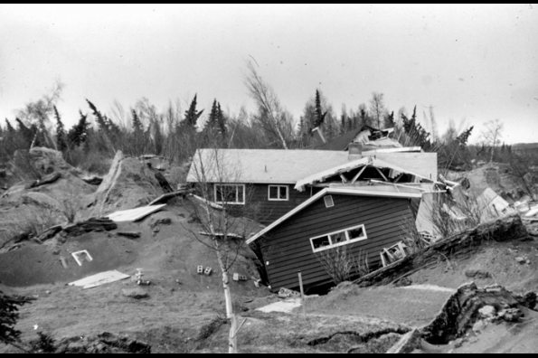

Slide 21
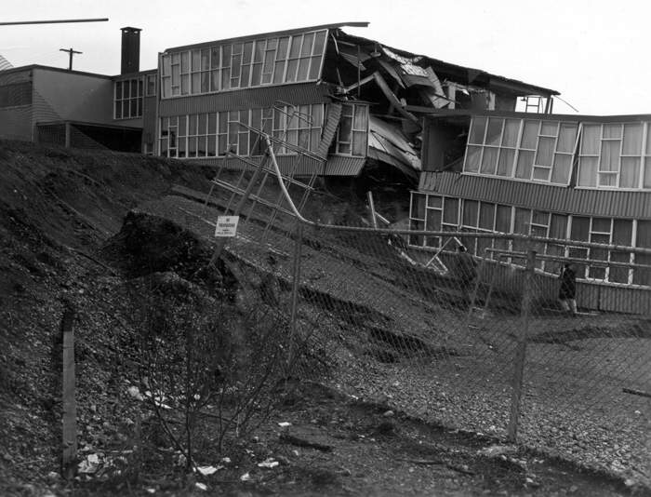

Slide 22
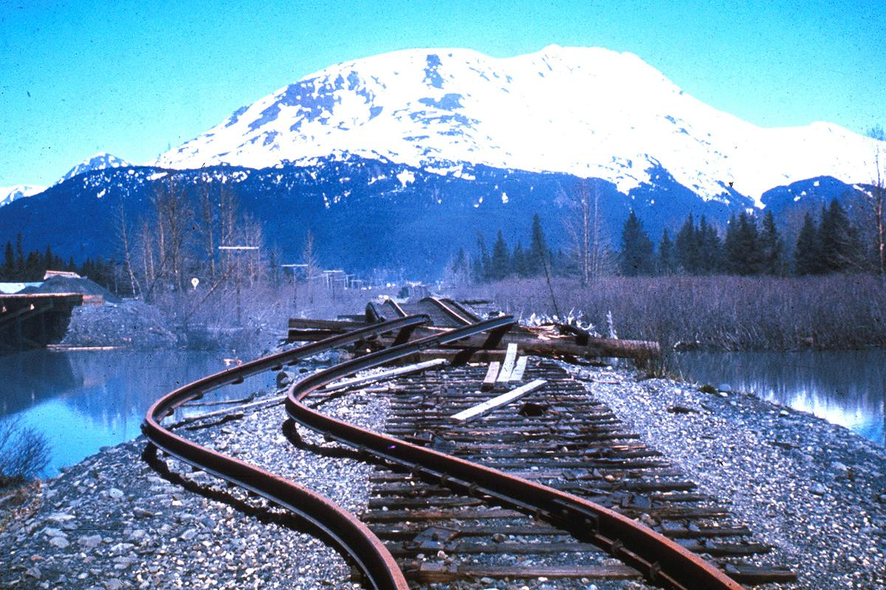
What sort of wave?

Slide 23
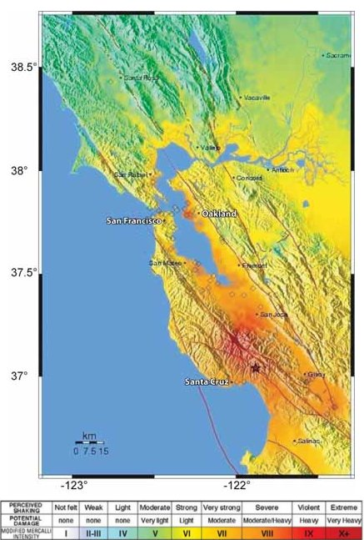
1989 Loma Prieta
6.9
17 October, 5PM
63 deaths, 3757 injuries.
Occurred during a world series game in CA

Slide 24
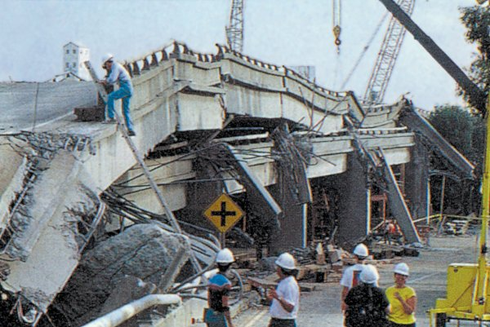
42 of the deaths were freeway collapse.
Relatively few, as folks were at or watching the game, not on the roads.

Slide 25
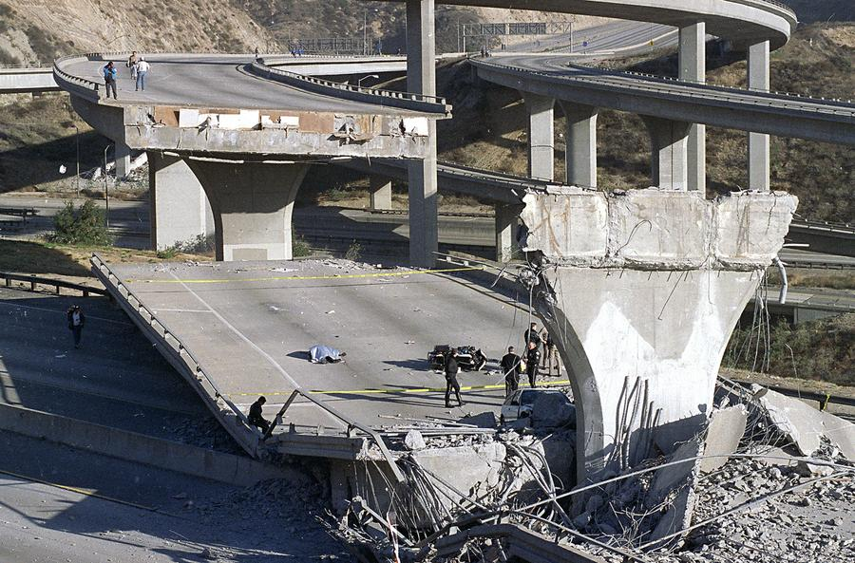

Slide 26
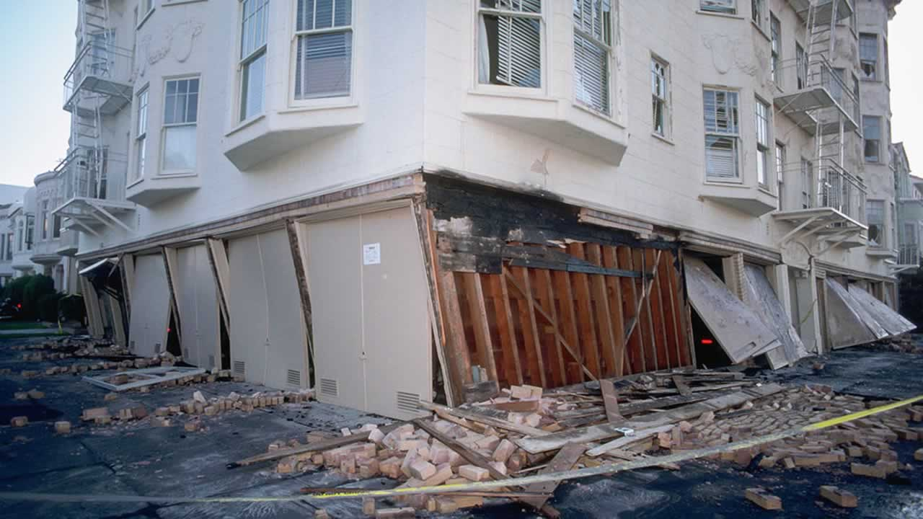

Slide 27
Taiwan quake. 6 feb 2018
https://en.wikipedia.org/wiki/2018_Hualien_earthquake
https://www.google.com/search?q=taiwan+quake+2018&client=firefox-b-1-ab&source=lnms&tbm=isch&sa=X&ved=0ahUKEwiV66TT16LgAhUTHXwKHYkgBIMQ_AUIDygC&biw=1758&bih=1276

Slide 28
Tohuku
March 2011
Mag 9
Massive tsunamis
Fukushima reactors
16k+ deaths
https://www.livescience.com/39110-japan-2011-earthquake-tsunami-facts.html
Google pics and tsunami vids

Slide 29
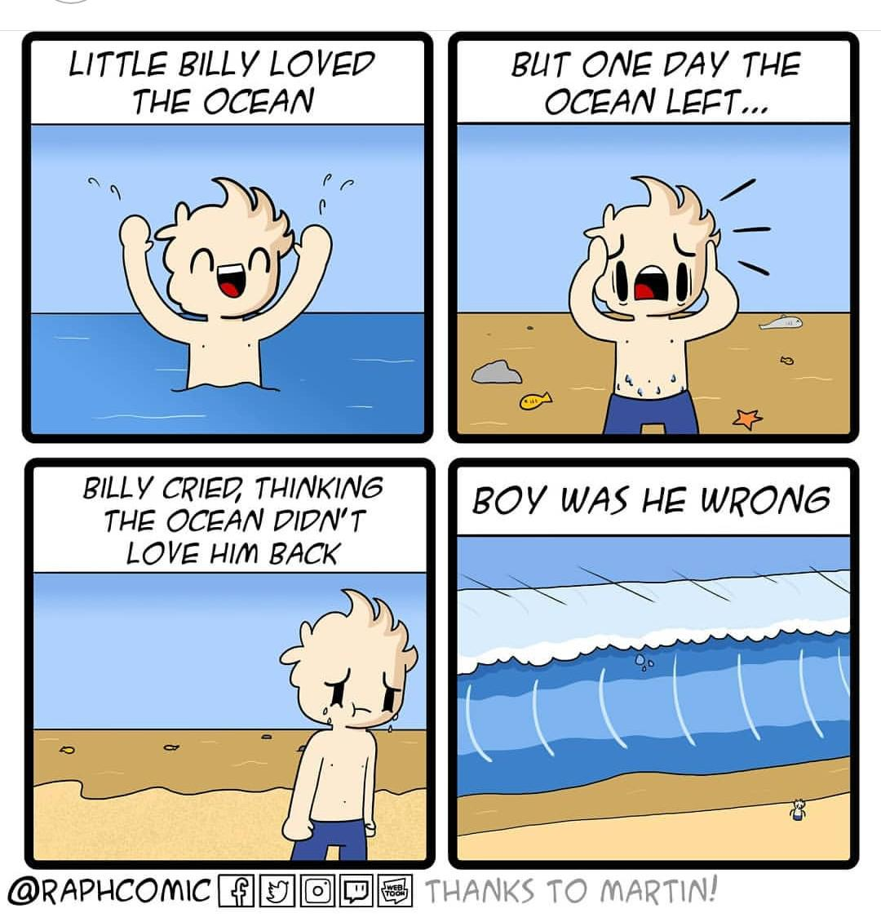
What to do?
http://emergency.cdc.gov/disasters/earthquakes/during.asp

Slide 30
https://www.usgs.gov/media/images/2018-long-term-national-seismic-hazard-map

